Slide 1
What is Chinese opera?

Slide 2
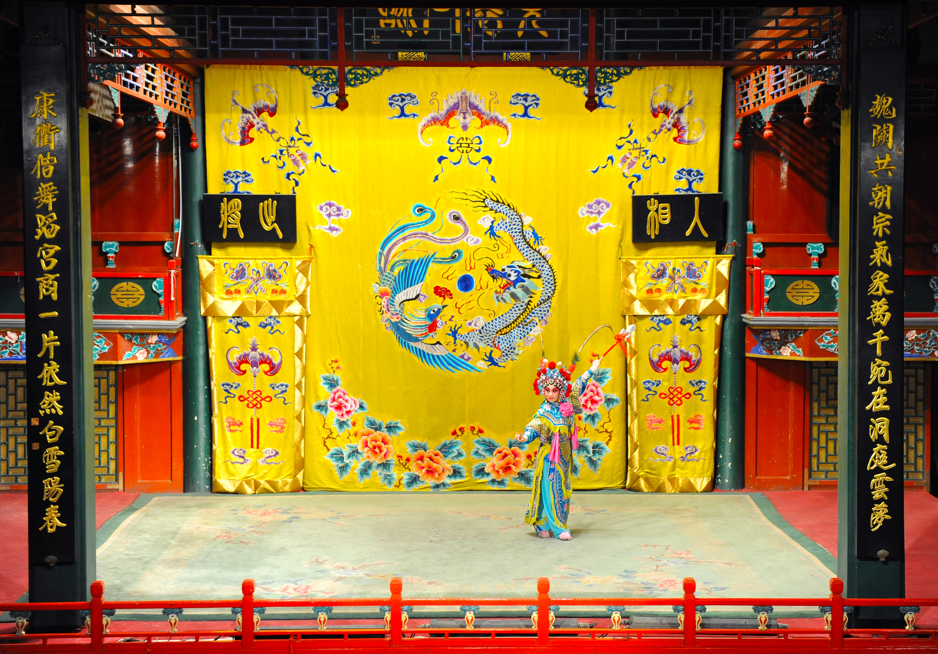

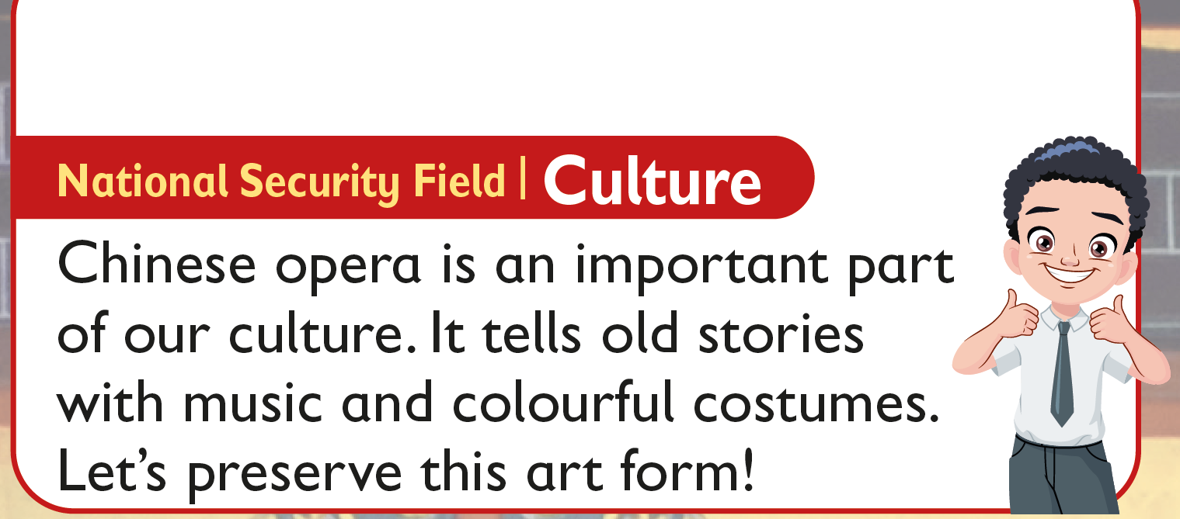

Leaves are different in shape and size.
How else are they different?
READING
NOW I KNOW
LET’S THINK
LET’S DO THIS

Slide 3
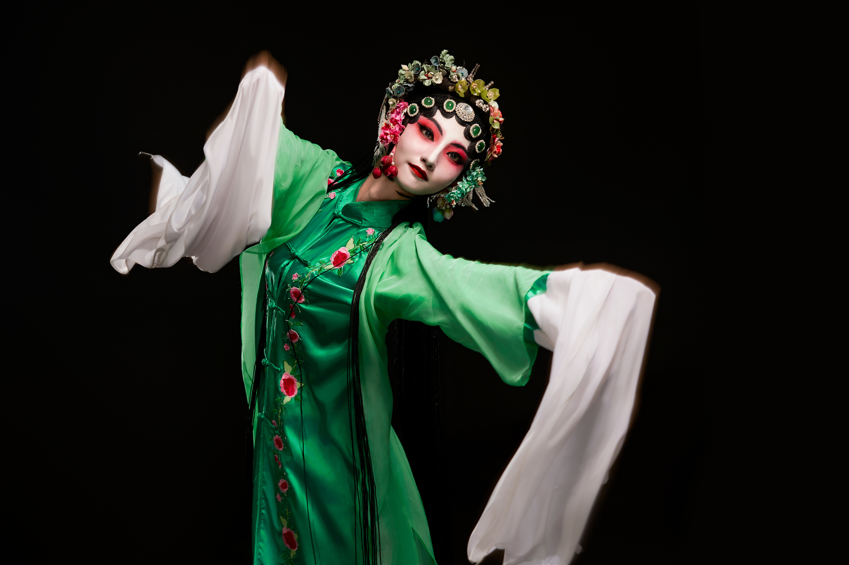
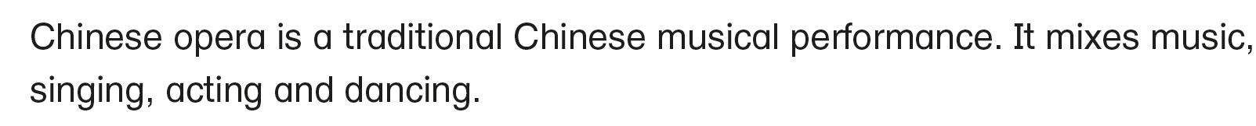
Leaves are different in shape and size.
How else are they different?
What is Chinese opera?
READING
NOW I KNOW
LET’S THINK
LET’S DO THIS

Slide 4
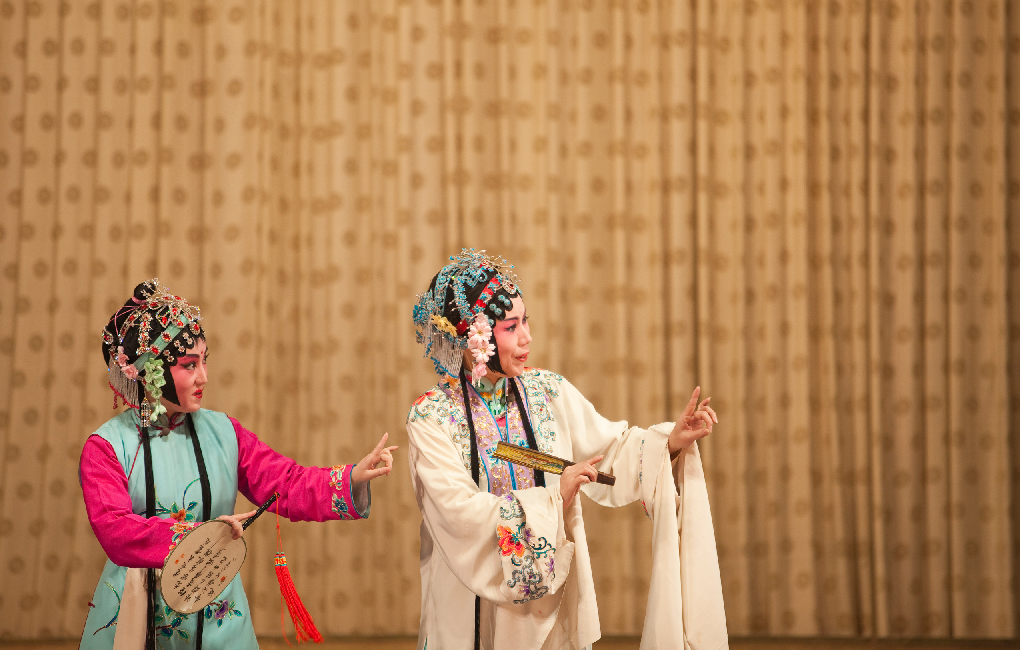
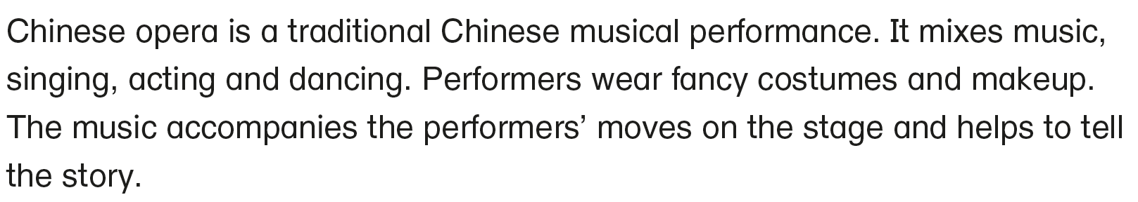
Leaves are different in shape and size.
How else are they different?
READING
NOW I KNOW
LET’S THINK
LET’S DO THIS

Slide 5
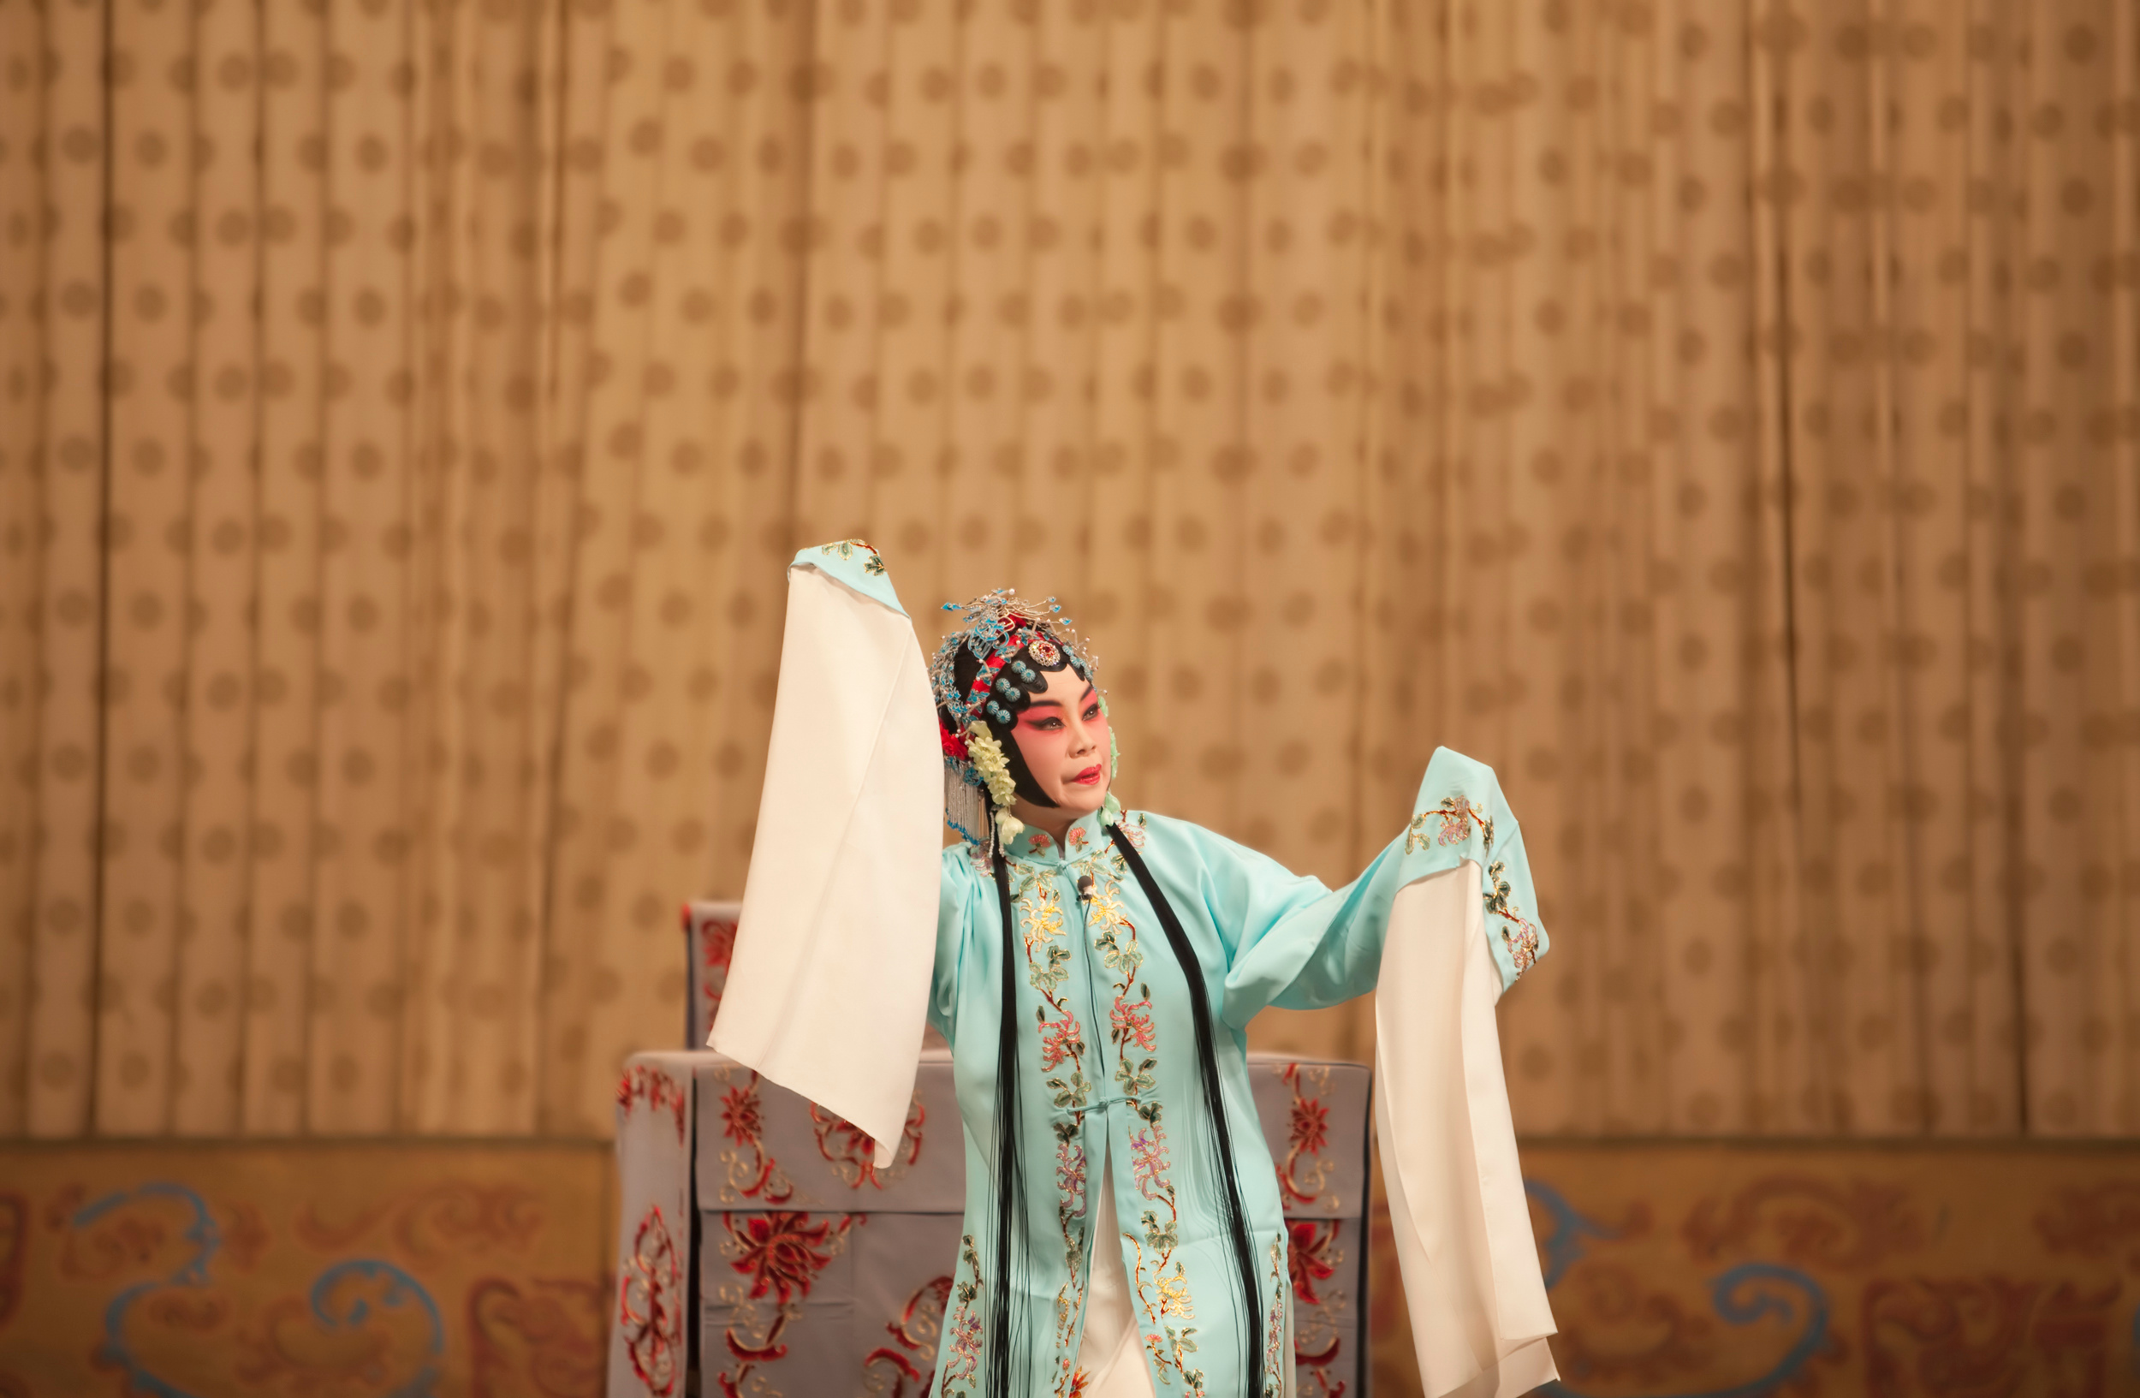
Leaves are different in shape and size.
How else are they different?
READING
NOW I KNOW
LET’S THINK
LET’S DO THIS

Slide 6
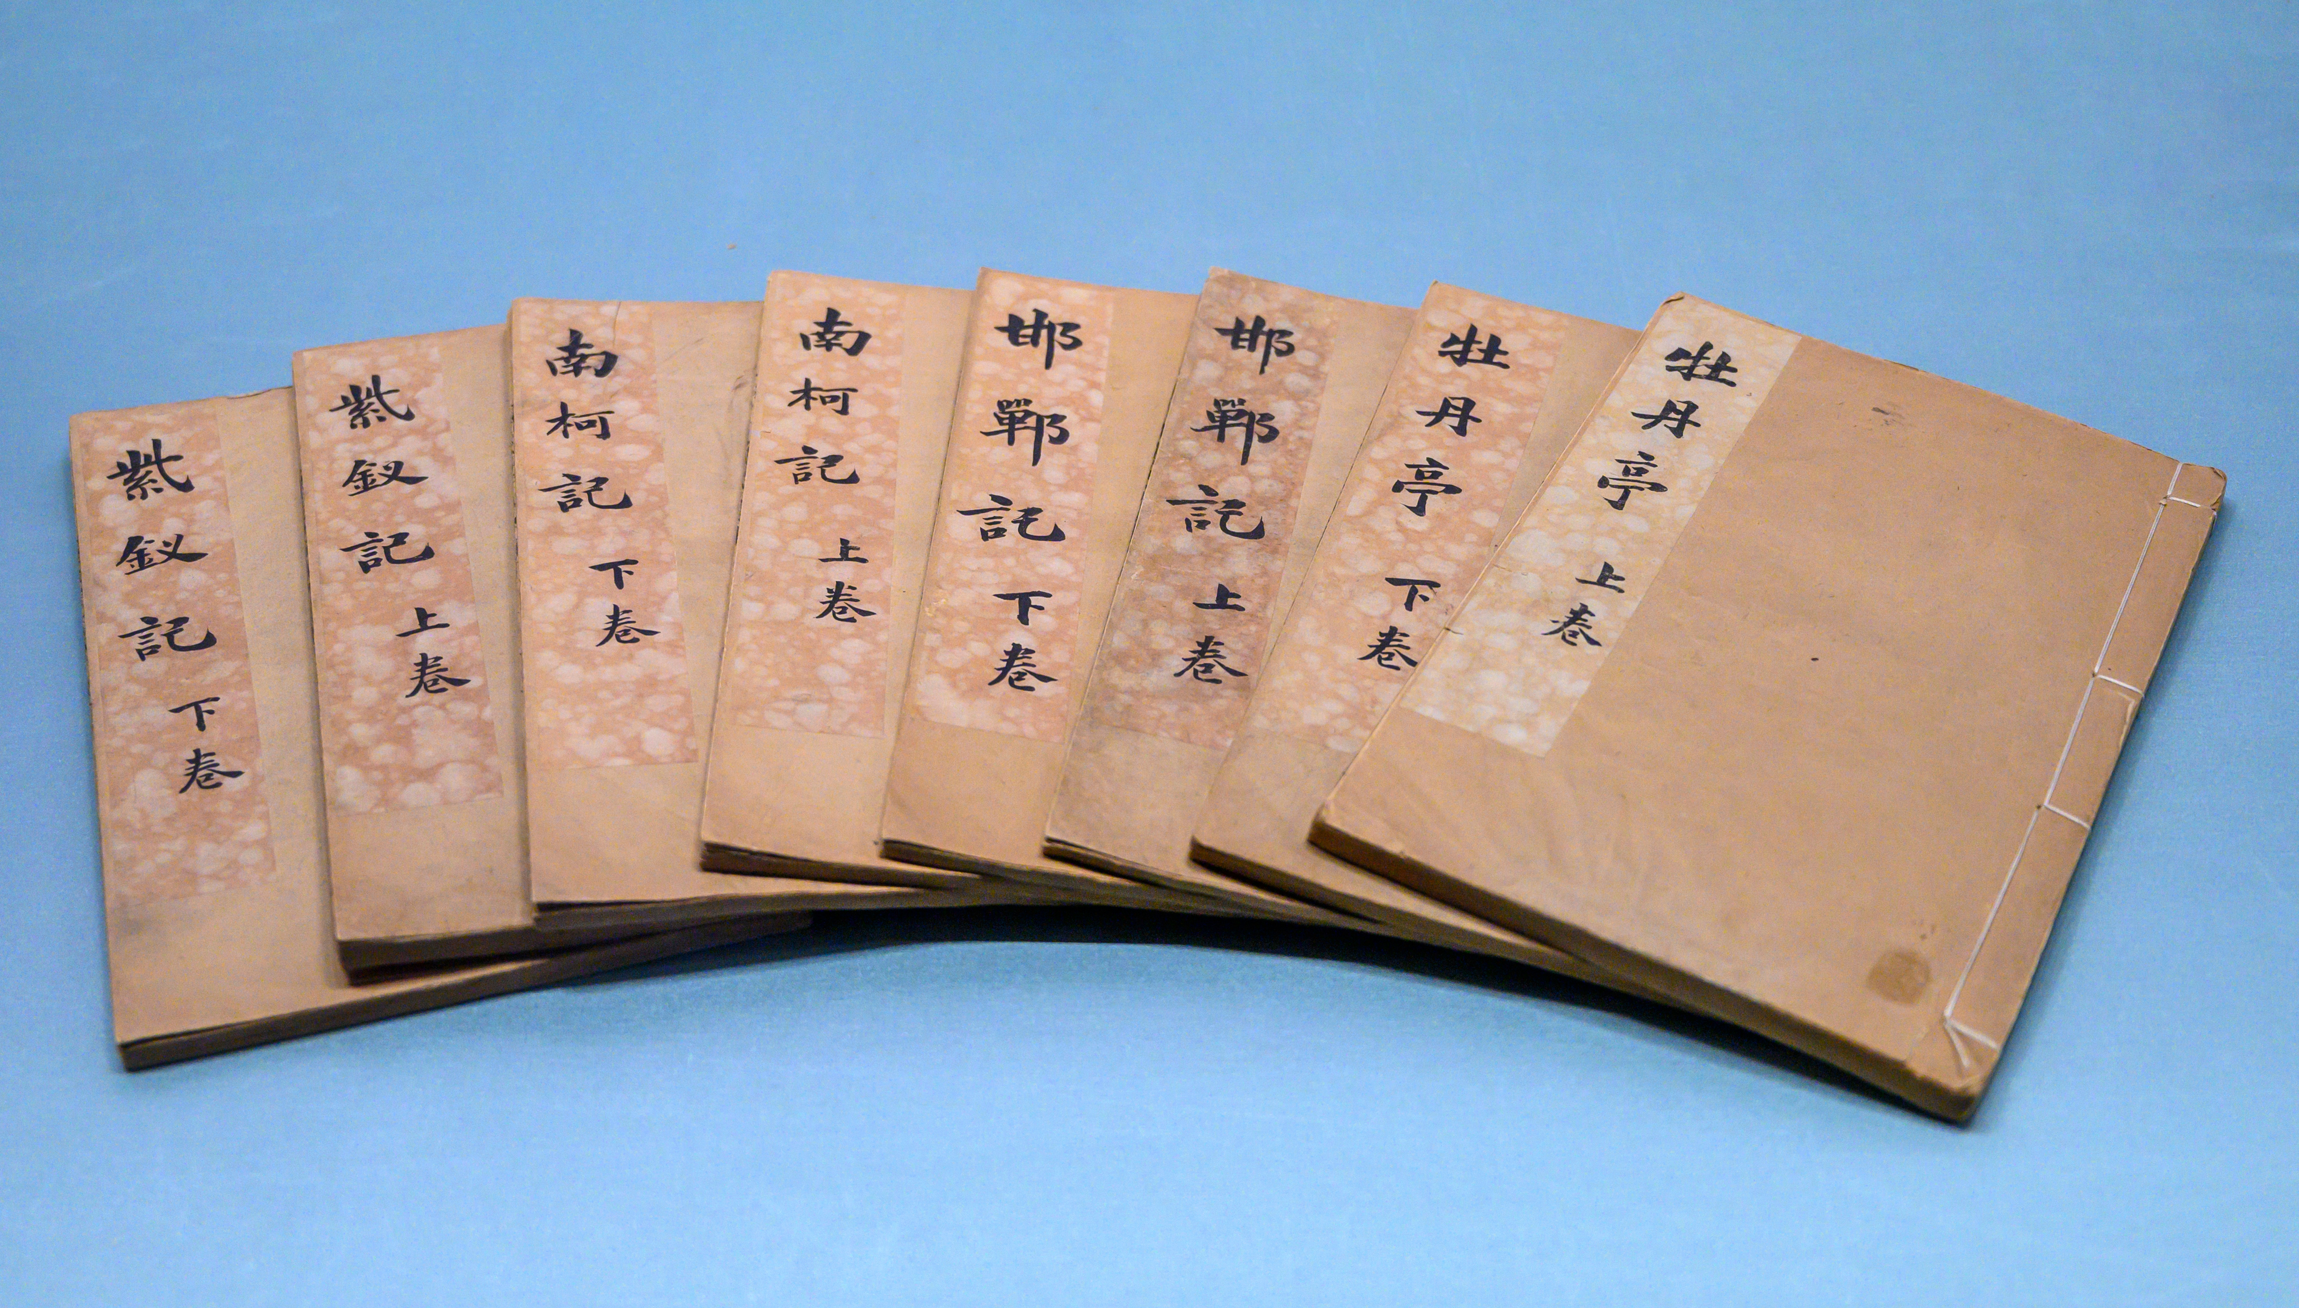
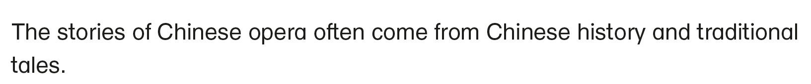
READING
NOW I KNOW
LET’S THINK
LET’S DO THIS

Slide 7
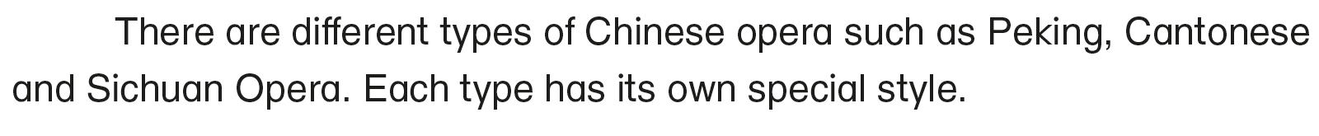
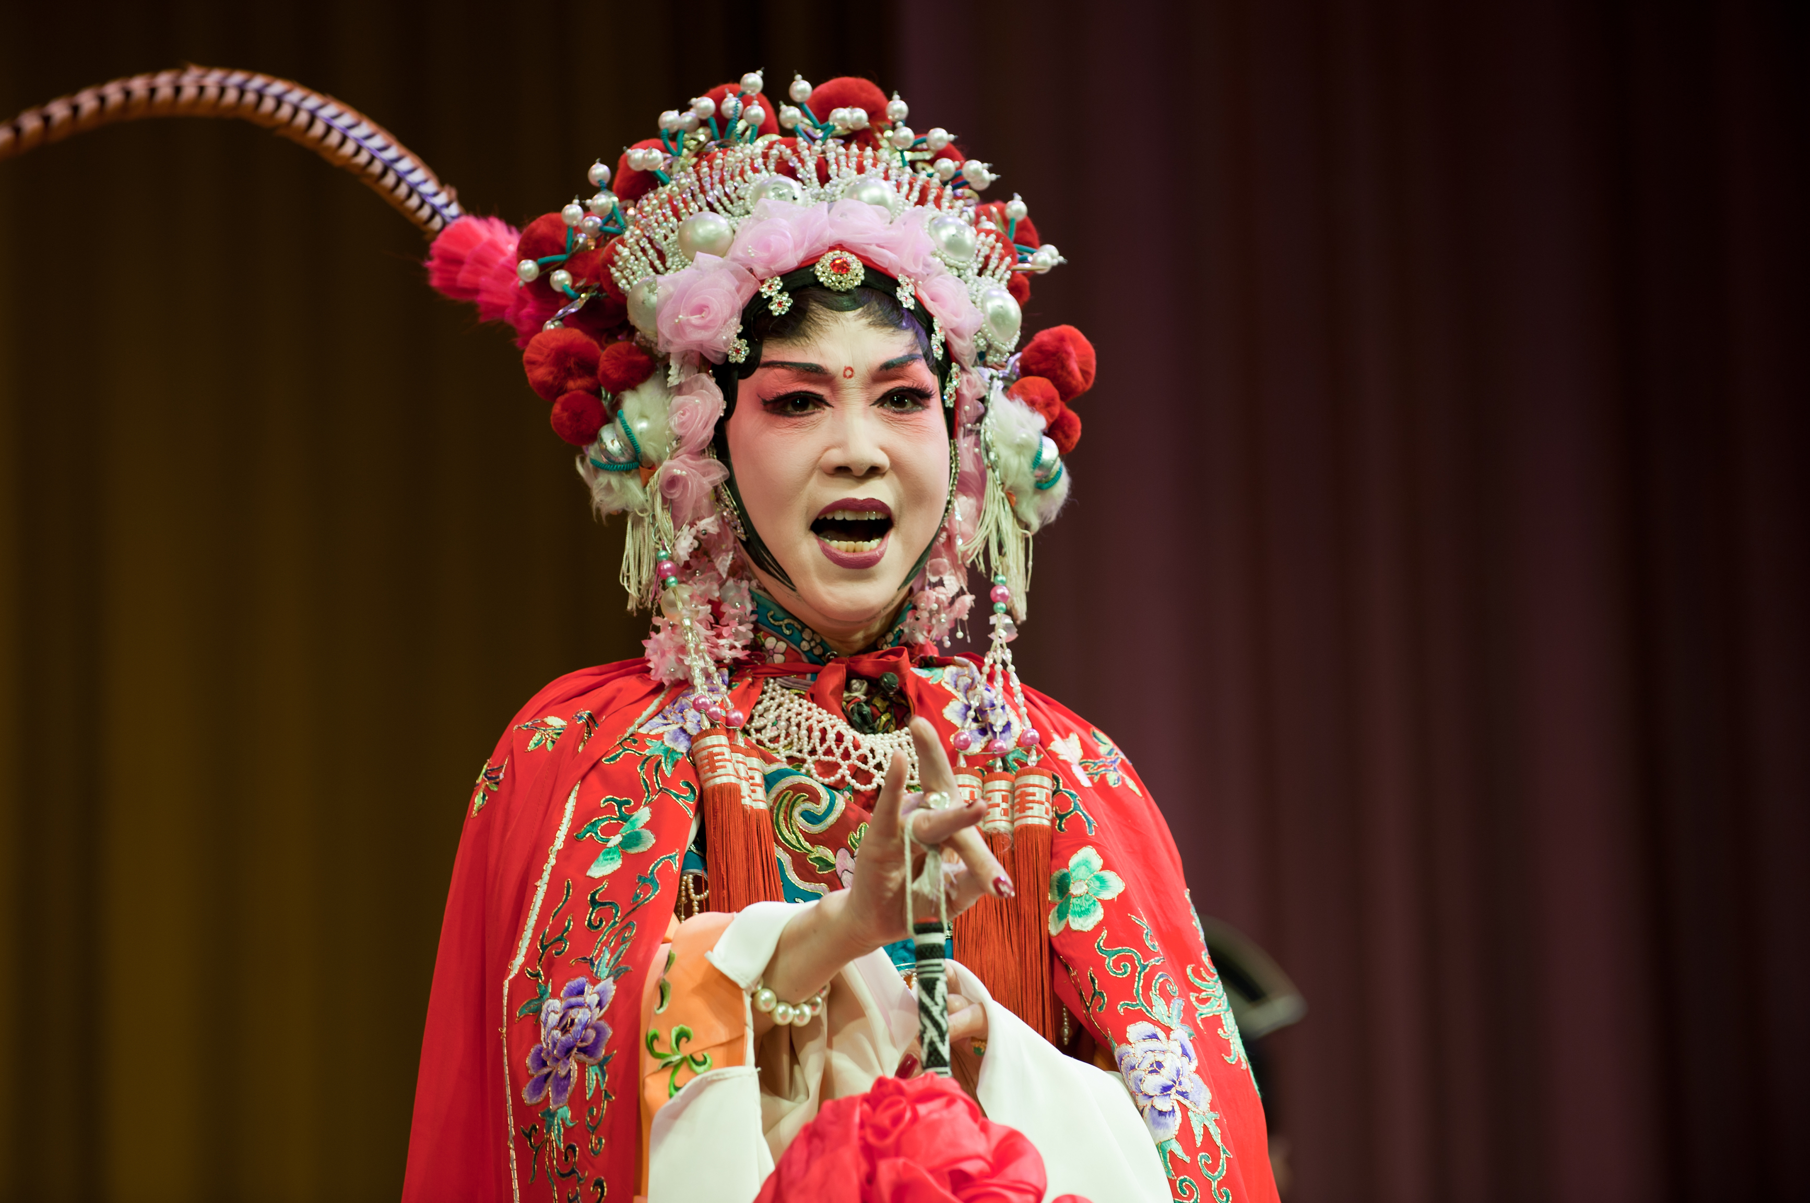
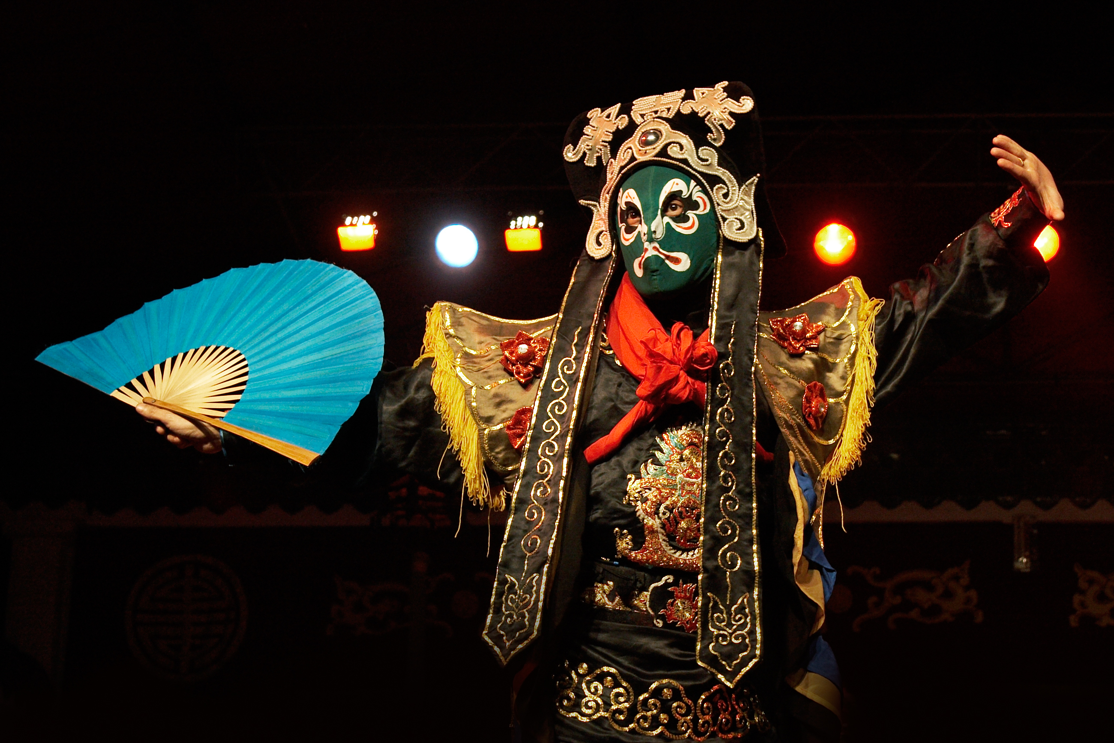
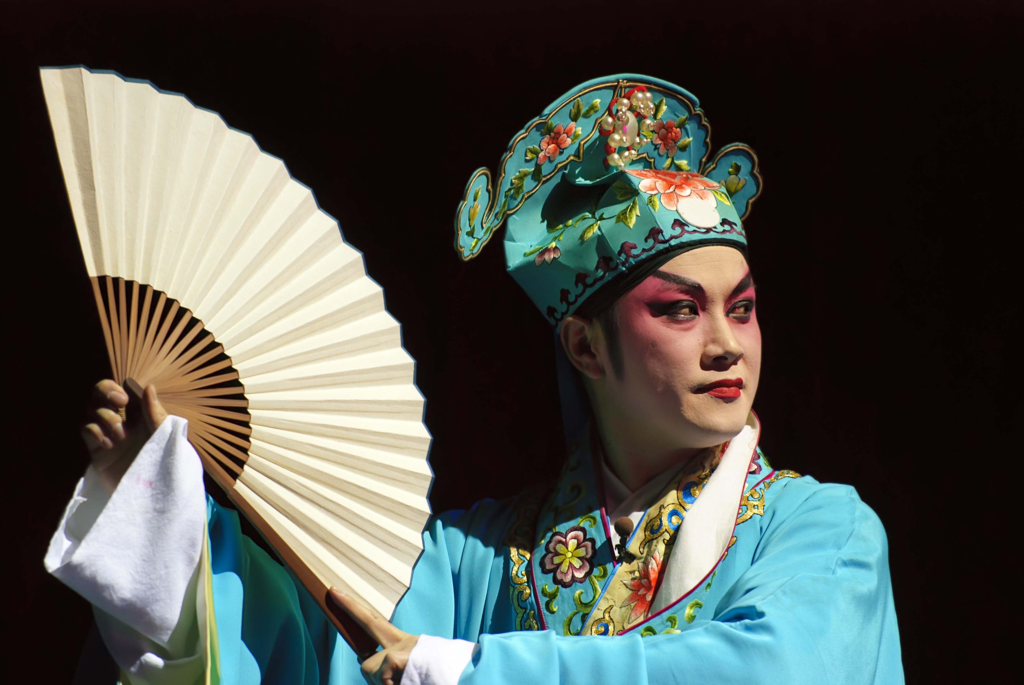
Peking Opera
Sichuan Opera
Cantonese Opera
READING
NOW I KNOW
LET’S THINK
LET’S DO THIS

Slide 8
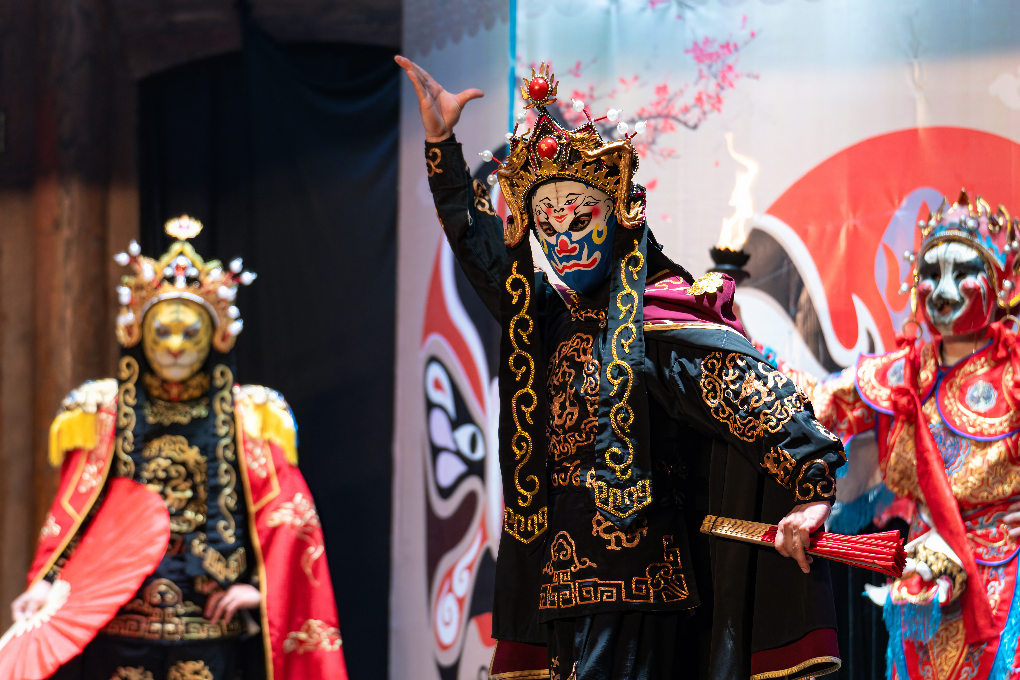
READING
NOW I KNOW
LET’S THINK
LET’S DO THIS

Slide 9
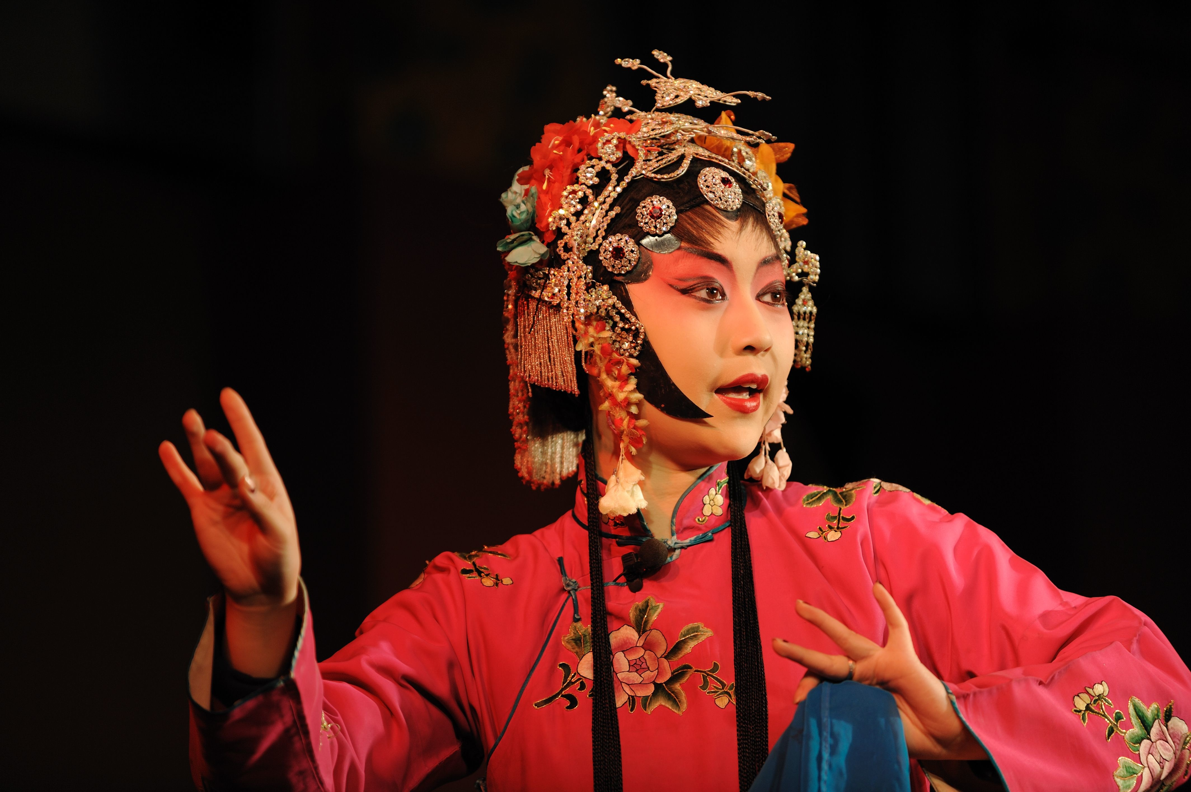


UNESCO: The United Nations Educational, Scientific and Cultural Organisation
READING
NOW I KNOW
LET’S THINK
LET’S DO THIS

Slide 10
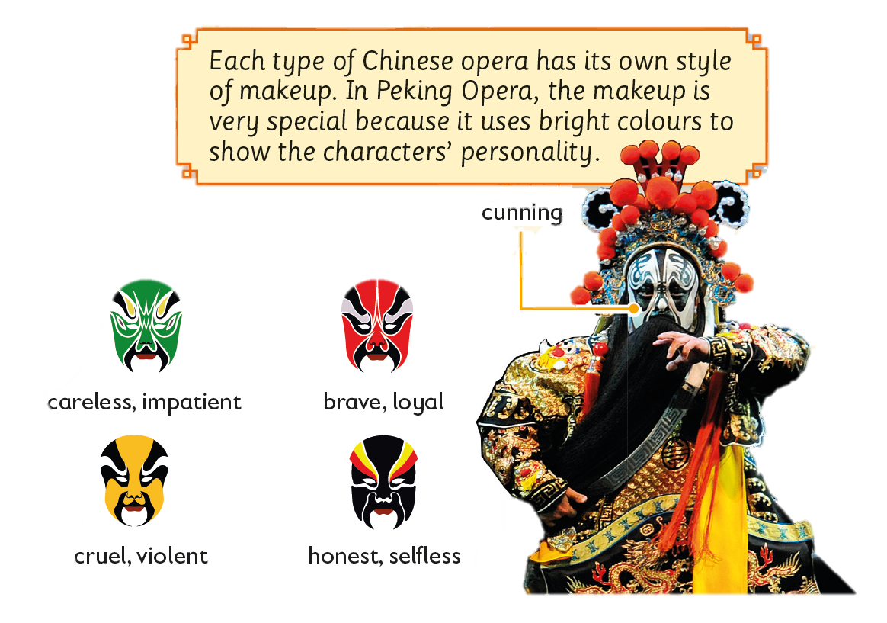
Leaves are different in shape and size.
How else are they different?
READING
NOW I KNOW
LET’S THINK
LET’S DO THIS

Slide 11
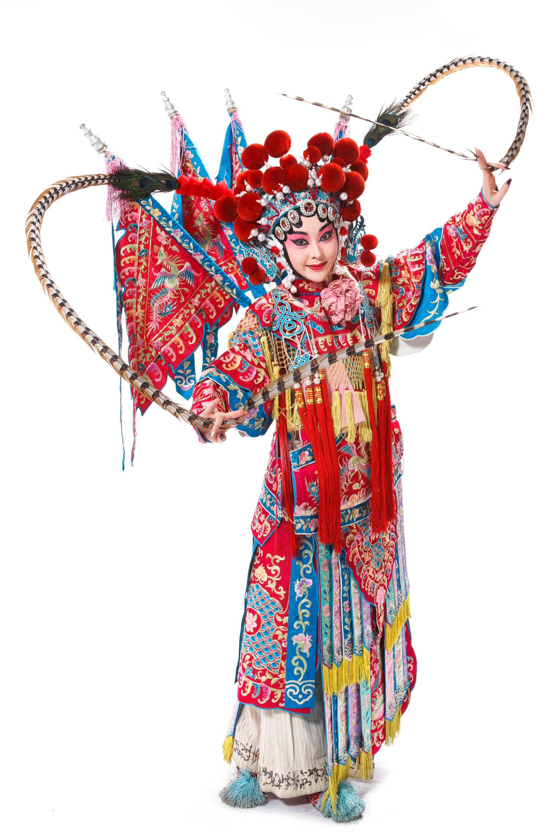
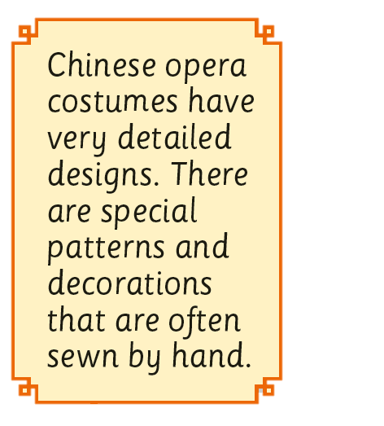
READING
NOW I KNOW
LET’S THINK
LET’S DO THIS

Slide 12
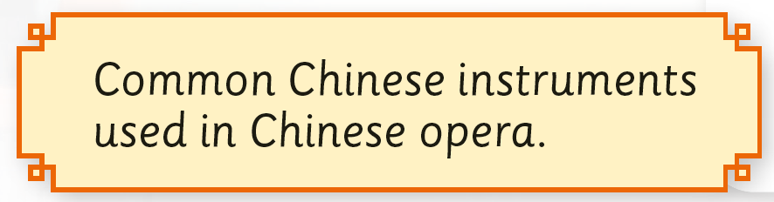
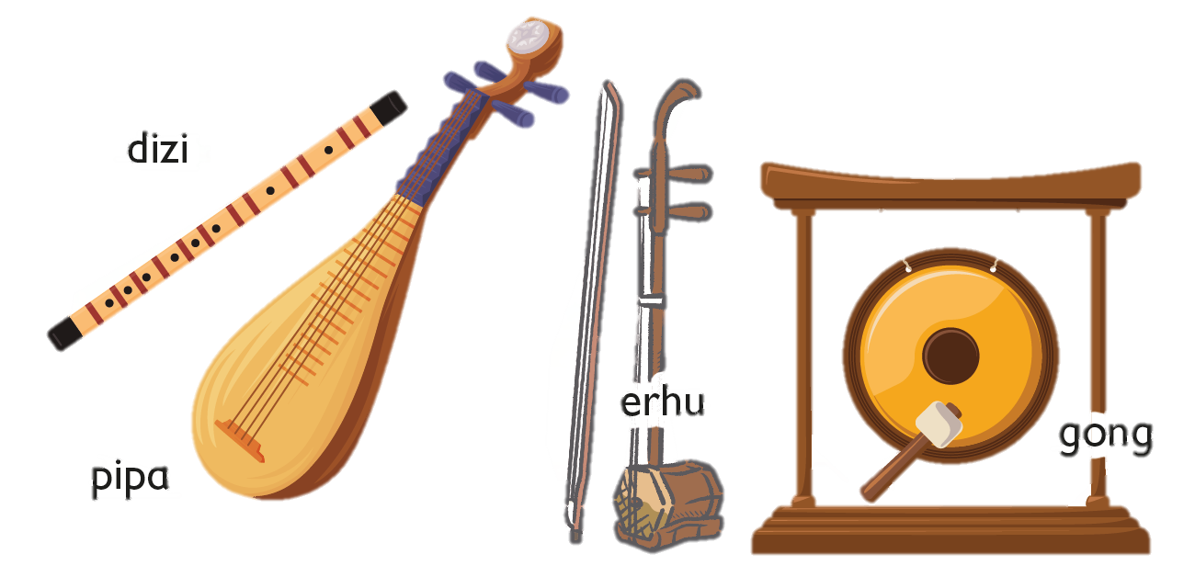
READING
NOW I KNOW
LET’S THINK
LET’S DO THIS

Slide 13

READING
NOW I KNOW
LET’S THINK
LET’S DO THIS

Slide 14
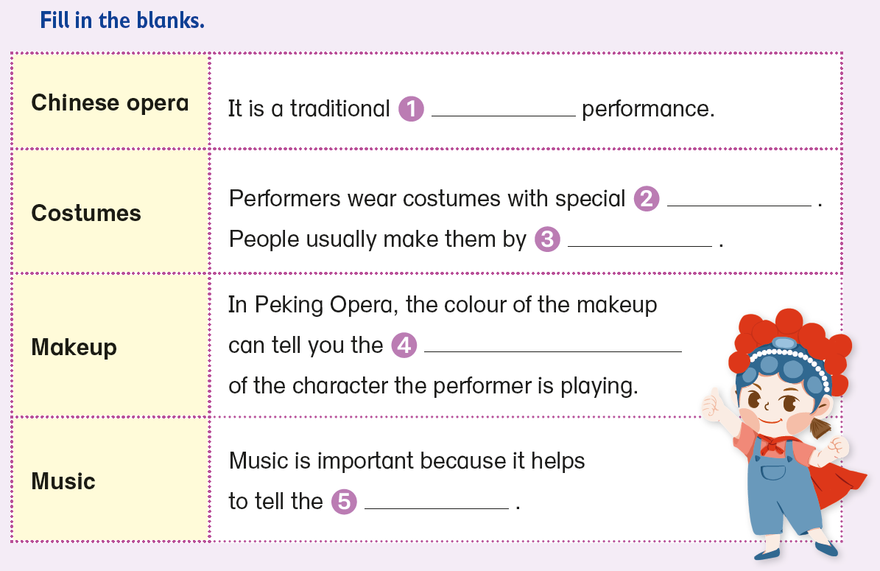


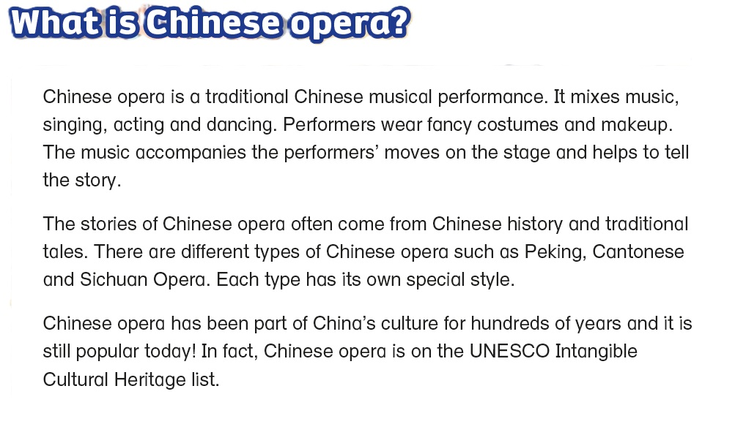
musical
READING
NOW I KNOW
LET’S THINK
LET’S DO THIS

Slide 15
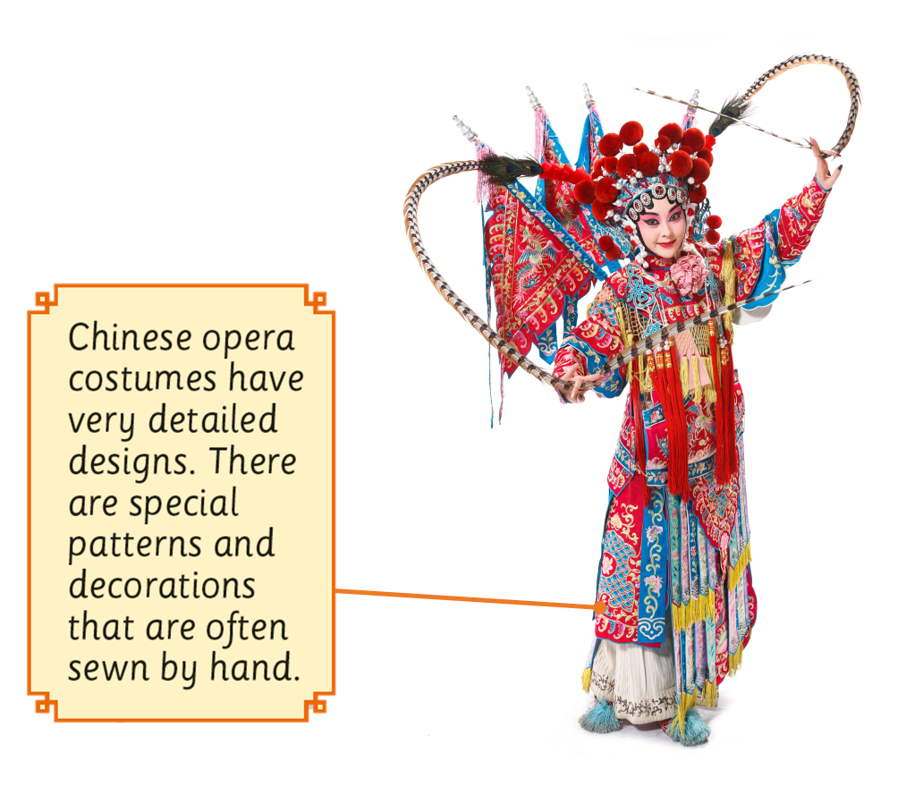






designs / patterns
READING
NOW I KNOW
LET’S THINK
LET’S DO THIS

Slide 16


hand
READING
NOW I KNOW
LET’S THINK
LET’S DO THIS

Slide 17
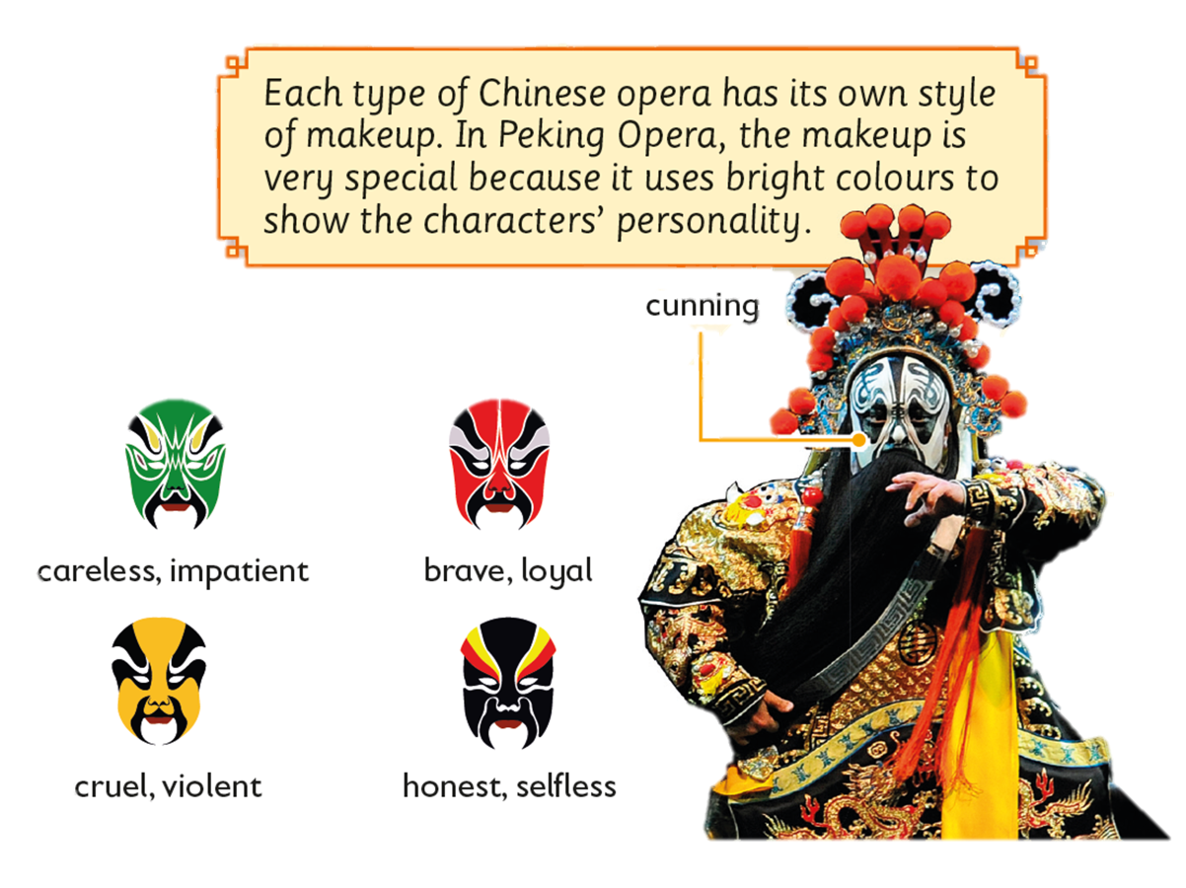


personality
READING
NOW I KNOW
LET’S THINK
LET’S DO THIS

Slide 18
story
READING
NOW I KNOW
LET’S THINK
LET’S DO THIS

Slide 19

5 Try using different leaves.
READING
NOW I KNOW
LET’S THINK
LET’S DO THIS

Slide 20

Leaves are different in shape and size.
How else are they different?
READING
NOW I KNOW
LET’S THINK
LET’S DO THIS

Slide 21
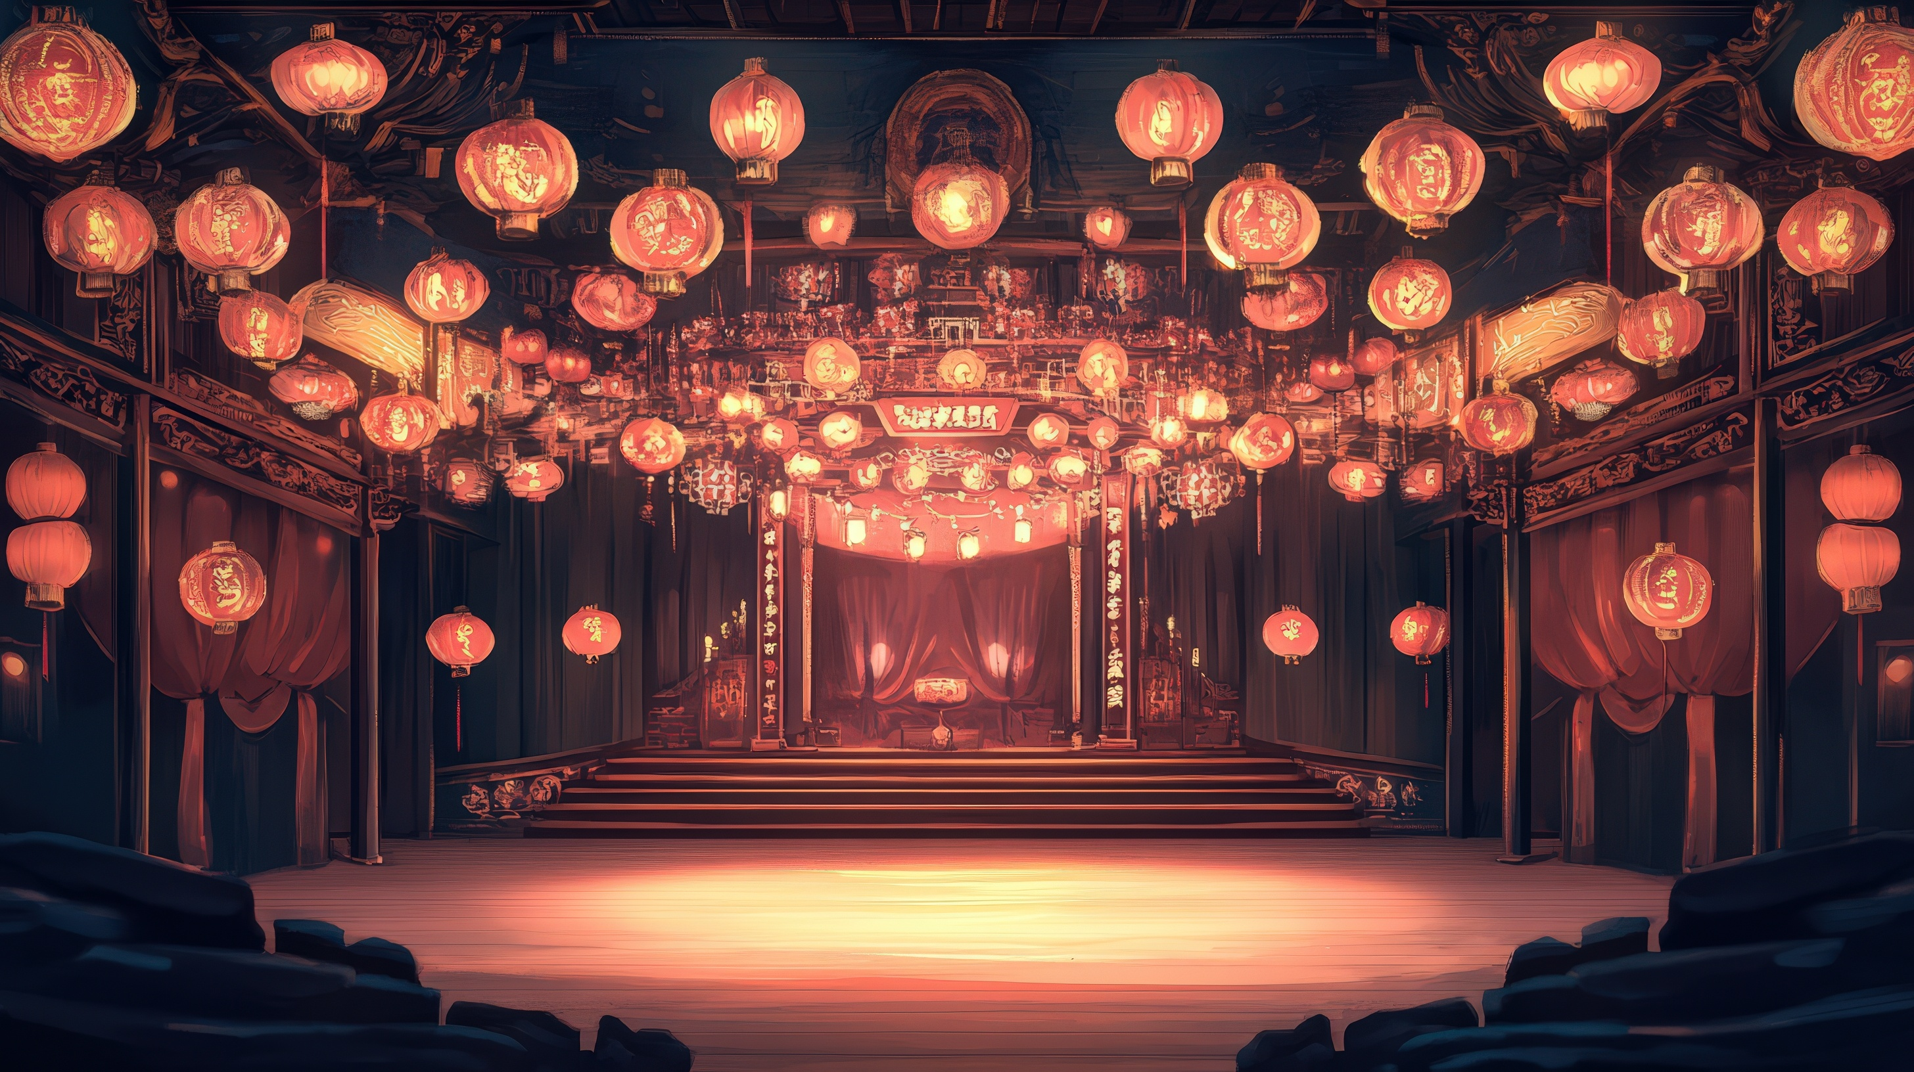

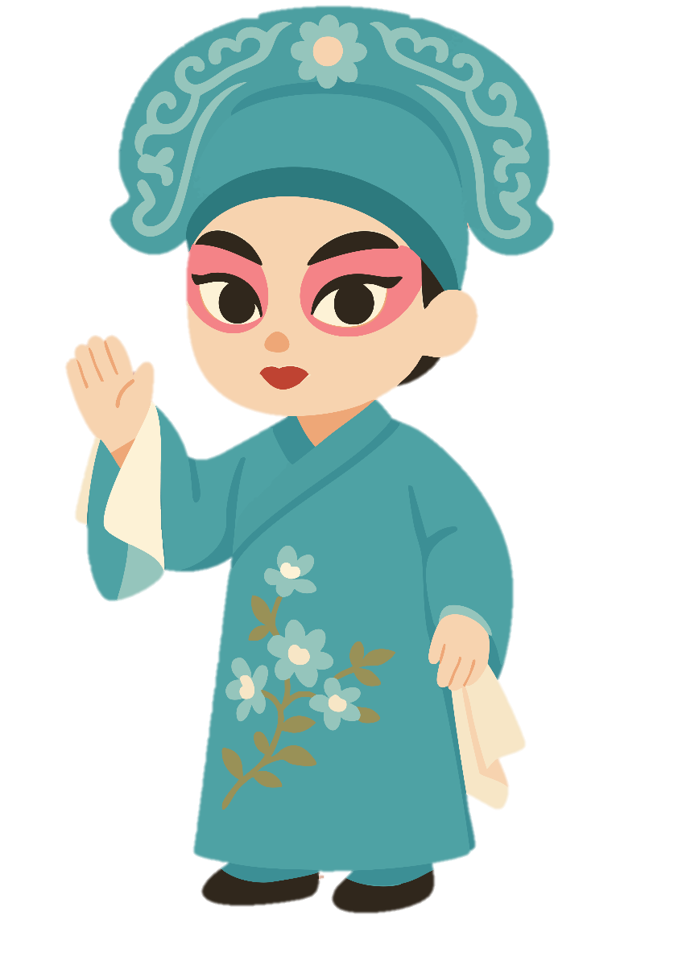
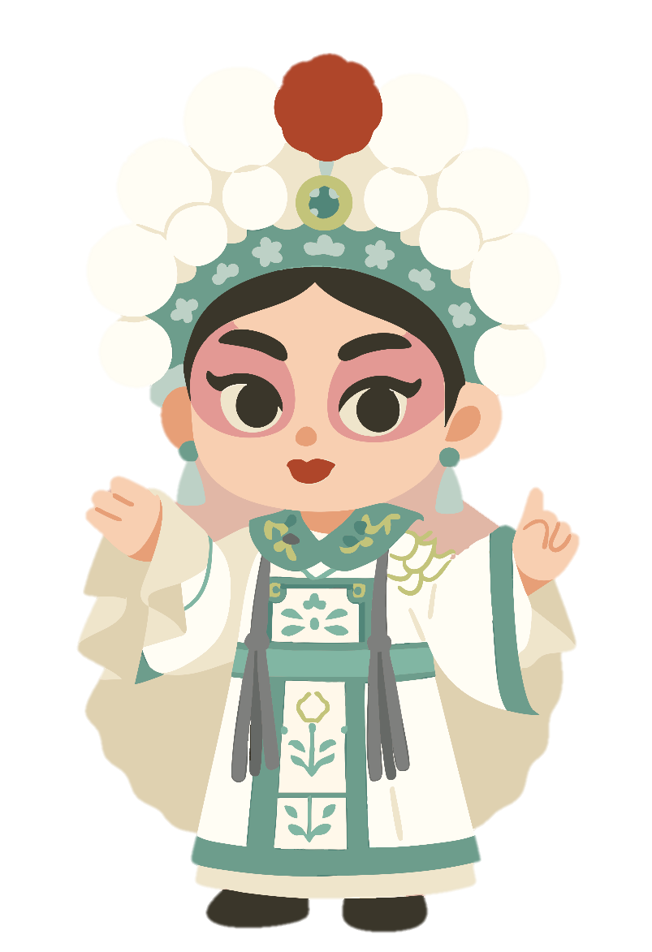

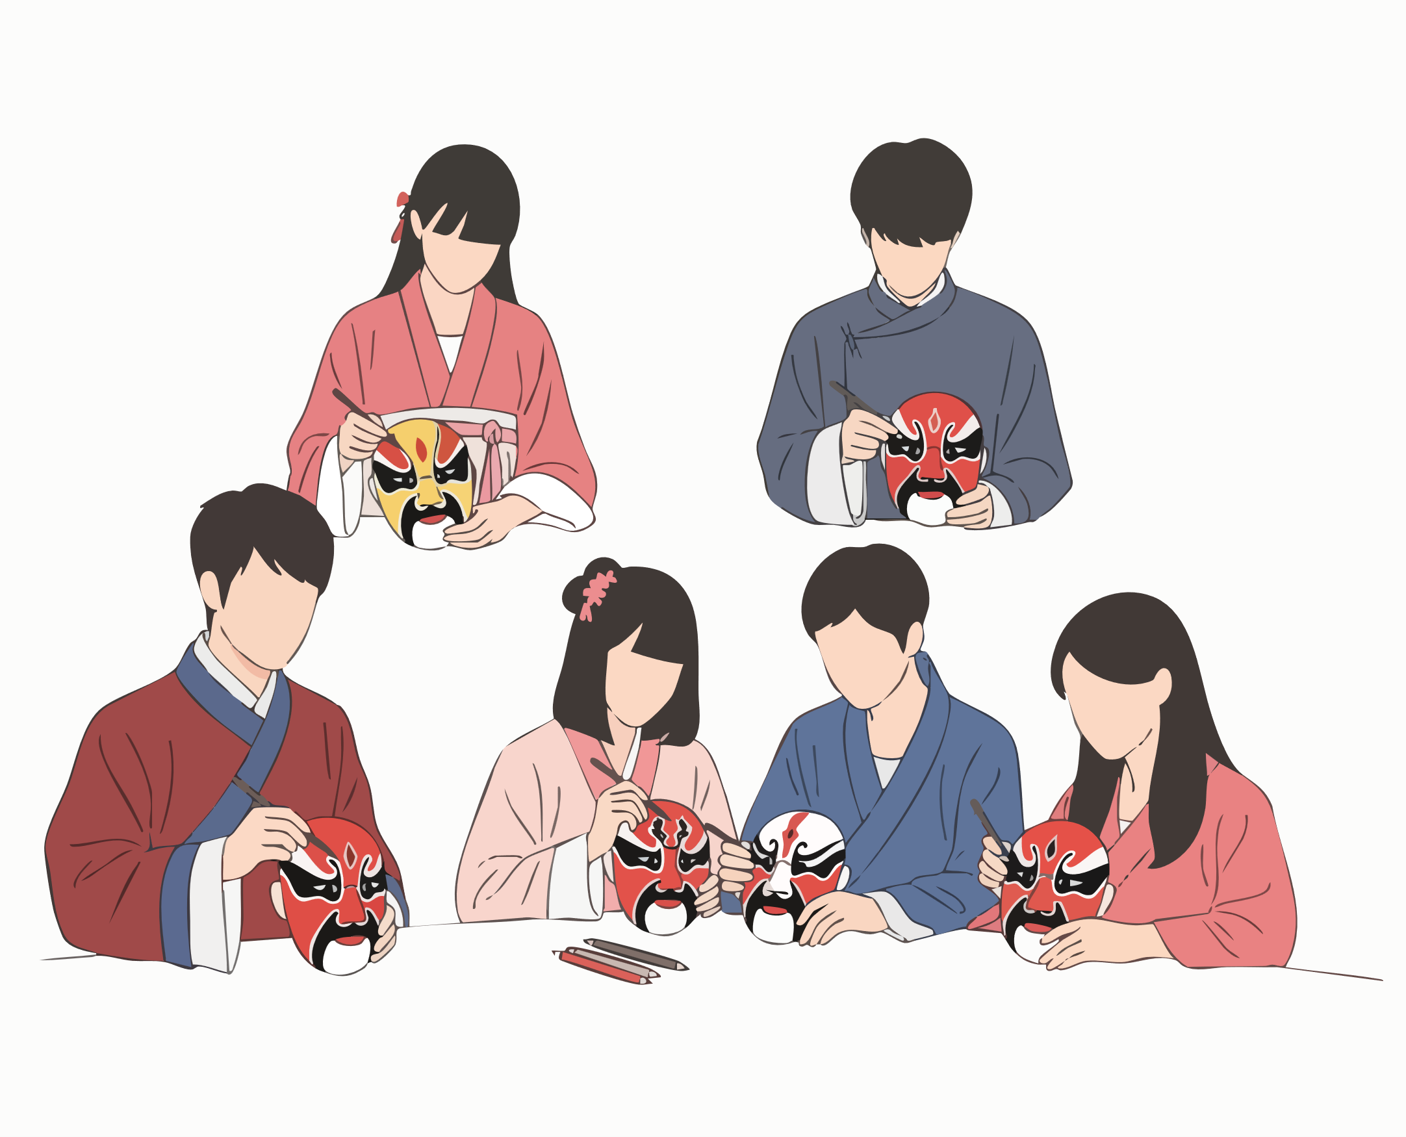

Join the Chinese Opera Club
Watch performances
5 Try using different leaves.
Share stories
Create art project
Invite experts
READING
NOW I KNOW
LET’S THINK
LET’S DO THIS

Slide 22


Slide 23

READING
NOW I KNOW
LET’S THINK
LET’S DO THIS

Slide 24
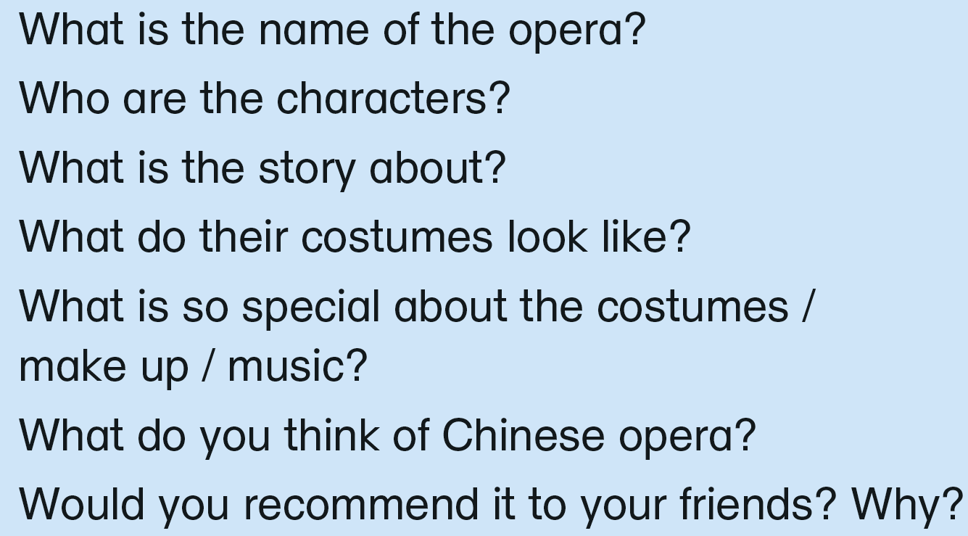

Let’s think about what we can write in the blog entry!
Name:
The Peony Pavilion: The Garden
READING
NOW I KNOW
LET’S THINK
LET’S DO THIS
Notes:
The Peony Pavilion 牡丹亭驚夢

Slide 25
Let’s think about what we can write in the blog entry!
Can you describe one or two characters and their roles in the story?
Characters:
Du Liniang, Liu Mengmei
Roles:
Du Liniang: a young lady
Liu Mengmei: a scholar
READING
NOW I KNOW
LET’S THINK
LET’S DO THIS

Slide 26
Let’s think about what we can write in the blog entry!
What are some important events that happen in the story?
The plot
A story about love
Important events:
Du wakes up missing the scholar in her dream.
Du becomes lovesick and dies; her spirit waits by the Peony Pavilion.
READING
NOW I KNOW
LET’S THINK
LET’S DO THIS

Slide 27
Let’s think about what we can write in the blog entry!
Can you describe any special details or colours in the costumes?
Costumes
Du’s costumes: a flowing pink robe with peony patterns and long water sleeves
Liu’s costumes: a blue scholar robe
READING
NOW I KNOW
LET’S THINK
LET’S DO THIS

Slide 28
Let’s think about what we can write in the blog entry!
Makeup
elegant, with soft white face and red lips
What did you notice about the makeup or music in the opera?
How did these elements make the opera more interesting or exciting?
Music
gentle Kunqu singing with dizi and pipa
Movement
Graceful movement, like dancing
READING
NOW I KNOW
LET’S THINK
LET’S DO THIS

Slide 29
Let’s think about what we can write in the blog entry!
Special
Keep our history and art alive
Learn about love
What do you think about Chinese opera after watching this performance?
Did you learn anything new or interesting?
READING
NOW I KNOW
LET’S THINK
LET’S DO THIS

Slide 30
Let’s think about what we can write in the blog entry!
Yes, because it is meaningful and unique.
Chinese culture
Would you recommend this opera to your friends? Why or why not?
What might your friends enjoy about it?
READING
NOW I KNOW
LET’S THINK
LET’S DO THIS

Slide 31

Now put everything together to write a blog entry!
Review of ‘The Peony Pavilion: The Garden’
I watched a Chinese opera called The Peony Pavilion: The Garden. The main characters are Du Liniang, a young lady, and Liu Mengmei, a scholar. The story shows Du Liniang walking in a garden, dreaming of love, and later meeting the scholar from her dream.
READING
NOW I KNOW
LET’S THINK
LET’S DO THIS

Slide 32
Now put everything together to write a blog entry!
The costumes were beautiful. Du Liniang wore a flowing pink robe with peony patterns and long water sleeves. Liu Mengmei wore a blue scholar robe. The makeup was elegant, with soft white face and red lips. The music was gentle Kunqu singing with dizi and pipa. The actors moved gracefully, like dancing.
READING
NOW I KNOW
LET’S THINK
LET’S DO THIS

Slide 33
Now put everything together to write a blog entry!
I think Chinese opera is special because it keeps our history and art alive. Watching it helps us value and protect our culture, an important part of cultural security and national pride. I recommend it to my friends because it is meaningful and unique.
READING
NOW I KNOW
LET’S THINK
LET’S DO THIS

Slide 35
Acknowledgements
We would like to thank the following organisations and people for permission to use their images:
arri / stock.adobe.com
dttmstock / Shutterstock
Hung Chung Chih / Shutterstock
Hung Chung Chih / Shutterstock
InsideCreativeHouse / stock.adobe.com
Iuliia / stock.adobe.com
Jack.Q / Shutterstock
kamomeen / Shutterstock
kikujungboy / stock.adobe.com
LadyBeck / stock.adobe.com
lam / stock.adobe.com
Mus Illustrations / stock.adobe.com
natrot / stock.adobe.com
Seti / stock.adobe.com
Seti / stock.adobe.com
Shanvood / stock.adobe.com
shupian / Shutterstock
Supakorn / stock.adobe.com
topvectors / stock.adobe.com
View Stock / Alamy Stock Photo
Xiao Ming / 123RF
youm / stock.adobe.com
zuzendesign / stock.adobe.com
亮亮 徐 / stock.adobe.com
夏妃 吉野 / stock.adobe.com

