Slide 1
Write an article about my favourite holiday destination

Slide 2
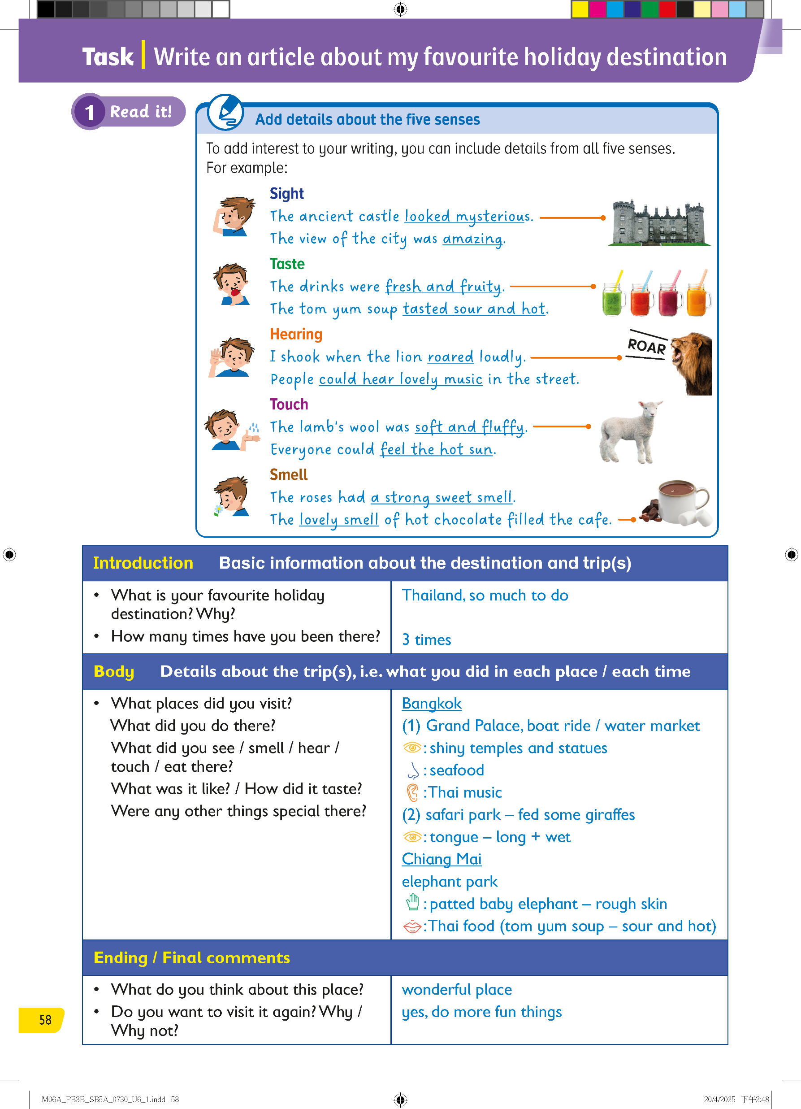
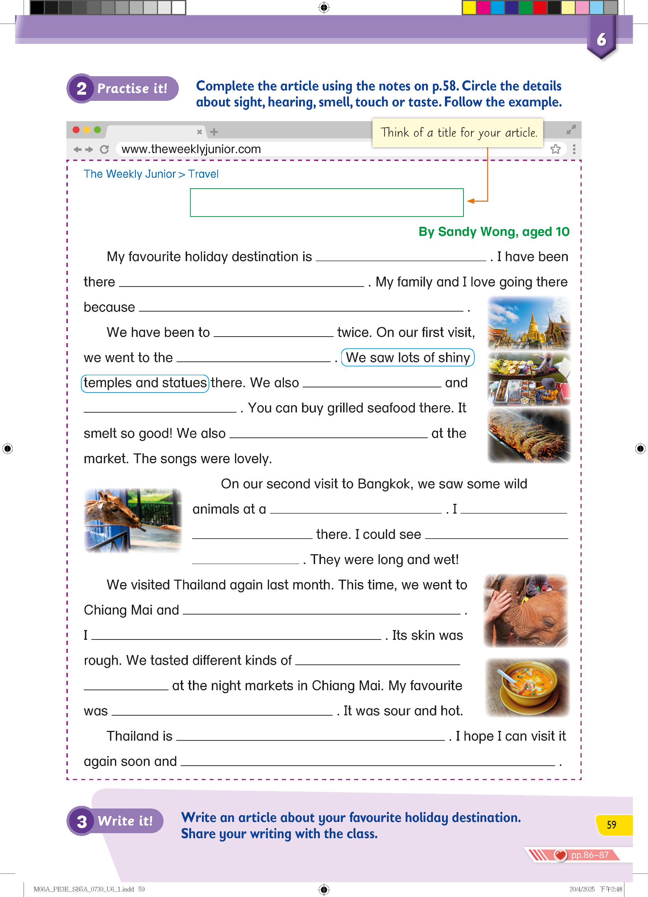
In this chapter, we learnt about going on a holiday.

Slide 3
Today, you’re going to write an article about your favourite holiday destination.

Slide 4
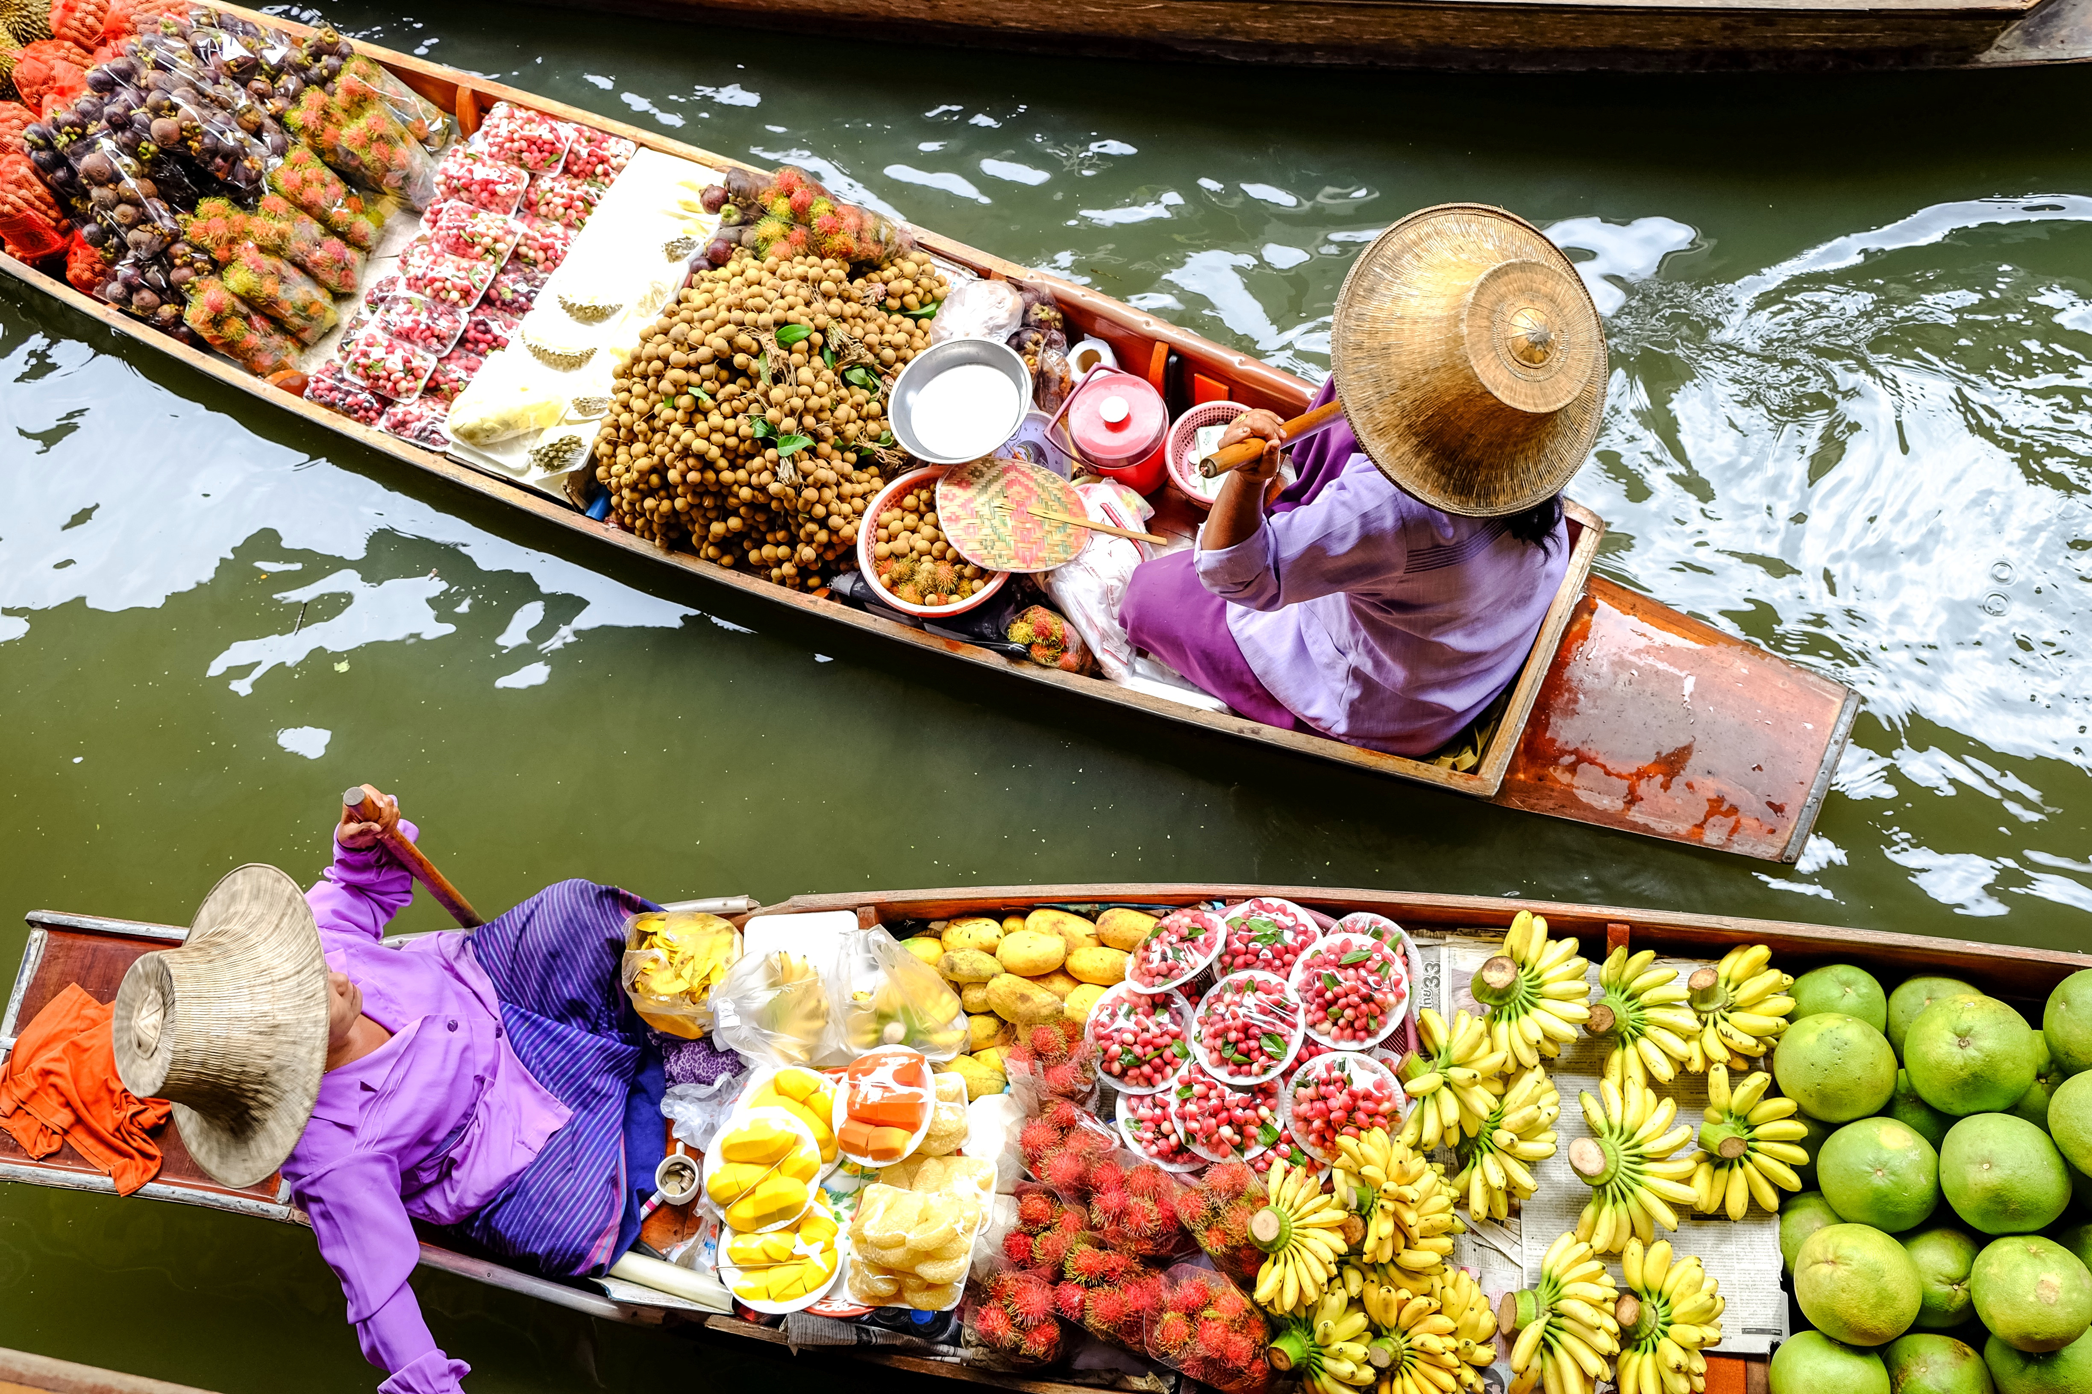
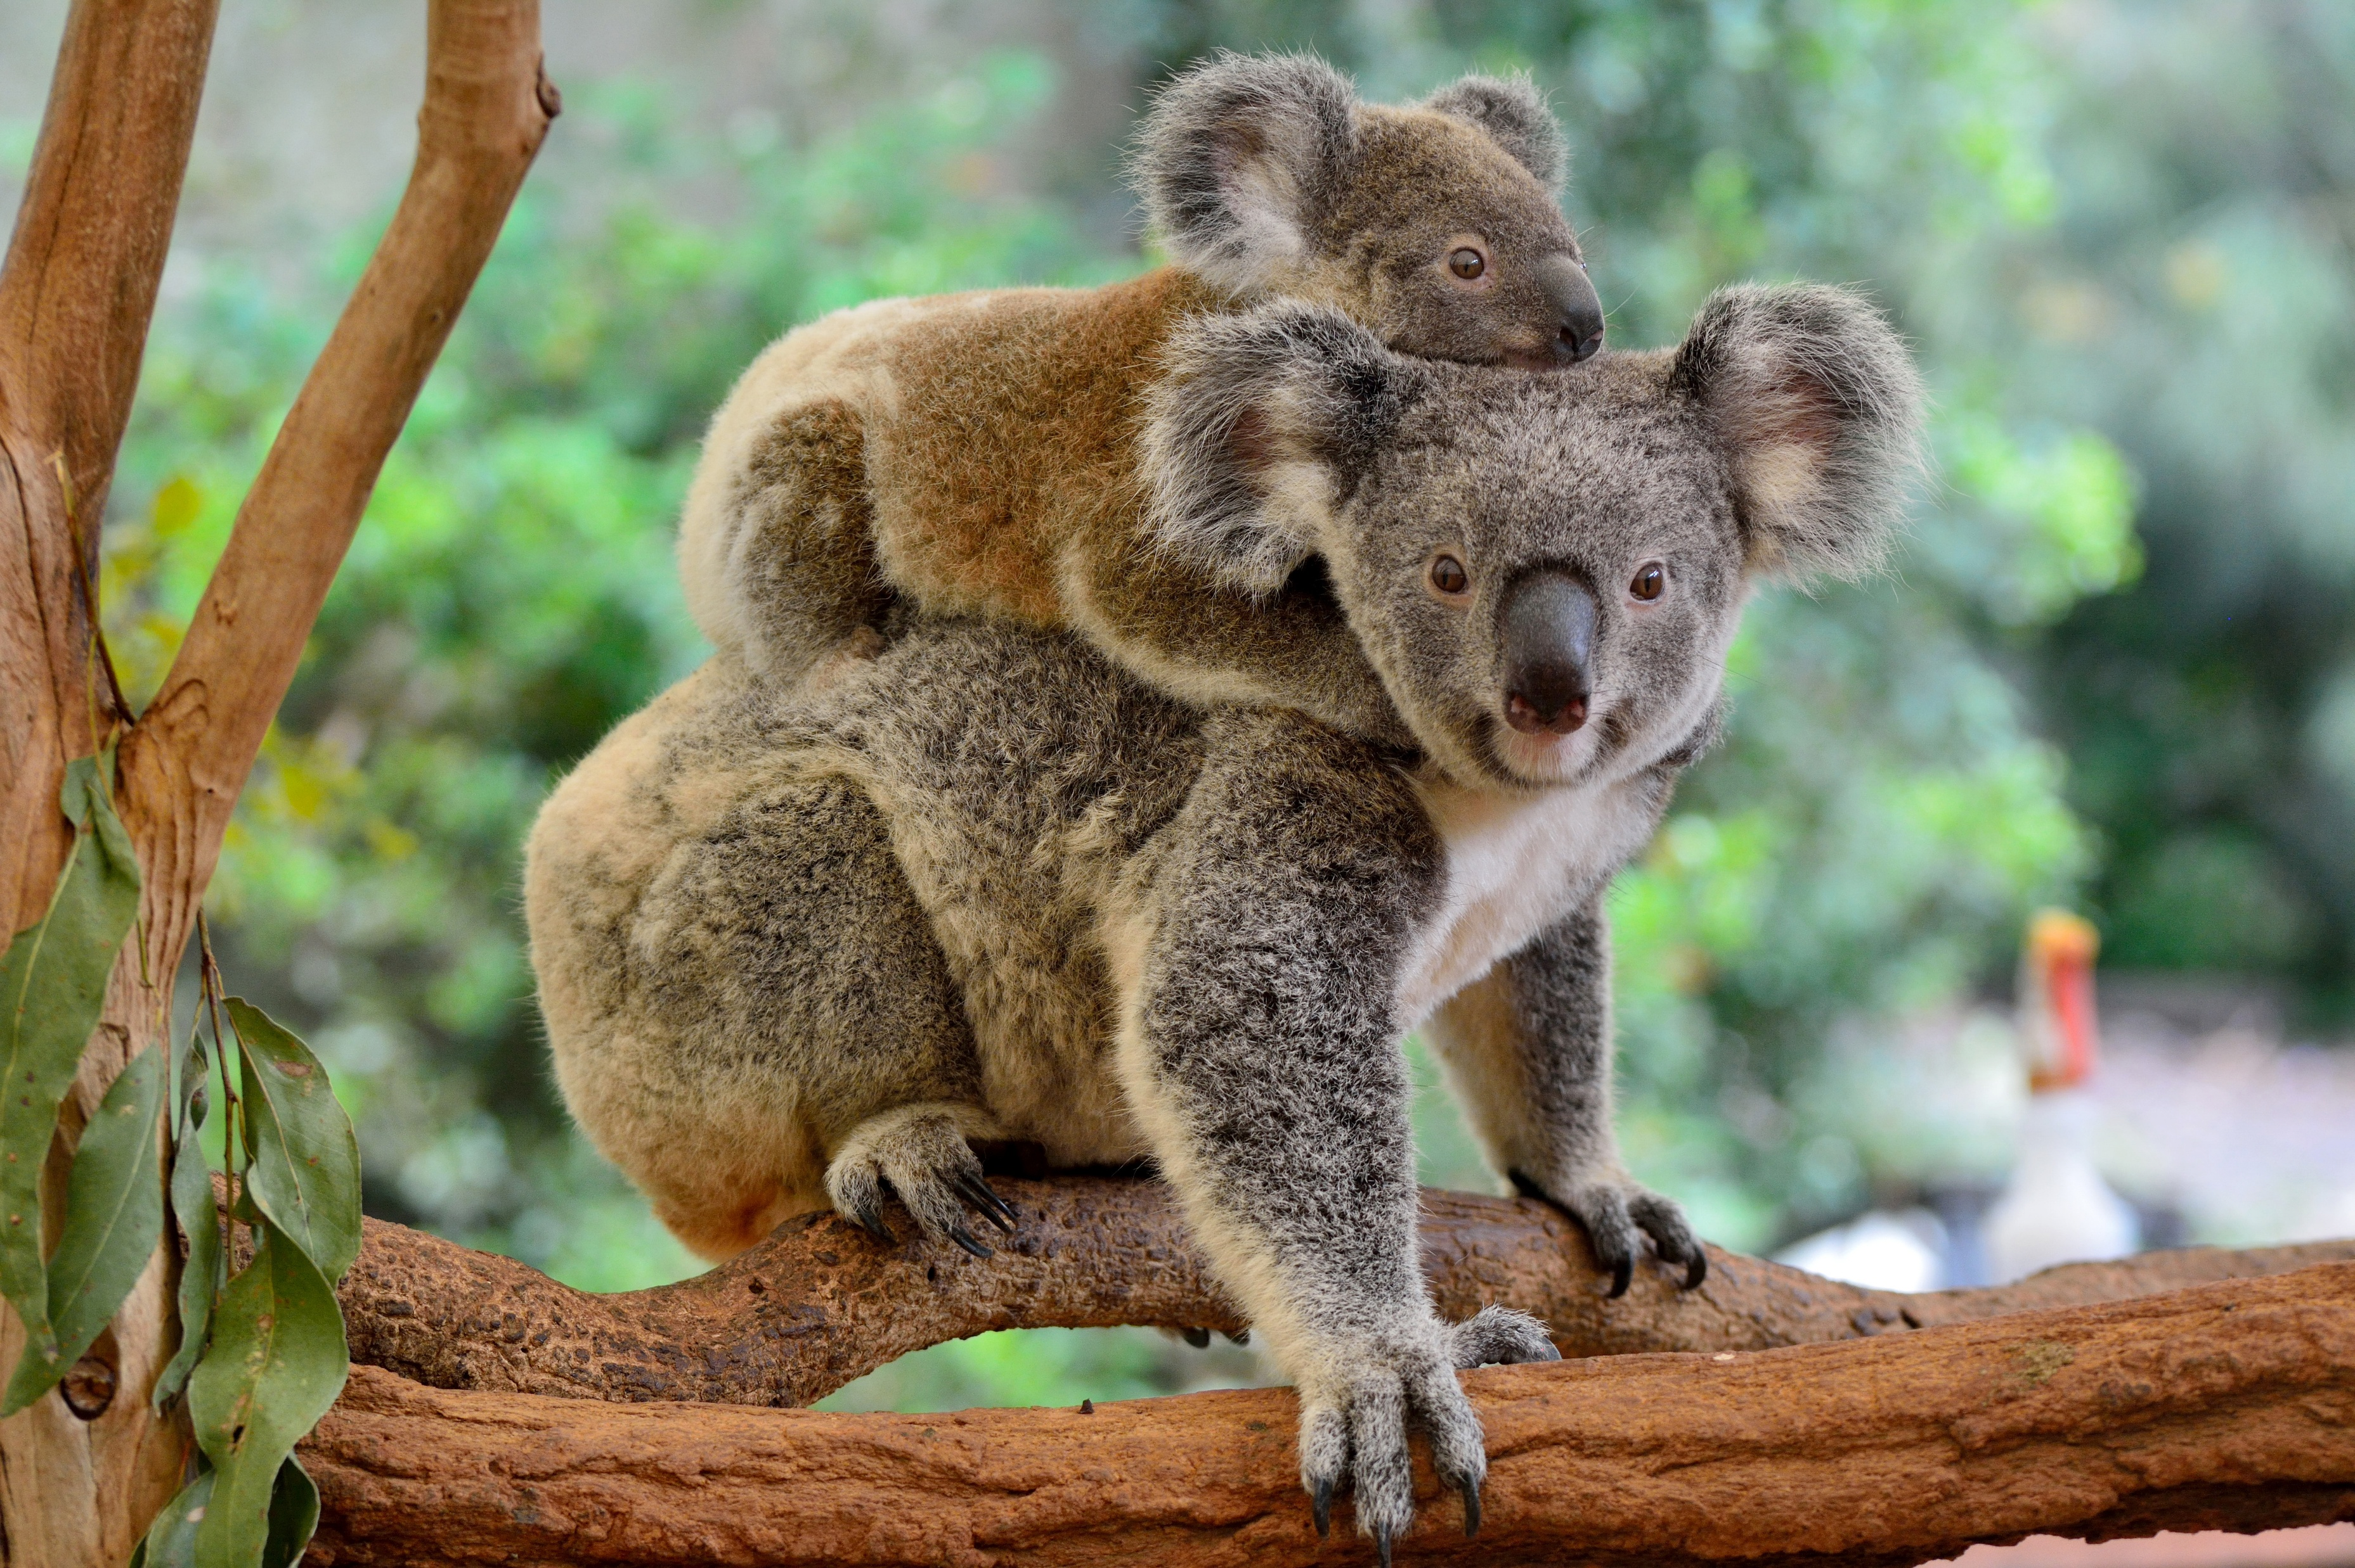
Think about a place you have visited.
What makes it special for you?

Slide 5
First, let’s organise our writing into three parts:
an introduction, a body and an ending.

Slide 6




The introduction is the beginning paragraph of your writing and should include basic information about the destination and your trip(s).

Slide 7


The body is the main part of your writing and should include the details about their trip. For example, what you did in each place each time.

Slide 8


The ending can include your thoughts, feelings and final comments about the trip.

Slide 9
You can use these questions to help you write your article.

Slide 10





You use the simple present tense when you are talking about your preferences, thoughts and feelings.

Slide 11

You use the present perfect tense when you talk about your travelling experience, e.g. how many times we have been to a place.

Slide 12






You use the simple past tense when describing the holiday activities that you did.

Slide 13
When you add more information and details about your trip, your text becomes more interesting.

Slide 14
You can add details from all your five senses, not just what you see.

Slide 15
Ask yourself: What do I see, taste, hear, touch and smell?
What words can we use to describe the things we sense around us?

Slide 16
You can use different words to describe these senses, including nouns, verbs and adjectives.

Slide 17
Sometimes, you can even use adverbs!

Slide 18
These details help readers imagine more vividly the things described — they can almost see, taste, smell or hear what the writer (that’s you) can!

Slide 19
Look at the notes in the table to find the symbols which represent the five senses.

Slide 20










Look at the notes in the table to find the symbols which represent the five senses.

Slide 21
Let’s read an example!

Slide 22
Use the note to complete the introduction and the second paragraph.

Slide 23
The writer starts the article by telling the readers what his favourite holiday destination is and how many times he has been there.

Slide 24
To make it more interesting, he also tells the reader why his family go there so many times.

Slide 25


In the third and fourth paragraphs, the writer writes about his second and third visits to Thailand with his family.

Slide 26
Finally, he writes about how he feels about the visits to Thailand.

Slide 27
Let’s try to complete the article together.
First, think of a title for the article.
My favourite holiday destination

Slide 28


What is your favourite holiday destination?
How many times have you been there?
My favourite holiday destination
Thailand
three times

Slide 29

Why is Thailand your favourite holiday destination?
My favourite holiday destination
Thailand
three times
there is so much to do

Slide 30


What place did you visit twice?
Where did you go on your first visit to Bangkok?
My favourite holiday destination
Thailand
three times
there is so much to do
Bangkok
Grand Palace

Slide 31


Where else did you go?
What did you see / smell / hear / touch / eat at the water market?
My favourite holiday destination
Thailand
three times
there is so much to do
Bangkok
Grand Palace
went on a boat ride
visited a water market
listened to Thai music

Slide 32
Can you circle the details about sight, hearing, smell, touch or taste?
My favourite holiday destination
Thailand
three times
there is so much to do
Bangkok
Grand Palace
went on a boat ride
visited a water market
listened to Thai music

Slide 33


Where did you go on your second visit to Bangkok?
What did you do at a safari park?
safari park
fed some
giraffes

Slide 34

What did you see / smell / hear / touch / eat at the safari park?
Can you circle the details about sight, hearing, smell, touch or taste?
safari park
fed some
giraffes
their tongues

Slide 35


Where did you go on your visit to Chiang Mai?
What did you do in the elephant park?
safari park
fed some
giraffes
their tongues
visit an elephant park
patted a baby elephant

Slide 36

What did you see / smell / hear / touch / eat at the night market?
What was your favourite Thai food?
safari park
fed some
giraffes
their tongues
visit an elephant park
patted a baby elephant
Thai food
tom yum soup

Slide 37
Can you circle the details about sight, hearing, smell, touch or taste?
safari park
fed some
giraffes
their tongues
visit an elephant park
patted a baby elephant
Thai food
tom yum soup

Slide 38


What do you think about Thailand?
Do you want to visit it again? Why / Why not?
safari park
fed some
giraffes
their tongues
visit an elephant park
patted a baby elephant
Thai food
tom yum soup
a wonderful place
do more fun things

Slide 39
Now it’s time to write your own article.

Slide 40
Before you write, you should organise your ideas into introduction, body and ending.

Slide 41
It is easier to describe what you saw, heard, tasted or smelled on the trip from your real experience.

Slide 42
If you have never been on holiday, you can do some online research about a holiday destination.

Slide 43
If you have never been on holiday, you can do some online research about a holiday destination.

Slide 44
Let’s look at some ideas about what to write!
Why is it your favourite holiday destination?
there are many famous / beautiful / interesting / exciting tourist attractions / sightseeing spots
the local food is yummy / delicious / a must-try
there are great places for shopping / things are cheap
the people are fun / nice / friendly / polite / helpful
there are a lot of parks / theme parks / farms / museums / activities for children
the weather is nice / wonderful / hot / warm / cold / comfortable / refreshing
the hotels are huge / comfortable / beautiful; the hotels have many facilities

Slide 45
Let’s look at some ideas about what to write!
What places did you visit?
visit …
an aquarium
a church
a hot spring
a local / night / street market
a museum
a palace
a tower
a waterfall

Slide 46
Let’s look at some ideas about what to write!
What did you do there?
watch …
fireworks
a football match
a parade
a show
look at …
the city / night views
exhibits
marine animals
statues

Slide 47
Let’s look at some ideas about what to write!
What did you do there?
go …
on a cruise trip
on a guided tour
shopping
horse-riding
buy …
clothes and accessories
handicrafts
local food
souvenirs

Slide 48
Let’s look at some ideas about what to write!
What do you think about this place?
It is a / an … place.
It is the most … place I have ever visited.
… is really a /an … city / country.
It was such a / an … experience.
Some positive adjectives you can use:
fantastic, lovely, wonderful, interesting, exciting, amazing, beautiful, incredible, unforgettable, fun

Slide 49
Let’s look at some ideas about what to write!
Do you want to go there again?
I hope I can visit … again soon.
I will definitely visit … again.
I will never get bored of … I hope I can go there every year.
My trip there was loads of fun / full of surprises! I can’t wait to go there again!

Slide 50
Let’s look at some ideas about what to write!
Do you want to go there again?
Here are some tips when you write your blog entry:
1 Remember to use the correct tense, e.g.
I have been / visited … twice!
On my first trip, I visited / tried …
I will definitely visit … again!
2 Try to use linking words to give reasons, give examples and link ideas, e.g.
I love the place because the people there are friendly / helpful.
I tried a lot of fun activities there such as taking a hot-air balloon ride and snorkelling.
The view on top was breathtaking and / as well as fantastic.
I have fed a kangaroo. I have also hugged a koala.
The ride was a bit scary but exciting!

Slide 51
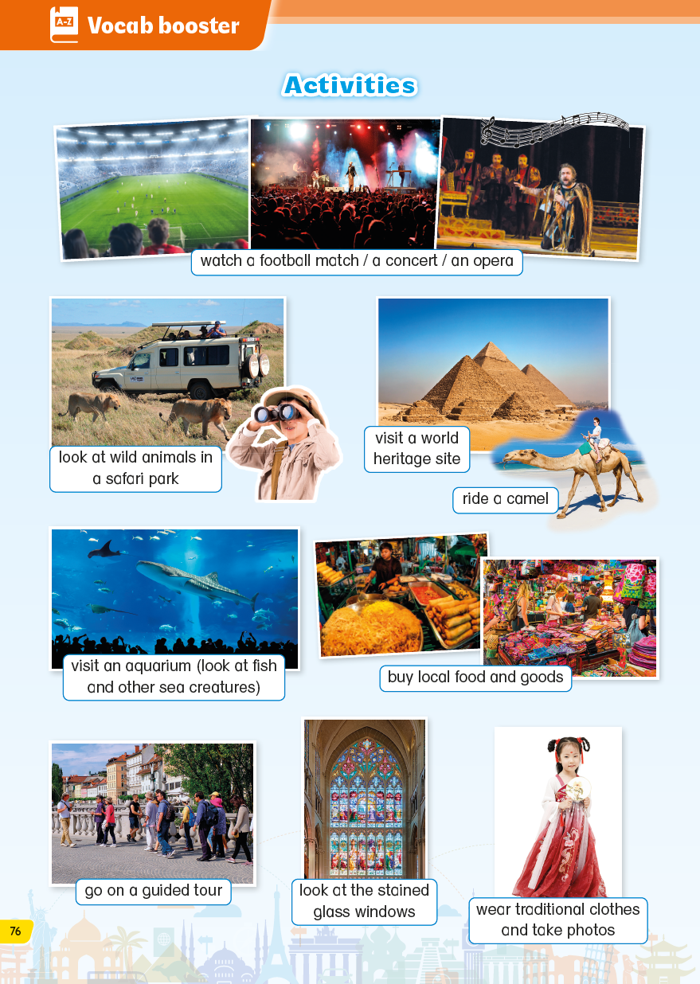
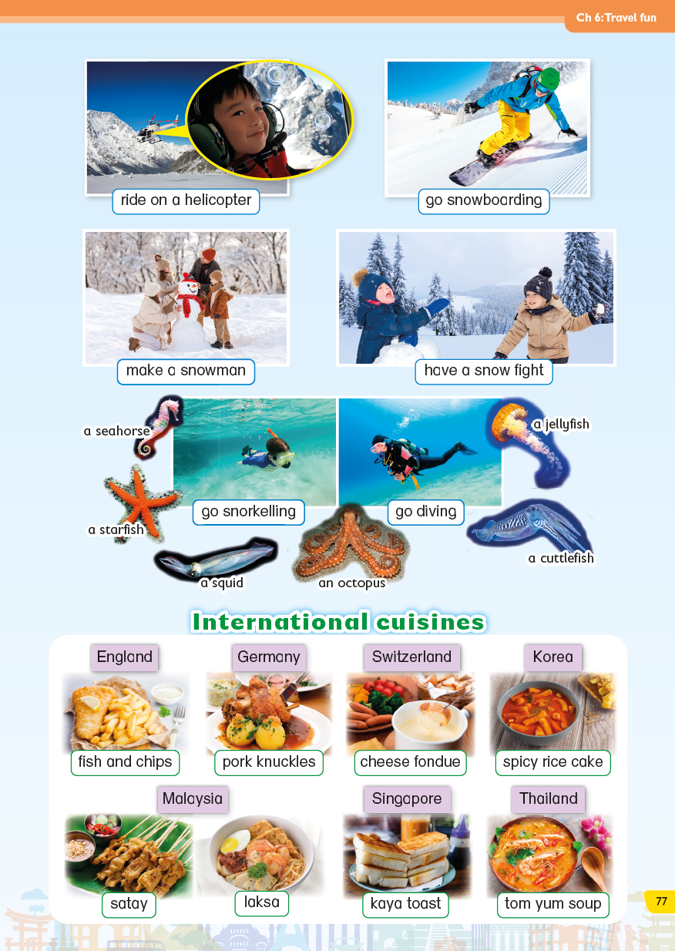
You can use words from the Vocab Booster section to make your writing more interesting.

Slide 52
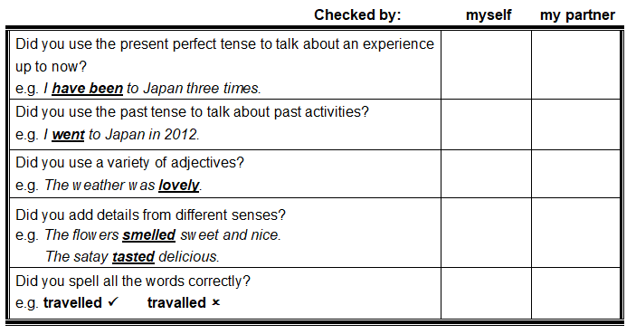
Check and revise your writing.

Slide 54
Acknowledgements
We would like to thank the following organisations and people for permission to use their images:
Africa Studio / stock.adobe.com
Alizada Studios / stock.adobe.com
chiradech / stock.adobe.com
Eric Isselée / stock.adobe.com
Intellson / Shutterstock
Marti Bug Catcher / Shutterstock
Nady / stock.adobe.com
New Africa / stock.adobe.com
passengerz / stock.adobe.com
PaulPaladin / stock.adobe.com
preto_perola / stock.adobe.com
Rafael Ben-Ari / stock.adobe.com
rolf_52 / stock.adobe.com
shujaa_777 / stock.adobe.com
Tatiana / stock.adobe.com
themorningglory / stock.adobe.com
Yeti Studio / stock.adobe.com

