Slide 1

Chapter 6
Make comments

Slide 2
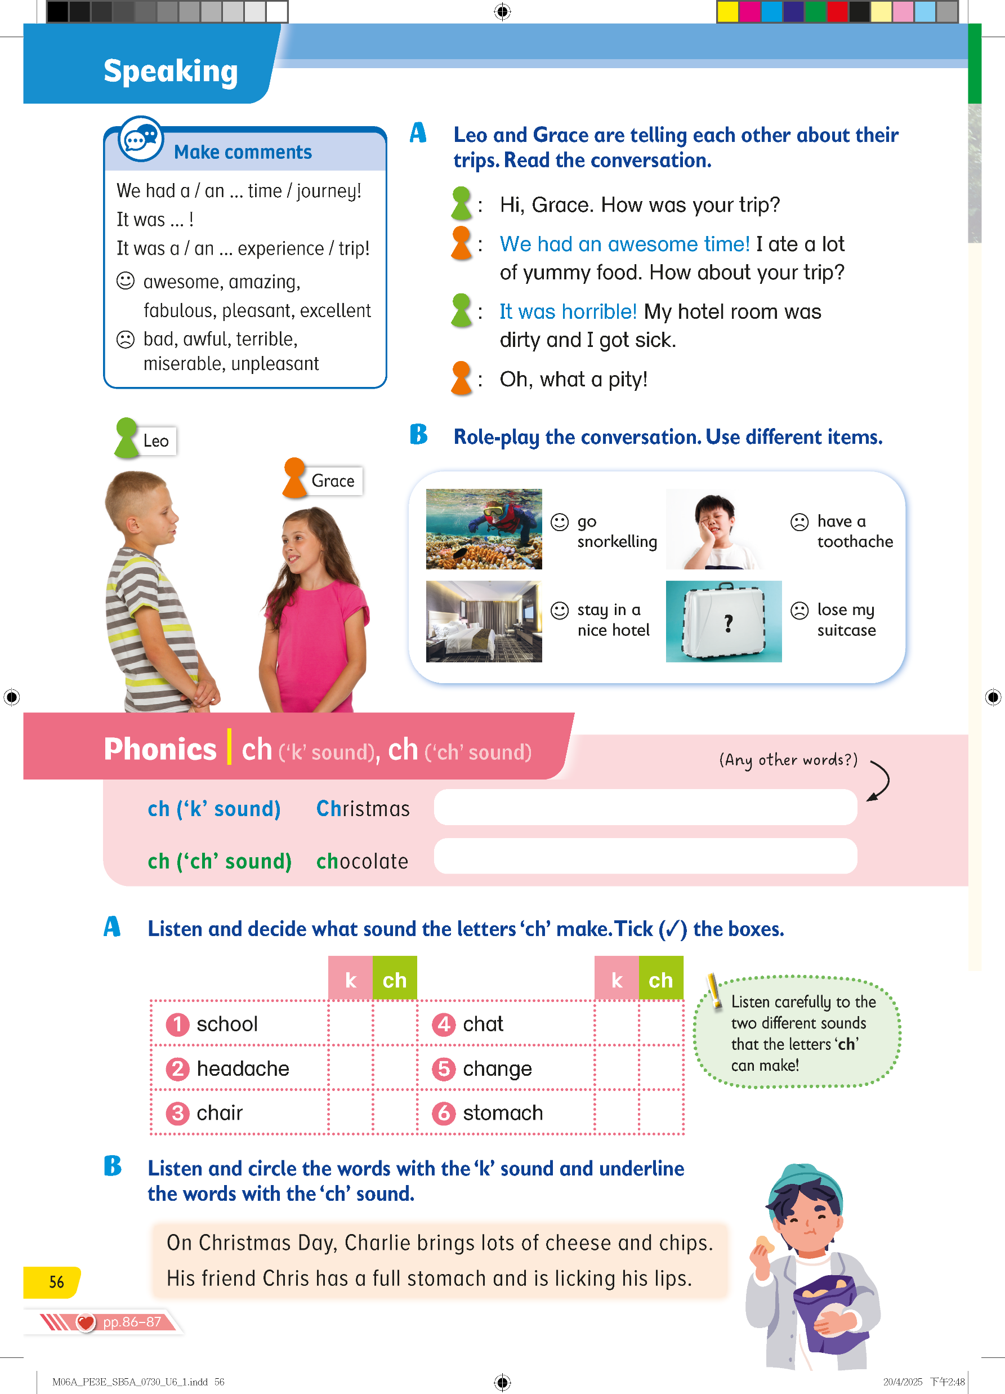
Today, we are going to learn how to make comments about different topics!
‘Making a comment’ means saying what you think or feel about something.

Slide 3
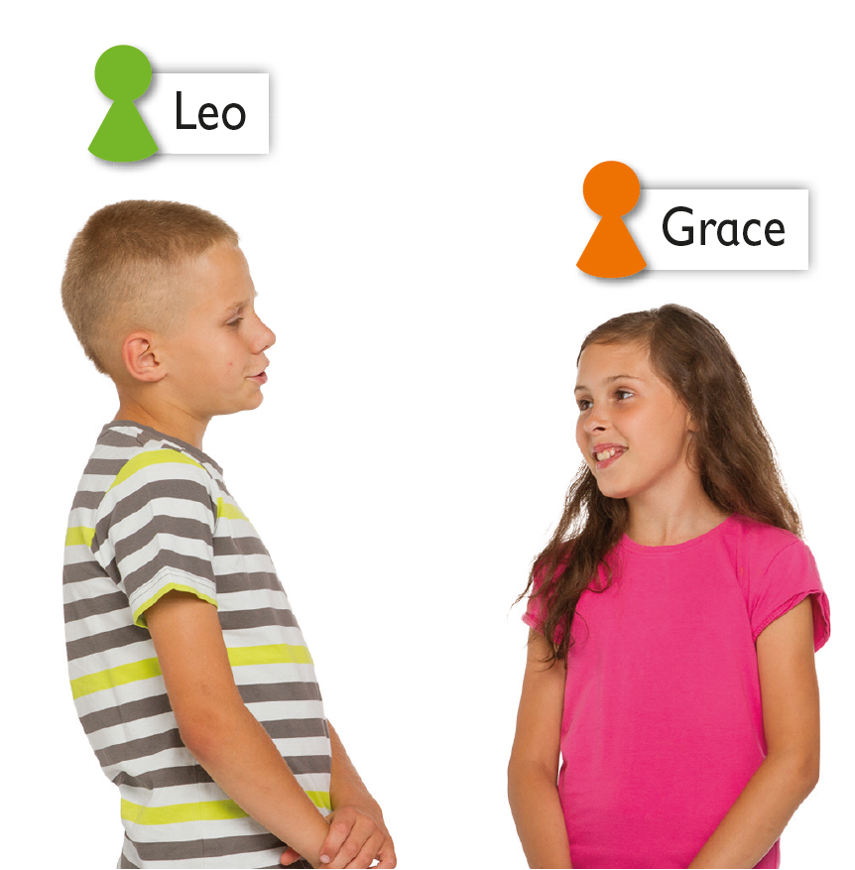
Look! Here’s Leo and Grace.
They are telling each other about trips they recently went on.

Slide 4
What do they say?
Let’s listen!

Slide 5


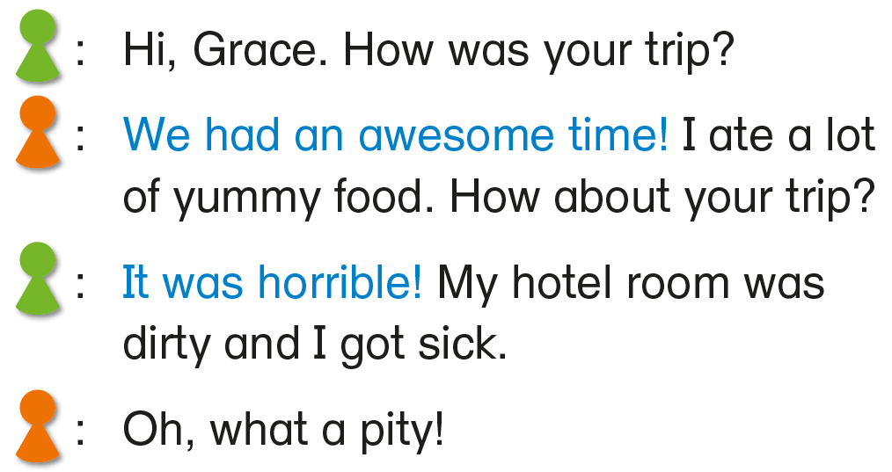



What did Grace do on her trip?
What did she think about the trip?
This is Grace’s comment on her trip.

Slide 6


What happened to Leo on his trip?
What did he think about the trip?
This is Leo’s comment on his trip.

Slide 7
Let’s look at how the children talk about their feelings about their trips.

Slide 8
The children are making comments about their trips by using different adjectives.

Slide 9
Grace has used a positive adjective
and Leo has used a negative adjective.

Slide 10
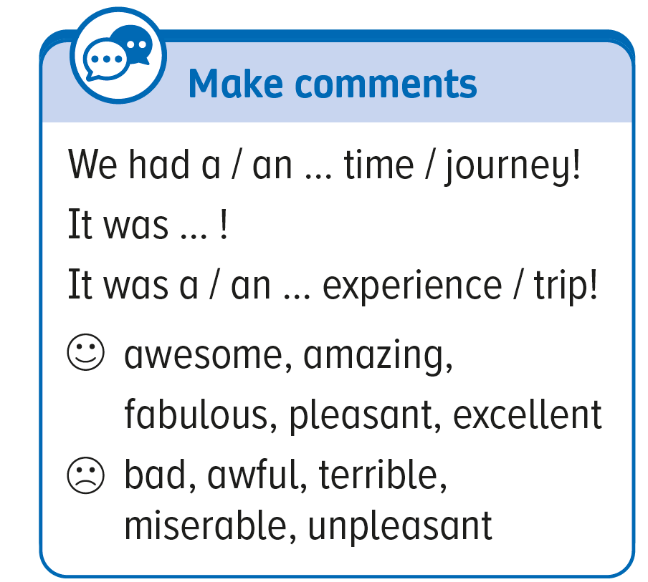
We can use different adjectives with these expressions to make comments about travel experiences.

Slide 11


Here are some examples:
Positive comments:
We had a fabulous time!
It was excellent!
It was a pleasant journey!
Negative comments:
We had a miserable time!
It was terrible!
It was a bad experience!

Slide 12
Well done! Let’s role-play Leo and Grace.
Talk about the trips.

Slide 13
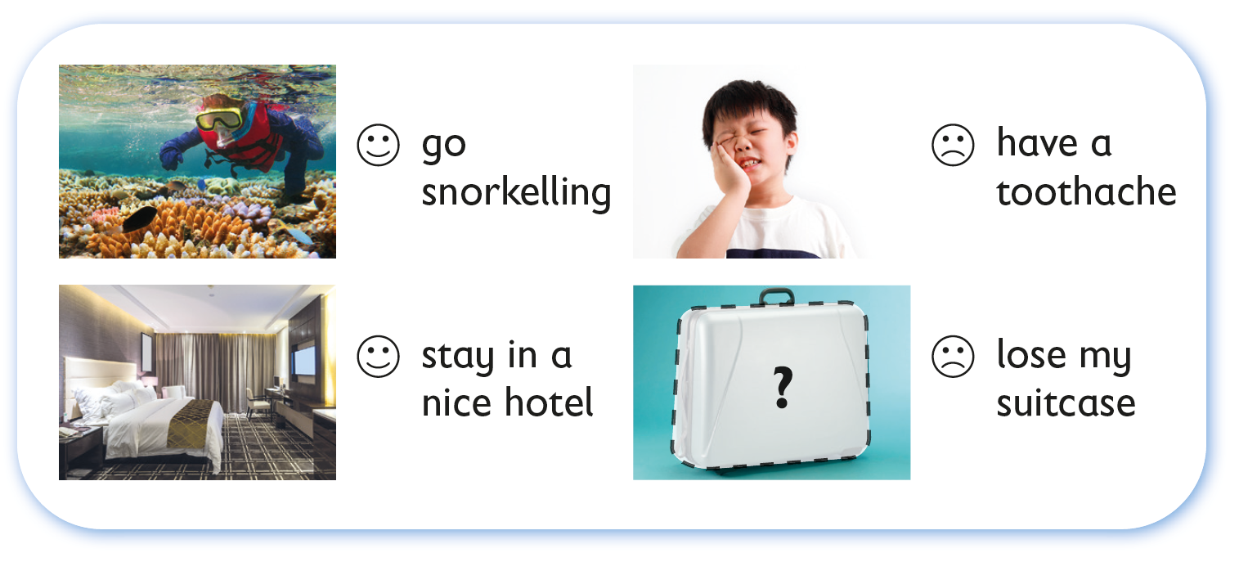
Let’s role-play the conversation talking about different things that happened during the trip.

Slide 14
Let’s role-play the conversation talking about different things that happened during the trip.

Slide 16
Acknowledgements
We would like to thank the following organisations and people for permission to use their images:
focal point / Shutterstock
Marcin Rosinski / Rafal Trubisz / Pearson Central Europe SP. Z.O.O.
Rafael Ben-Ari / 123RF
roseburn / 123RF
TY Lim / Shutterstock

