Slide 1


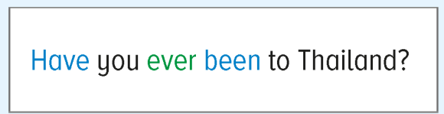
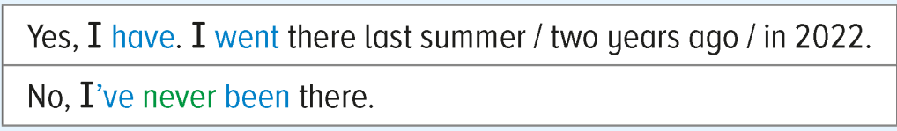

Chapter 6

Slide 2
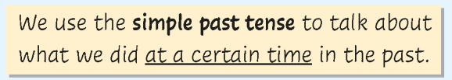
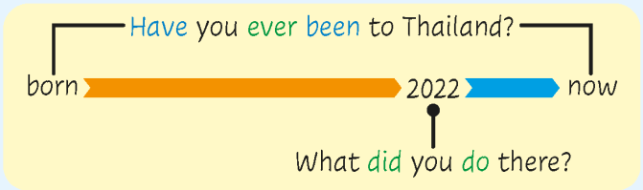
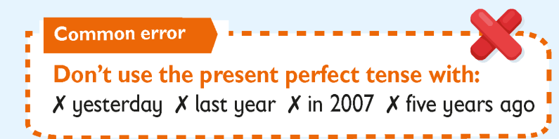
Grammar 1
In this part, you will learn:
to use the present perfect tense to ask and answer questions about whether people have been to certain places.
to use the past tense to talk about past activities.
verb table

Slide 3

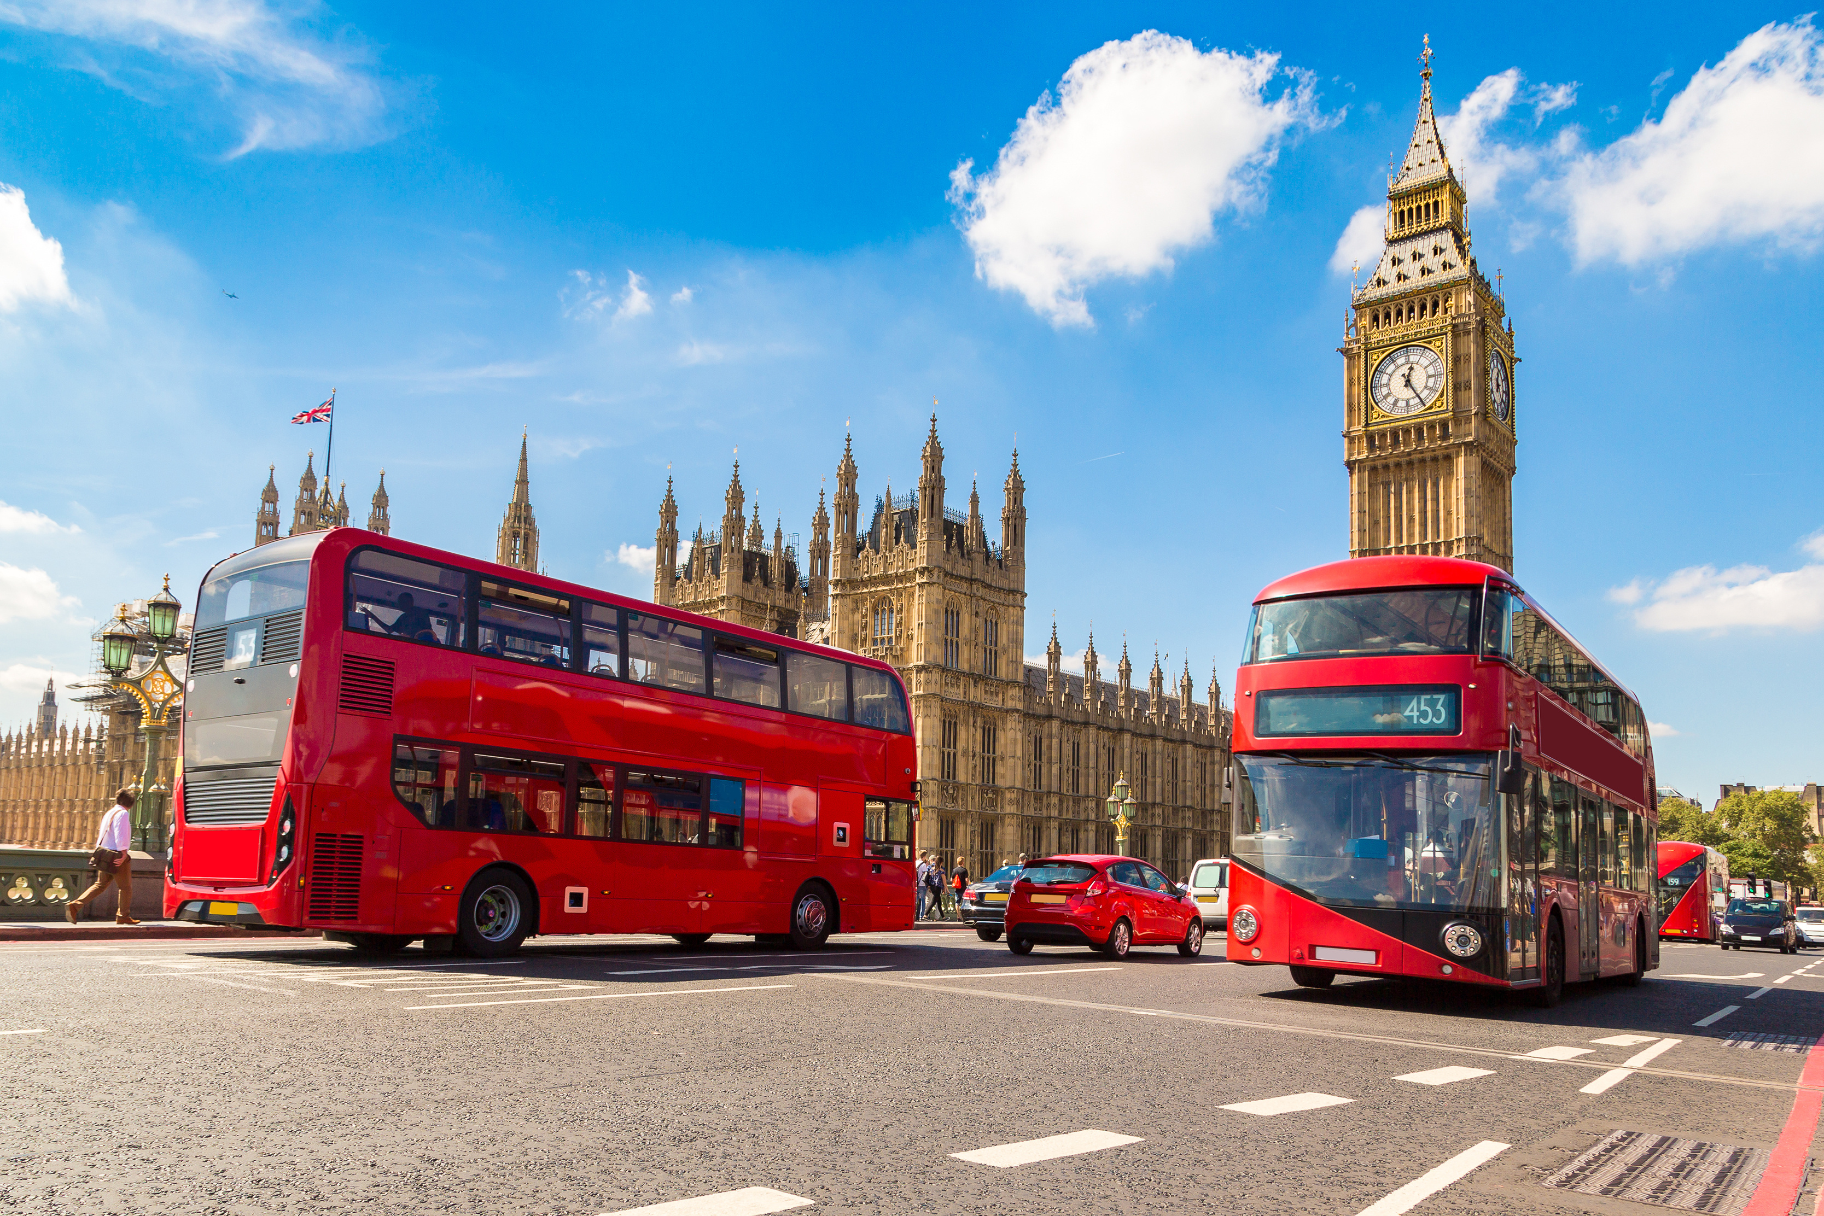

Travel experiences
We are going to talk about some travel experiences today. Let’s see what James is saying.
Have you ever been to London?
I went to London last summer.
What can he say to find out if someone has travelled to London before?

Slide 4
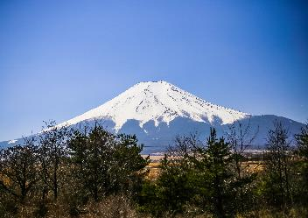



Have you ever been to …?
We can ask people if they have been to certain places using the present perfect tense.
born
now
We use ever to mean at any time in your life in this question.
Tim :
Pam :
Have you ever been to Japan?
Yes, I have.
Yes, I’ve.
Yes, I have been.

Slide 5
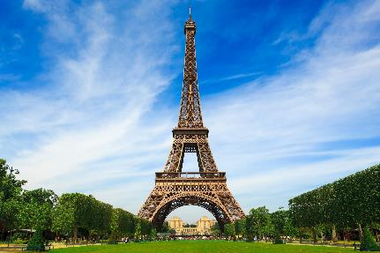


Have you ever been to …?
born
now
Tim :
Pam :
Have you ever been to France?
No, I’ve never been there.
We can use there to replace France in the answer.
What’s the difference between have been and have gone?

Slide 6




have been vs have gone
Where have you been?
Amanda
I’ve been to the library.
= Amanda went to the library and came back.
Where’s Amanda?
She’s gone to the library.
= Amanda is on her way to the library or she is there now.

Slide 7

Quick check
1. Choose the correct answers.
A: [Have / Did] you ever been to Thailand?
B: Yes, I [have / did].
✓

Slide 8
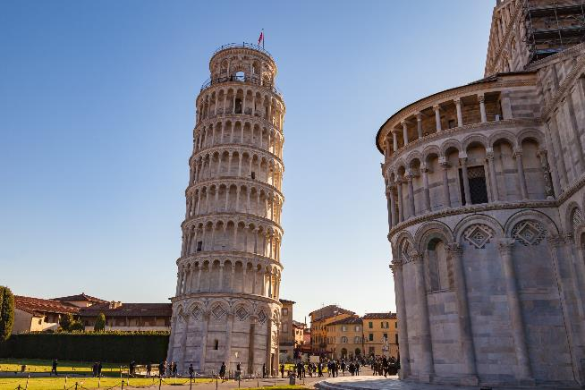
Quick check
2. Choose the correct answers.
A: [Have / Did] you ever been to Italy?
B: No, [I was / I’ve] never been there.
✗

Slide 9
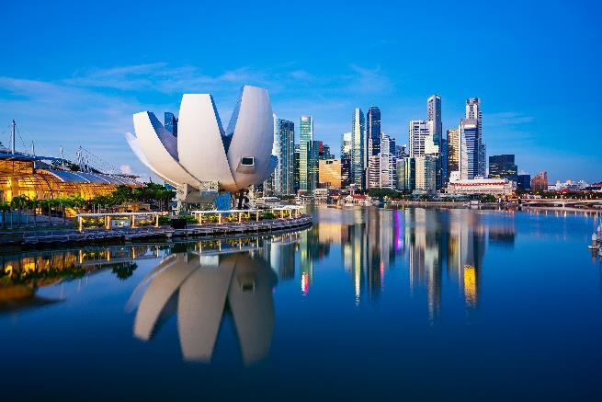
Quick check
3. Fill in the blanks.
A : _____ you _________ (be) to Singapore?
B : Yes, _______ .
Have
ever been
I have
✓

Slide 10
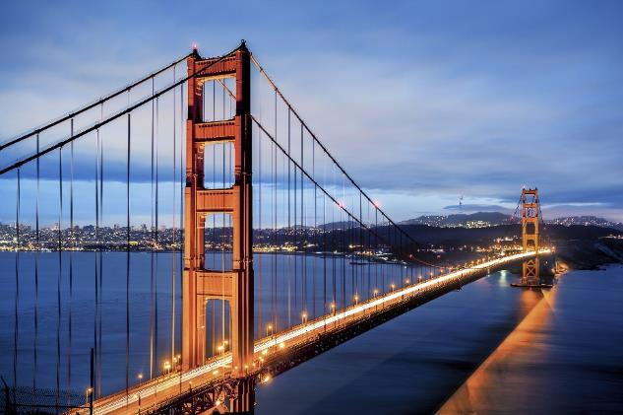
Quick check
4. Fill in the blanks.
✗
A : ___________________ (be) to San Francisco?
B : ___________________ there.
Have you ever been
No, I’ve never been

Slide 11
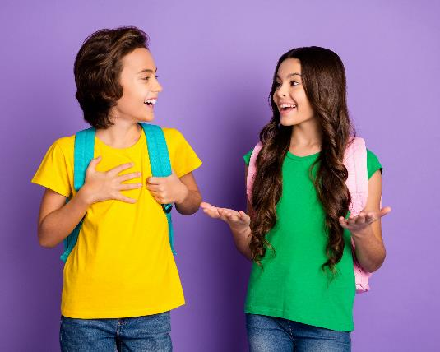

What did you do there?
Ken and Chloe are talking about their travel experiences.
Ken :
Chloe :
Ken :
Chloe :
Have you ever been to Japan?
Yes, I have.
What did you do there?
I visited a temple.
Let’s take a closer look at the difference between the present perfect tense and the simple past tense.
We use the simple past tense here because they are talking about what they did at a certain time in the past, i.e. the last time Chloe went to Japan.

Slide 12
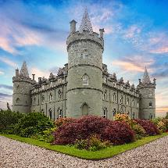
The present perfect vs the simple past
➢
We can use the present perfect tense to talk about an experience up to the present moment (now).
➢
We don’t say when it happened.
I have visited a castle.
born
now
I visited a castle last summer.
➢
We can use the simple past tense when we say exactly when it happened, e.g. yesterday, last winter, three years ago, in 2024.

Slide 13
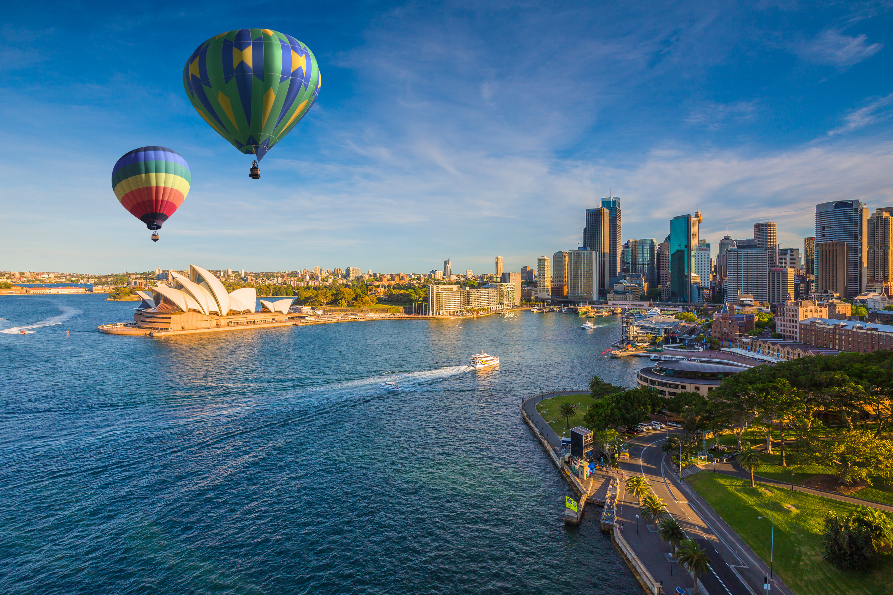
Quick check
1. Fill in the blanks.
A : I _____ (go) to Australia last month.
B : What ______ you _____ (do) there?
A : I ______ (take) a ride in a hot-air balloon.
went
did
do
took

Slide 14
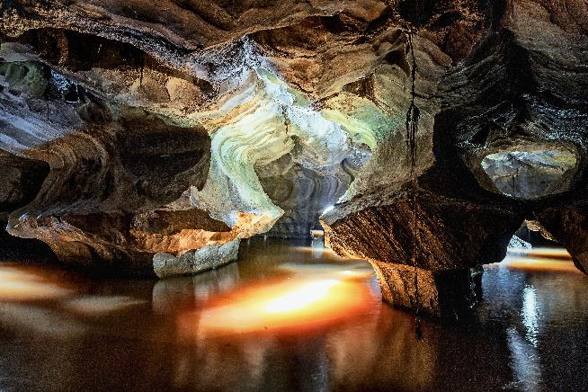
Quick check
2. Fill in the blanks.
A : I _____ (go) to Vietnam three years ago.
B : What ______ you _____ (do) there?
A : I _________ (explore) a cave.
went
did
do
explored

Slide 15
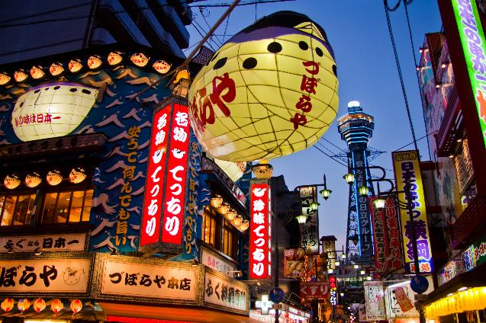
Quick check
3. Fill in the blanks.
✓
A : _____ you _________ (be) to Japan?
B : Yes, _______. I ______ (go) there in 2020.
Have
ever been
I have
went

Slide 17
Acknowledgements
We would like to thank the following organisations and people for permission to use their images:
2xSamara.com / stock.adobe.com
Andrii_M / Shutterstock
anekoho / stock.adobe.com
AntonioDiaz / stock.adobe.com
carlusgg / stock.adobe.com
deagreez / stock.adobe.com
Frédéric Prochasson / stock.adobe.com
gstockstudio / stock.adobe.com
ikostudio / stock.adobe.com
InsideCreativeHouse / stock.adobe.com
Nonwarit / stock.adobe.com
redlinevector / 123RF
Sergii Figurnyi / stock.adobe.com
structuresxx / stock.adobe.com
thanksforbuying / stock.adobe.com
TTstudio / stock.adobe.com
umike_foto / stock.adobe.com
Victor zastol'skiy / stock.adobe.com
Việt Nguyên / stock.adobe.com
wajan / stock.adobe.com

Slide 18


Verb table: Irregular verbs
Present | Past | Past participle
bring | brought | brought
build | built | built
buy | bought | bought
feel | felt | felt
get | got | got
have | had | had
keep | kept | kept
learn | learnt | learnt
pay | paid | paid
spend | spent | spent
teach | taught | taught
think | thought | thought

Slide 19

Verb table: Irregular verbs
Present | Past | Past participle
be (is / am / are) | was / were | been
become | became | become
choose | chose | chosen
do | did | done
eat | ate | eaten
fall | fell | fallen
go | went | gone
see | saw | seen
take | took | taken

