Slide 1
Chapter 6
Practice Answer key

Slide 2
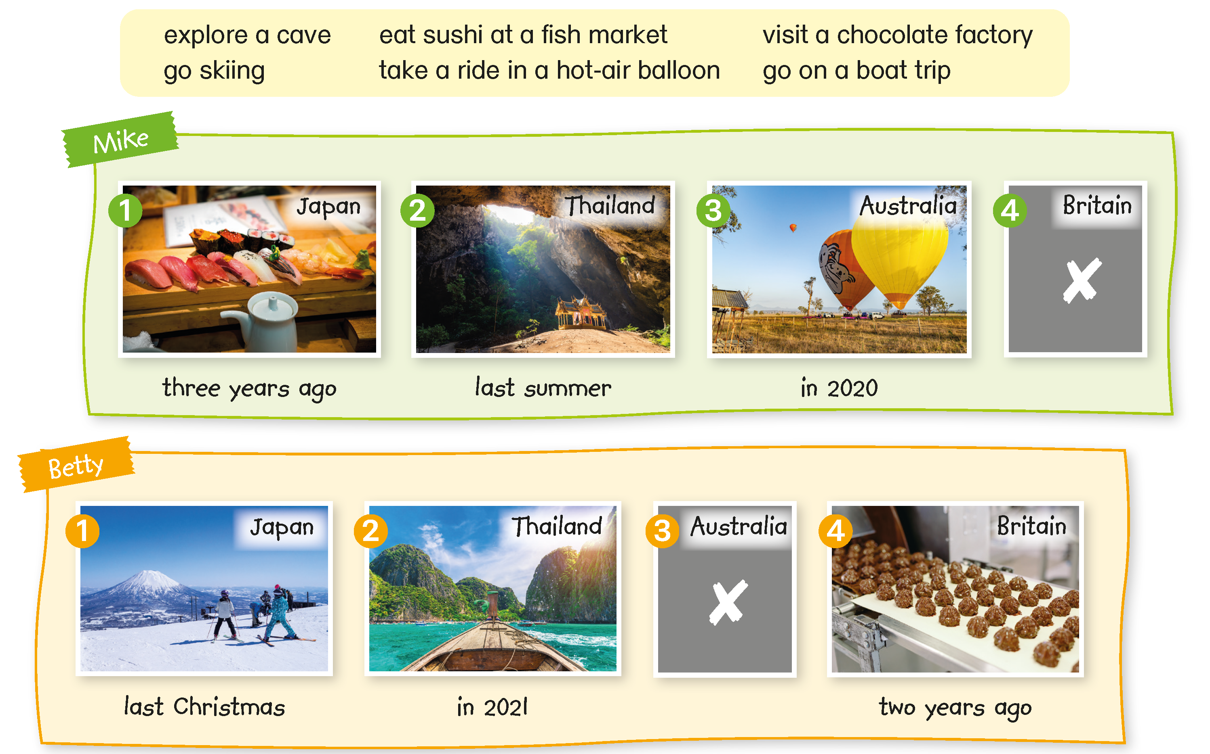
The children are talking about the places they have visited. Finish what they say.

Slide 3
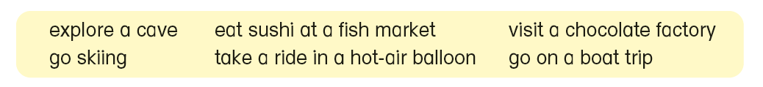



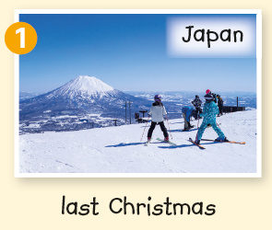
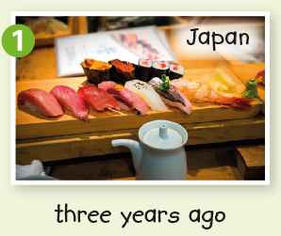


Here is an example.
Betty:
Mike:
Betty:
Mike:
Betty:
Mike:
Betty:
Have you ever been to Japan?
Yes, I have. I went there three years ago.
What did you do there?
I ate sushi at a fish market.
How about you? Have you ever been to Japan?
Yes, I have. I went there last Christmas.
What did you do there?
I went skiing.

Slide 4

Now you try.

Slide 5

The children are talking about the places they have visited. Finish what they say.
Betty:
Mike:
Betty:
Mike:
Betty:
Mike:
Betty:
Have you ever been to Japan?
Yes, I have. I went there three years ago.
What did you do there?
I ate sushi at a fish market.
How about you? Have you ever been to Japan?
Yes, I have. I went there last Christmas.
What did you do there?
I went skiing.

Slide 6
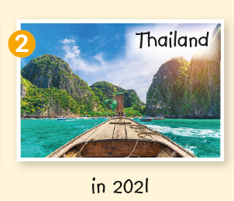
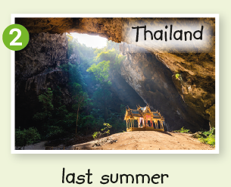
The children are talking about the places they have visited. Finish what they say.
Betty:
Mike:
Betty:
Mike:
Betty:
Mike:
Betty:
Have you ever been to Thailand?
Yes, I have. I went there last summer.
What did you do there?
I explored a cave.
How about you? Have you ever been to Thailand?
Yes, I have. I went there in 2021.
What did you do there?
I went on a boat trip.

Slide 7
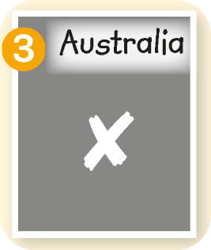
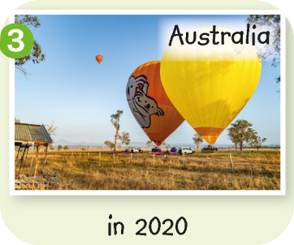
The children are talking about the places they have visited. Finish what they say.
Betty:
Mike:
Betty:
Mike:
Betty:
Have you ever been to Australia?
Yes, I have. I went there in 2020.
What did you do there?
I took a ride in a hot-air balloon.
How about you? Have you ever been to Australia?
No, I’ve never been there.

Slide 8
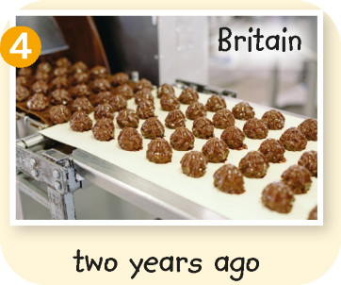
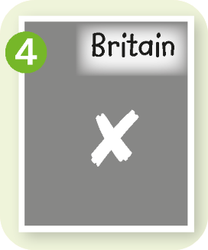
The children are talking about the places they have visited. Finish what they say.
Betty:
Mike:
Betty:
Mike:
Betty:
Have you ever been to Britain?
No, I’ve never been there.
How about you? Have you ever been to Britain?
Yes, I have. I went there two years ago.
What did you do there?
I visited a chocolate factory.

Slide 10
Acknowledgements
We would like to thank the following organisations and people for permission to use their images:
Brent Randall / stock.adobe.com
davit85 / stock.adobe.com
day2505 / stock.adobe.com
deagreez / stock.adobe.com
flas100 / stock.adobe.com
Mayumi.K.Photography / stock.adobe.com
Patrick.Wong / Shutterstock
powerbeephoto / stock.adobe.com

