Slide 1
Chapter 6
Activities
International cuisines

Slide 2


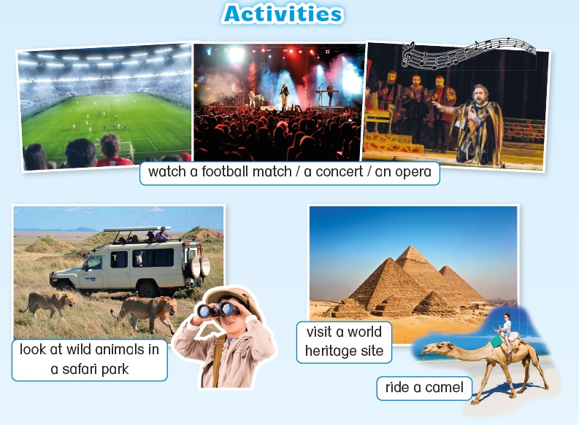

Slide 3
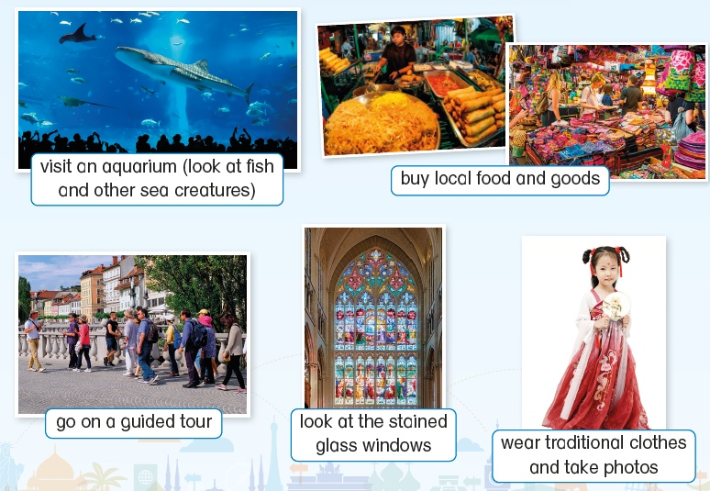

Slide 5
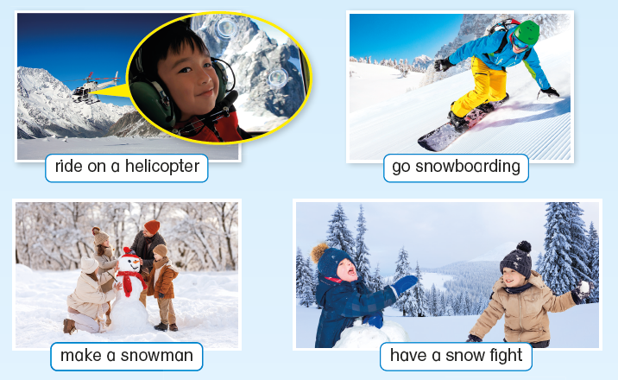

Slide 7
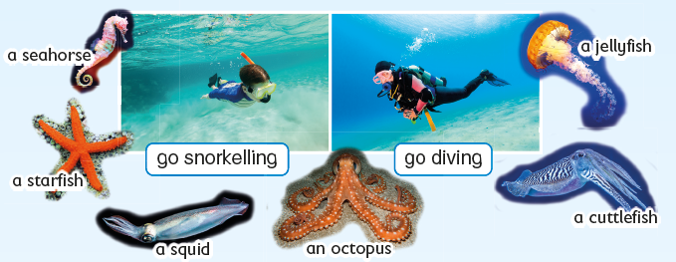

Slide 8
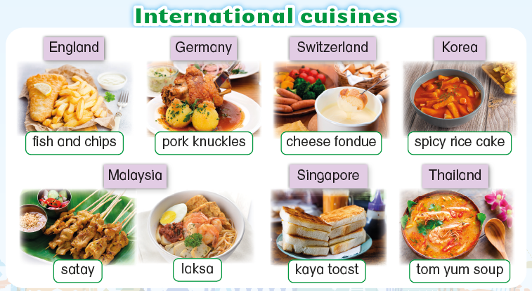

Slide 10
Acknowledgements
We would like to thank the following organisations and people for permission to use their images:
Alpha_7D / Shutterstock
BlueOrange Studio / stock.adobe.com
BlueOrange Studio / stock.adobe.com
Chamaiporn Taylor / Shutterstock
Christian Bertrand / Shutterstock
cokemomo / 123RF
dam / stock.adobe.com
David Litman / Shutterstock
DenisMArt / stock.adobe.com
GOLFX / Shutterstock
Gorodenkoff / stock.adobe.com
Hafiz Johari / Shutterstock
Igor Bulgarin / Shutterstock
Irina Mikhailichenko / stock.adobe.com
Jed RT / Shutterstock
JenkoAtaman / stock.adobe.com
kai / stock.adobe.com
Linda_K / Shutterstock
Luis Louro / Shutterstock
Lukas Gojda / Shutterstock
meunierd / Shutterstock
Nagel Photography / Shutterstock
nazar12 / stock.adobe.com
NuFa Studio / stock.adobe.com
Olek / stock.adobe.com
perfectloop / stock.adobe.com
Peter Leahy / Shutterstock
Richard Whitcombe / Shutterstock
Sakis Lazarides / Shutterstock
SEUNGJIN / stock.adobe.com
suriya yapin / Shutterstock
Vassamon Anansukkasem / Shutterstock
Vitalii_Mamchuk / stock.adobe.com
VLADGRIN / Shutterstock
Wandering views / Shutterstock
WitR / Shutterstock
yu_photo / stock.adobe.com
ztony1971 / stock.adobe.com

