Slide 1


Chapter 6
National identity
Love our culture

Slide 2
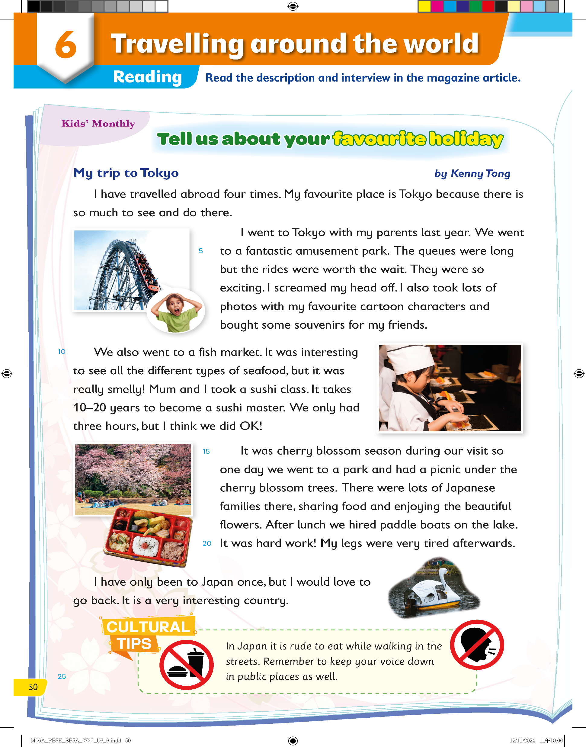
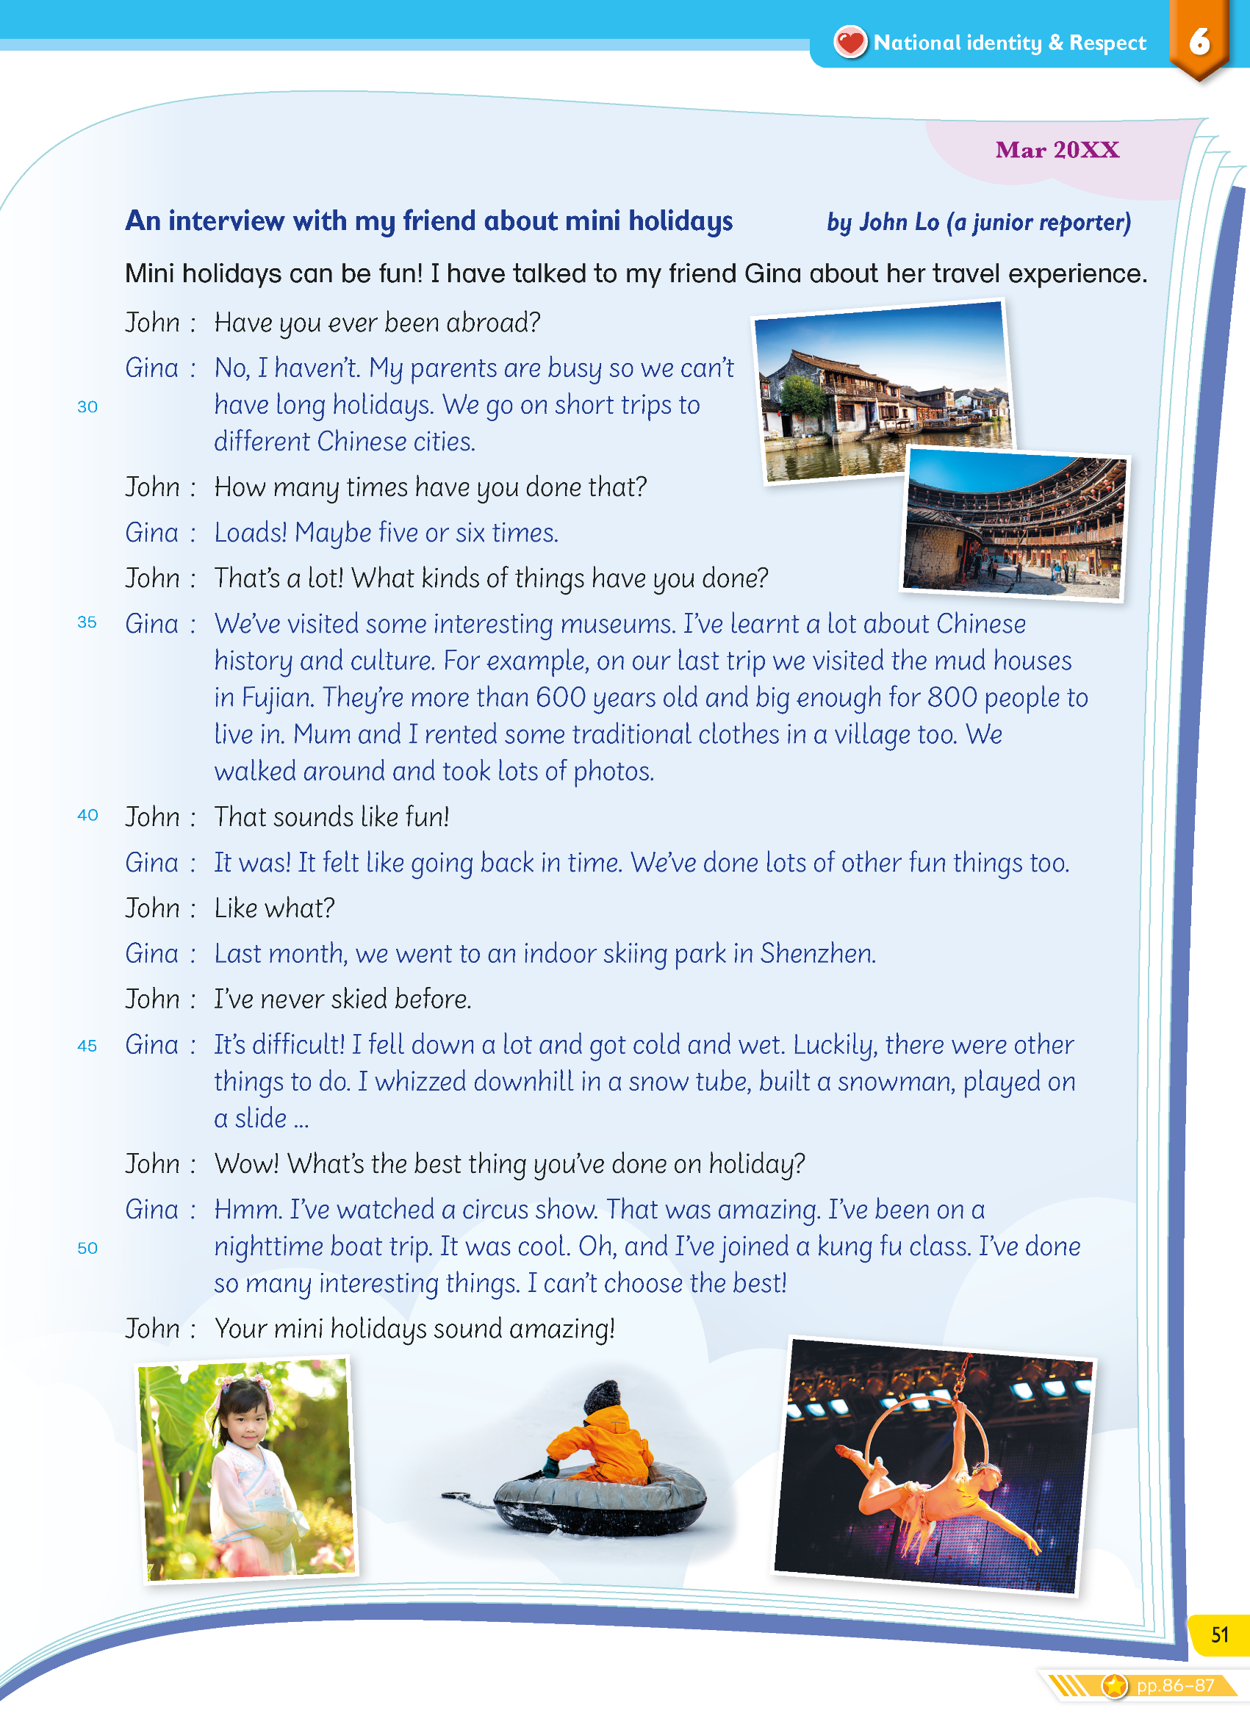
In the magazine article, what did Kenny and Gina share?

Slide 3
Where did they go?

Slide 4
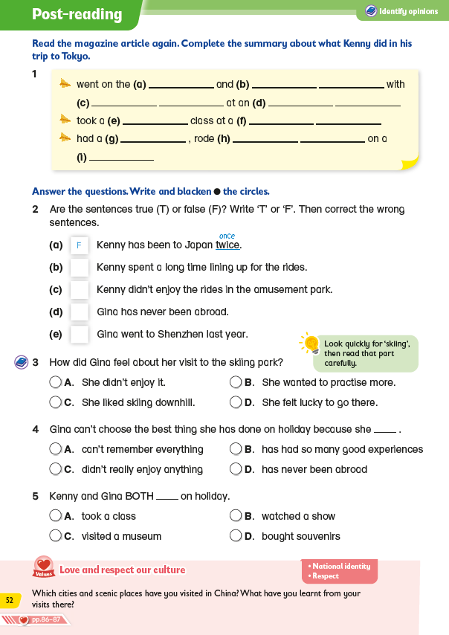
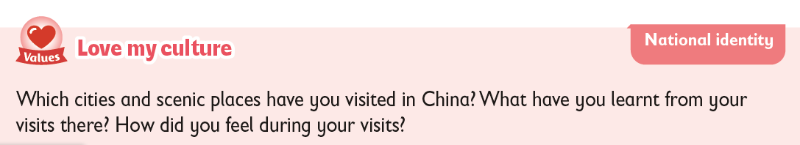
What can we learn from their experiences?

Slide 5

How can we learn to love our culture when we travel?
Let’s find out!

Slide 6

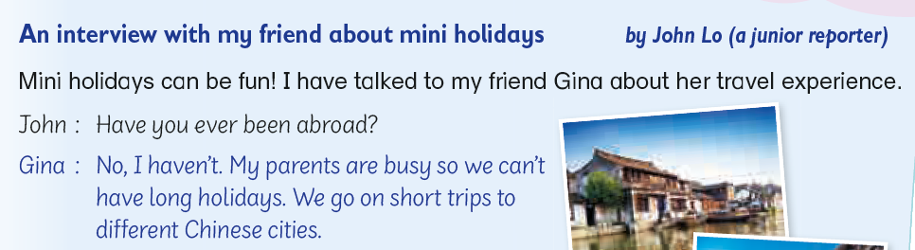
In the article, Kenny and Gina have done some travelling.

Slide 7
Kenny went to Tokyo in Japan.

Slide 8
Gina went to different Chinese cities.

Slide 9
It is fun to travel because we can do lots of fun activities but there’s more! Do you know what that is?
We can learn a lot about a culture when we travel!

Slide 10
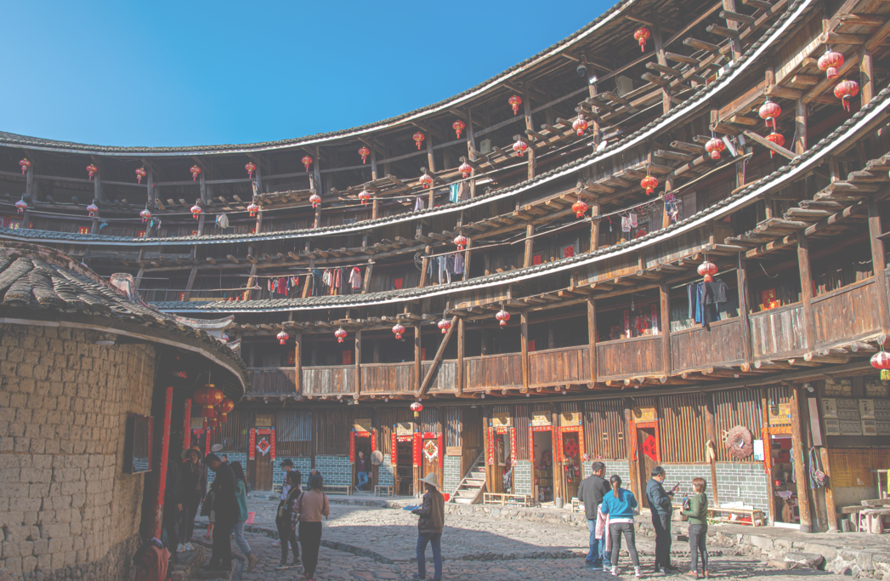
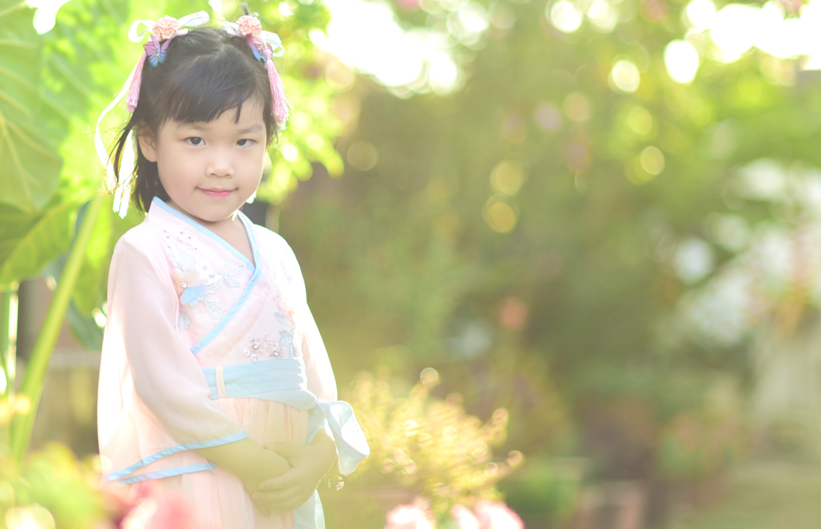
In particular, Gina learned a lot about her own culture.
She visited some tradition mud houses in Fujian and learnt about traditional clothes in a village.

Slide 11

In particular, Gina learned a lot about her own culture.
She also joined a kung fu class, which is also an important part of Chinese culture!

Slide 12
Let’s look at a few Chinese cities popular among tourists from around the world.
Have you been to any of these cities? Which of these cities do you want to visit?
What can we learn about our culture in these places?

Slide 13


Beijing
We visited the Great Wall of China and learnt about the history of China.
We watched the Peking Opera to experience this special art form.
We tried special street food there.
✓
History
Traditional arts
Food
✓
✓

Slide 14
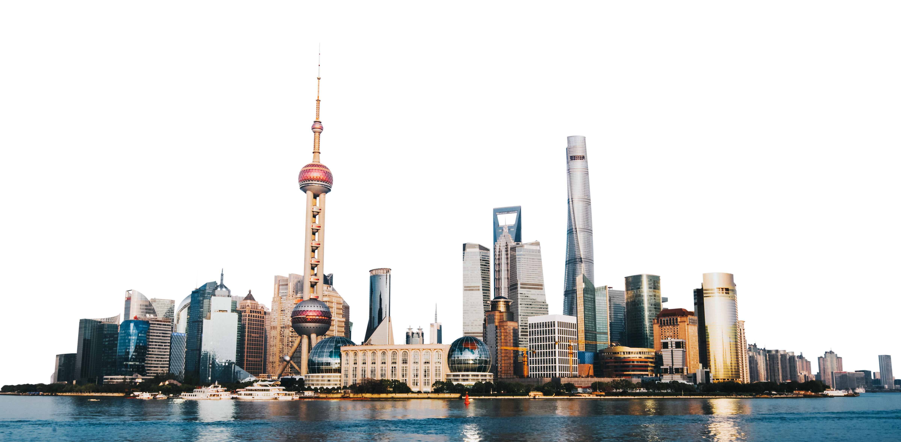
Shanghai
We saw both old and modern buildings there. They’re all beautiful!
Some people spoke Shanghainese there.
✓
I like the pan-fried buns there.
Building design
Food
Language
✓
✓

Slide 15
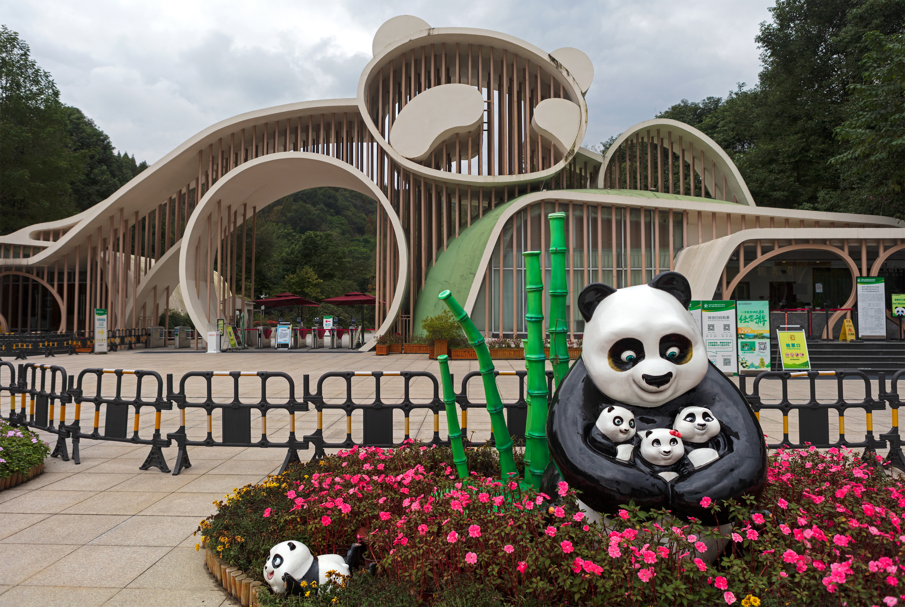
✓
Native animals
Art
People’s daily life
Chengdu
✓
✓
The face-changing performance was exciting!
It was so much fun seeing so many pandas in the panda reserve!
I got a taste of the people’s life there by visiting a big local park.

Slide 16
China is a big country with many different regions, each with its own traditions, food, and ways of living.
Visiting different Chinese cities helps us understand our country’s rich culture.

Slide 17
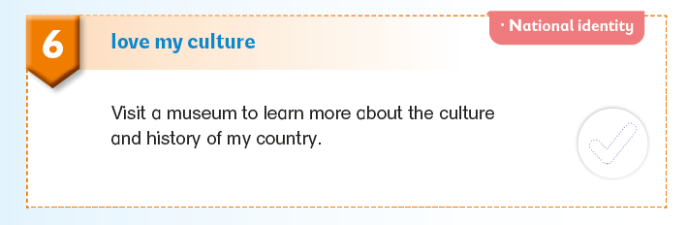
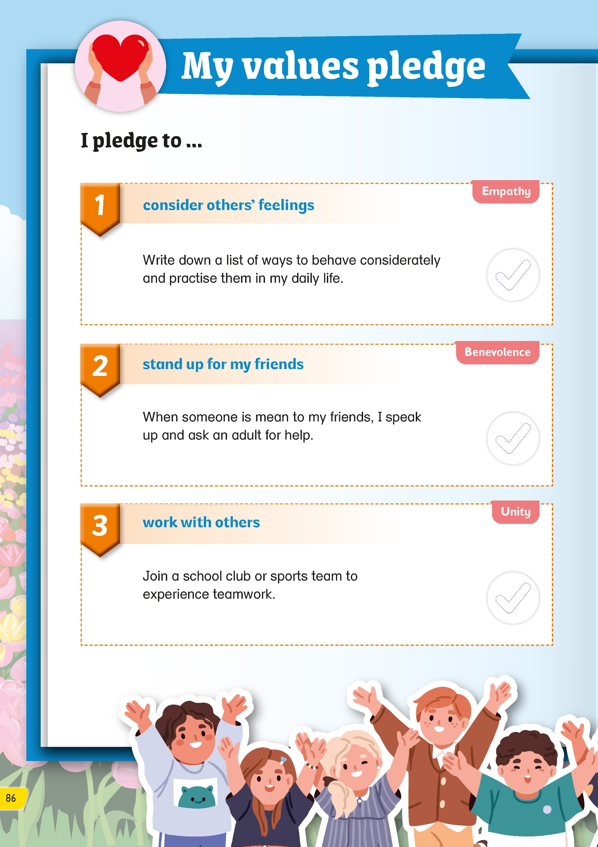
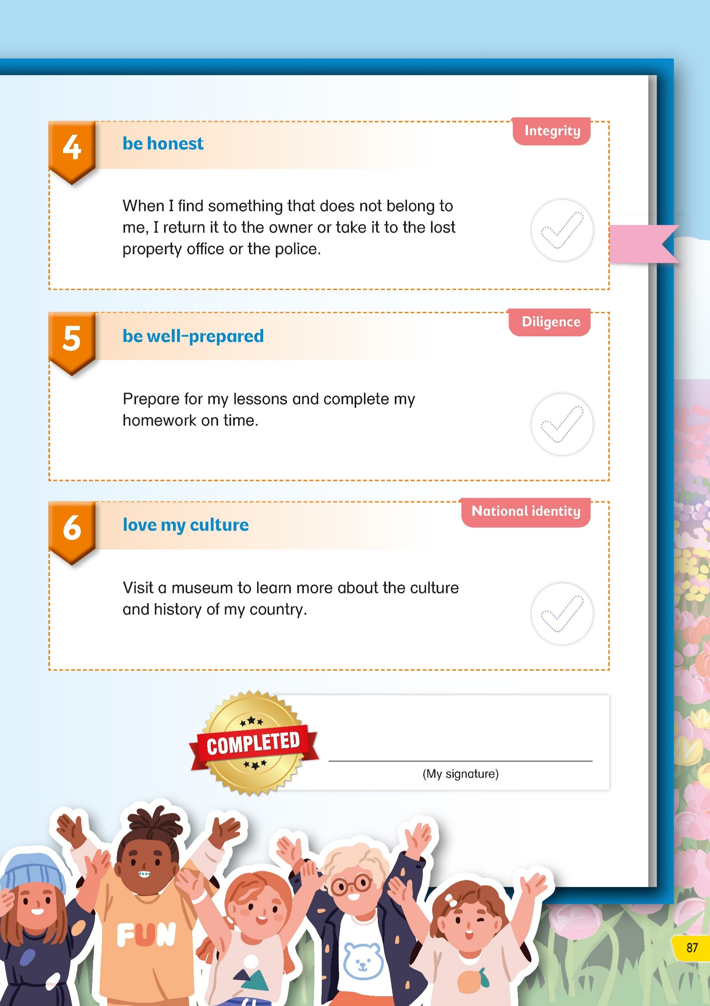
Don’t forget to complete My values pledge!
✓

Slide 19
Acknowledgements
We would like to thank the following organisations and people for permission to use their images:
Aquir / stock.adobe.com
blacklight_trace / stock.adobe.com
Eagle - stock.adobe.com
evagattuso / stock.adobe.com
Good Studio / stock.adobe.com
Graphic Gurus / stock.adobe.com
gui yong nian / stock.adobe.com
Hung Chung Chih / Shutterstock
hwongcc / stock.adobe.com
hwongcc / stock.adobe.com
karapati / stock.adobe.com
maxximmm / stock.adobe.com
Natalia Udalova / stock.adobe.com
Only Best PNG's / stock.adobe.com
Patricia / stock.adobe.com
photosomething / stock.adobe.com
Rawpixel.com / stock.adobe.com
sajjat / stock.adobe.com
solthanya / stock.adobe.com
Stephan Haerer / stock.adobe.com
Tatiana_kashko_photo / Shutterstock
Tatiana_kashko_photo / Shutterstock
Thaweewong Vichaiururoj / Shutterstock
vacant - stock.adobe.com
Vitaliy / stock.adobe.com
YP_Studio / Shutterstock
YP_Studio / Shutterstock
Наталья Удалова / stock.adobe.com
ヨーグル / stock.adobe.com

