Slide 1
Chapter 6
Identify opinions

Slide 2

Do you remember what facts and opinions are?

Slide 3
Fact
Something that you can prove to be true or false.
E.g. I have travelled abroad four times.

Slide 4
Opinion
What someone thinks or feels.
There is no right or wrong opinion.
E.g. My favourite place is Tokyo.

Slide 5
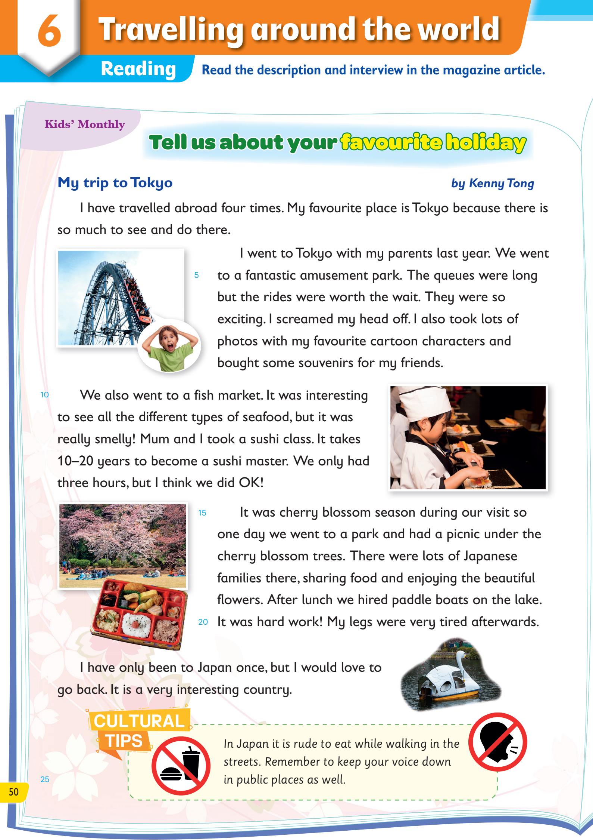
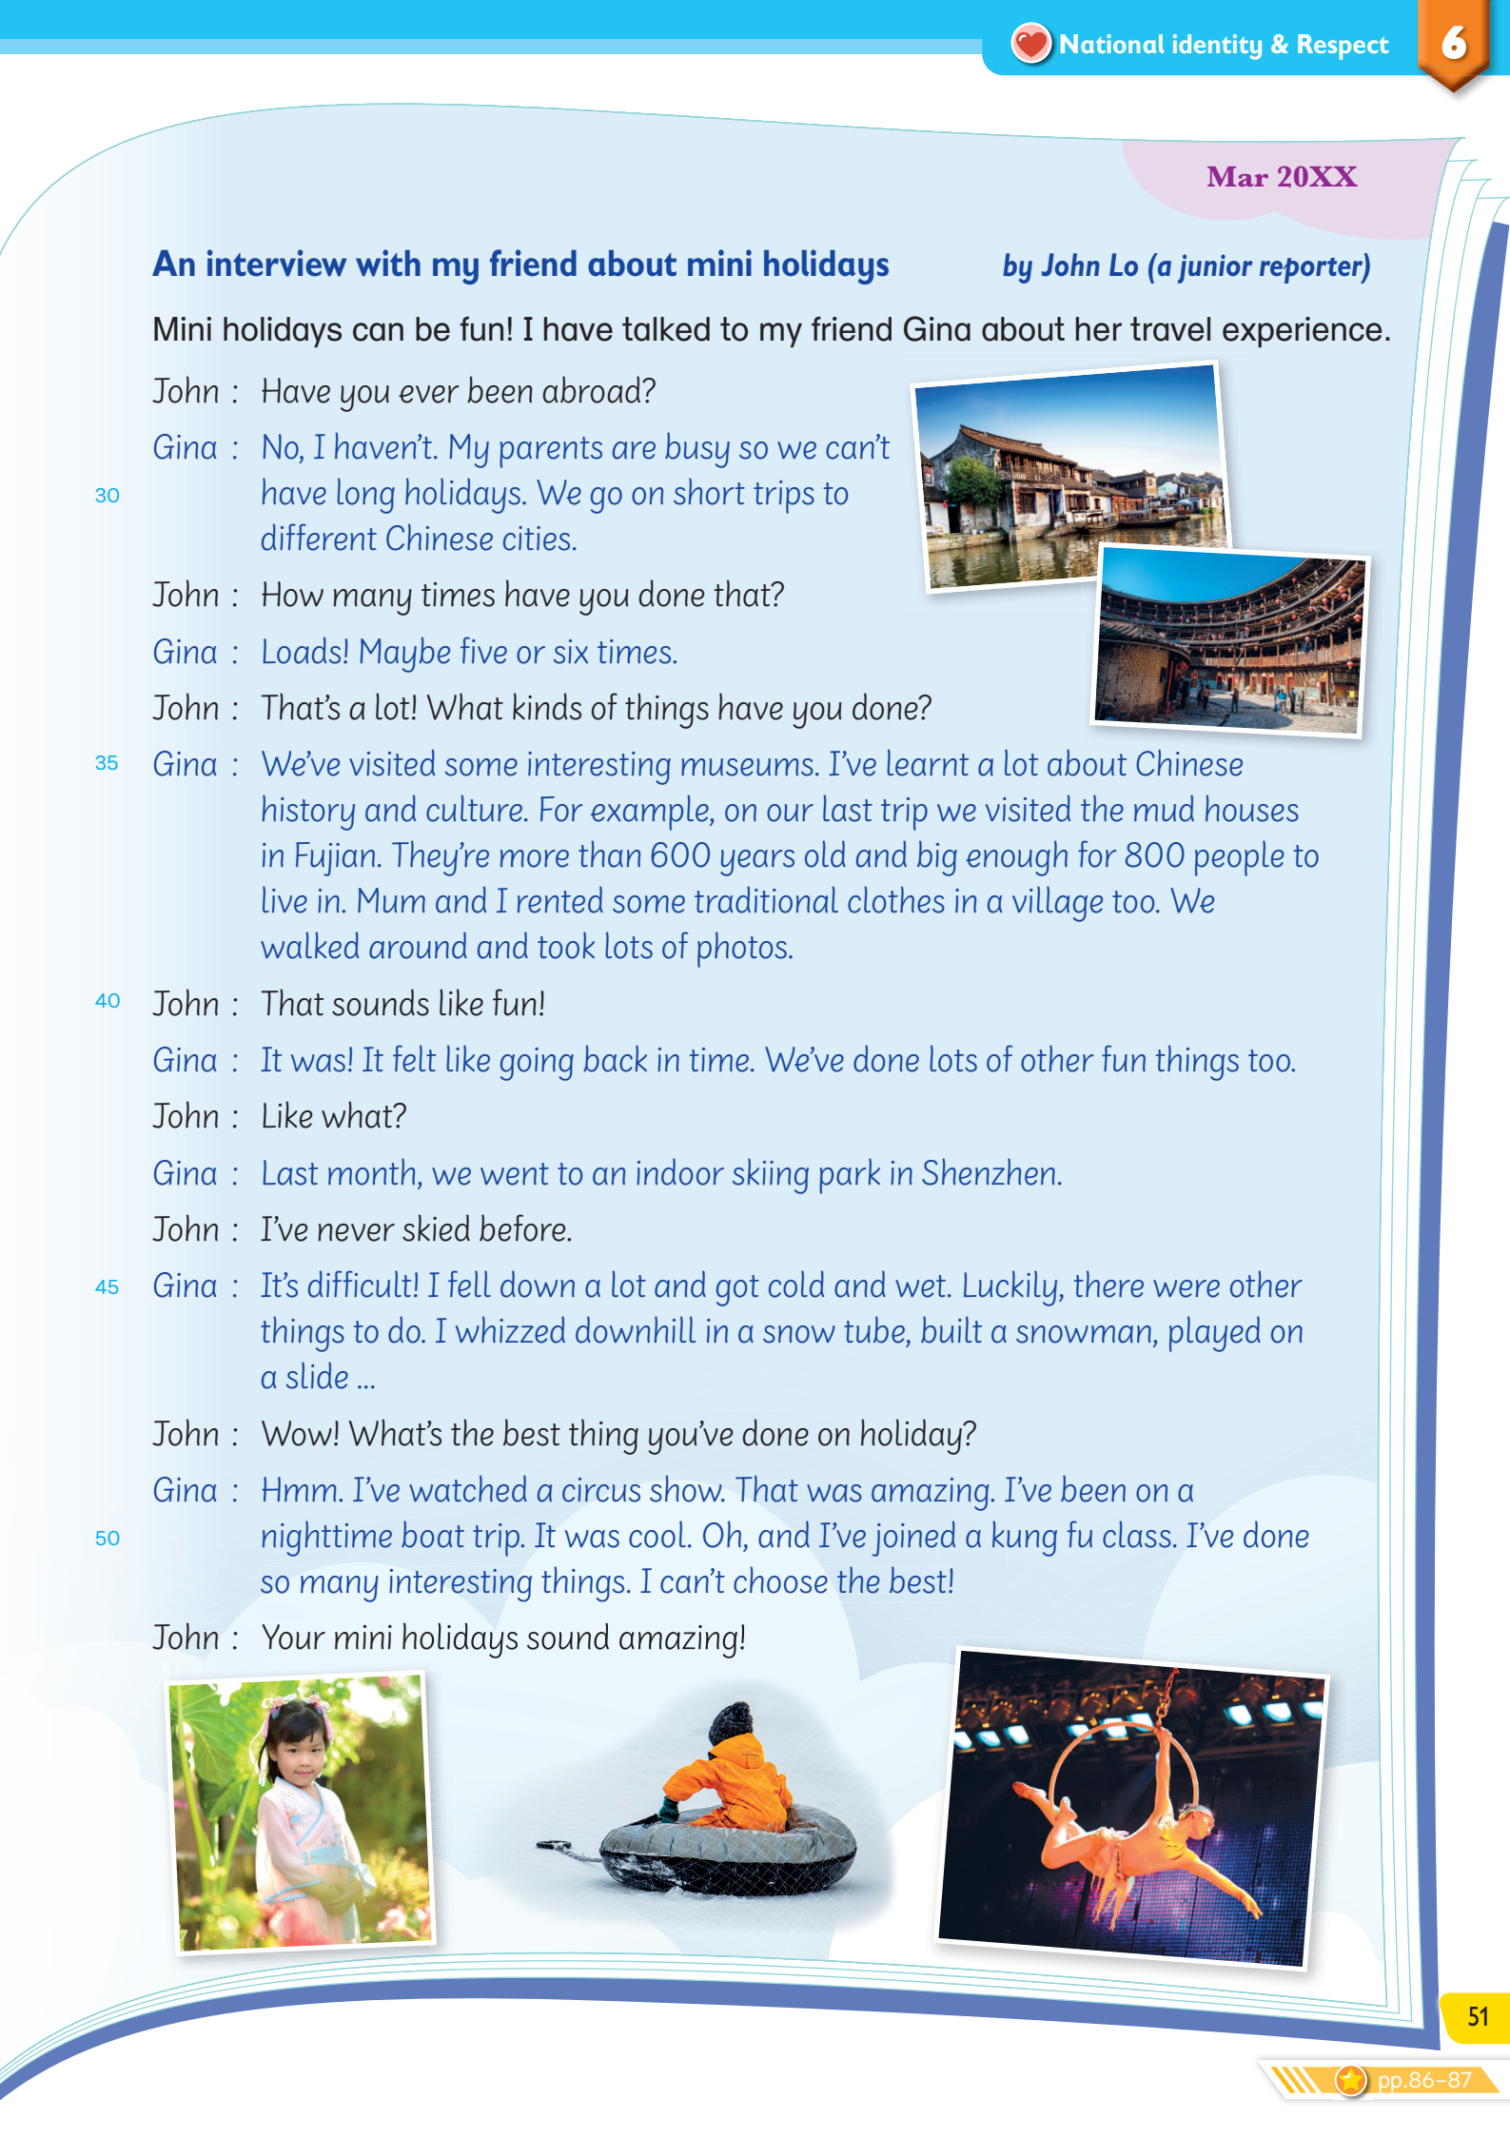
Let’s look at the magazine article in Reading.

Slide 6
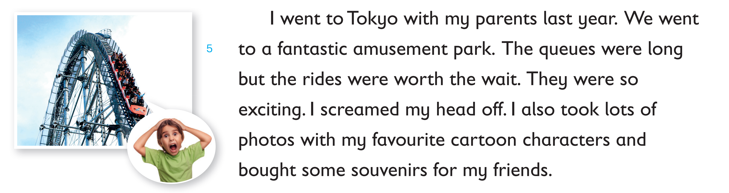
Are these sentences facts or opinions?
an opinion

Slide 7
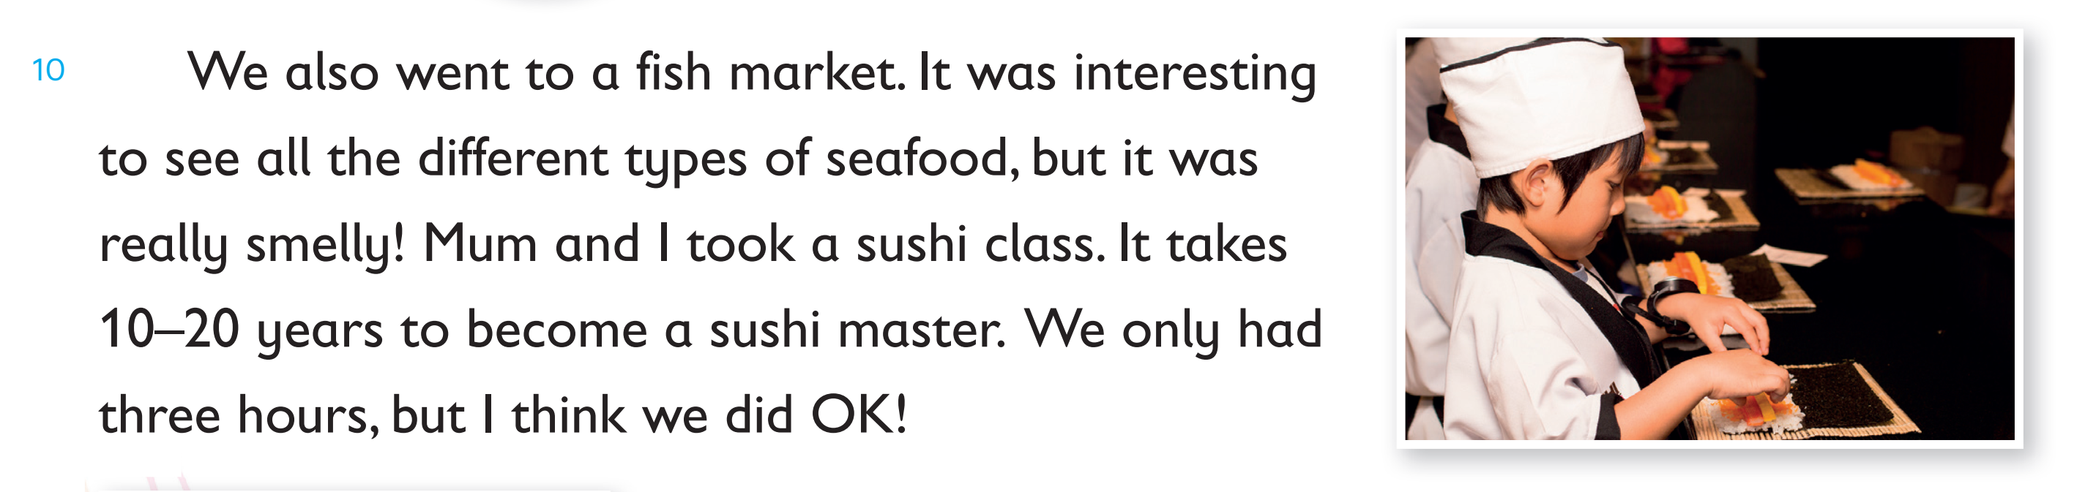
Are these sentences facts or opinions?
an opinion

Slide 8
Look at the sentences which are opinions again.
The rides were so exciting.
It was interesting to see all the different types of seafood.
They all have an adjective.
We can spot adjectives to identify opinions.

Slide 9
Can you find more examples in the magazine article?

Slide 10
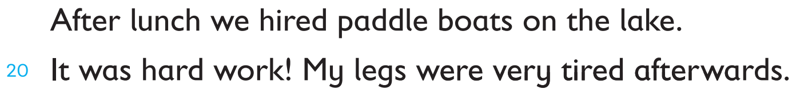
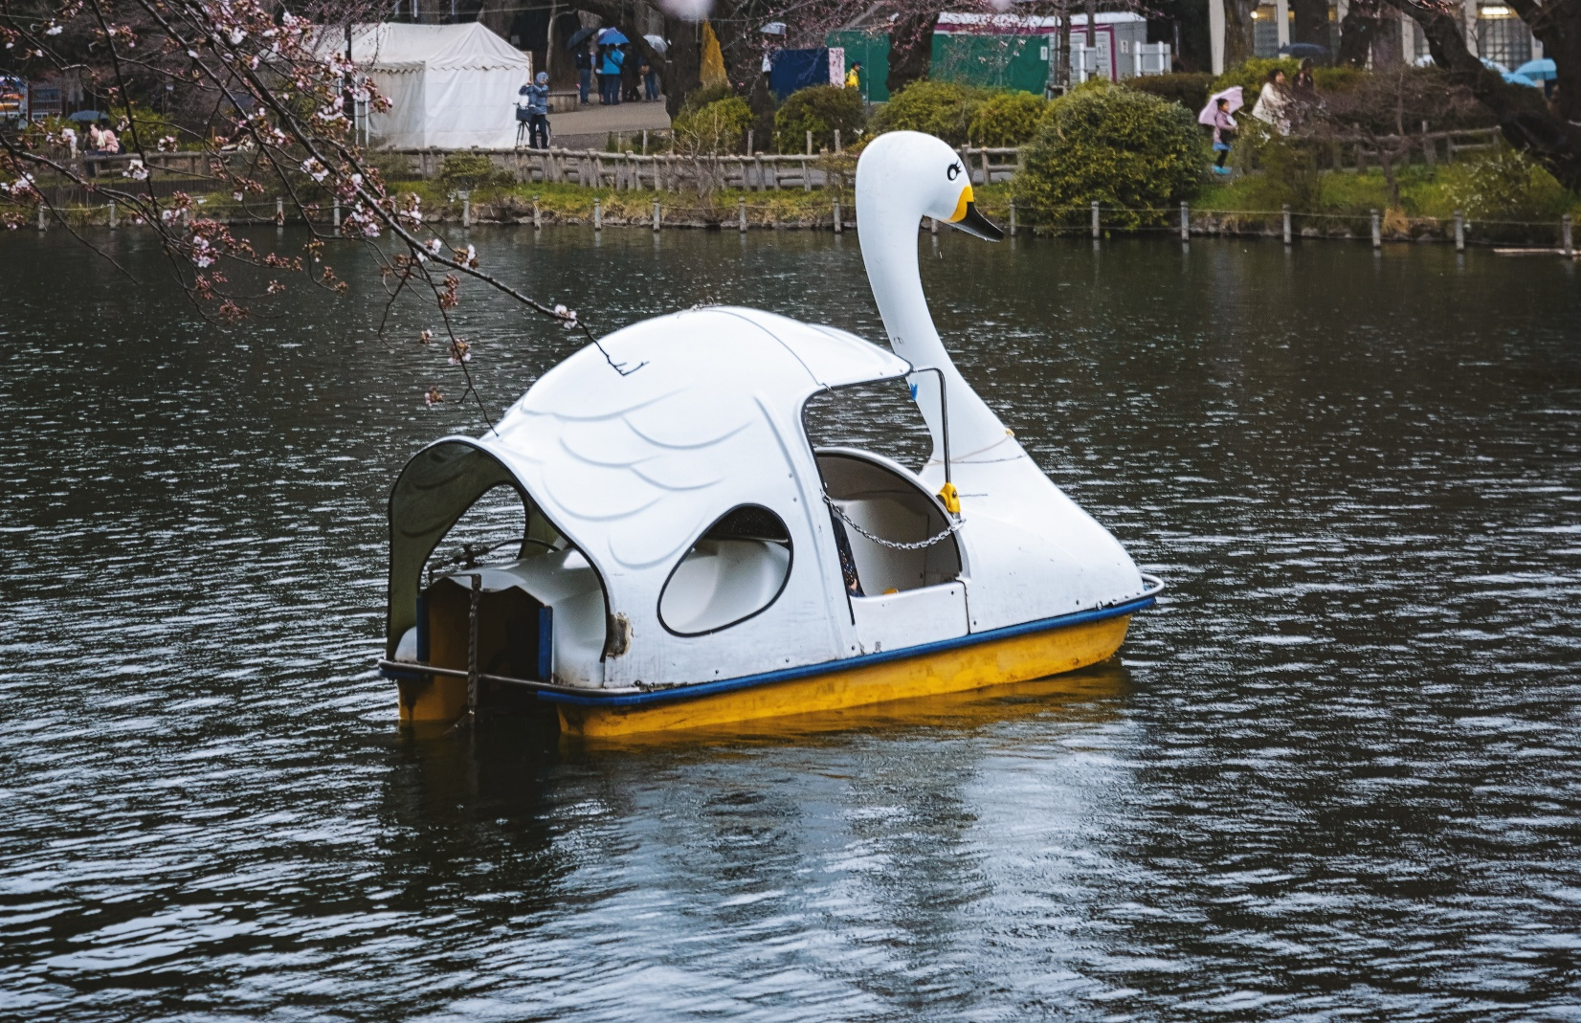
Can you find more examples in the magazine article?
an adjective
an opinion

Slide 11
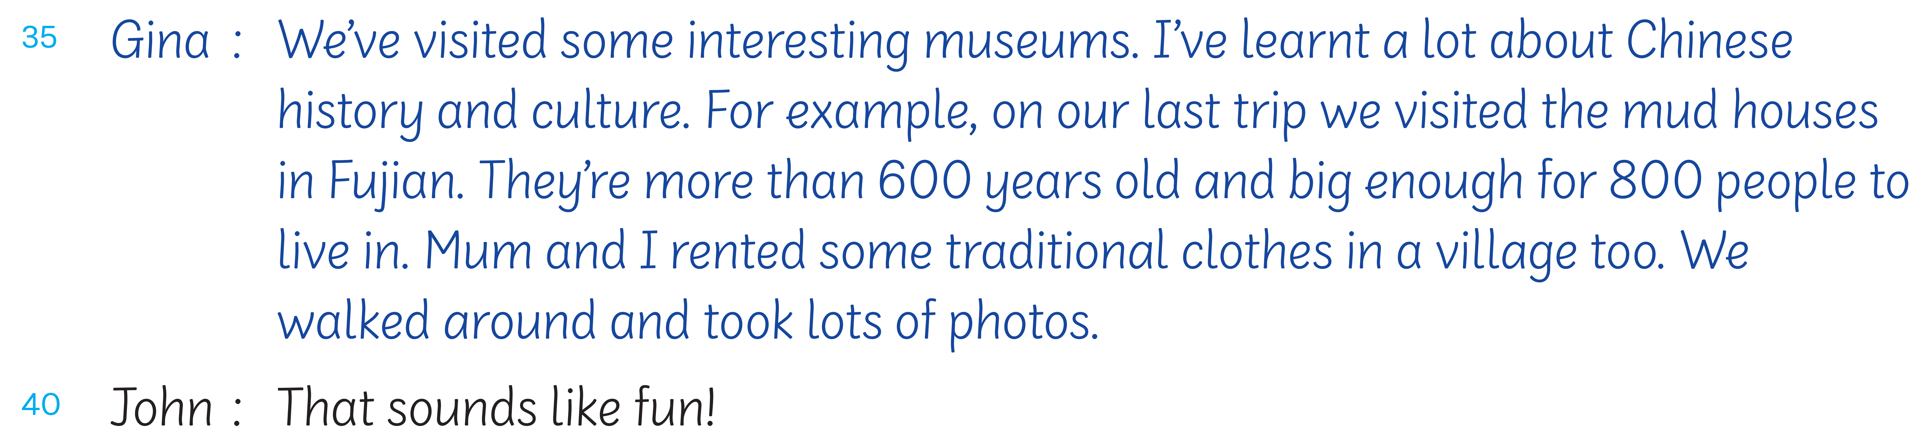
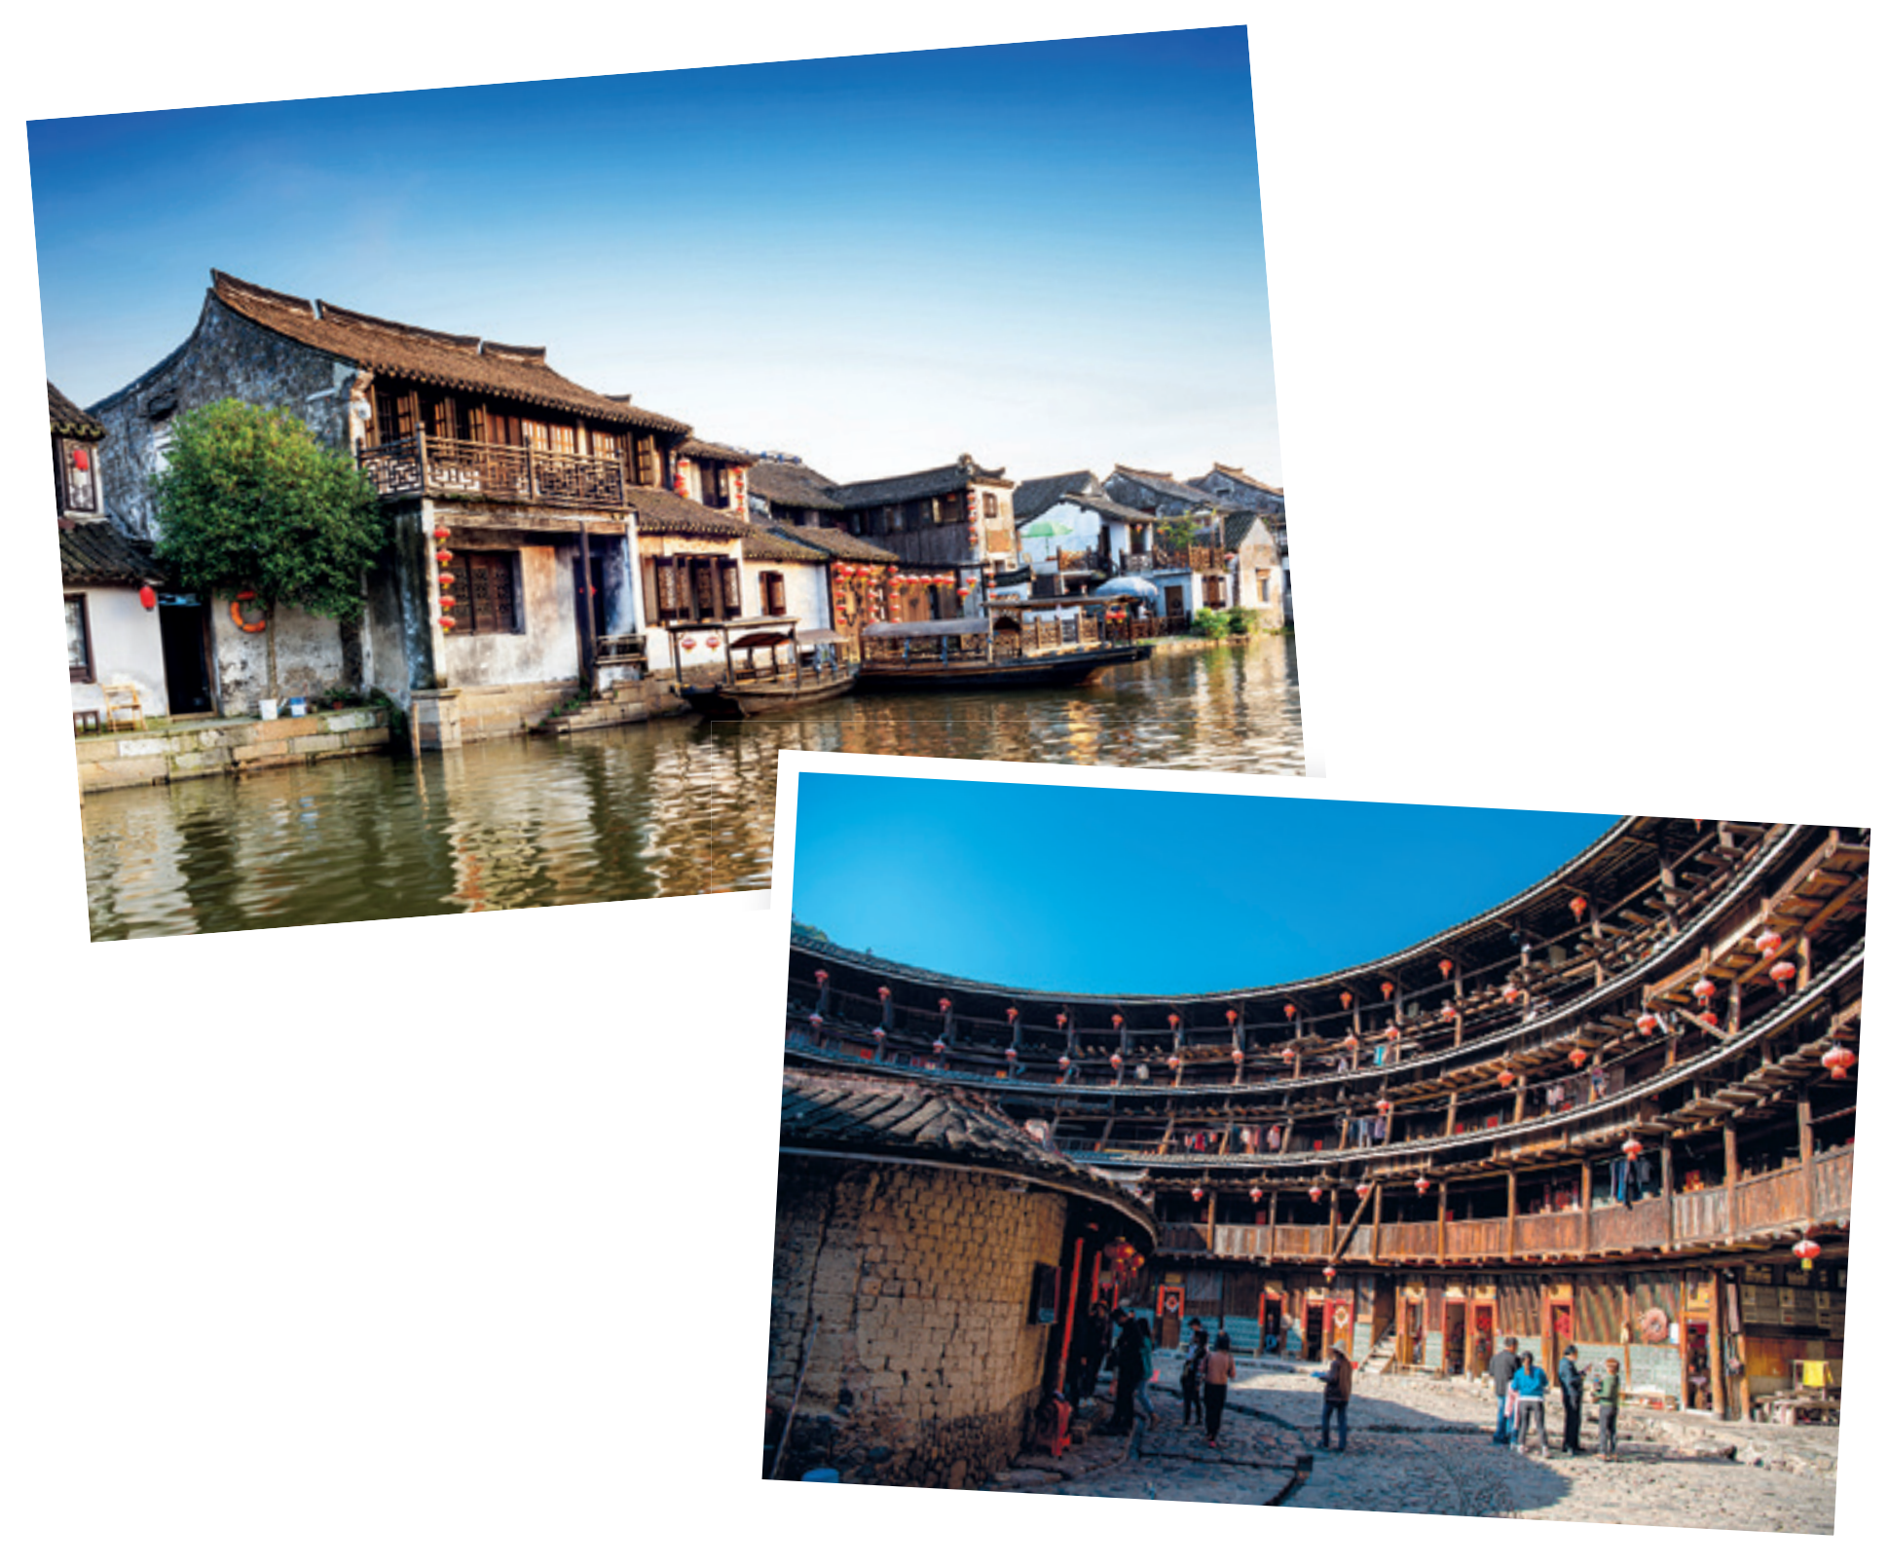
Can you find more examples in the magazine article?
an adjective
an opinion

Slide 12
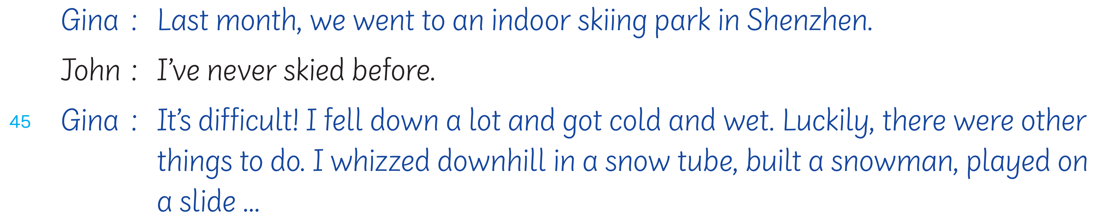
Can you find more examples in the magazine article?
an adjective
an opinion

Slide 13
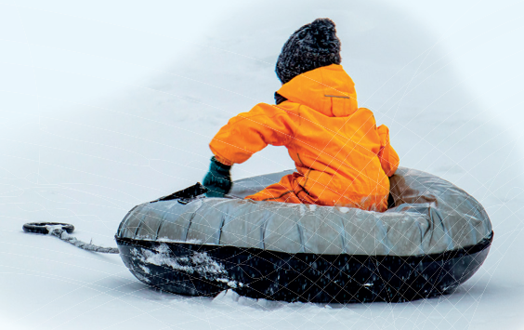
How did Gina feel about the skiing park? Did she like it there?

Slide 14
How did Gina feel about her visit to the skiing park?
A. She didn’t enjoy it.
B. She wanted to practice more.
C. She liked skiing downhill.
D. She felt lucky to go there.

Slide 15
When a writer uses verbs such as
they are likely to be giving their opinions as well.
think
like / dislike

Slide 16
Let’s find an example in the magazine article.

Slide 17
Let’s find an example in the magazine article.
an opinion

Slide 18
Remember:
Facts are something that you can prove to be true or false.
Opinions are what someone thinks or feels. There is no right or wrong opinion.

Slide 19
Knowing which parts of the text are opinions helps us understand the story or information better.

Slide 21
Acknowledgements
We would like to thank the following organisations and people for permission to use their images:
evagattuso / stock.adobe.com
Graphic Gurus / stock.adobe.com
gui yong nian / stock.adobe.com
Hung Chung Chih / Shutterstock
hwongcc / stock.adobe.com
karapati / stock.adobe.com
maxximmm / stock.adobe.com
Only Best PNG's / stock.adobe.com
Patricia / stock.adobe.com
photosomething / stock.adobe.com
Tatiana_kashko_photo / Shutterstock
Thaweewong Vichaiururoj / Shutterstock
vacant - stock.adobe.com
YP_Studio / Shutterstock
Наталья Удалова / stock.adobe.com
ヨーグル / stock.adobe.com

