Slide 1
Chapter 6
Travelling around the world

Slide 2
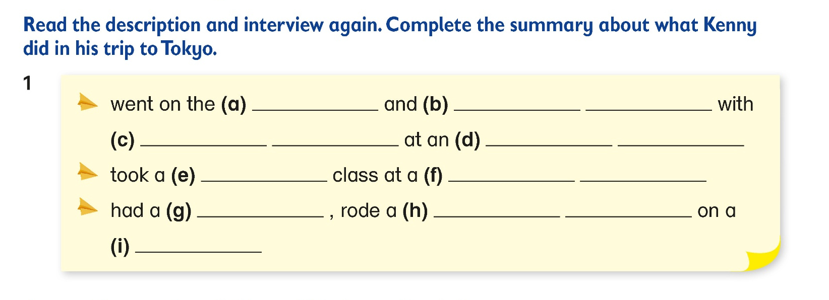

rides
took
photos
cartoon
characters
amusement
park
sushi
fish
market
picnic
paddle
boat
lake

Slide 3
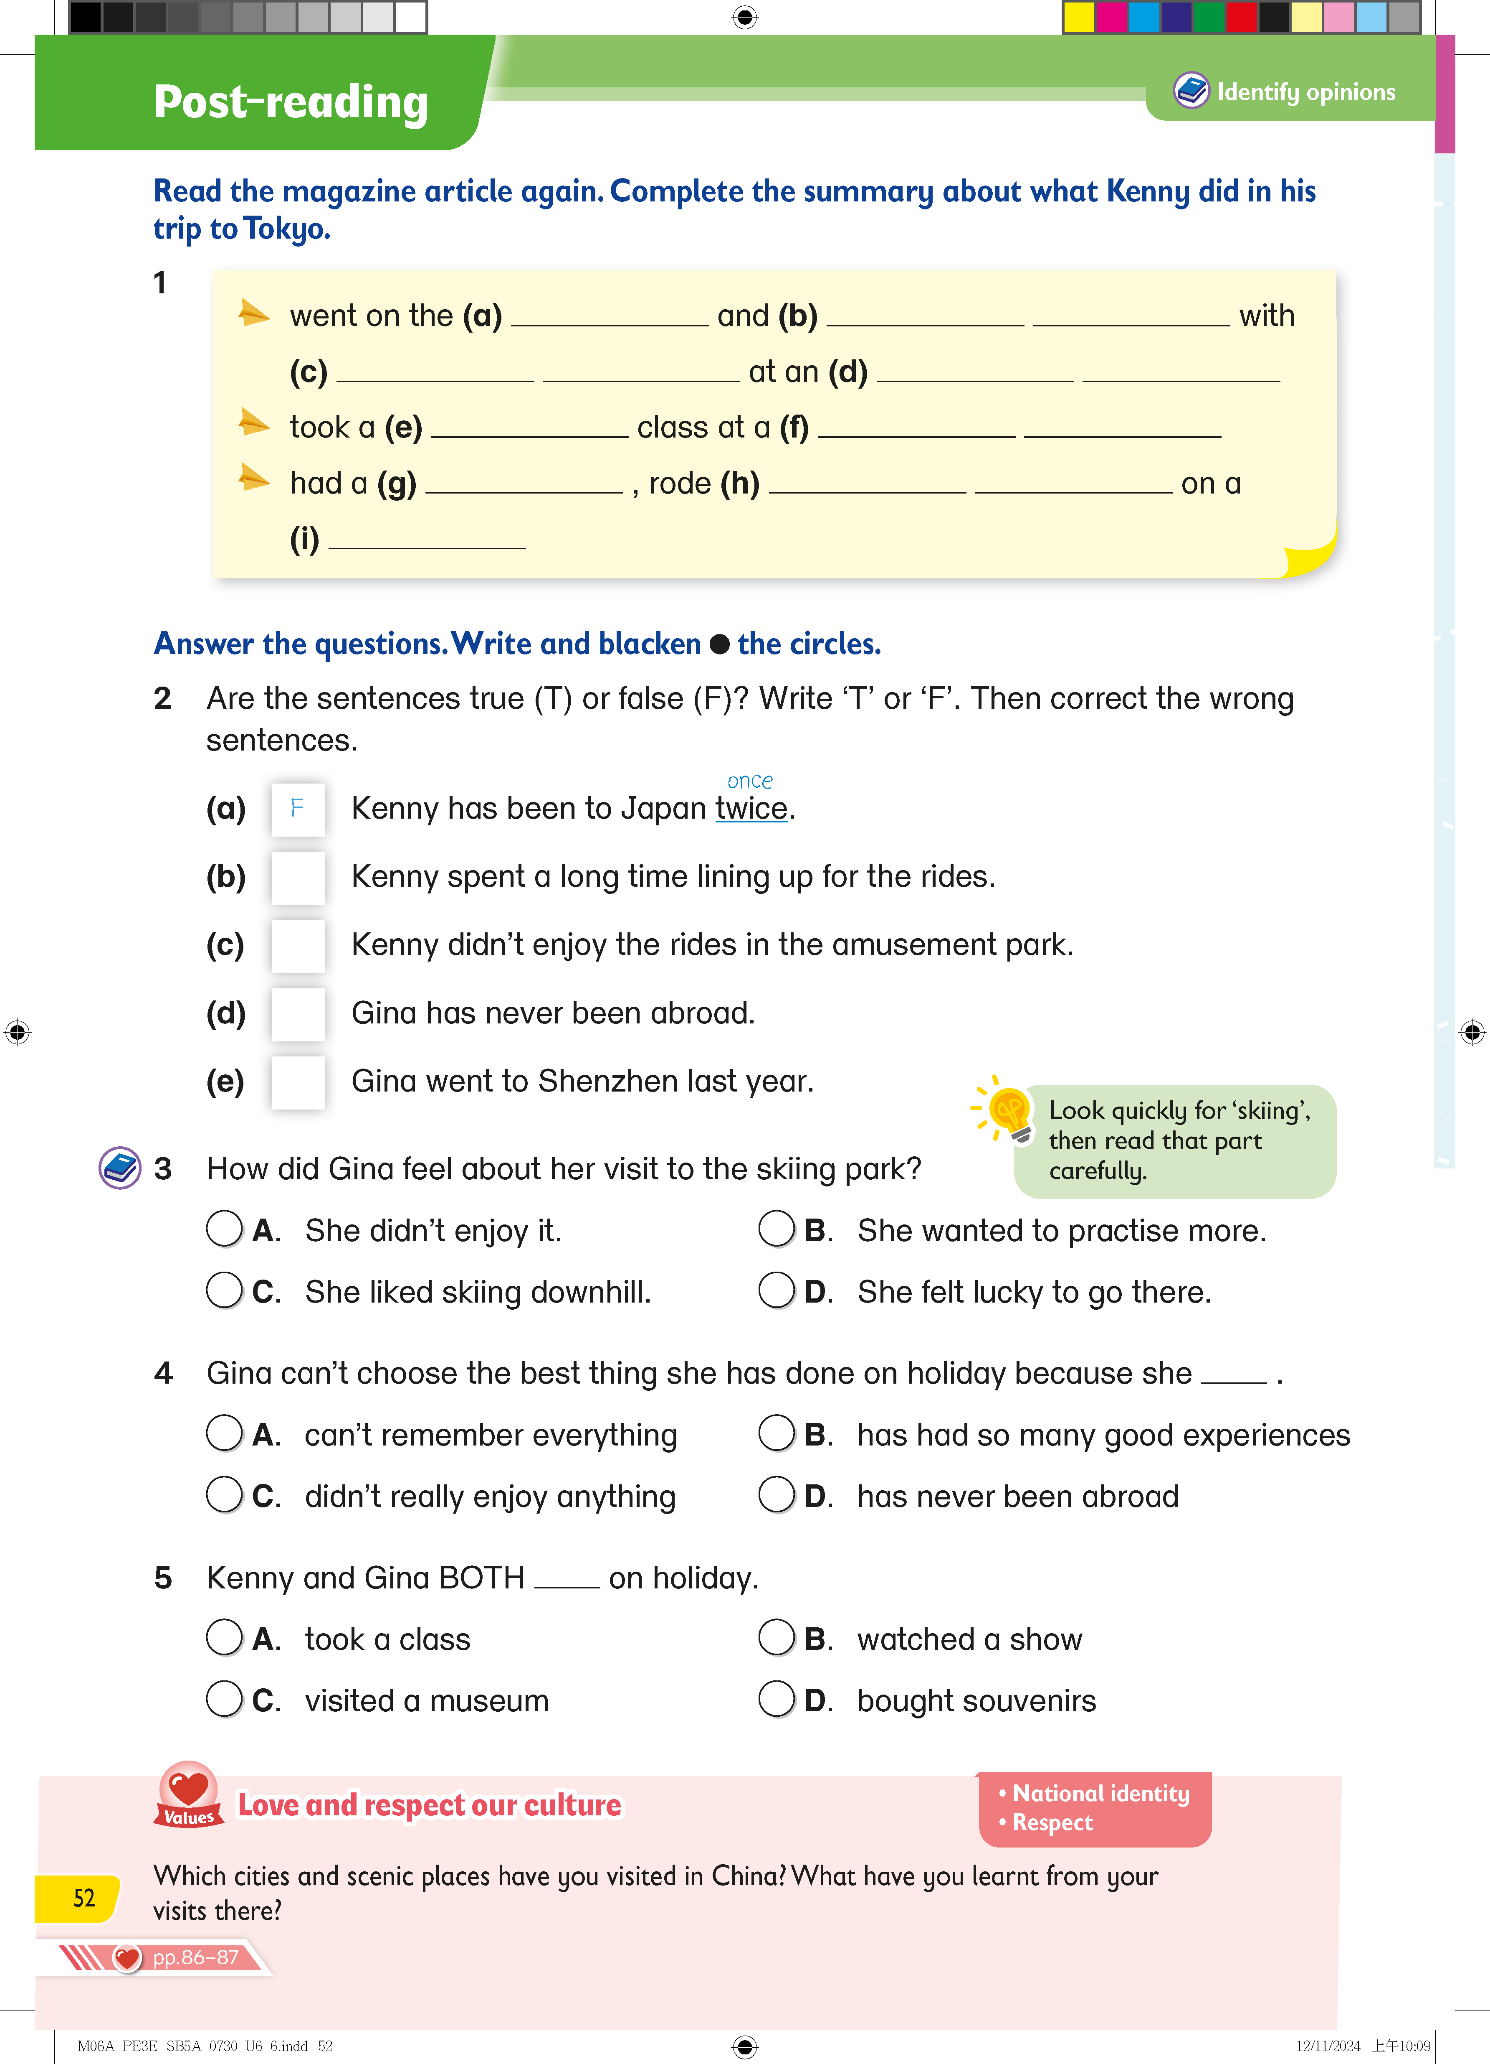

T
enjoyed
F
T
month
F

Slide 4
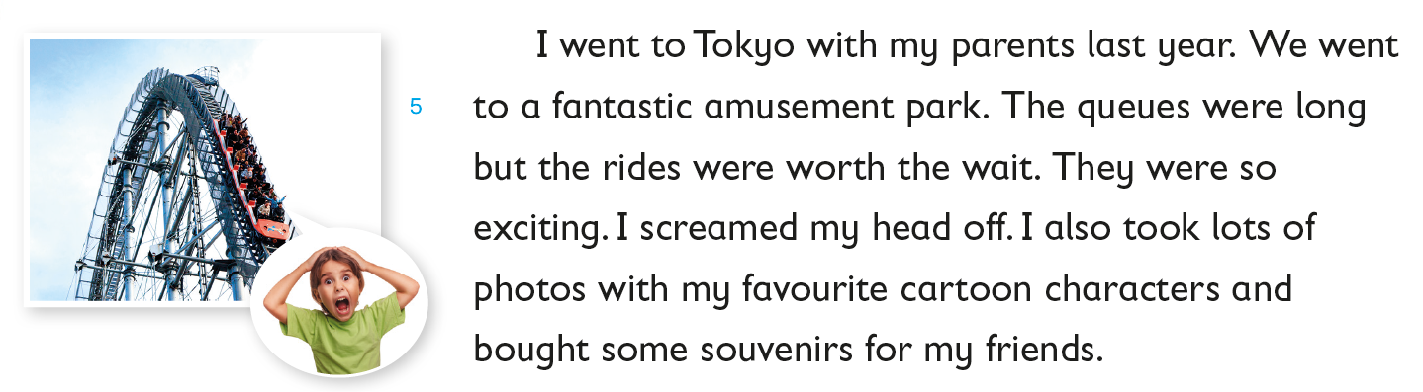
Go back to Q2

Slide 5
The rides were really fun. They were so exciting that Kenny screamed with joy.
Go back to Q2

Slide 6
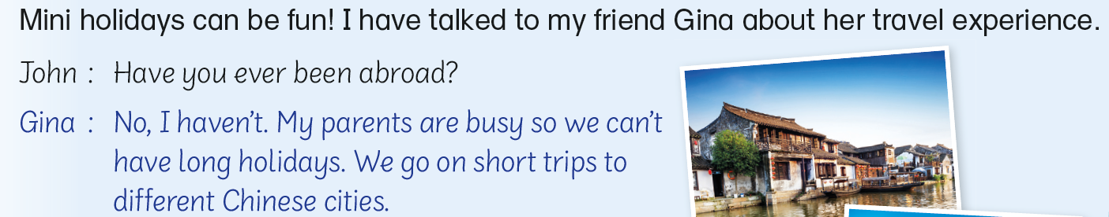
Go back to Q2

Slide 7
Gina went to Shenzhen last month, not last year.
Go back to Q2

Slide 8
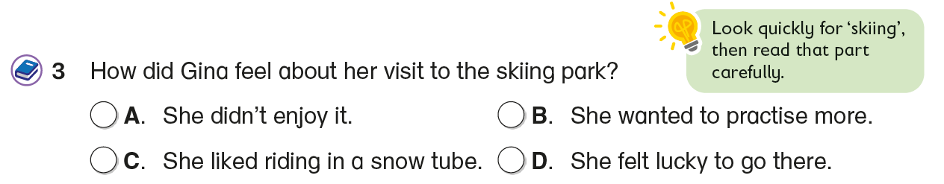
Answer the question. Blacken  the circle.

Slide 9
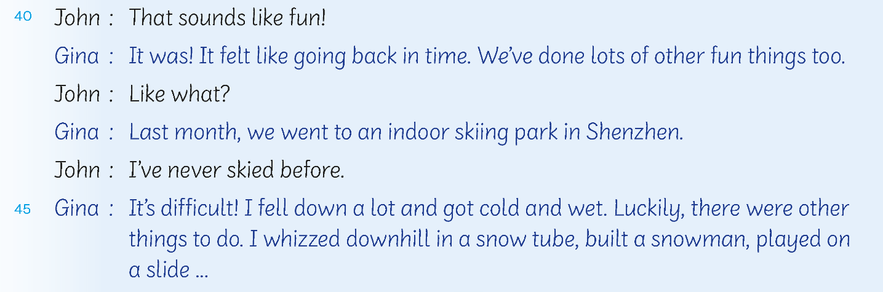
Gina mentioned one of the things she did although skiing is difficult.
Go back to Q3

Slide 10
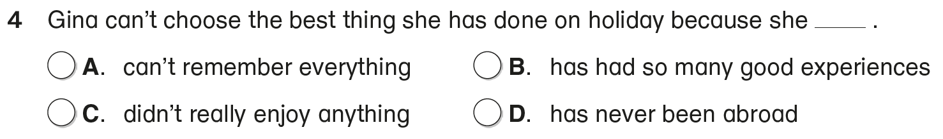
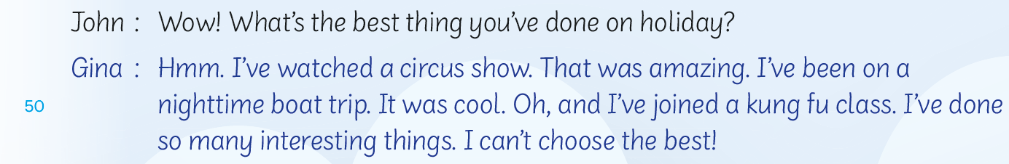
Answer the question. Blacken  the circle.
Gina has done lots of interesting things and she can’t choose the best.

Slide 11
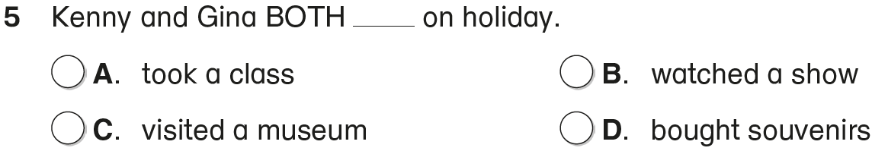
Answer the question. Blacken  the circle.
‘B’ is not correct because Kenny didn’t watch a show.
‘C’ is not correct because Kenny didn’t visit a museum.
‘D’ is not correct because Gina didn’t buy souvenirs.
The correct answer is ‘A’ because Kenny took a sushi class and Gina joined a kung fu class.

Slide 13
Acknowledgements
We would like to thank the following organisations and people for permission to use their images:
sajjat / stock.adobe.com

