Slide 1
Chapter 6
Post-reading
Travelling around the world

Slide 2
Today we’re going to read description and an interview!
Pre-reading
Reading
After Reading

Slide 3
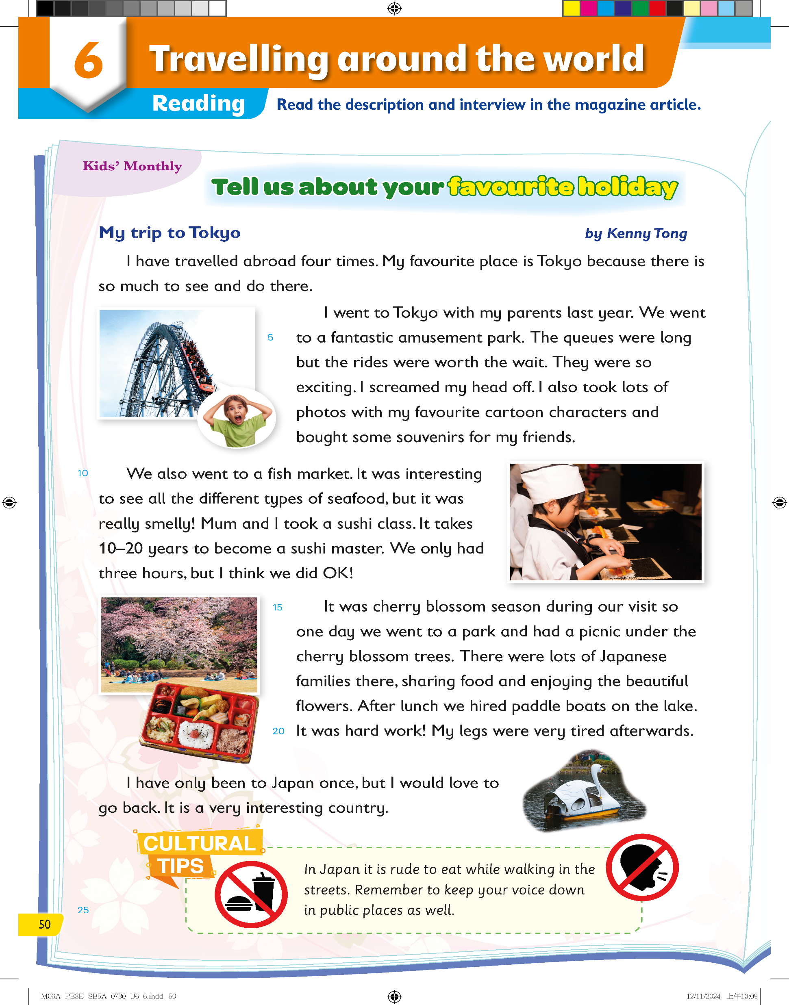
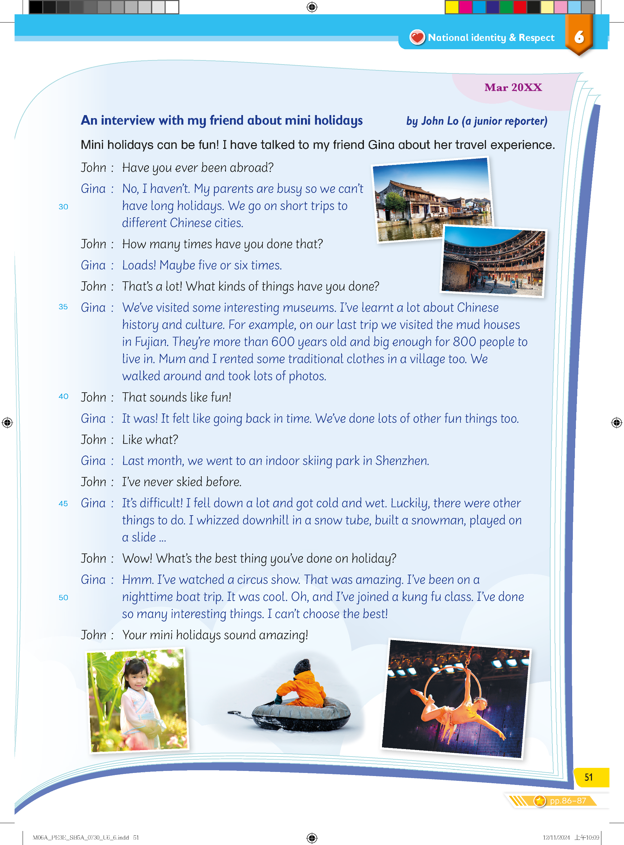


What is the name of the magazine?
What is the month of the issue?
Pre-reading
Reading
After Reading

Slide 4
The title of this magazine article is ‘Tell us about your favourite holiday’.
Pre-reading
Reading
After Reading

Slide 5
In the first part of the article, a student writes to Kids’ Monthly to tell them about their favourite trip.
Pre-reading
Reading
After Reading

Slide 6


Who wrote the first part of the article?
What is the title of his writing?
Pre-reading
Reading
After Reading

Slide 7
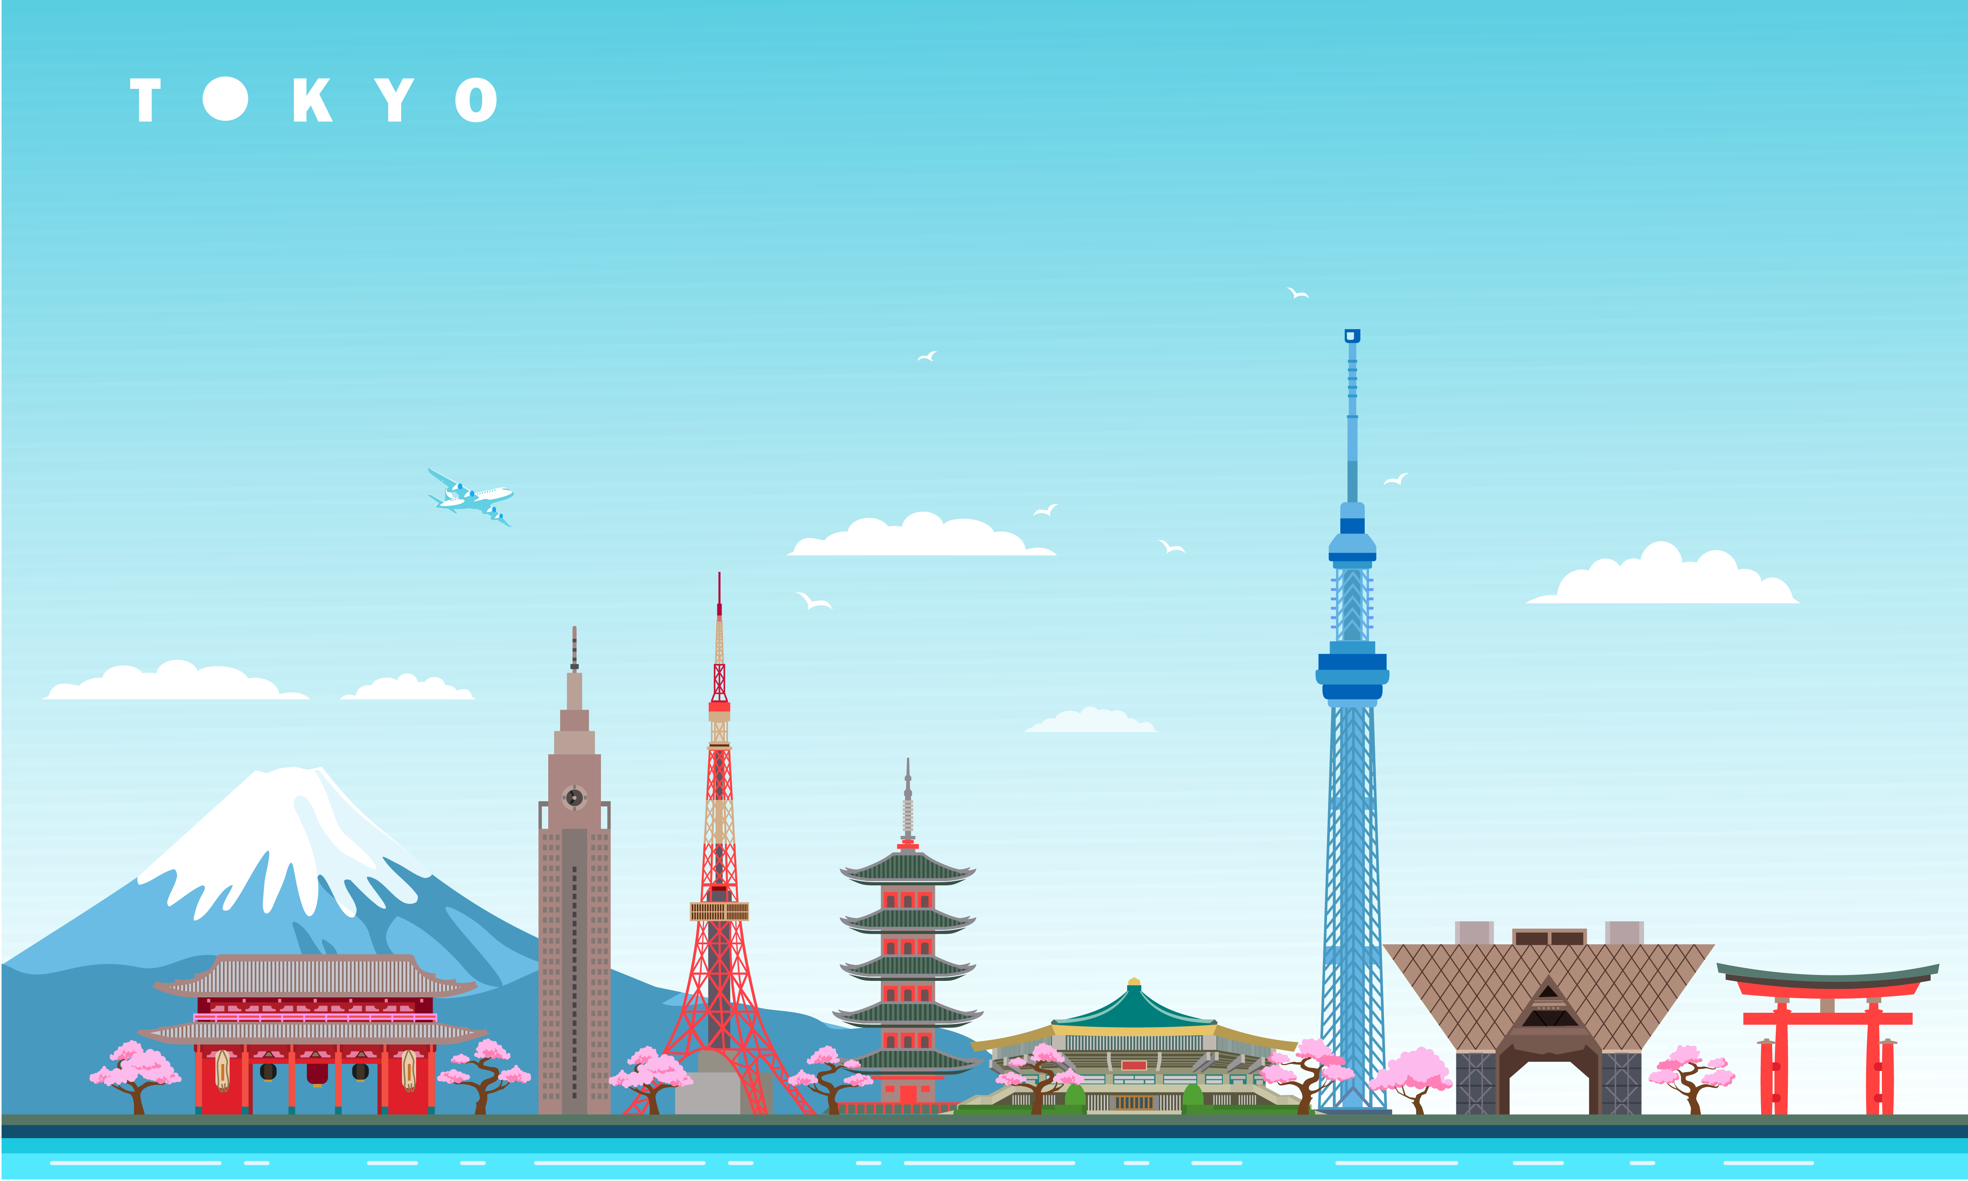
Which country is Tokyo in?
Pre-reading
Reading
After Reading

Slide 8
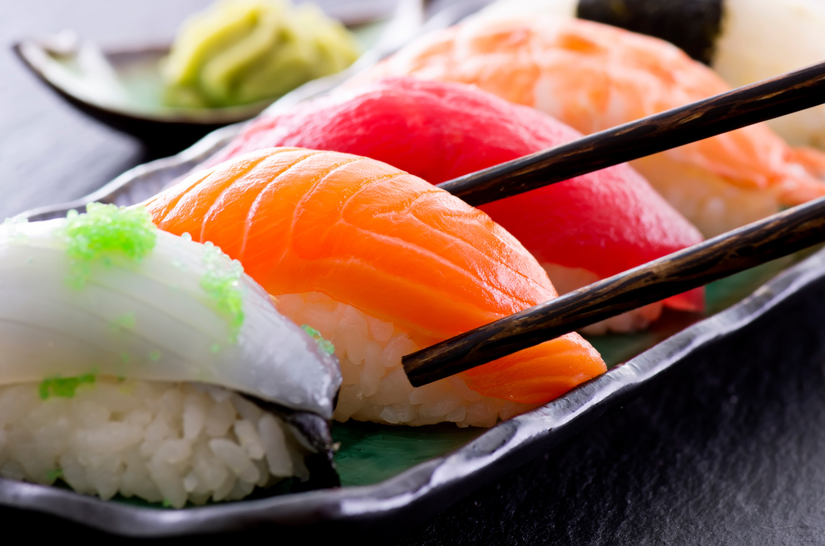
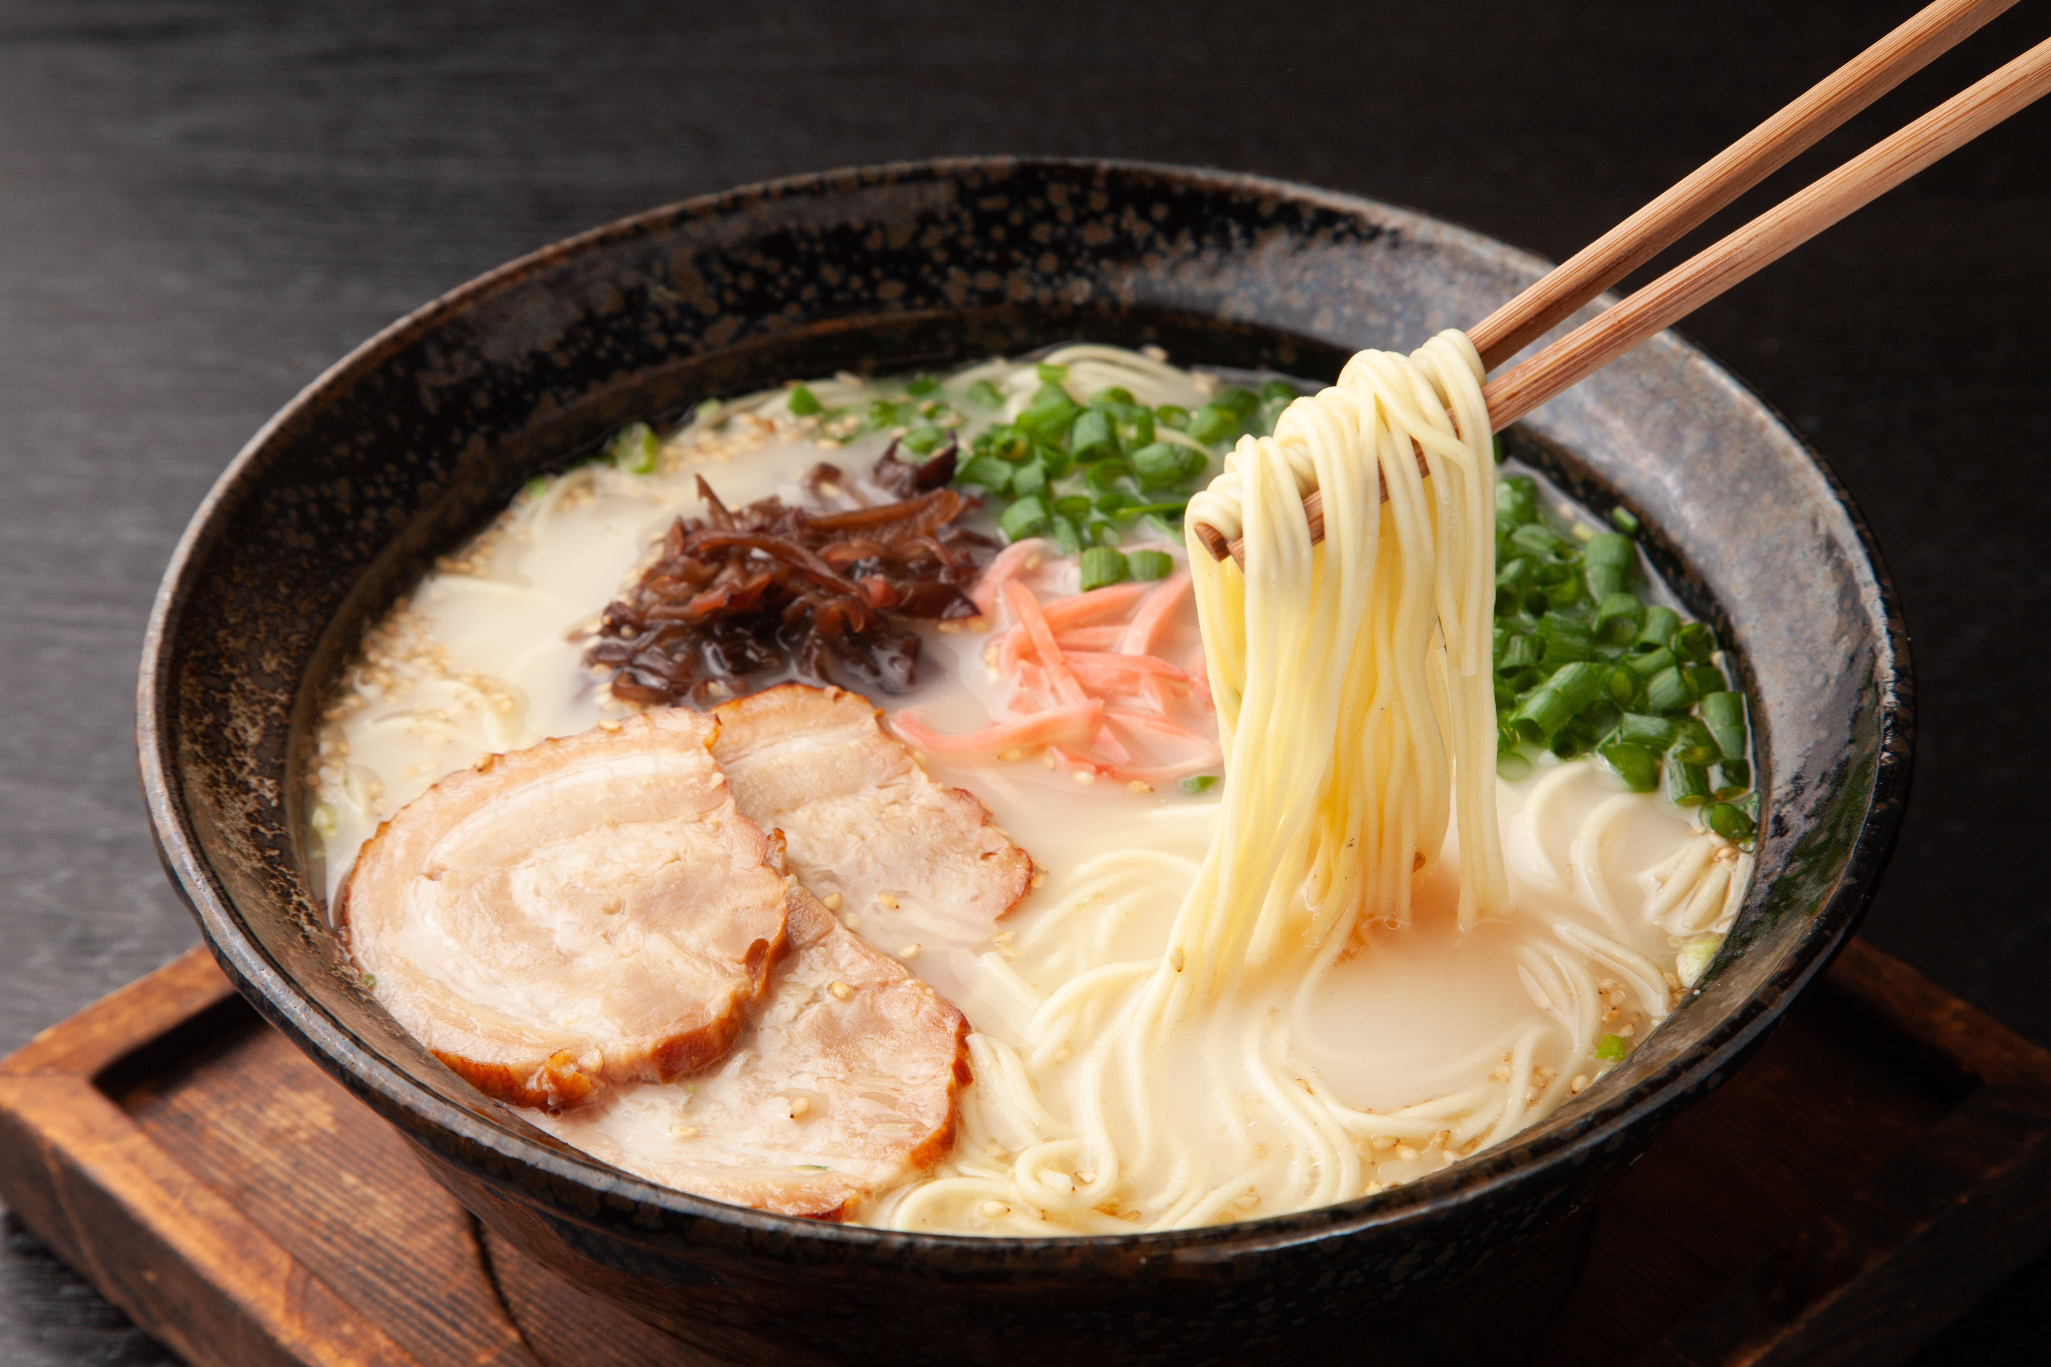
Do you know any local dishes in Tokyo?
Pre-reading
Reading
After Reading

Slide 9
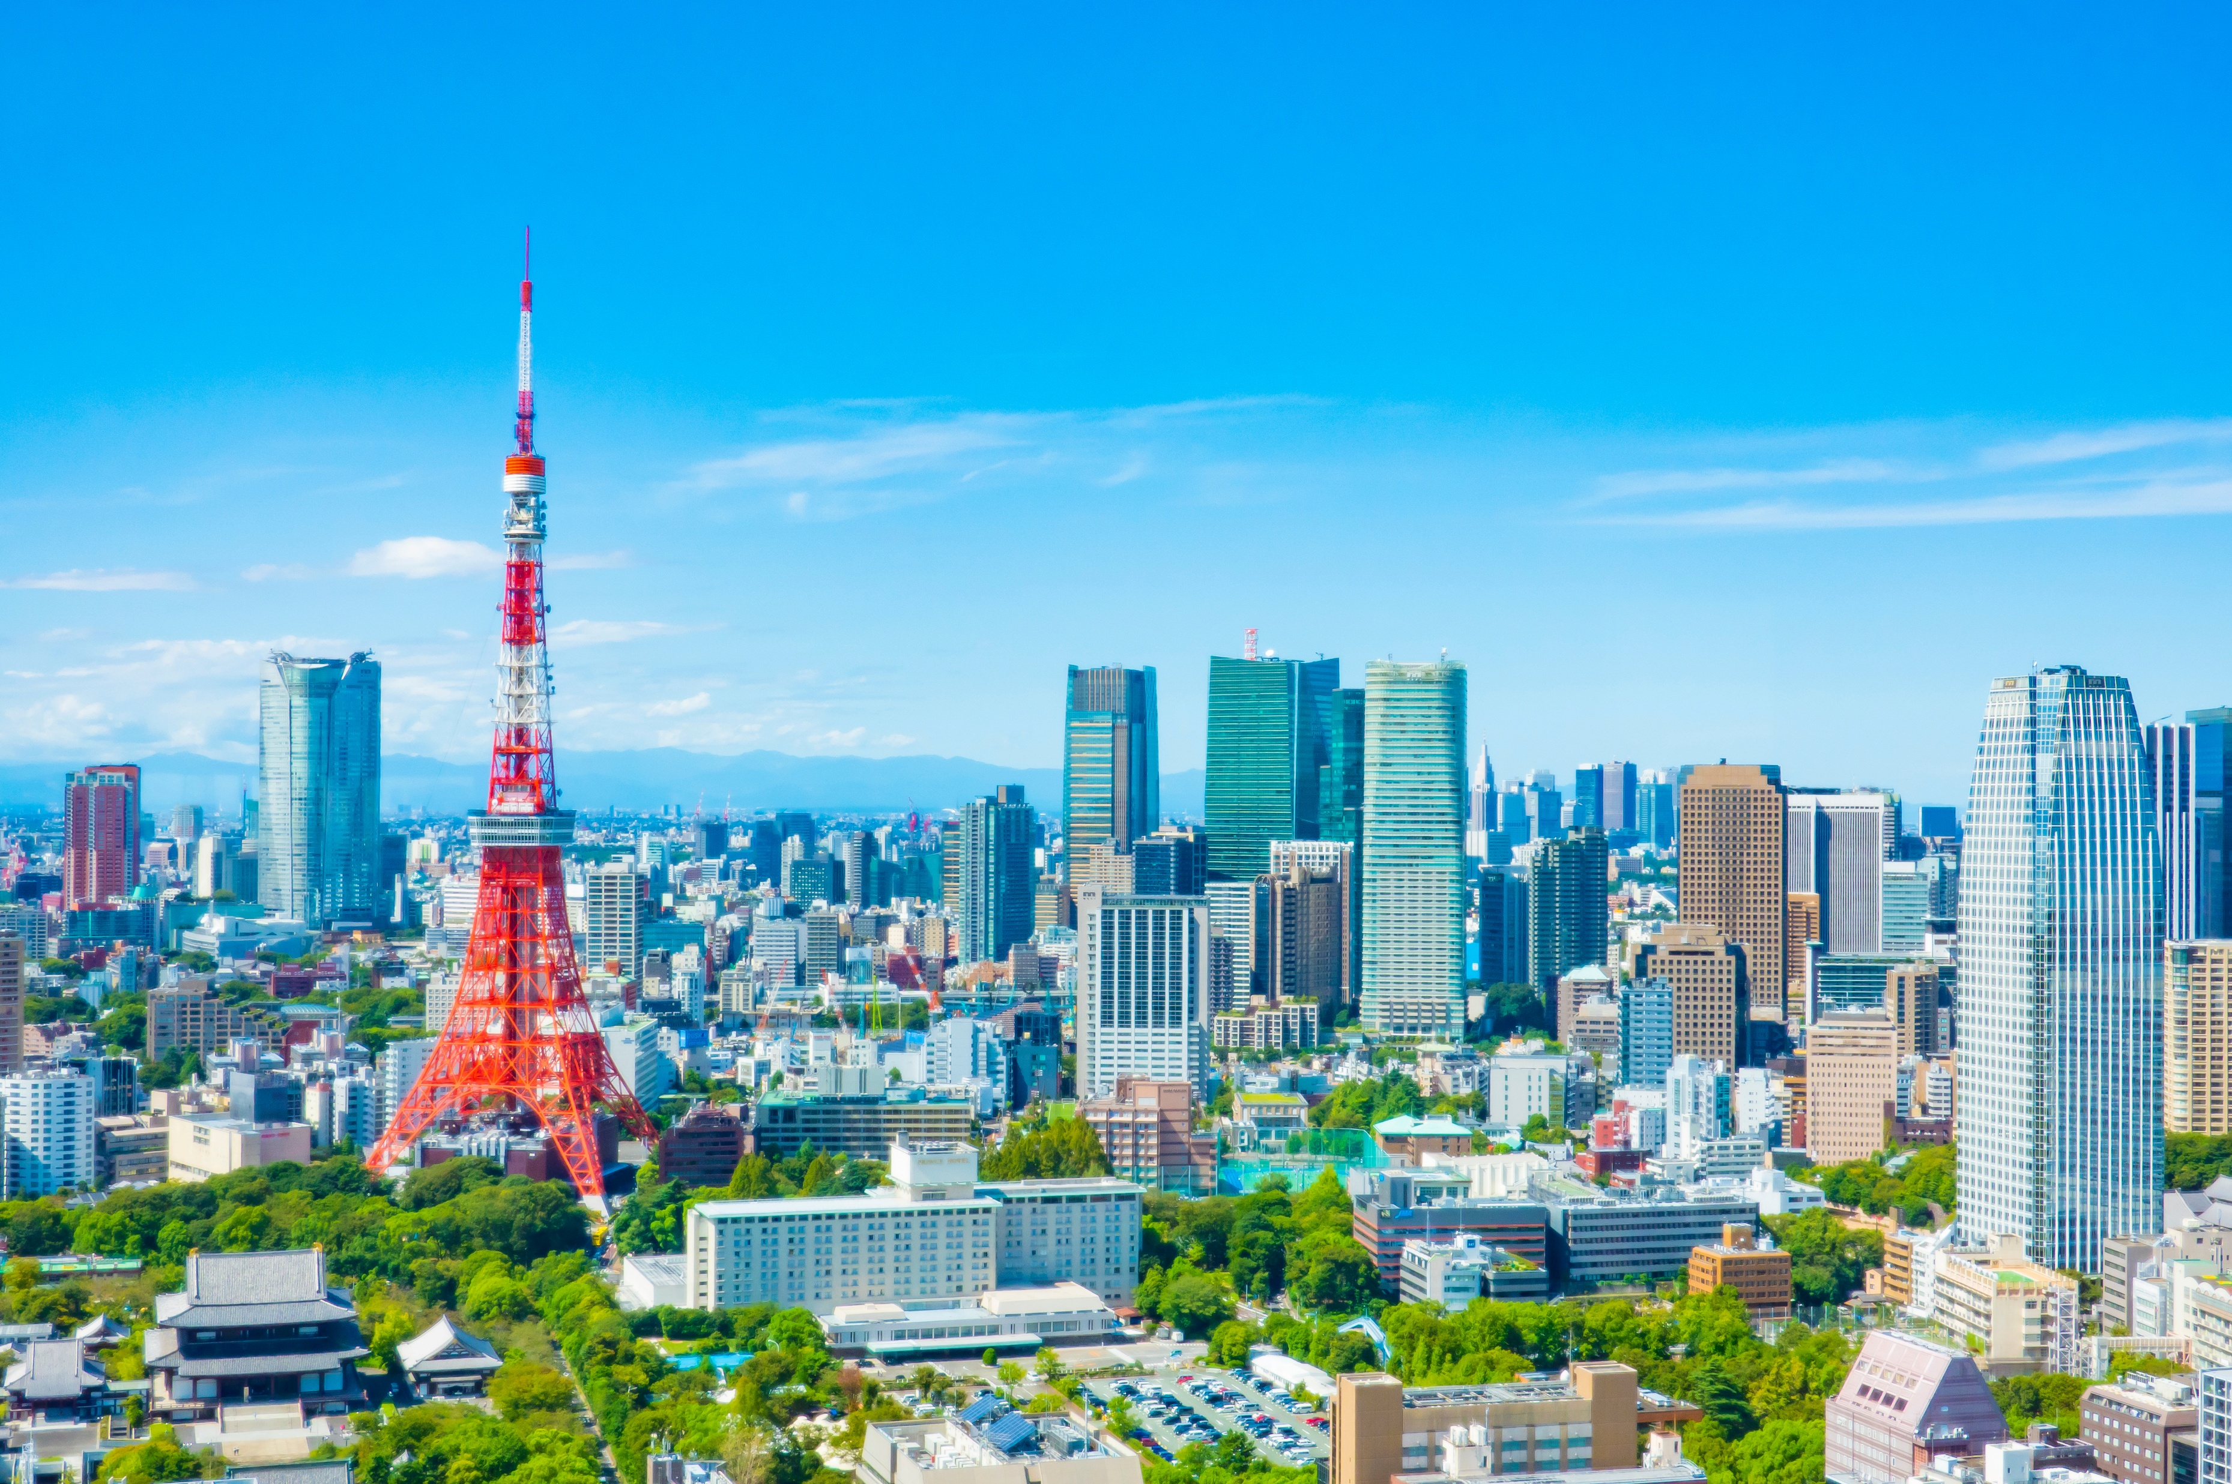
Do you know any local dishes in Tokyo?
Do you know any attractions there?
Pre-reading
Reading
After Reading

Slide 10
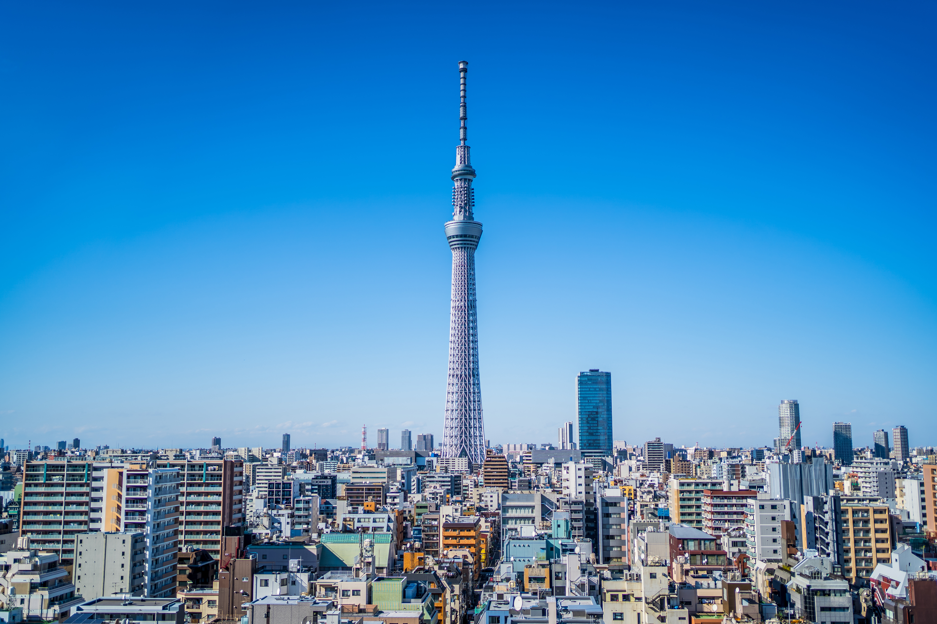
Do you know any local dishes in Tokyo?
Do you know any attractions there?
Tokyo Skytree
Pre-reading
Reading
After Reading

Slide 11
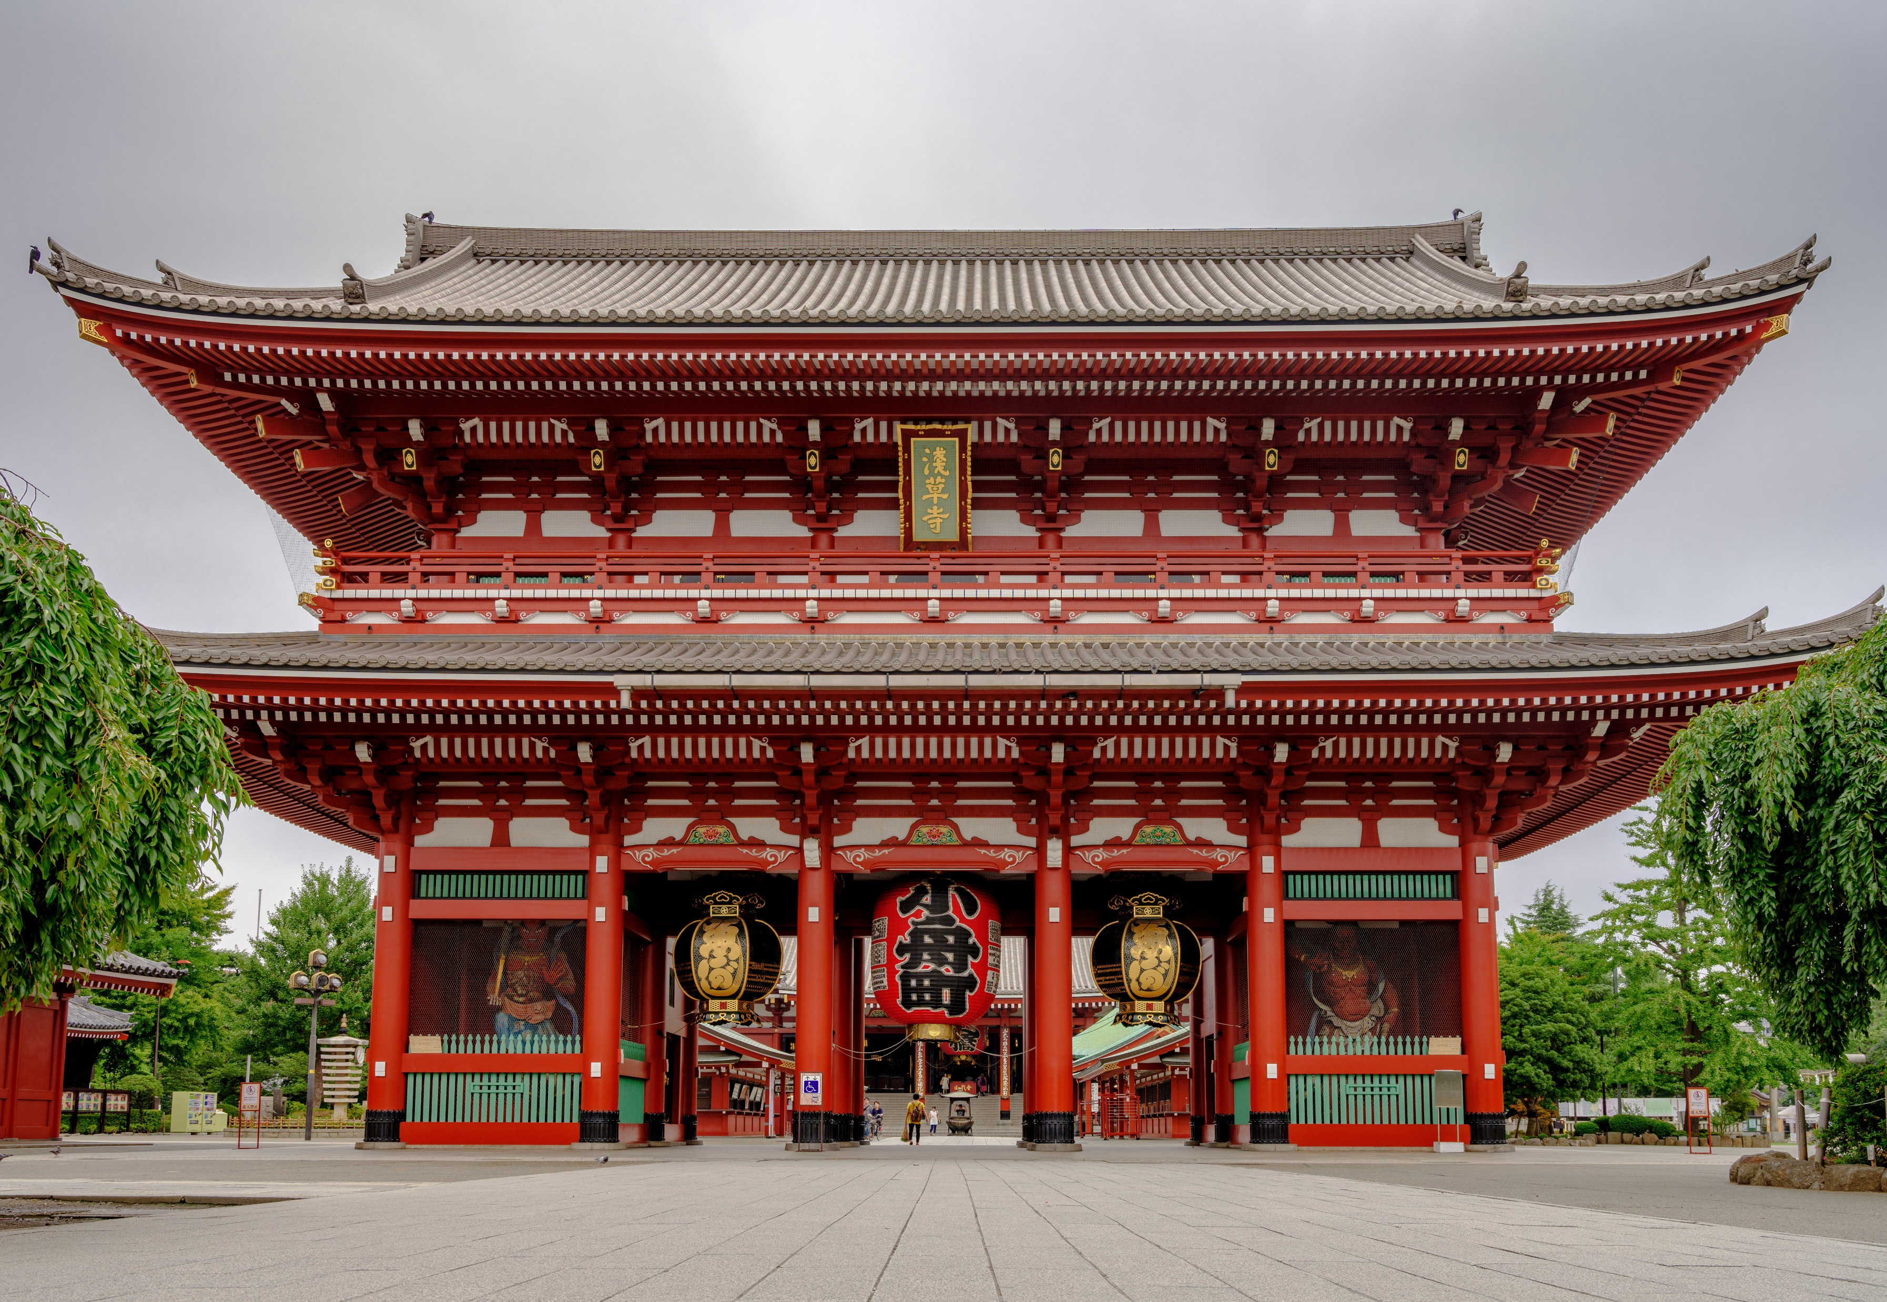
Do you know any local dishes in Tokyo?
Do you know any attractions there?
Asakusa
Pre-reading
Reading
After Reading
Notes:
Asakusa (淺草)

Slide 12
In the second part of the article, a junior reporter called John Lo interviews his friend about mini holidays.
Pre-reading
Reading
After Reading

Slide 13
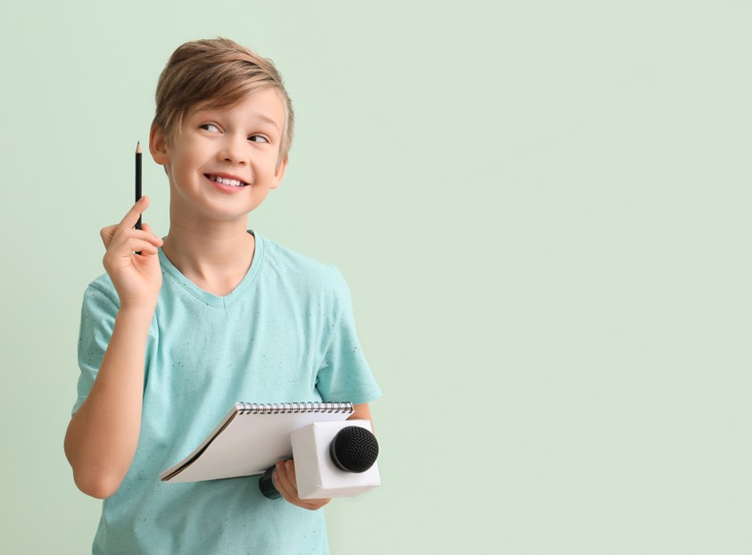
A junior reporter is a student who writes stories for a school magazine.
Pre-reading
Reading
After Reading

Slide 14
What do you know about the word ‘mini’?
Does it mean ‘big’ or ‘small’?
Mini
Pre-reading
Reading
After Reading

Slide 15
Have you heard of ‘mini holidays’?
What is a mini holiday?
Pre-reading
Reading
After Reading

Slide 16
Let’s read the magazine article and find out about the student’s favourite holidays!
Pre-reading
Reading
After Reading

Slide 17
Let’s read the magazine article and find out!
Pre-reading
Reading
After Reading

Slide 18


What has Kenny done four times?
What is his favourite place?
Pre-reading
Reading
After Reading

Slide 19
What did Kenny do in Tokyo last year?
What were the long queues for?
Pre-reading
Reading
After Reading

Slide 20
Did he wait a long time for the rides?
Pre-reading
Reading
After Reading

Slide 21
‘Worth the wait’ means something is good enough that it is okay to wait for it, even if it takes a long time.
Pre-reading
Reading
After Reading

Slide 22
Why did he scream his head off?
What did he think of the rides?
Pre-reading
Reading
After Reading

Slide 23
What two other things did he do there?
Pre-reading
Reading
After Reading

Slide 24
Do you think Kenny enjoyed the amusement park?
Can you find a word that tells us this?
Pre-reading
Reading
After Reading

Slide 25
Which two adjectives did Kenny use to describe the fish market?
Pre-reading
Reading
After Reading

Slide 26
Can you guess why it was smelly?
Pre-reading
Reading
After Reading

Slide 27
Where was Kenny?
Pre-reading
Reading
After Reading

Slide 28
What else did Kenny do there?
They learnt how to make sushi.
Pre-reading
Reading
After Reading

Slide 29
Do you think it is hard?
Why or why not?
Pre-reading
Reading
After Reading

Slide 30
Masters train for ten to twenty years to become the best sushi makers.
Pre-reading
Reading
After Reading

Slide 31
They need to learn many skills, like how to make the best-tasting rice, cut fish perfectly and roll sushi well.
Pre-reading
Reading
After Reading

Slide 32
Making sushi is like creating art!
Pre-reading
Reading
After Reading

Slide 33
Where else did Kenny and his family go?
Pre-reading
Reading
After Reading

Slide 34
Where else did Kenny and his family go?
Can you see the cherry blossoms in the picture?
Pre-reading
Reading
After Reading

Slide 35
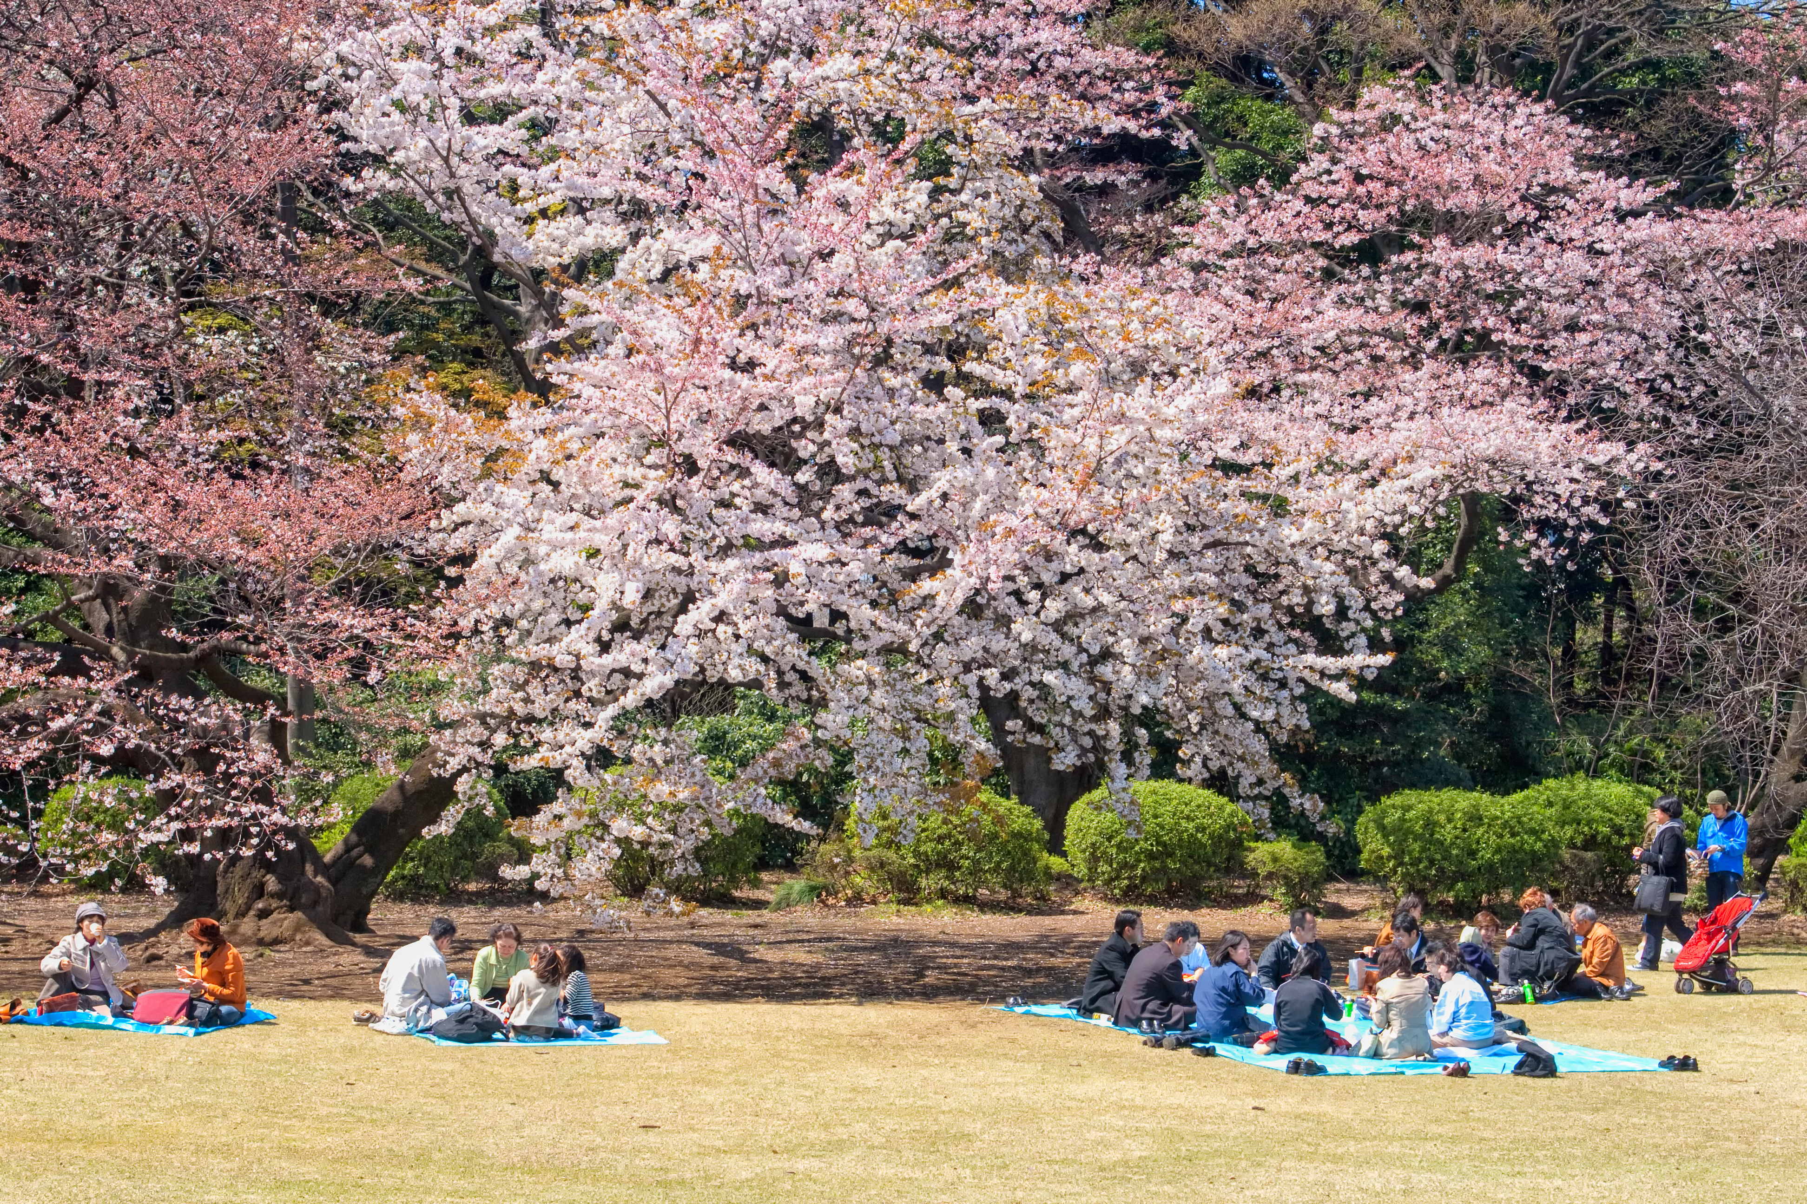
Where else did Kenny and his family go?
Can you see the cherry blossoms in the picture?
Pre-reading
Reading
After Reading

Slide 36
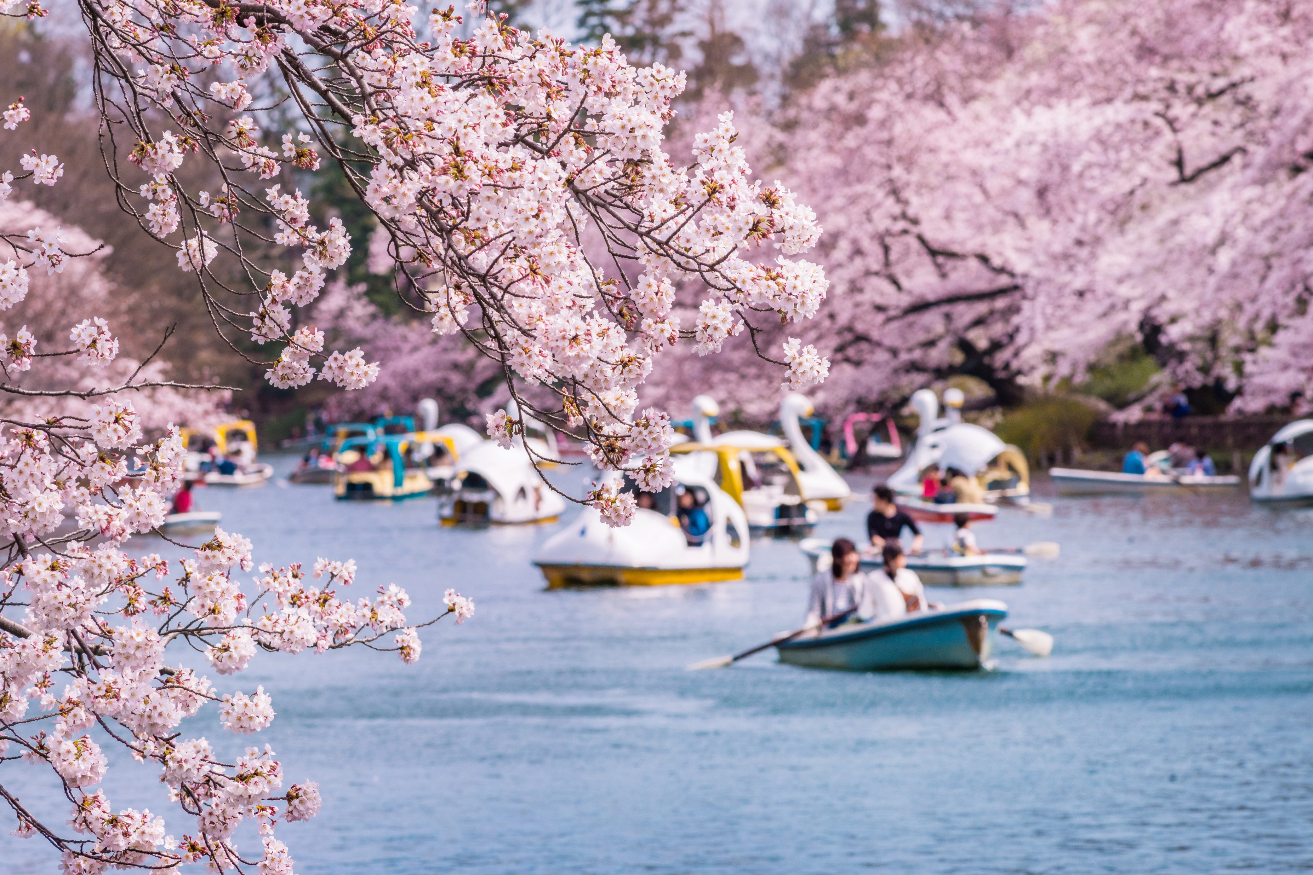
It was cherry blossom season, so Kenny could see their beautiful flowers!
Pre-reading
Reading
After Reading

Slide 37
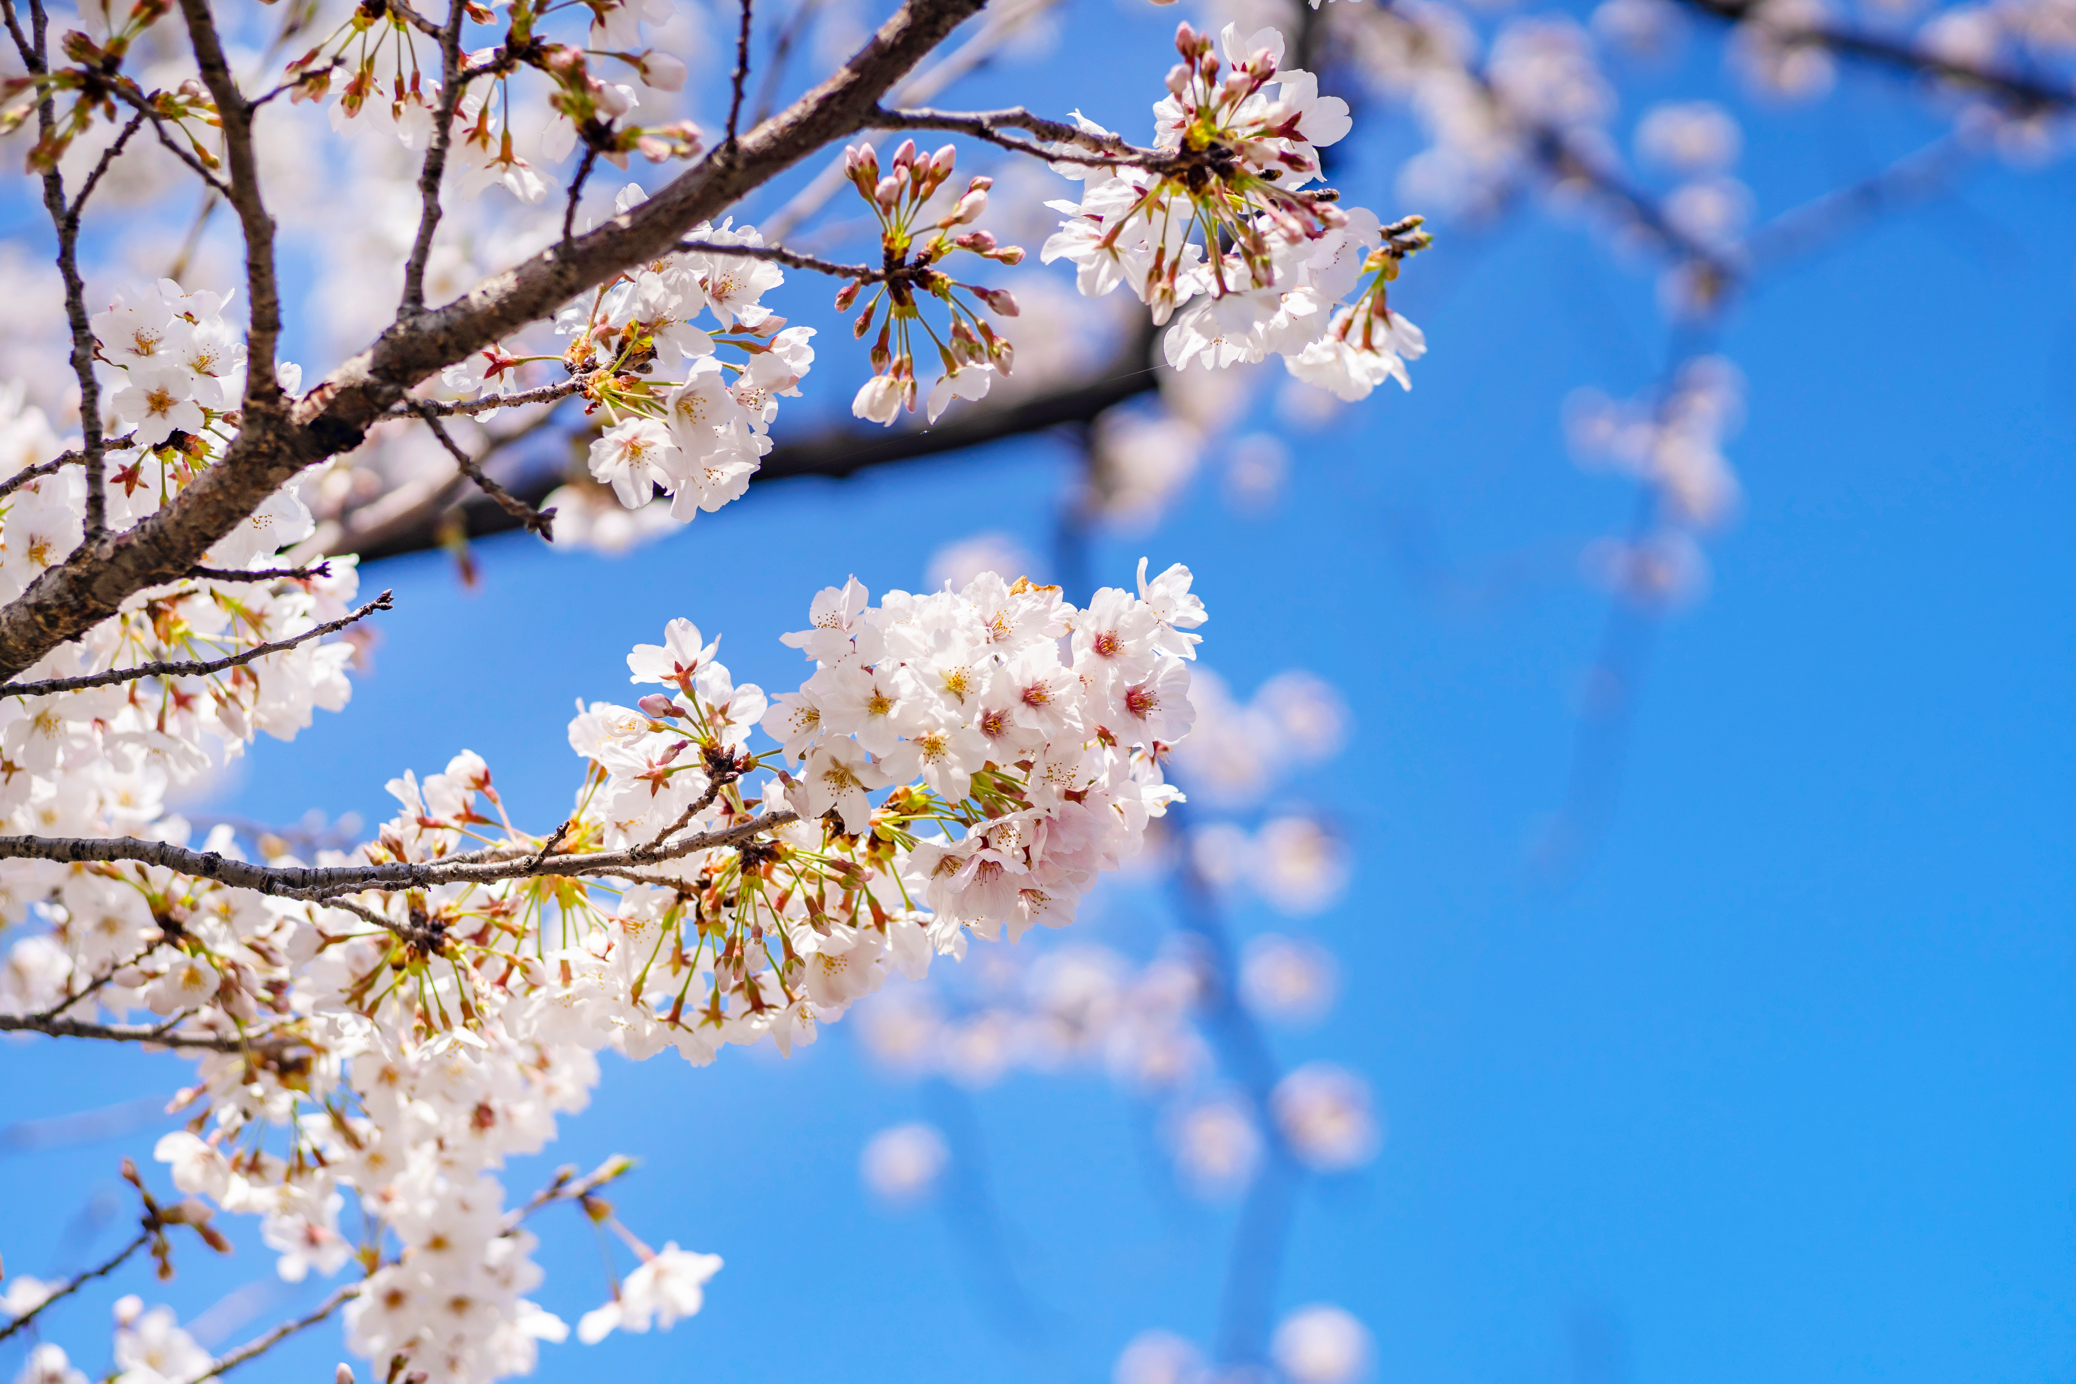
They come out once a year, in early spring.
Then, the flowers only live for around two weeks.
Pre-reading
Reading
After Reading

Slide 38
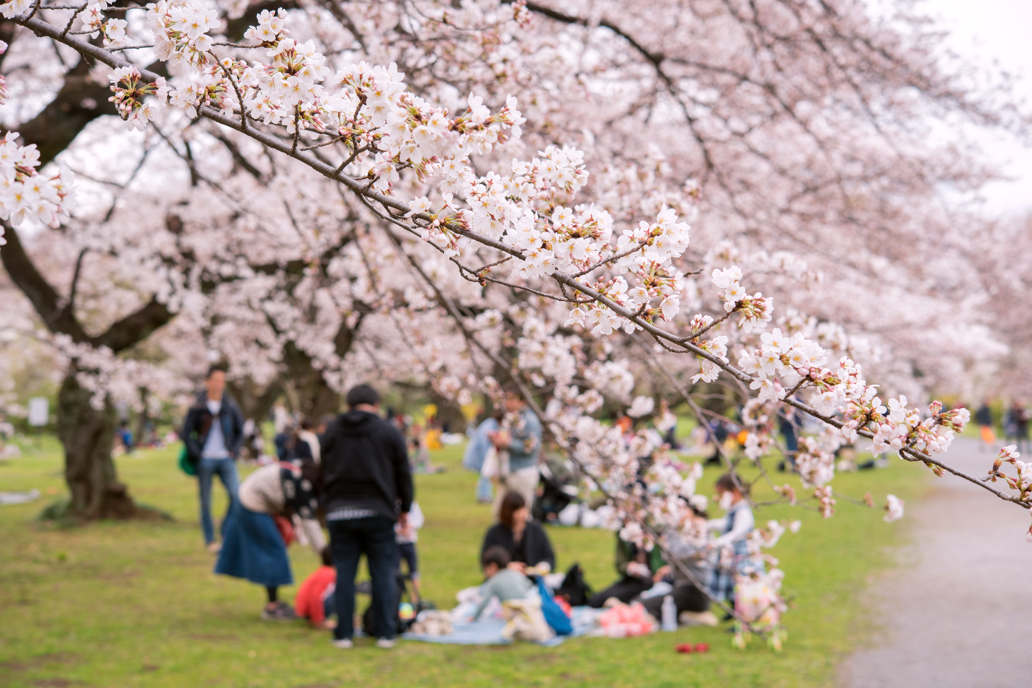
Cherry blossom season is a special time in Japan because people can gather and enjoy the nature together.
Pre-reading
Reading
After Reading

Slide 39
What did they do after the picnic?
Why were Kenny’s legs tired? What did he do?
Pre-reading
Reading
After Reading

Slide 40
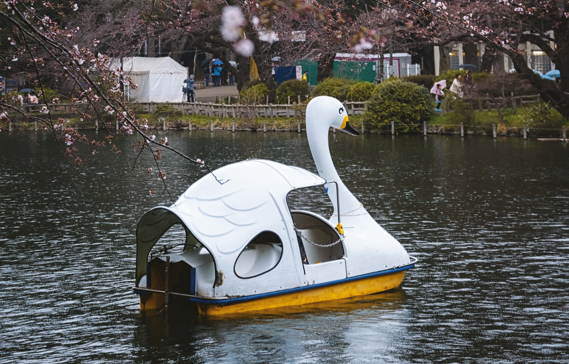
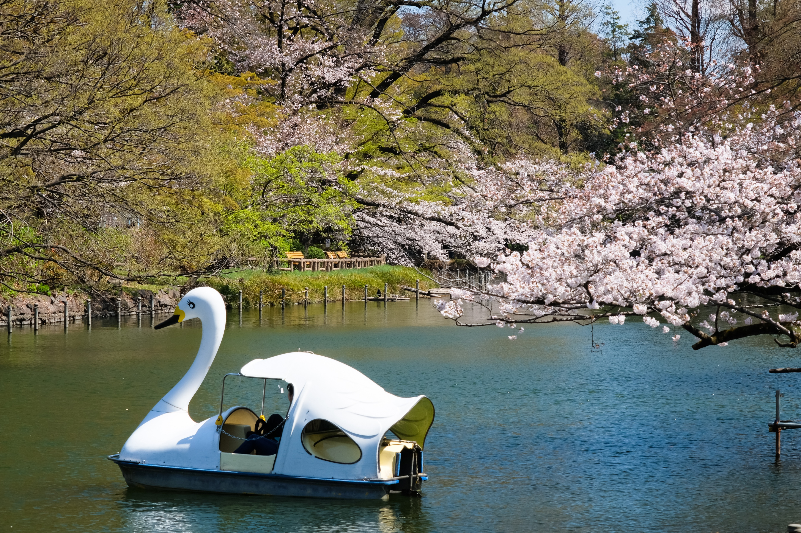
These boats have big pedals, like bike pedals, that we push with our feet. Otherwise, the boat doesn’t move!
Pre-reading
Reading
After Reading

Slide 41
How many times has Kenny been to Japan?
Do you think he will visit again? Which phrase tells us this?
Pre-reading
Reading
After Reading

Slide 42
People in different places live in different ways.
They have different cultures.
Pre-reading
Reading
After Reading

Slide 43
It is important to understand and respect the culture in the place we visit.
Pre-reading
Reading
After Reading

Slide 44
We can do this by following their rules or ways of living.
Pre-reading
Reading
After Reading

Slide 45
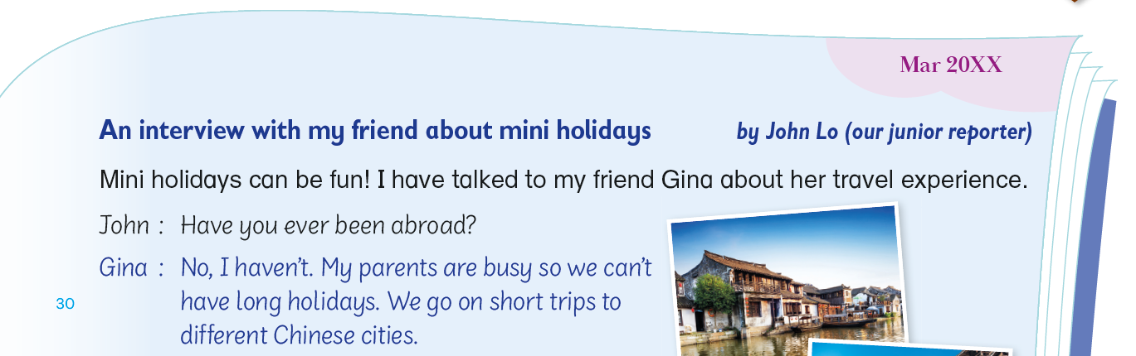
Do you remember what a mini holiday is?
Mini holidays are short holidays to nearby cities or places.
Pre-reading
Reading
After Reading

Slide 46
Where does Gina and her parents go on mini holidays?
Pre-reading
Reading
After Reading

Slide 47
How many times have Gina and her parents gone on mini holidays?
Pre-reading
Reading
After Reading

Slide 48
What does ‘loads’ mean?
A few times or lots of times?
Pre-reading
Reading
After Reading

Slide 49
What did Gina learn about on her trips?
Where did she visit in Fujian?
Pre-reading
Reading
After Reading

Slide 50
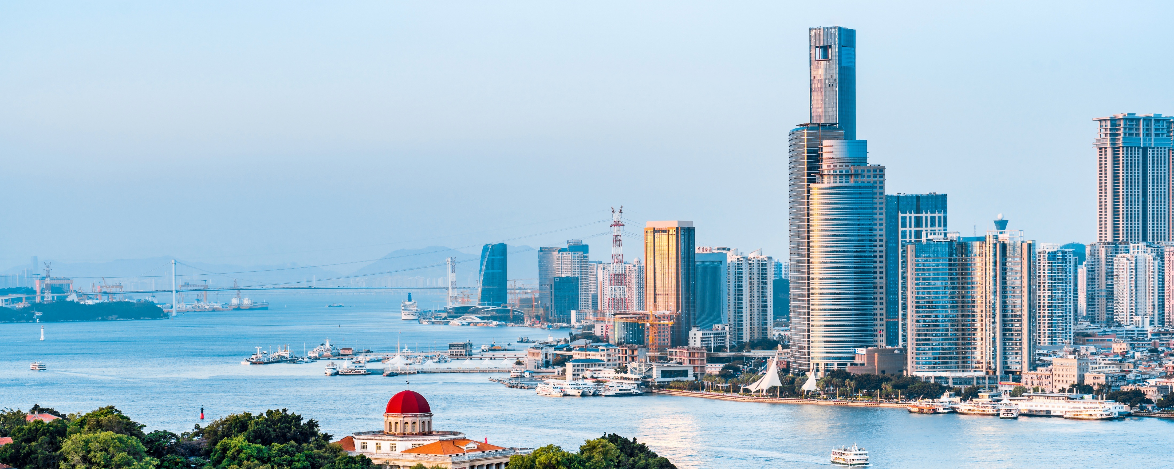
Fujian is next to the Guangdong province.
It is about five to six hours away from Hong Kong by train.
Pre-reading
Reading
After Reading

Slide 51
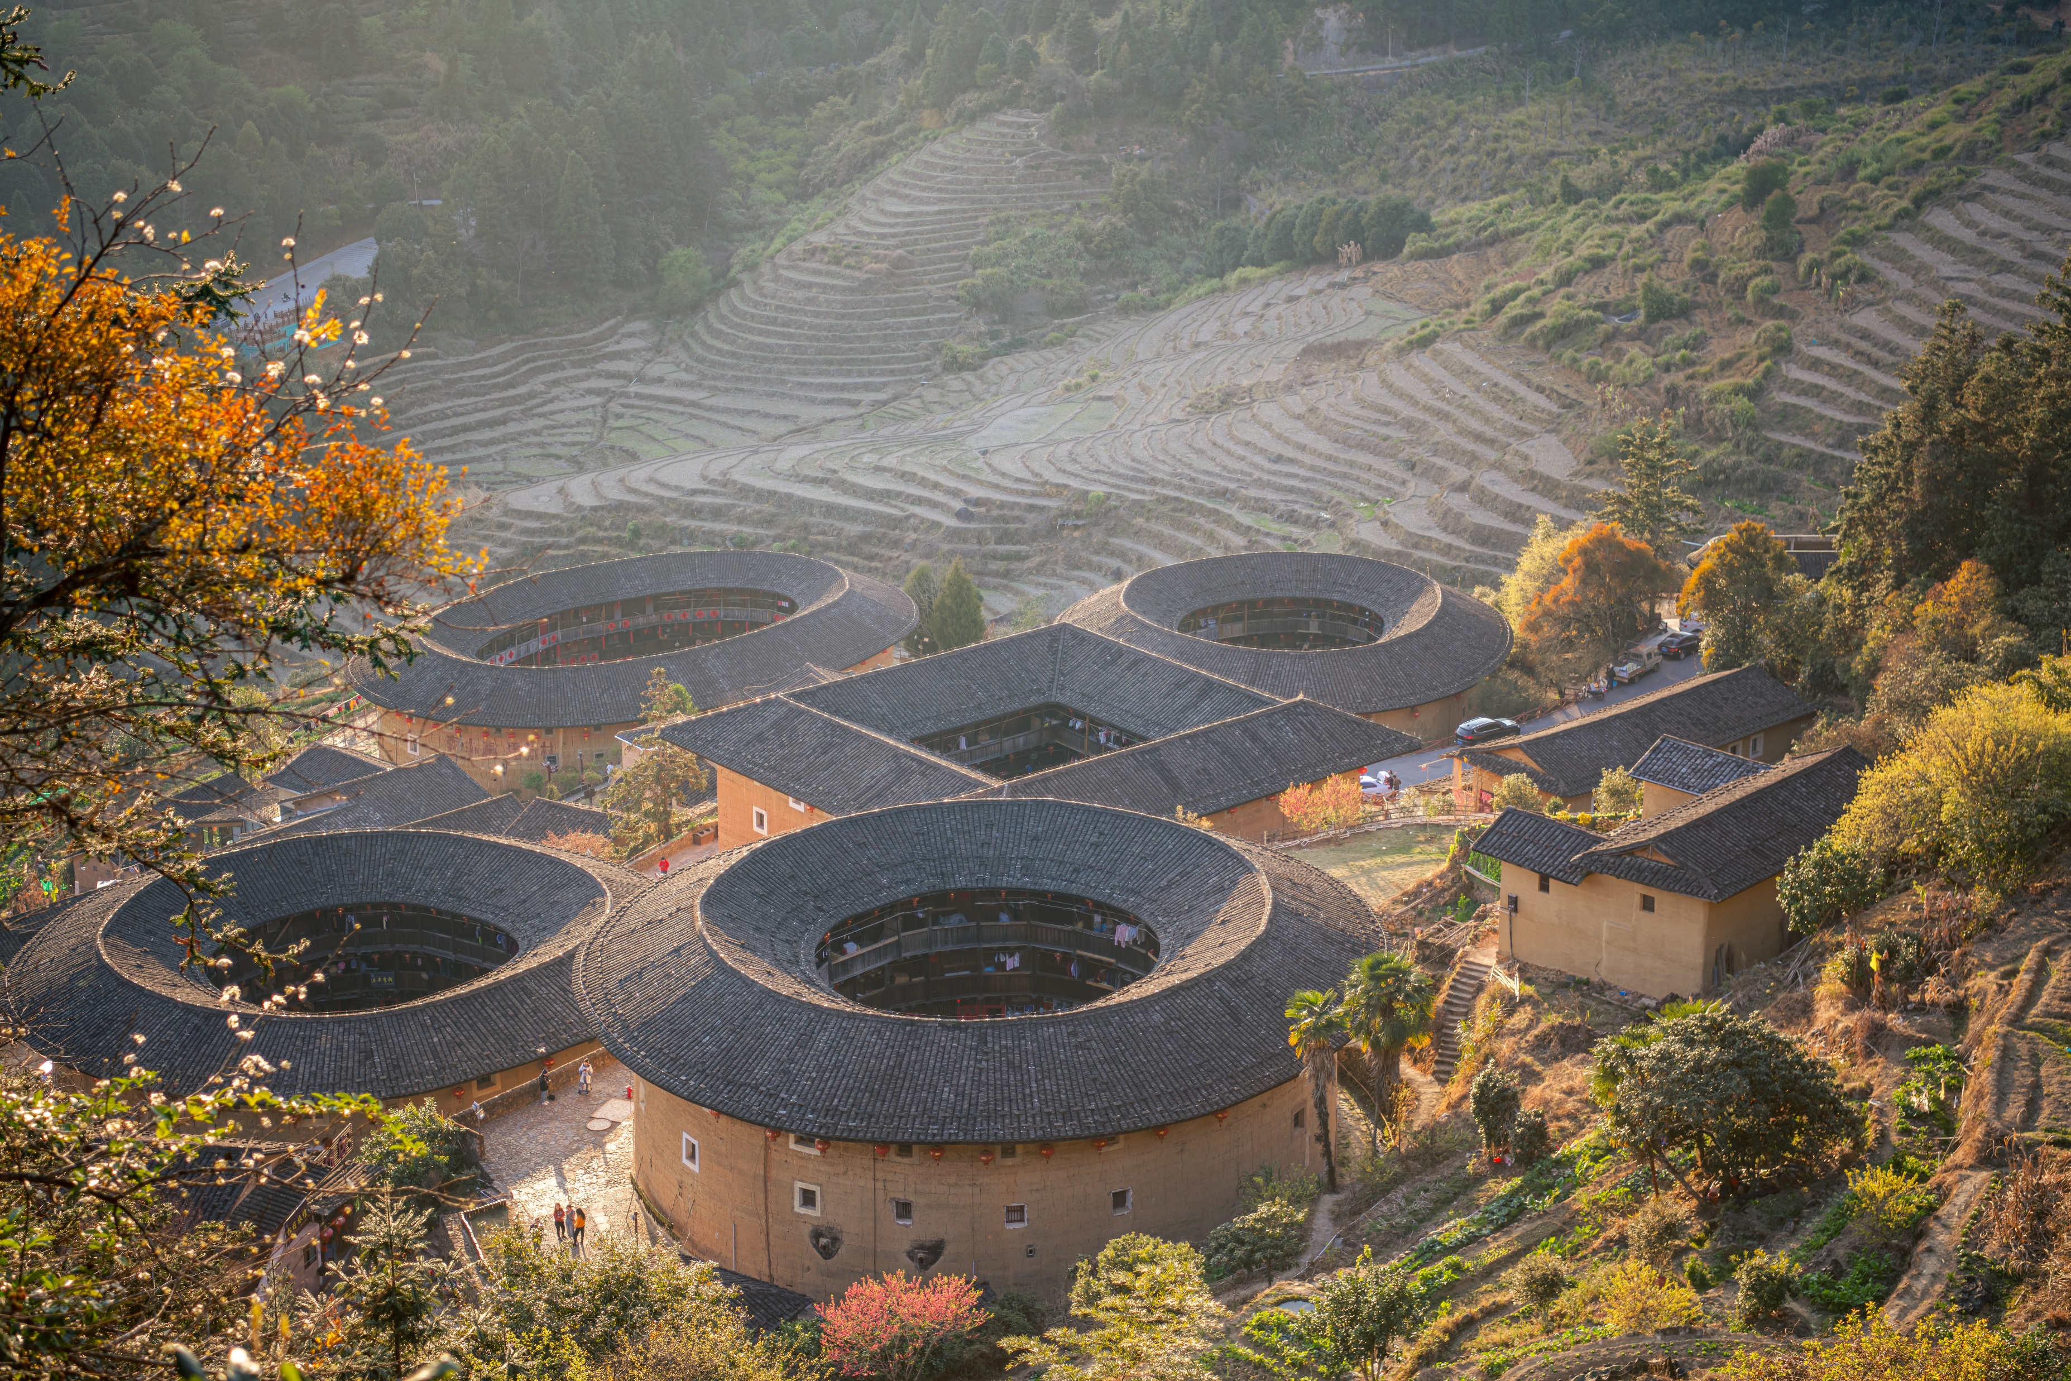
In Fujian, some villagers still live in mud houses, or tulou.
Pre-reading
Reading
After Reading

Slide 52
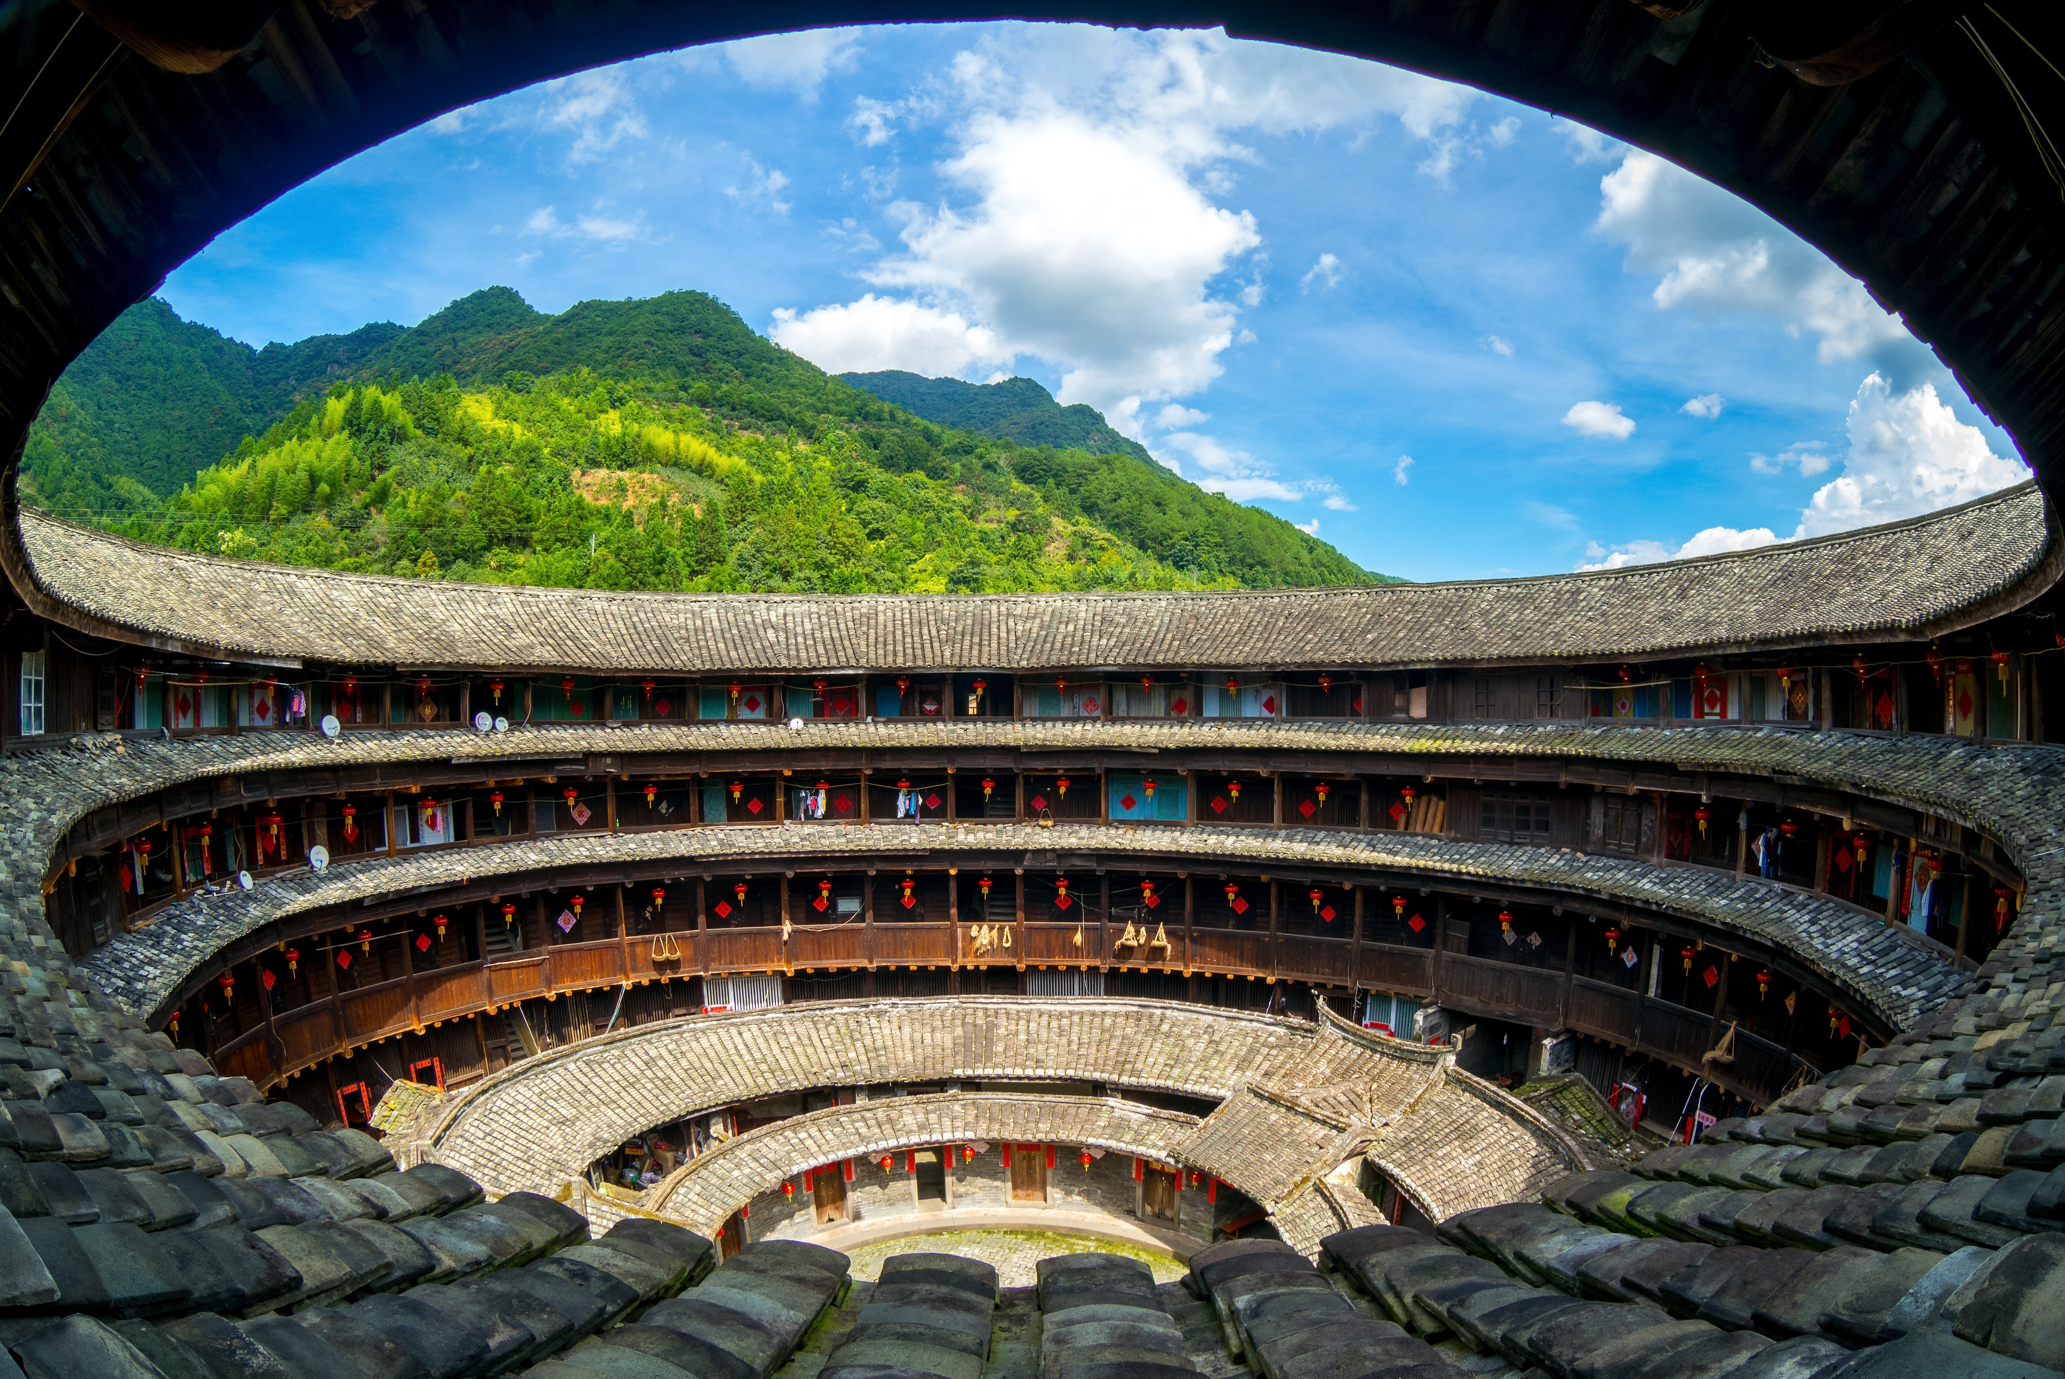
Just like their name suggests, these special homes are made with mud!
Pre-reading
Reading
After Reading

Slide 53
What else did Gina do in a village?
What did John think about that?
Pre-reading
Reading
After Reading

Slide 54
What did Gina do in Shenzhen?
Pre-reading
Reading
After Reading

Slide 55
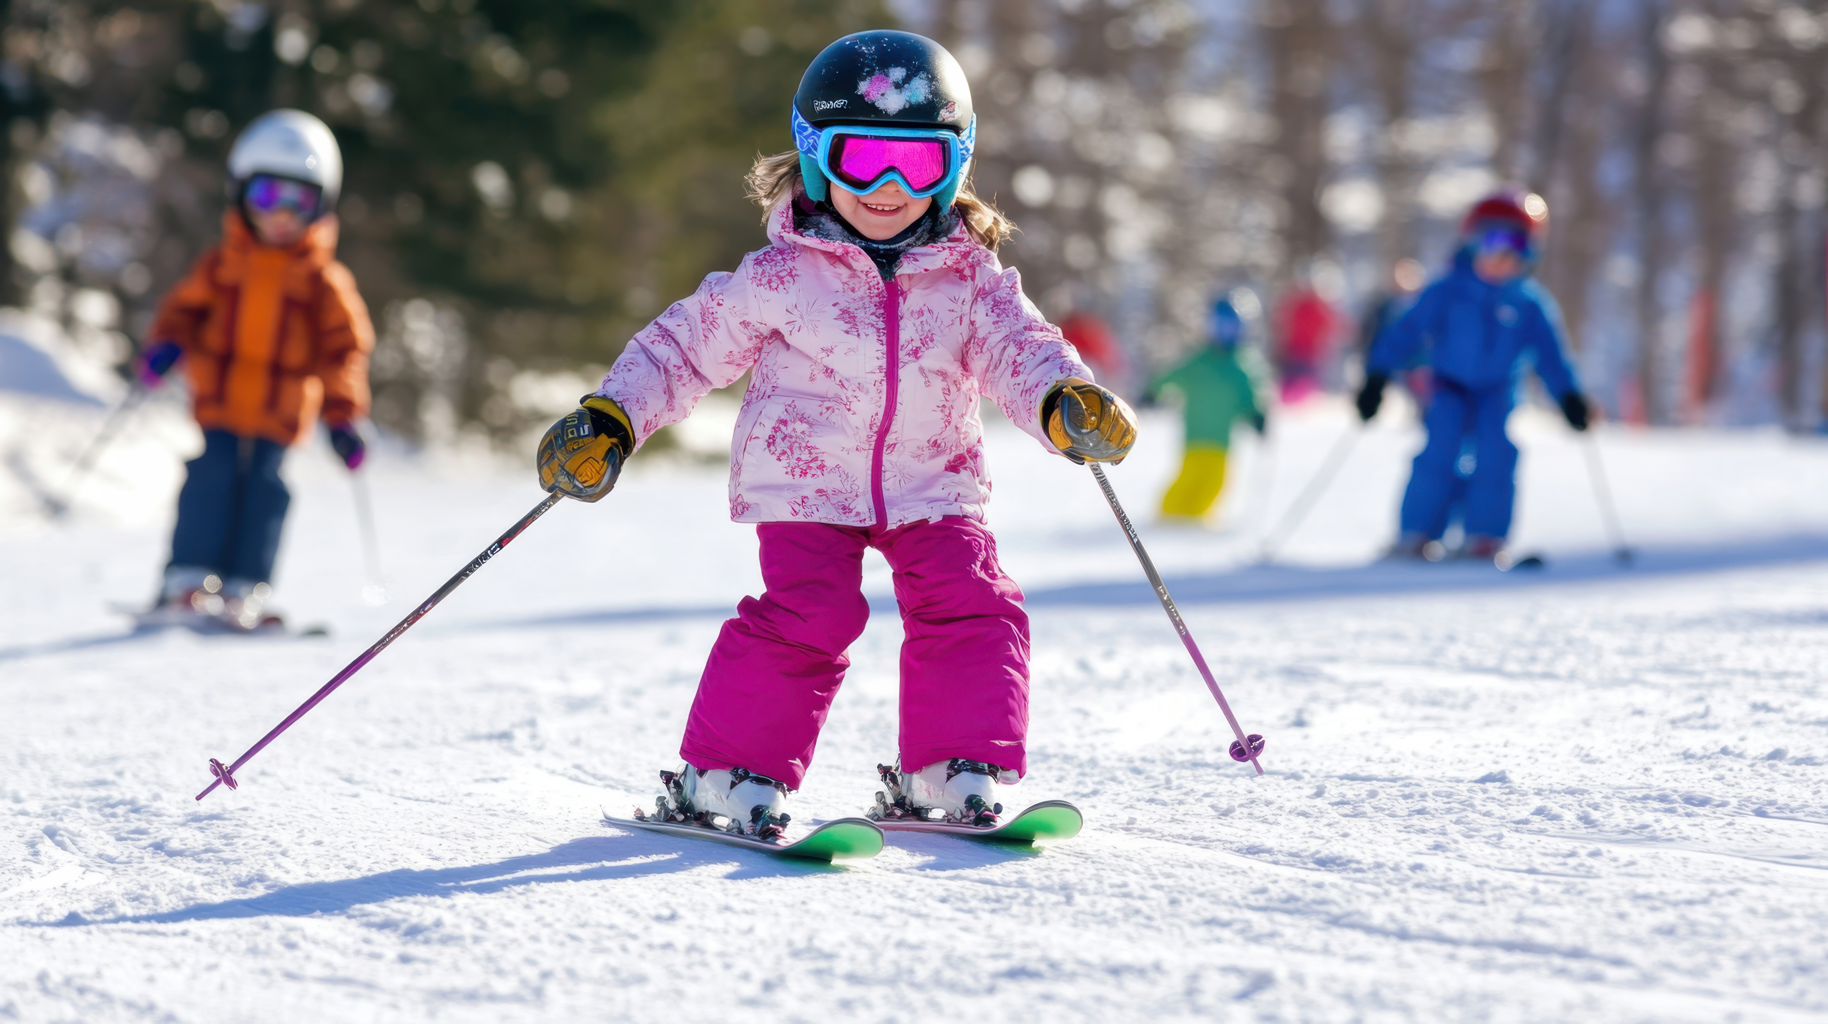
We usually ski outdoors on a mountain.
Pre-reading
Reading
After Reading

Slide 56
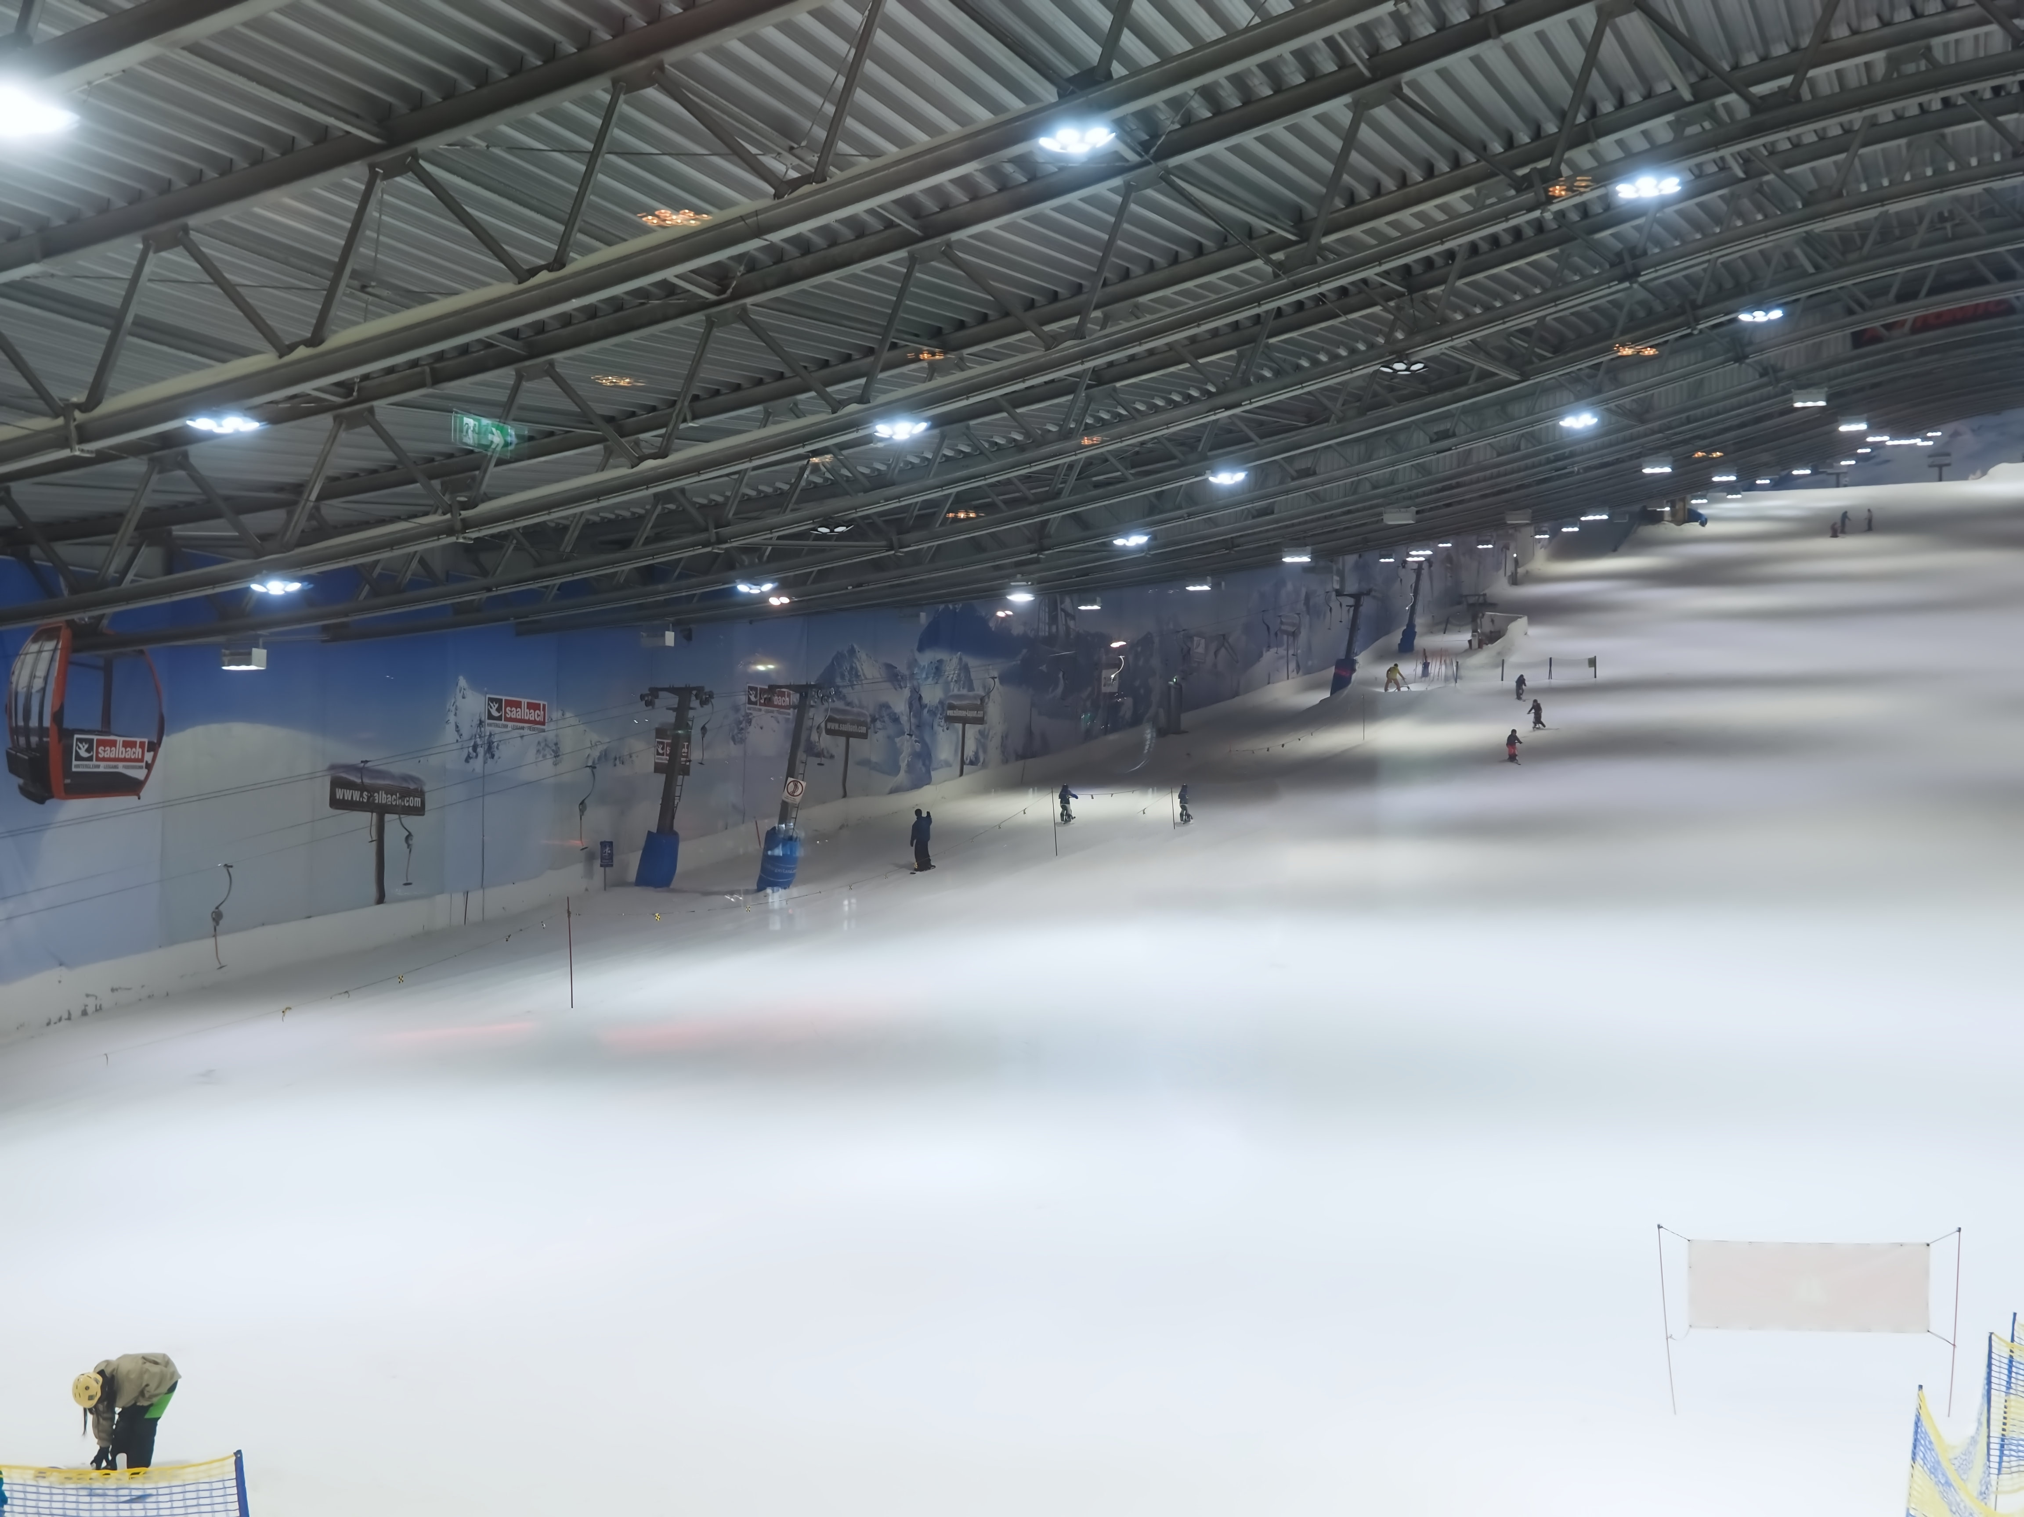
But there is an indoor skiing park in Shenzhen where we can ski indoors!
Pre-reading
Reading
After Reading

Slide 57
What does Gina think about skiing?
Is it easy?
Pre-reading
Reading
After Reading

Slide 58
Do you think she enjoyed skiing?
Which sentence tells us this?
Pre-reading
Reading
After Reading

Slide 59
Luckily, she could do other things at the indoor skiing park.
What is this?
Pre-reading
Reading
After Reading

Slide 60
She could slide downhill in it!
Pre-reading
Reading
After Reading

Slide 61
Do you think it can go fast?
Find a word that means ‘to go fast’.
Pre-reading
Reading
After Reading

Slide 62
What was the best thing Gina did on holiday?
Can she choose one?
Pre-reading
Reading
After Reading

Slide 63
Why not?
Pre-reading
Reading
After Reading

Slide 64
Wow! Do you think they sound interesting?
Why or why not?
Pre-reading
Reading
After Reading

Slide 65
Let’s recap the description and interview.
Pre-reading
Reading
After Reading

Slide 66
How many times has Kenny travelled abroad?
4 times.
What did Kenny and his mum do at the fish market?
Joined a sushi class.
Where is Kenny’s favourite place to visit?
Tokyo.
What special season was it when Kenny visited Tokyo?
Cherry blossom season.
Who did Kenny go to Tokyo with?
His parents.
had a picnic in the park
rode a paddle boat on the lake
Who did Kenny go to Tokyo with?
What did Kenny do at the amusement park?
Kenny found Japan very interesting and would love to go back.
visited an amusement park
enjoyed exciting rides
took photos with cartoon characters
Would Kenny like to visit Japan again? Why?
Pre-reading
Reading
After Reading

Slide 67
How many times has Gina gone on mini holidays?
5 or 6 times.
What are the special things about mud houses in Fujian?
600 years old
big enough for 800 people to live in
tried skiing
whizzed downhill in a snow tube
built a snowman,
played on a slide
What fun activities did Gina do at the indoor skiing park in Shenzhen?
Where does Gina go for her mini holidays?
Different Chinese cities.
museums,
mud houses
an indoor skiing park
It is because Gina has done many fun and interesting things on her mini holidays.
What kinds of places has Gina visited on her trips?
Why does Gina find it hard to choose her favourite holiday activity?
Pre-reading
Reading
After Reading

Slide 69
Acknowledgements
We would like to thank the following organisations and people for permission to use their images:
beeboys / stock.adobe.com
evagattuso / stock.adobe.com
Govan / stock.adobe.com
Graphic Gurus / stock.adobe.com
gui yong nian / stock.adobe.com
HLPhoto / stock.adobe.com
Hung Chung Chih / Shutterstock
hwongcc / stock.adobe.com
karapati / stock.adobe.com
maxximmm / stock.adobe.com
Metin Özgür / stock.adobe.com
Patricia / stock.adobe.com
photosomething / stock.adobe.com
picture cells / stock.adobe.com
picture cells / stock.adobe.com
Pixel-Shot / stock.adobe.com
Richie Chan / stock.adobe.com
sasazawa / stock.adobe.com
Stimmungsbilder1 / stock.adobe.com
Tatiana Kashko / stock.adobe.com
Tatiana_kashko_photo / Shutterstock
tatoman / stock.adobe.com
Thaweewong Vichaiururoj / Shutterstock
vacant - stock.adobe.com
wooooooojpn / stock.adobe.com
YP_Studio / Shutterstock
Наталья Удалова / stock.adobe.com
яна винникова / stock.adobe.com
ヨーグル / stock.adobe.com
健太 上田 / stock.adobe.com
拓也 神崎 / stock.adobe.com

