Slide 1
Chapter 5
Blog entries

Slide 2
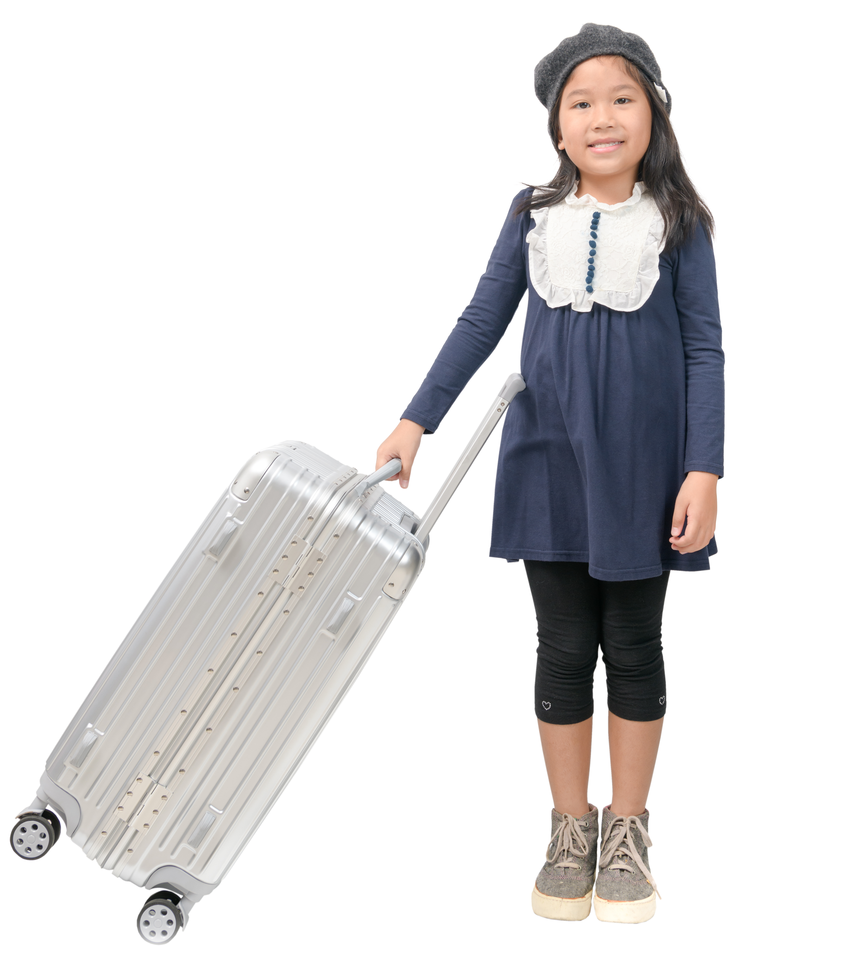
This is Clara. She joined a study tour during summer holiday.

Slide 3
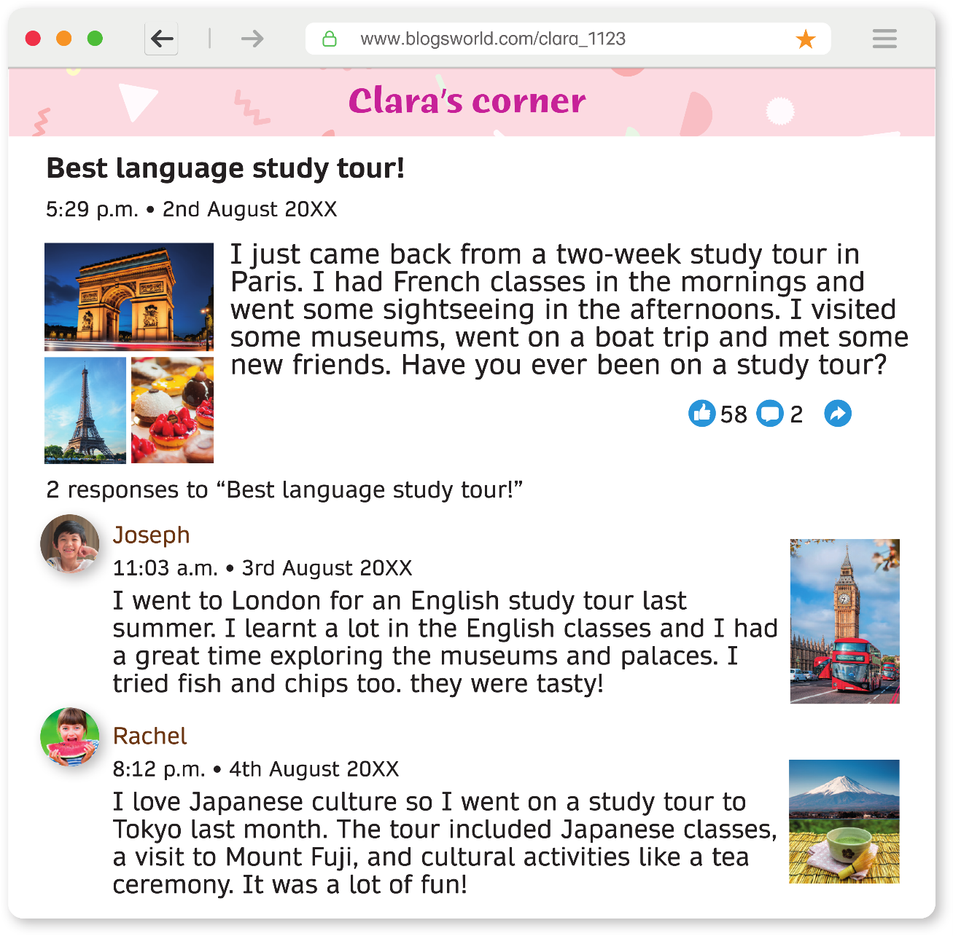
She wrote a blog entry about her experience.

Slide 4
A blog is like an online diary where people share their thoughts, ideas or stories on the Internet.

Slide 5
A blog entry is a piece of writing on the blog. It is like a page in a diary.

Slide 6

A person who writes a blog is called a blogger.

Slide 7
Let’s read Clara’s blog entry and find out what she shared with her readers!

Slide 8
What is the web address of Clara’s blog?
Web address

Slide 9
A web address is like the home address for a website on the Internet.
Web address

Slide 10
To visit Clara’s blog, type this web address into the address bar at the top of the Internet browser.
Web address

Slide 11

Every blog has a name. What is the name of Clara’s blog?
Name of the blog

Slide 12

What is the title of this blog entry?
Title of the blog entry
Name of the blog

Slide 13
What kind of study tour did Clara join?
Title of the blog entry
Name of the blog

Slide 14
What do students do during a language study tour?
Do they learn a new language?
Title of the blog entry
Name of the blog

Slide 15

From the title, do you think Clara enjoy the tour?
Which word tells you this?
Title of the blog entry
Name of the blog

Slide 16

When did Clara post this blog entry?
Title of the blog entry
Name of the blog
When the blogger posted the entry

Slide 17
When a blogger posts an entry, the blogging platform automatically generates the date and time.
Title of the blog entry
Name of the blog
When the blogger posted the entry

Slide 18
This helps readers know when the blogger created or updated the content.
Title of the blog entry
Name of the blog
When the blogger posted the entry

Slide 19
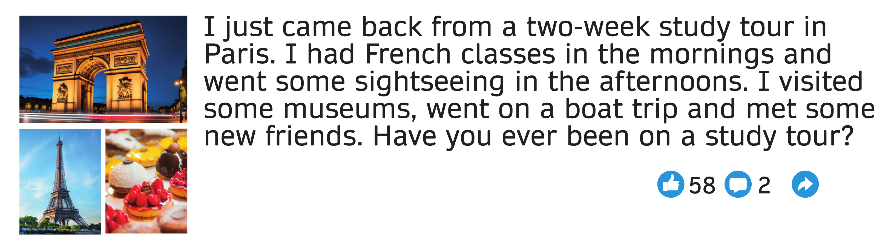
Let’s read the content of the entry together.
Title of the blog entry
Name of the blog
When the blogger posted the entry

Slide 20
Where did Clara go?
Web address
Title of the blog entry
Name of the blog
When the blogger posted the entry

Slide 21
What language did she learn?
Web address
Title of the blog entry
Name of the blog
When the blogger posted the entry

Slide 22
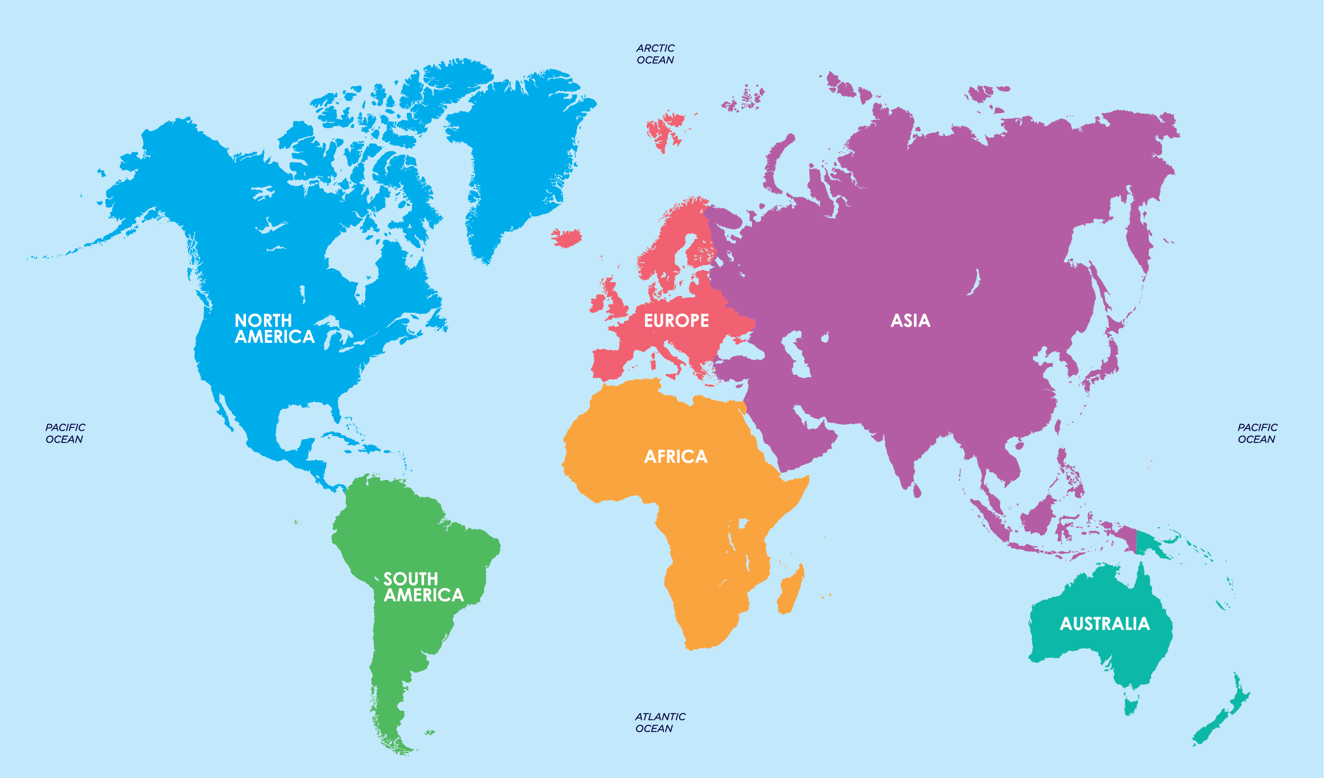

Paris is the capital city of France.
The people in France speak French.
Web address
Title of the blog entry
Name of the blog
When the blogger posted the entry

Slide 23
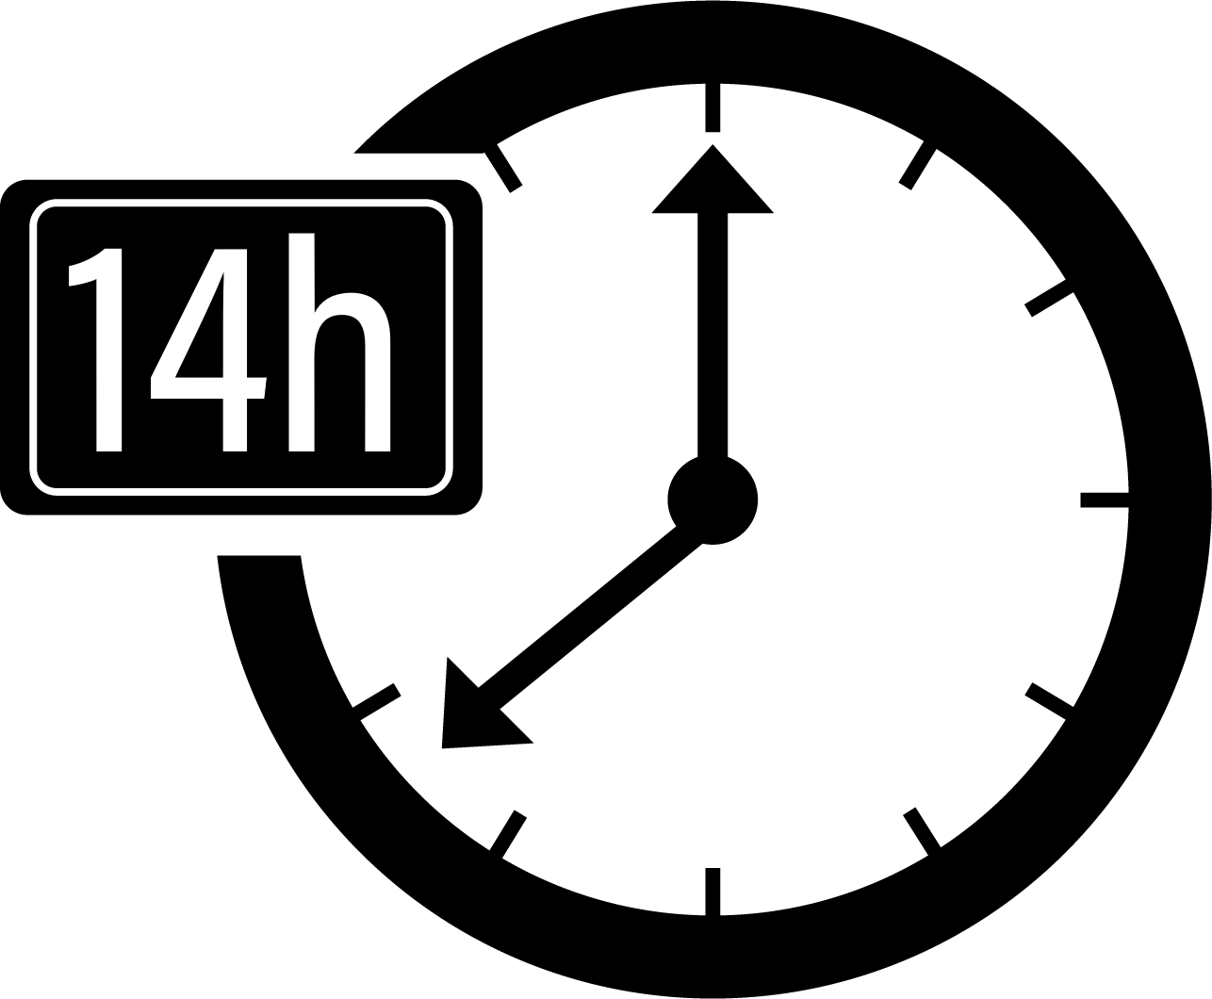

It takes about 14 hours to fly from Hong Kong to Paris.
Web address
Title of the blog entry
Name of the blog
When the blogger posted the entry

Slide 24
What else did Clara do besides learning French?
Web address
Title of the blog entry
Name of the blog
When the blogger posted the entry

Slide 25
Bloggers can upload photos to make their blog entries more attractive.
Web address
Title of the blog entry
Name of the blog
When the blogger posted the entry
Photos about the entry

Slide 26

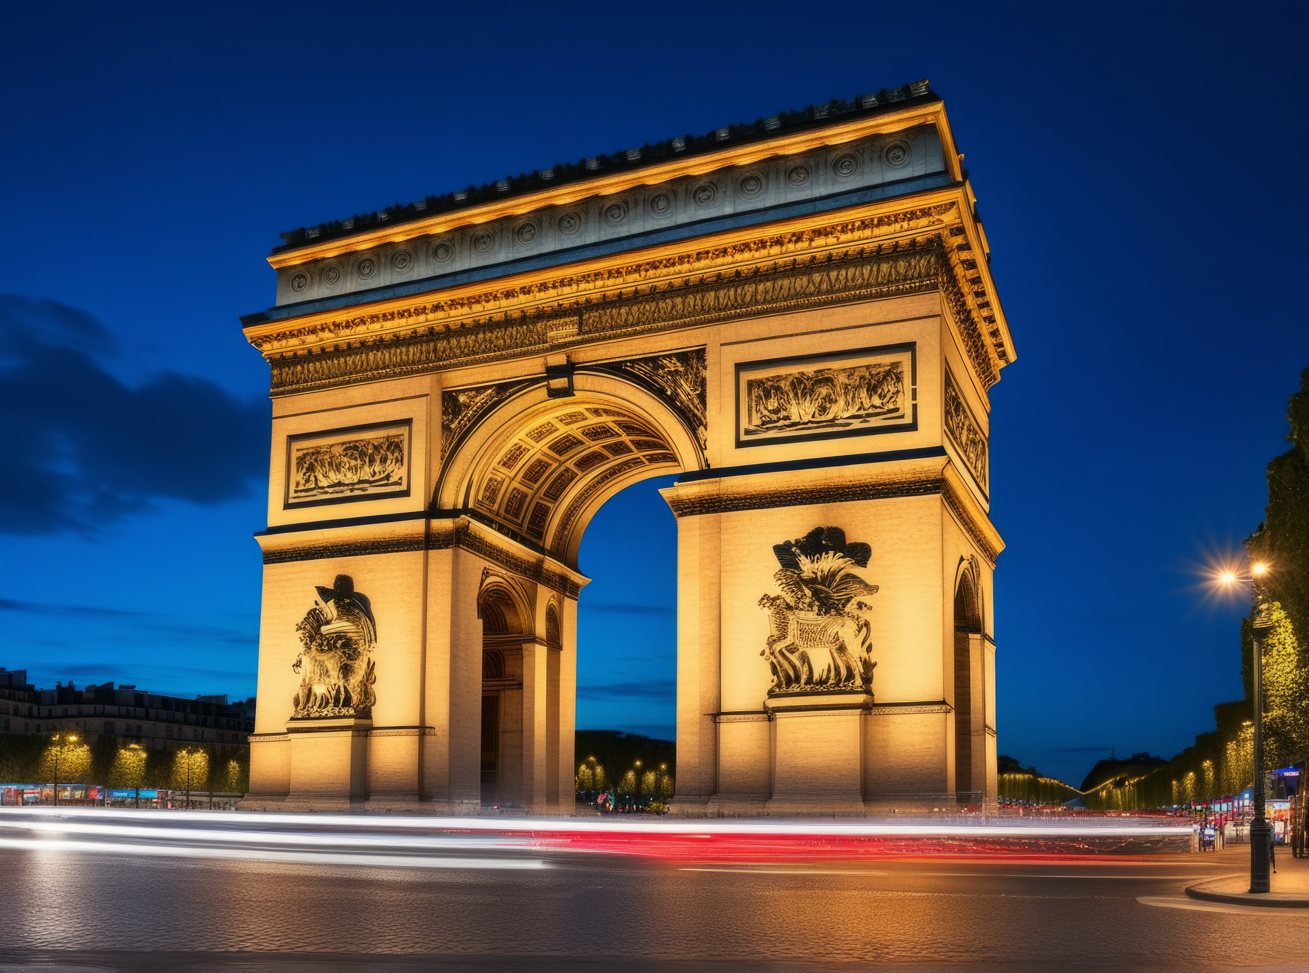

This is the Arc de Triomphe, one of the most famous sights in Paris. It was built to honour soldiers who fought for France.
Web address
Title of the blog entry
Arc de Triomphe
Name of the blog
When the blogger posted the entry
Photos about the entry

Slide 27
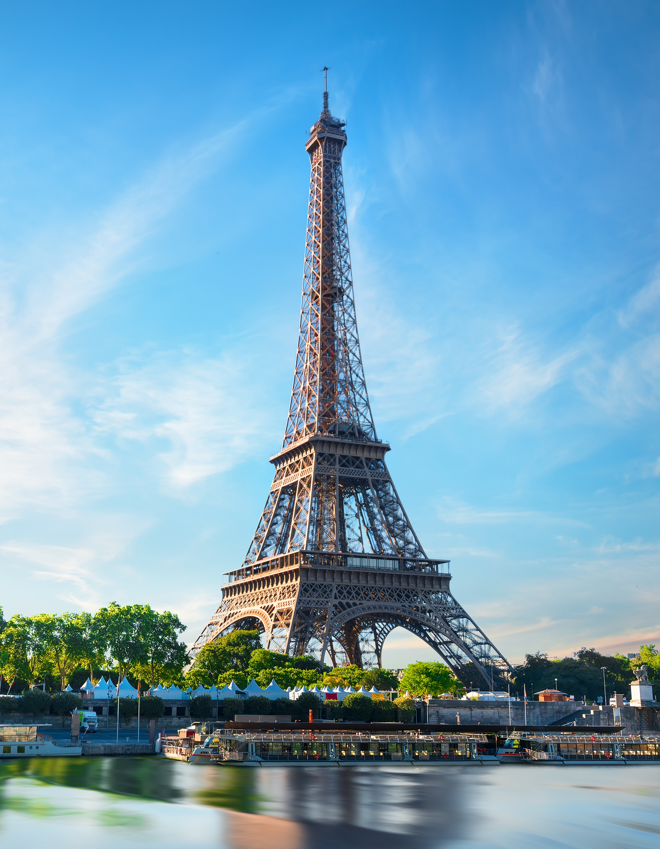
Do you know this building?
Web address
Title of the blog entry
Name of the blog
When the blogger posted the entry
Photos about the entry

Slide 28
This is Eiffel Tower, another famous sight in Paris.
Web address
Title of the blog entry
Name of the blog
When the blogger posted the entry
Photos about the entry

Slide 29
It was built in 1889 for a big world fair and is named after the engineer Gustave Eiffel.
Web address
Title of the blog entry
Name of the blog
When the blogger posted the entry
Photos about the entry

Slide 30
Gustave Eiffel’s company designed and built the tower.
Web address
Title of the blog entry
Name of the blog
When the blogger posted the entry
Photos about the entry

Slide 31
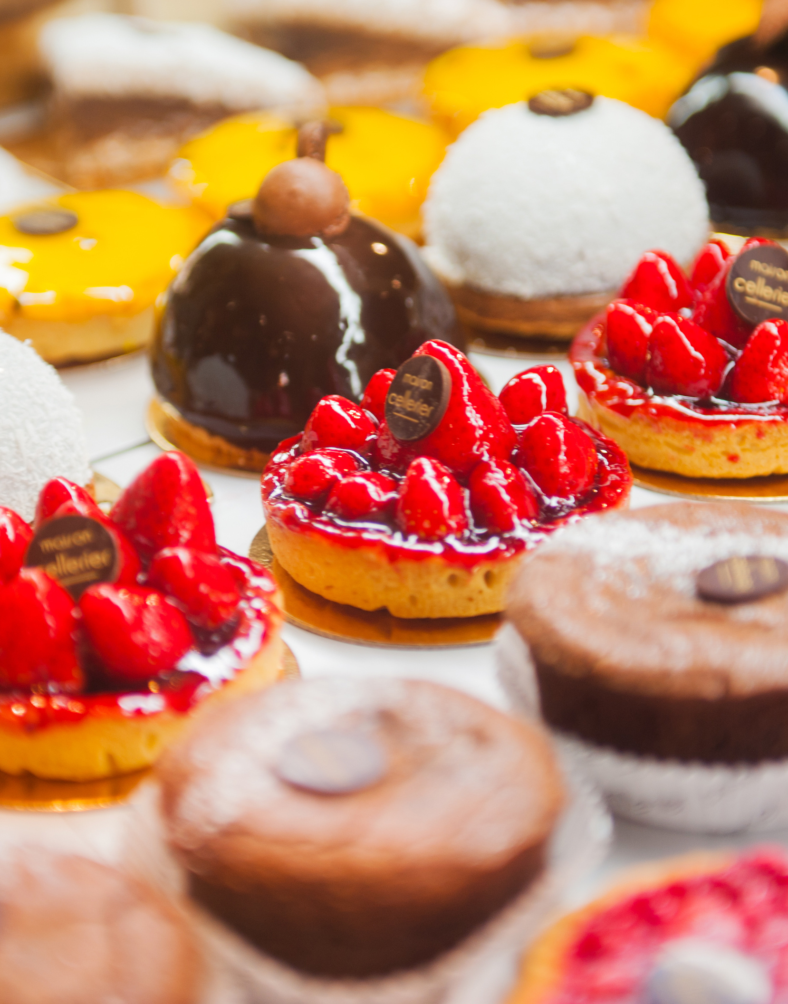
France is also famous for its desserts. Yum😋!
Web address
Title of the blog entry
Name of the blog
When the blogger posted the entry
Photos about the entry

Slide 32
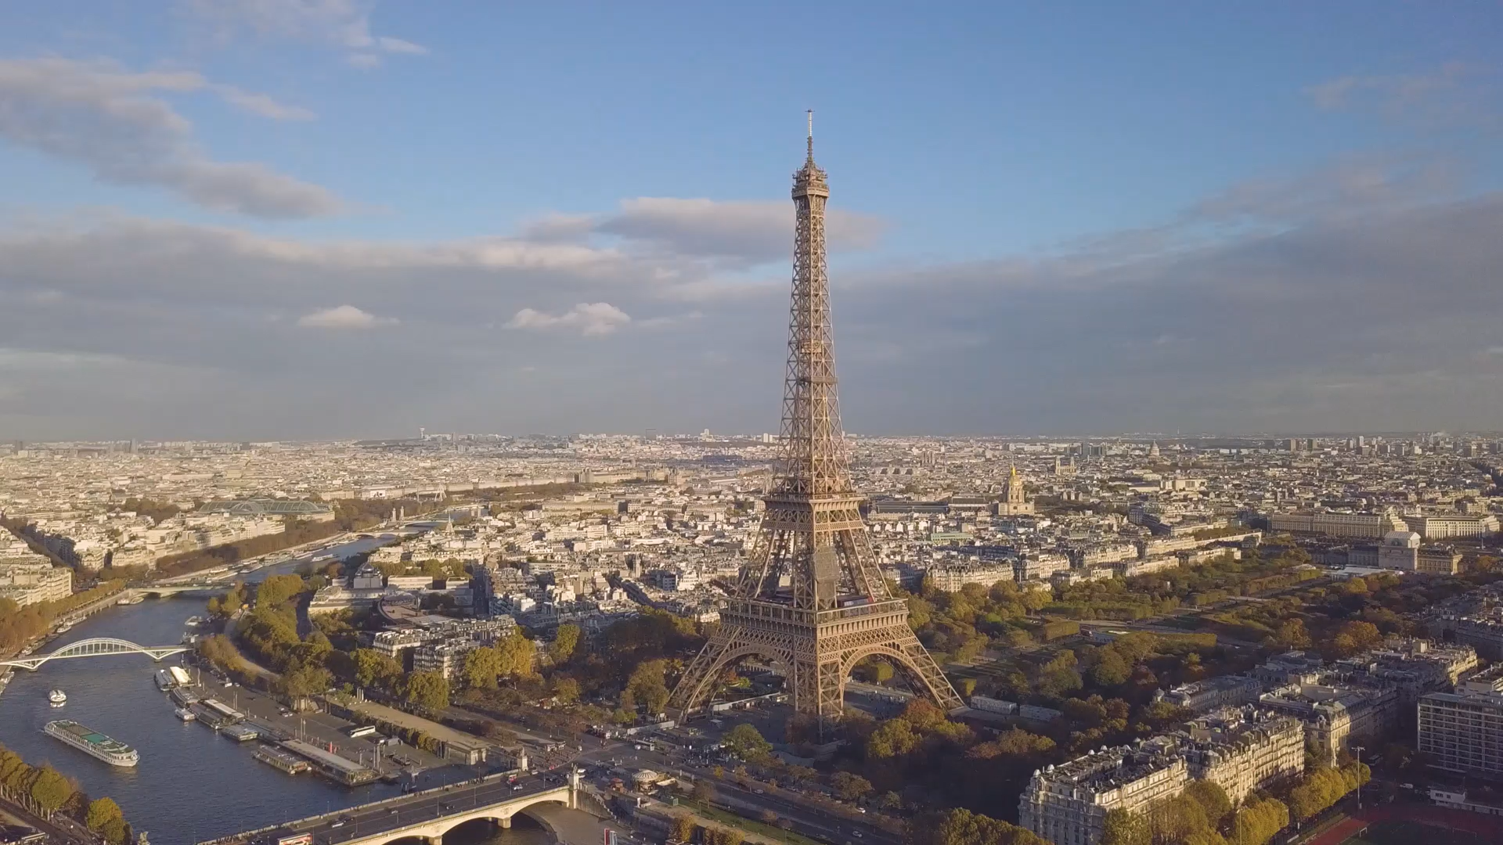
Do you think Paris is a beautiful city?
Web address
Title of the blog entry
Name of the blog
When the blogger posted the entry
Photos about the entry

Slide 33
What do these buttons and numbers mean?
Web address
Title of the blog entry
Name of the blog
When the blogger posted the entry
Readers can like, comment on and share the entry.

Slide 34
How many readers liked this blog entry?
Web address
Title of the blog entry
Name of the blog
When the blogger posted the entry
Readers can like, comment on and share the entry.

Slide 35
How many readers commented on it?
Web address
Title of the blog entry
Name of the blog
When the blogger posted the entry
Readers can like, comment on and share the entry.

Slide 36
Did the two readers respond to Clara’s question?
Web address
Title of the blog entry
Name of the blog
When the blogger posted the entry
Readers can like, comment on and share the entry.

Slide 37
Let’s read their comments one by one.
Web address
Title of the blog entry
Name of the blog
When the blogger posted the entry
Readers can like, comment on and share the entry.
Photos about the entry
Readers’ comments

Slide 38
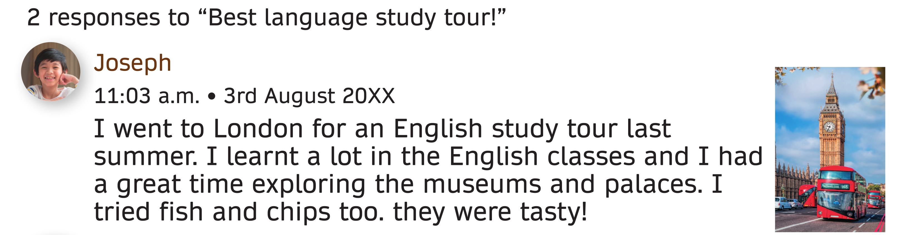
What is the name of this reader?
Web address
Title of the blog entry
Name of the blog
When the blogger posted the entry
Readers can like, comment on and share the entry.
Photos about the entry
Readers’ comments

Slide 39
When did he post the comment?
Web address
Title of the blog entry
Name of the blog
When the blogger posted the entry
Readers can like, comment on and share the entry.
Photos about the entry
Readers’ comments

Slide 40
When a reader posts a comment, the blogging platform automatically generates the time and date.
Web address
Title of the blog entry
Name of the blog
When the blogger posted the entry
Readers can like, comment on and share the entry.
Photos about the entry
Readers’ comments

Slide 41
Where did Jospeh go for his study tour?
Web address
Title of the blog entry
Name of the blog
When the blogger posted the entry
Readers can like, comment on and share the entry.
Photos about the entry
Readers’ comments

Slide 42
London is the capital city of the UK. The King of the UK lives there.
Web address
Title of the blog entry
Name of the blog
When the blogger posted the entry
Readers can like, comment on and share the entry.
Photos about the entry
Readers’ comments

Slide 43
What did Jospeh do in London?
Web address
Title of the blog entry
Name of the blog
When the blogger posted the entry
Readers can like, comment on and share the entry.
Photos about the entry
Readers’ comments

Slide 44
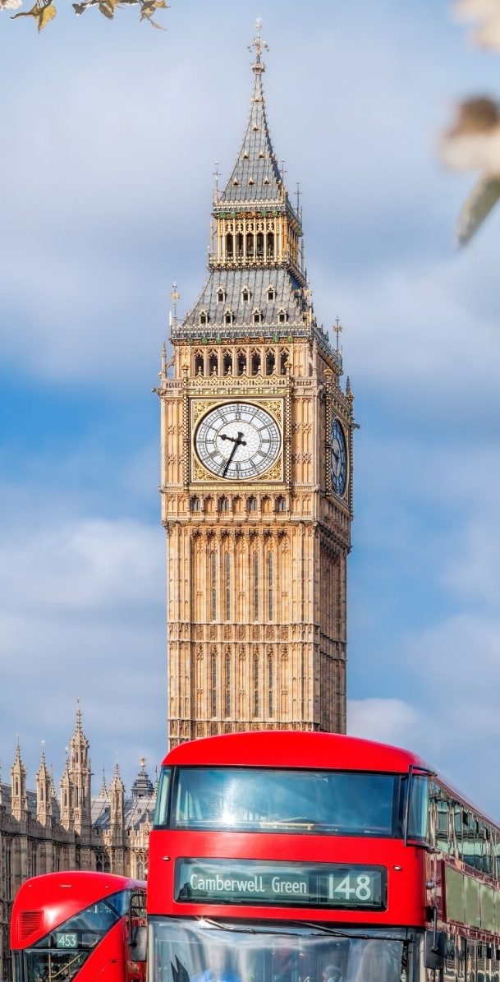
Do you know what this clock tower is called?
Web address
Title of the blog entry
Name of the blog
When the blogger posted the entry
Readers can like, comment on and share the entry.
Photos about the entry
Readers’ comments

Slide 45
This clock tower is called Big Ben. It’s a cultural symbol of the UK.
Web address
Title of the blog entry
Name of the blog
When the blogger posted the entry
Readers can like, comment on and share the entry.
Photos about the entry
Readers’ comments

Slide 46

Have you tried fish and chips before?
Web address
Title of the blog entry
Name of the blog
When the blogger posted the entry
Readers can like, comment on and share the entry.
Photos about the entry
Readers’ comments

Slide 47
It’s one of the most famous English dishes.
Web address
Title of the blog entry
Tartare sauce
Fried fish
Name of the blog
When the blogger posted the entry
Readers can like, comment on and share the entry.
Photos about the entry
Potato chips (French fries)
Lemon wedge
Readers’ comments

Slide 48
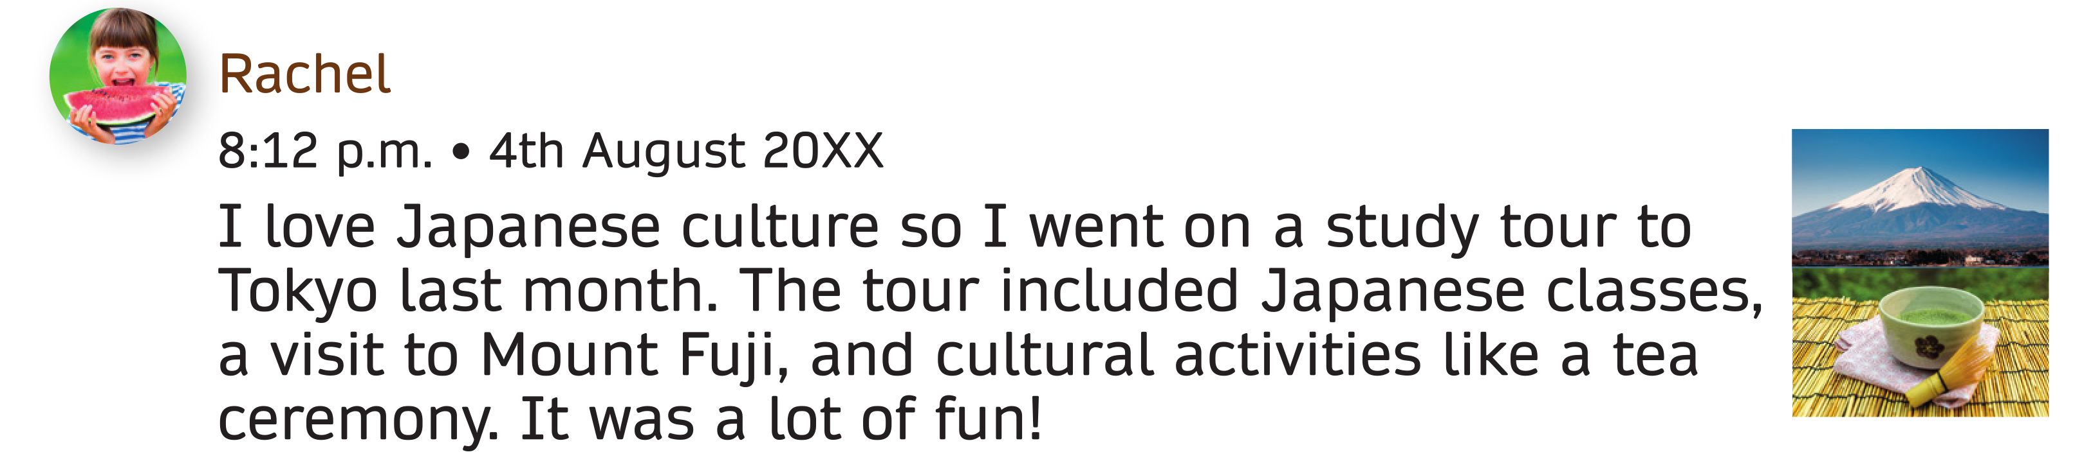
What is the name of this reader?
Web address
Title of the blog entry
Name of the blog
When the blogger posted the entry
Readers can like, comment on and share the entry.
Photos about the entry
Readers’ comments

Slide 49
When did she post the comment?
Web address
Title of the blog entry
Name of the blog
When the blogger posted the entry
Readers can like, comment on and share the entry.
Photos about the entry
Readers’ comments

Slide 50
Where did Rachel go for her study tour?
Web address
Title of the blog entry
Name of the blog
When the blogger posted the entry
Readers can like, comment on and share the entry.
Photos about the entry
Readers’ comments

Slide 51
Tokyo is the capital and largest city of Japan.
People in Japan speak Japanese.
Web address
Title of the blog entry
Name of the blog
When the blogger posted the entry
Readers can like, comment on and share the entry.
Photos about the entry
Readers’ comments

Slide 52
What did Rachel do in Tokyo?
Web address
Title of the blog entry
Name of the blog
When the blogger posted the entry
Readers can like, comment on and share the entry.
Photos about the entry
Readers’ comments

Slide 53
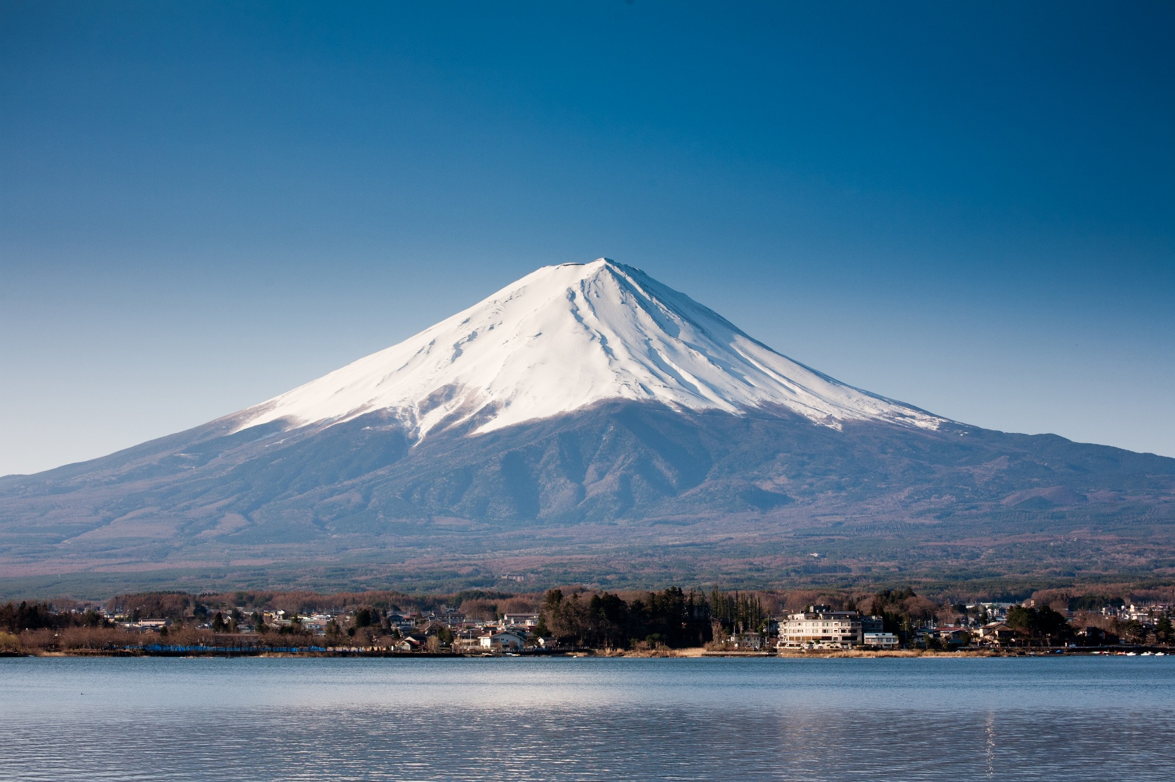
Do you know the name of this mountain?
Web address
Title of the blog entry
Name of the blog
When the blogger posted the entry
Readers can like, comment on and share the entry.
Photos about the entry
Readers’ comments

Slide 54
This is Mount Fuji. It is the highest mountain in Japan.
It is also an important cultural icon of Japan.
Web address
Title of the blog entry
Name of the blog
When the blogger posted the entry
Readers can like, comment on and share the entry.
Photos about the entry
Readers’ comments

Slide 55
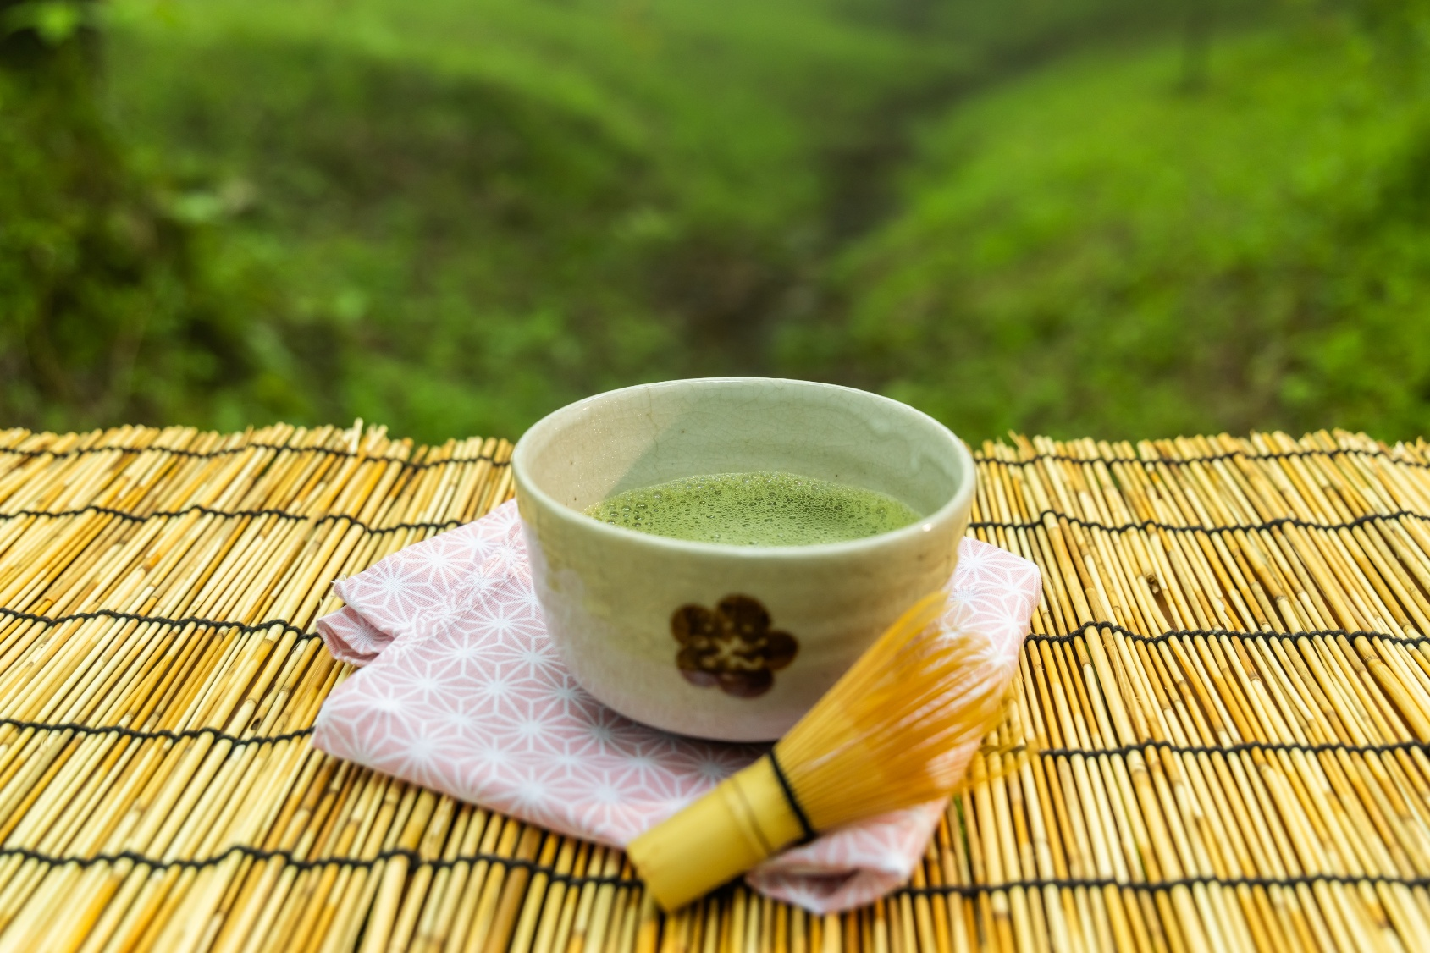
The Japanese tea ceremony is a special way of making and drinking matcha (powdered green tea).
Web address
Title of the blog entry
Name of the blog
When the blogger posted the entry
Readers can like, comment on and share the entry.
Photos about the entry
Readers’ comments

Slide 56
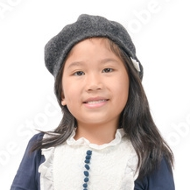
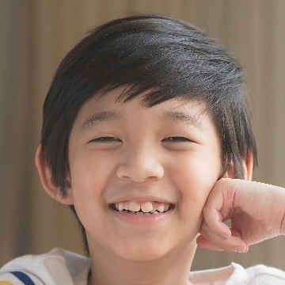
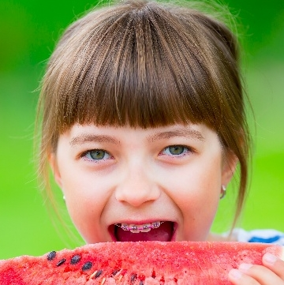
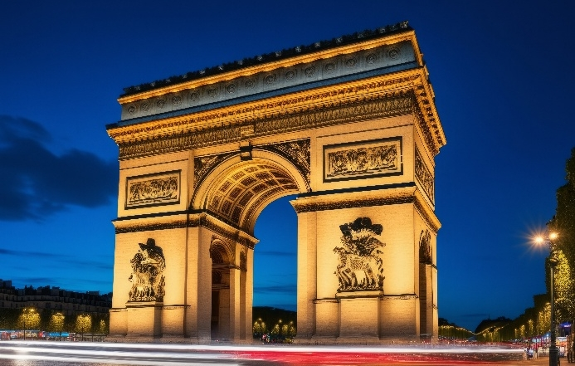
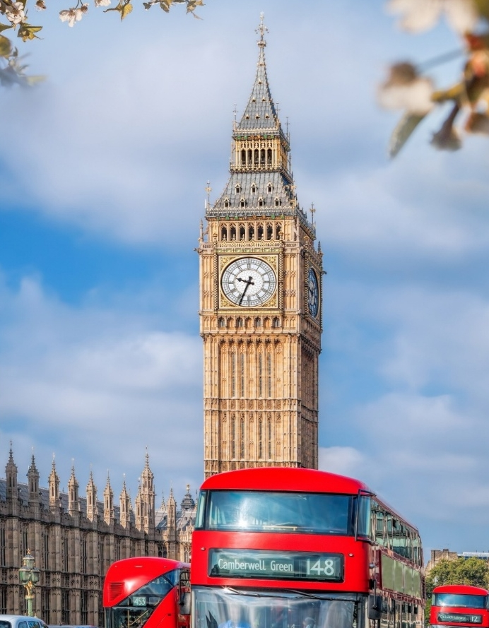
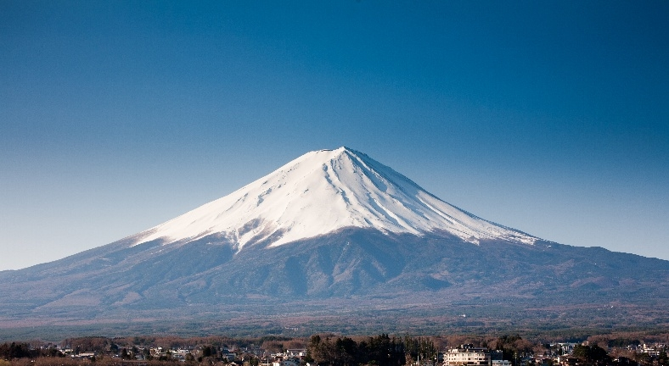
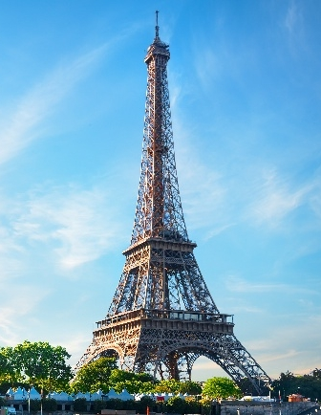
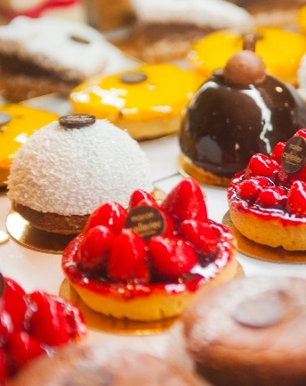
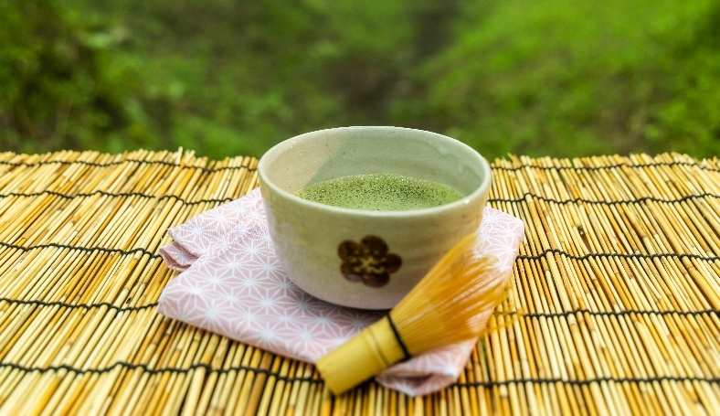
Do you find Clara’s, Joseph’s and Rachel’s study tours fun or interesting? Which tour is your favourite?

Slide 57
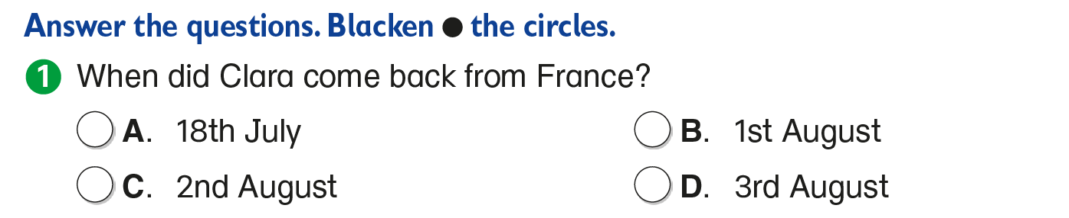


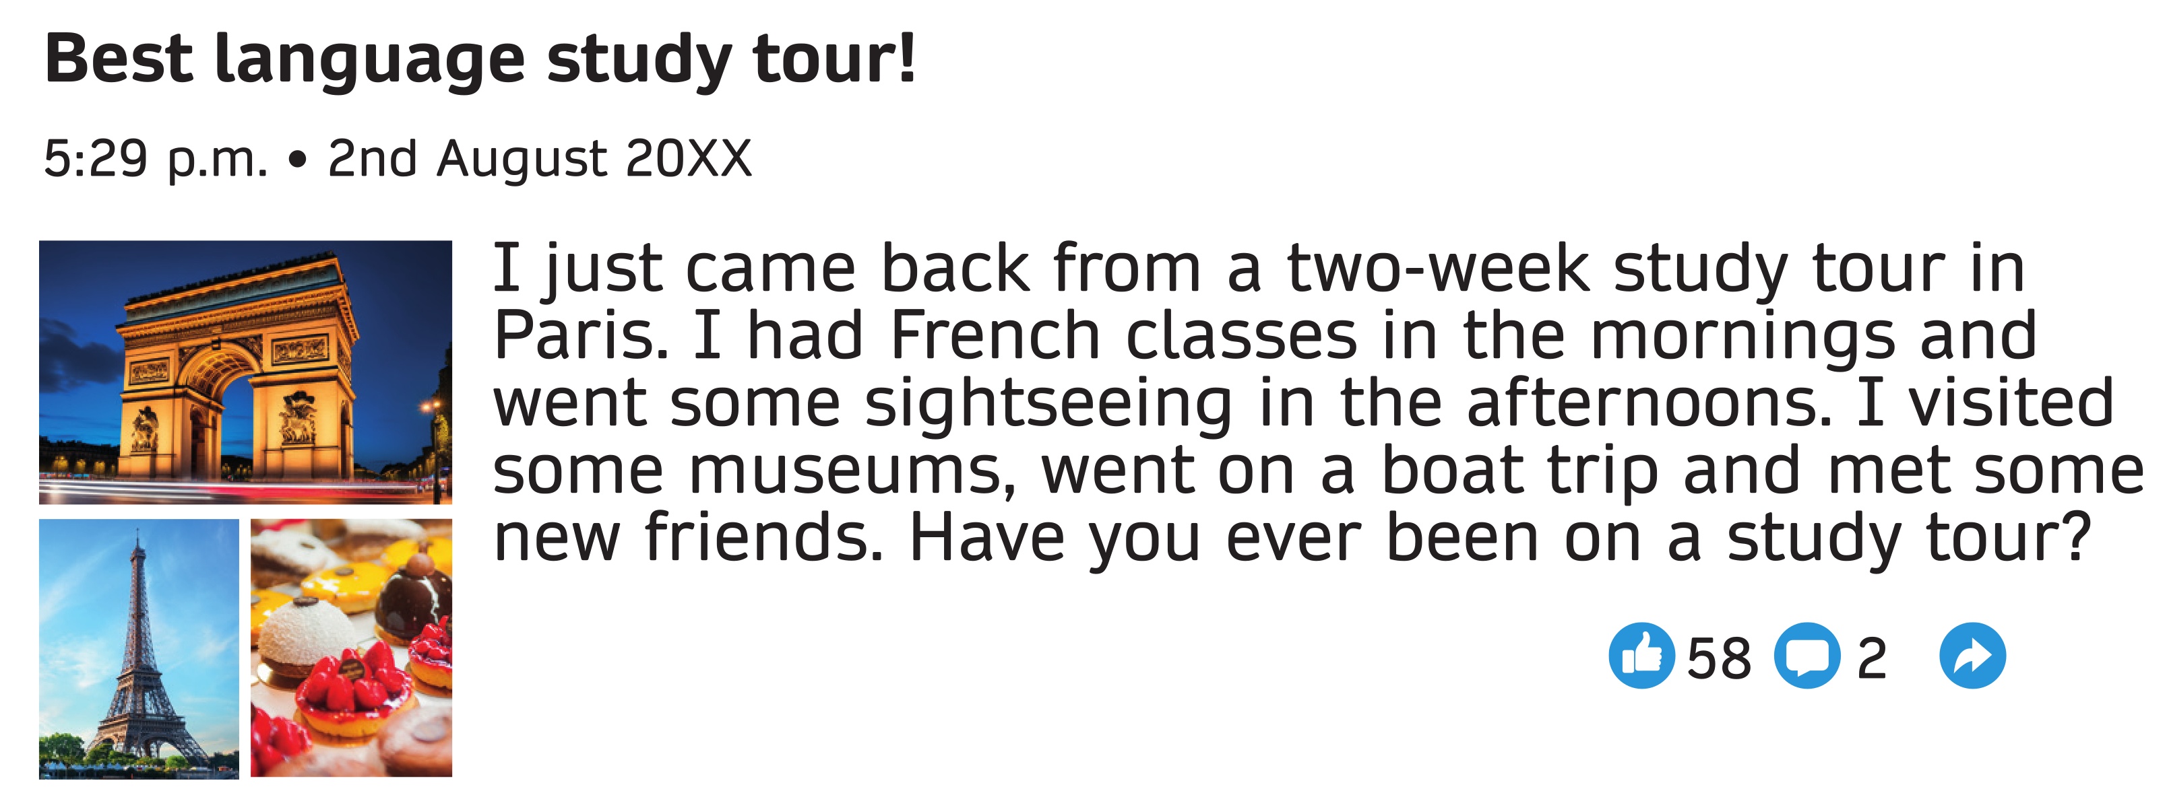
Now, let’s answer some questions.
Clara posted the blog entry a short time after she came back from France.

Slide 58
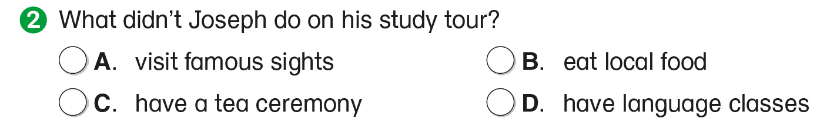



Now, let’s answer some questions.

Slide 59
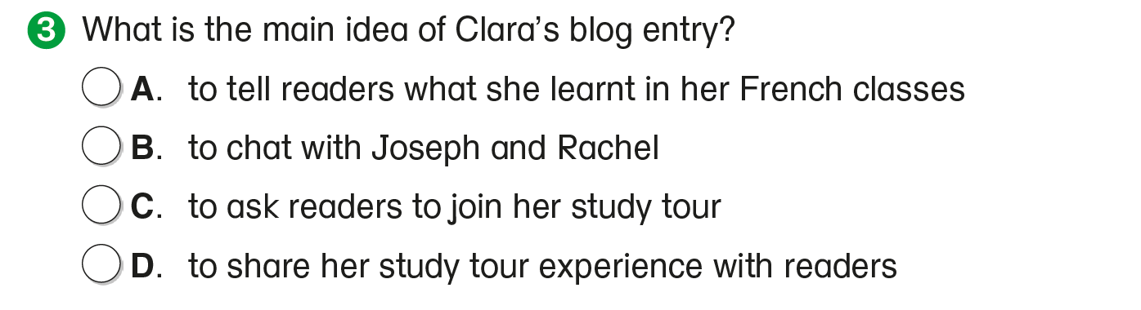
Now, let’s answer some questions.
In the blog entry, Clara talks about what she did during the study tour.

Slide 61
Acknowledgements
We would like to thank the following organisations and people for permission to use their images and videos:
10 FACE / Shutterstock
Anurak Pongpatimet / Shutterstock
elysart / Shutterstock
Givaga / stock.adobe.com
kwanchaichaiudom / stock.adobe.com
makrushka / Shutterstock
Marian Weyo / Shutterstock
Maxger / Shutterstock
moonart (AI) / stock.adobe.com
norikko / stock.adobe.com
pominova / stock.adobe.com
Ruslan Bond / stock.adobe.com
solomon7 / Shutterstock
Studio_G / Shutterstock
Tomas Marek / stock.adobe.com
topntp / stock.adobe.com

