Slide 1
Why are giant pandas a symbol of China?

Slide 2




Leaves are different in shape and size.
How else are they different?
READING
NOW I KNOW
LET’S THINK
LET’S DO THIS

Slide 3
Leaves are different in shape and size.
How else are they different?
READING
NOW I KNOW
LET’S THINK
LET’S DO THIS

Slide 4
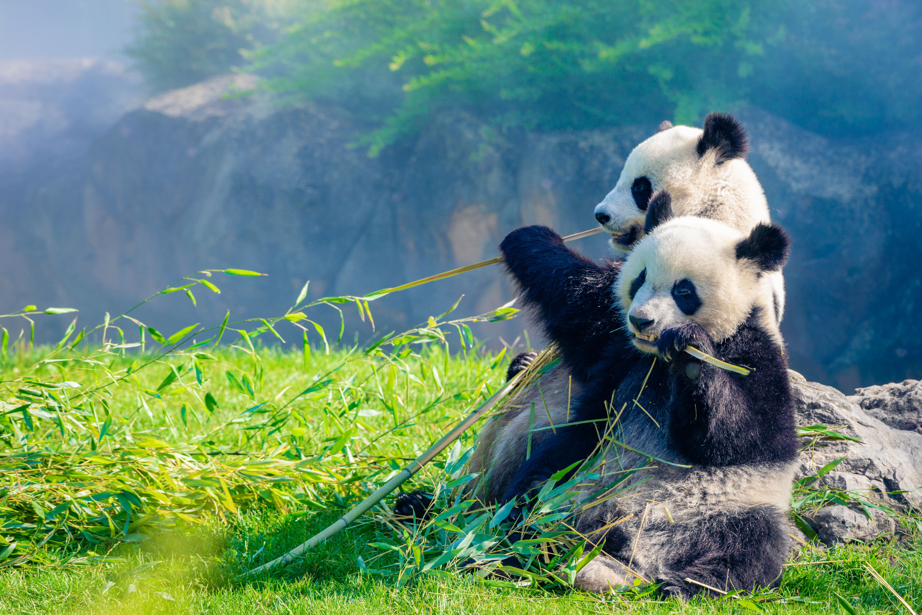
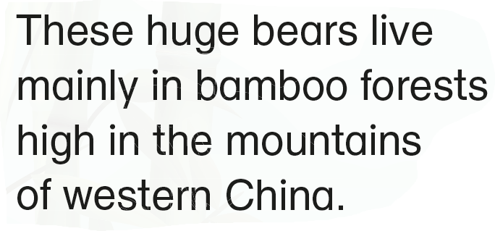
Leaves are different in shape and size.
How else are they different?
READING
NOW I KNOW
LET’S THINK
LET’S DO THIS

Slide 5
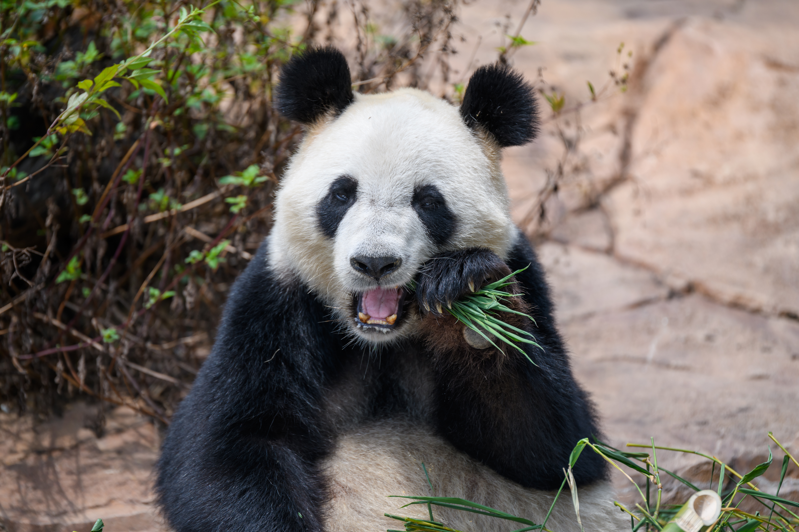
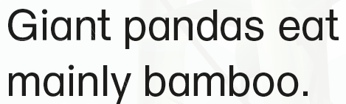
READING
NOW I KNOW
LET’S THINK
LET’S DO THIS

Slide 6
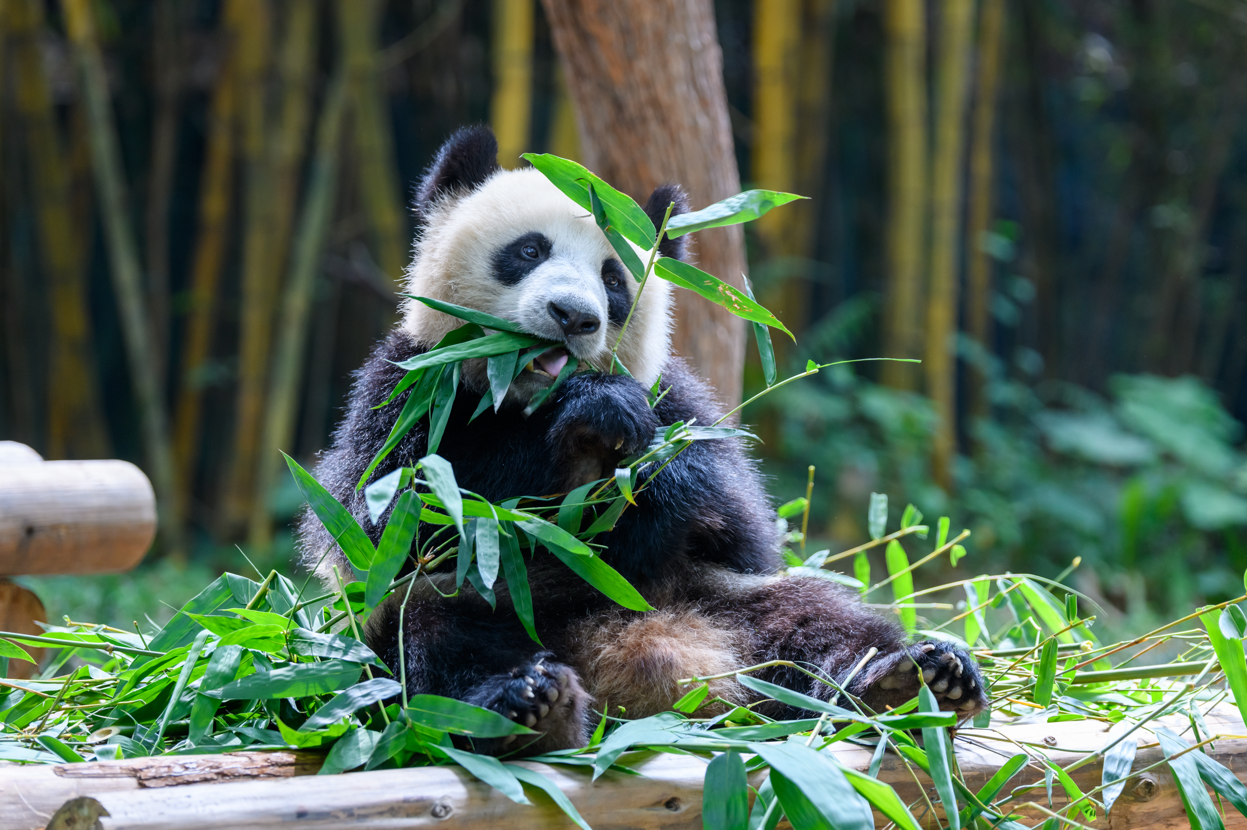
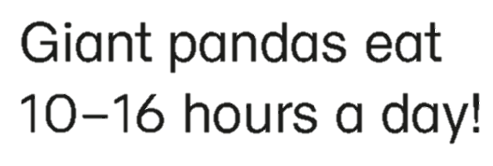
READING
NOW I KNOW
LET’S THINK
LET’S DO THIS

Slide 7
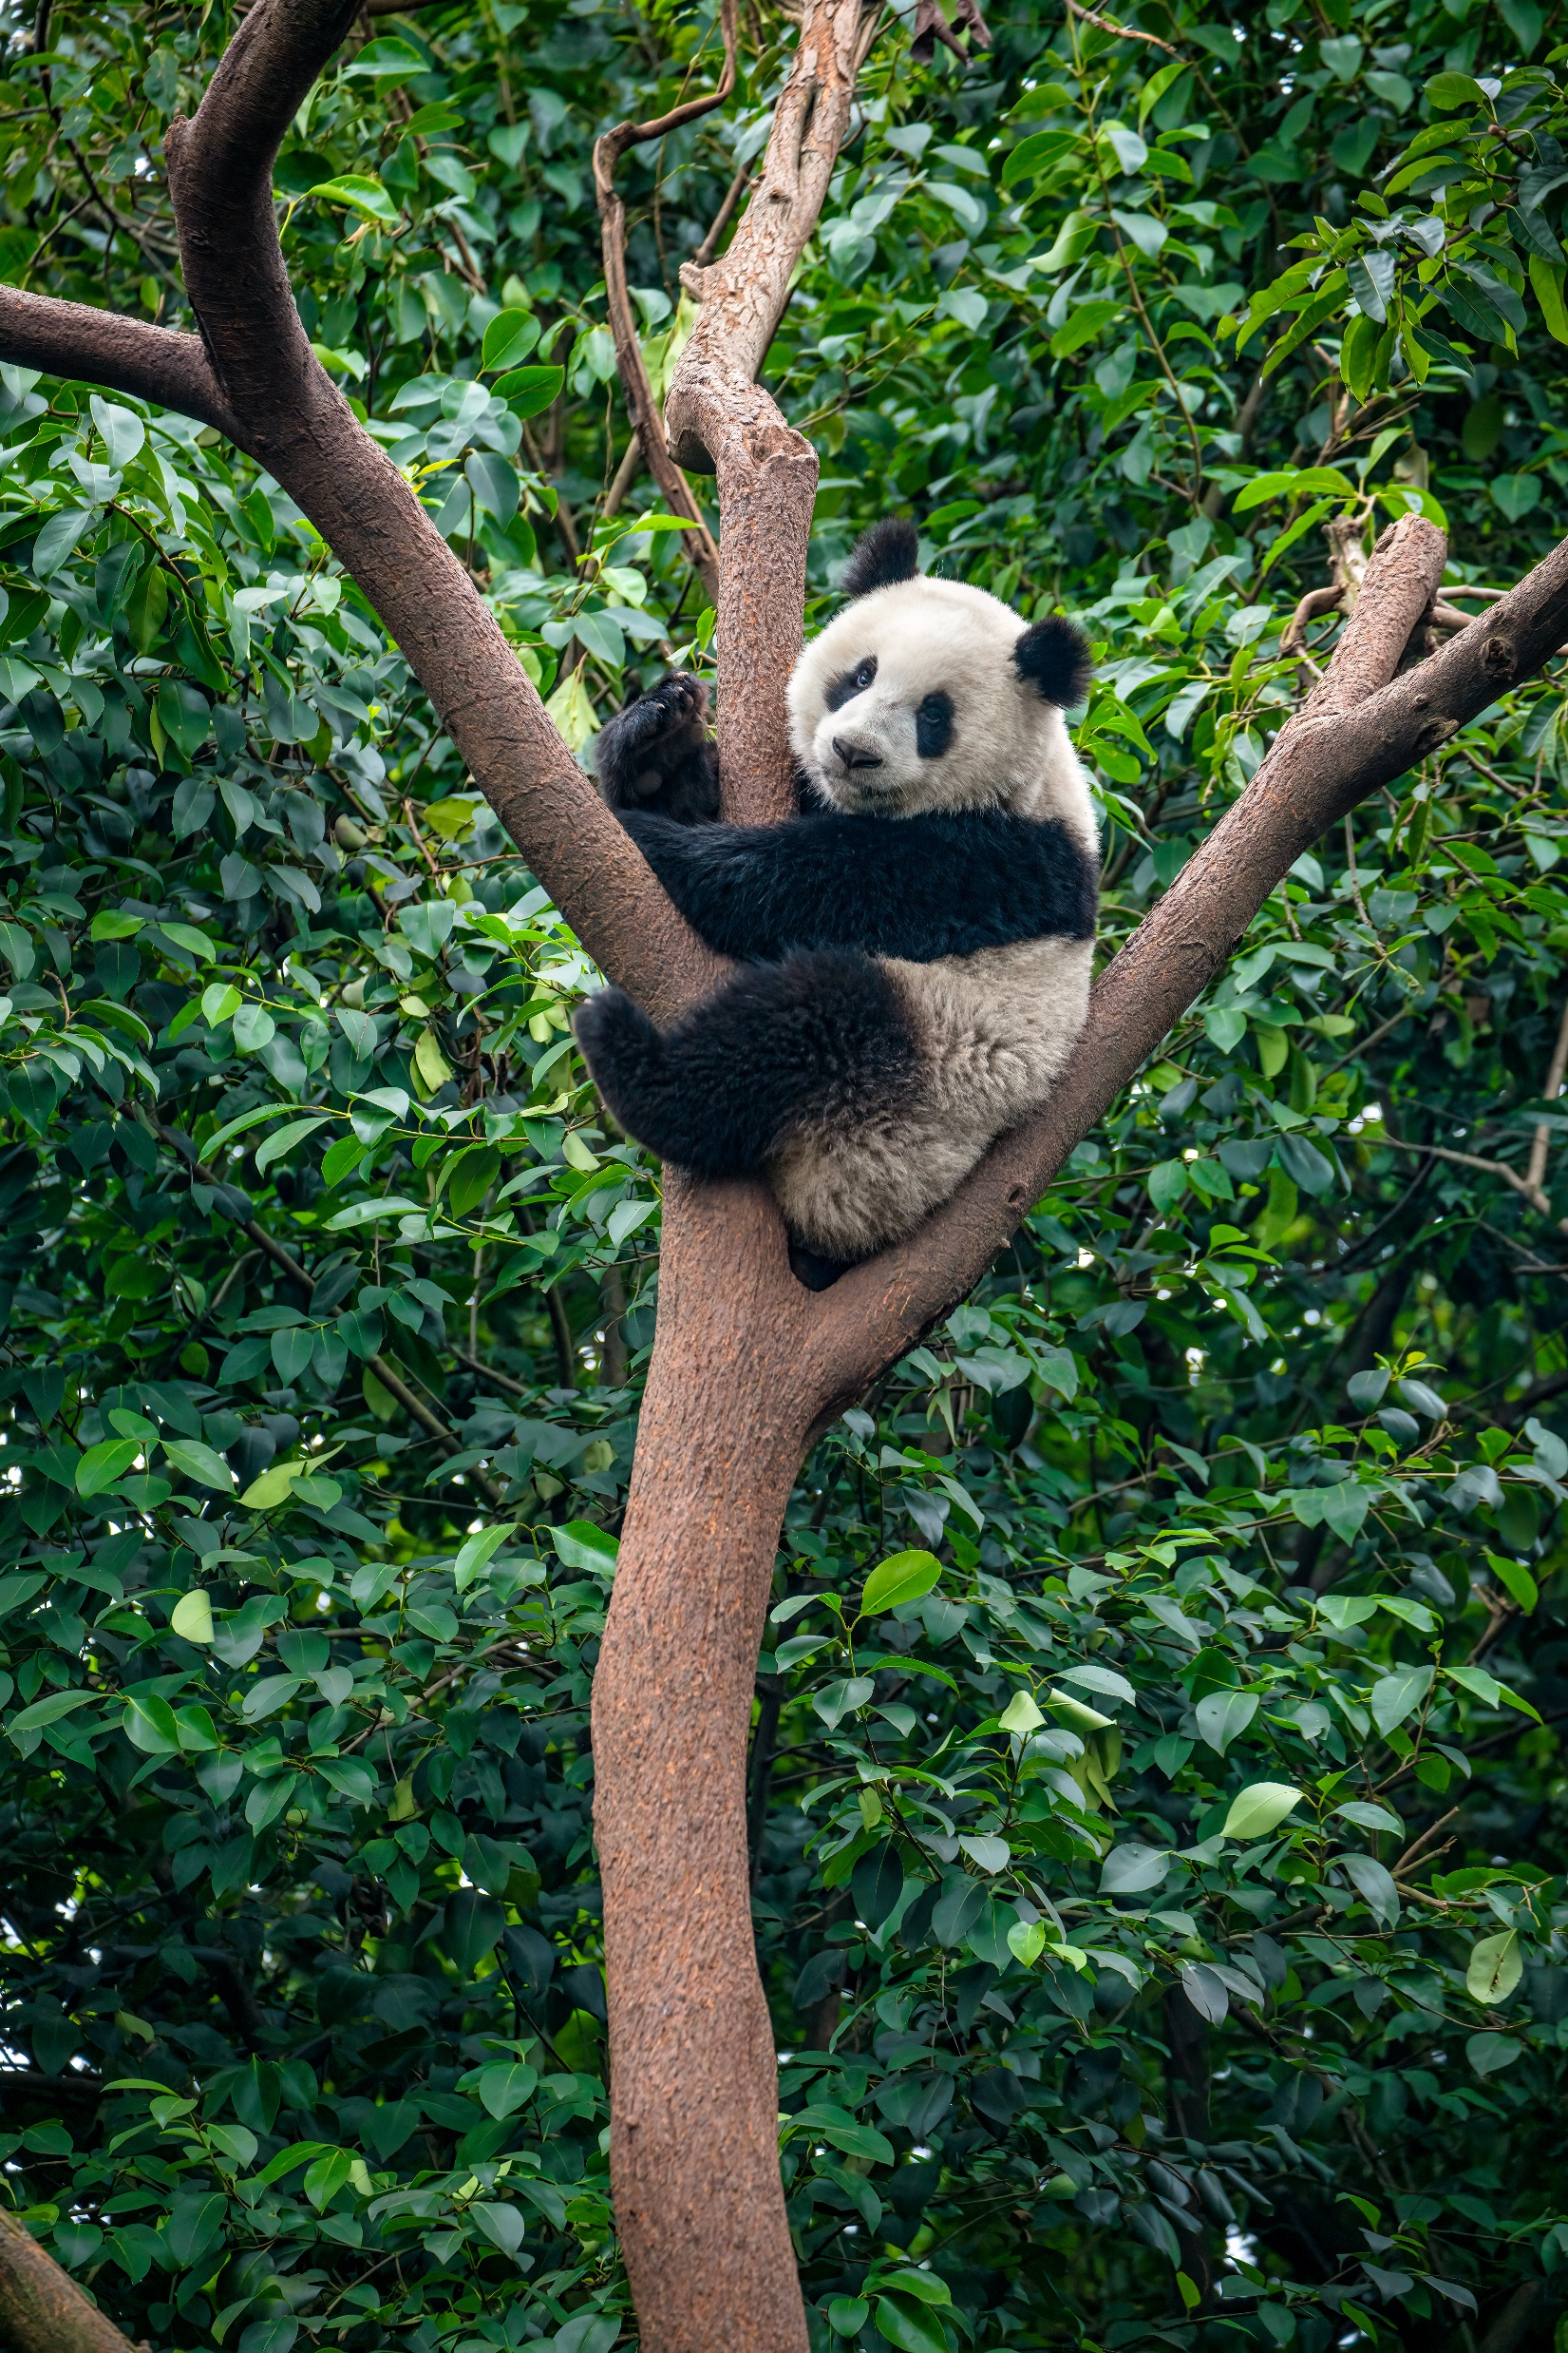
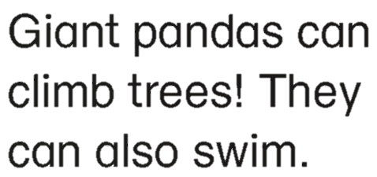
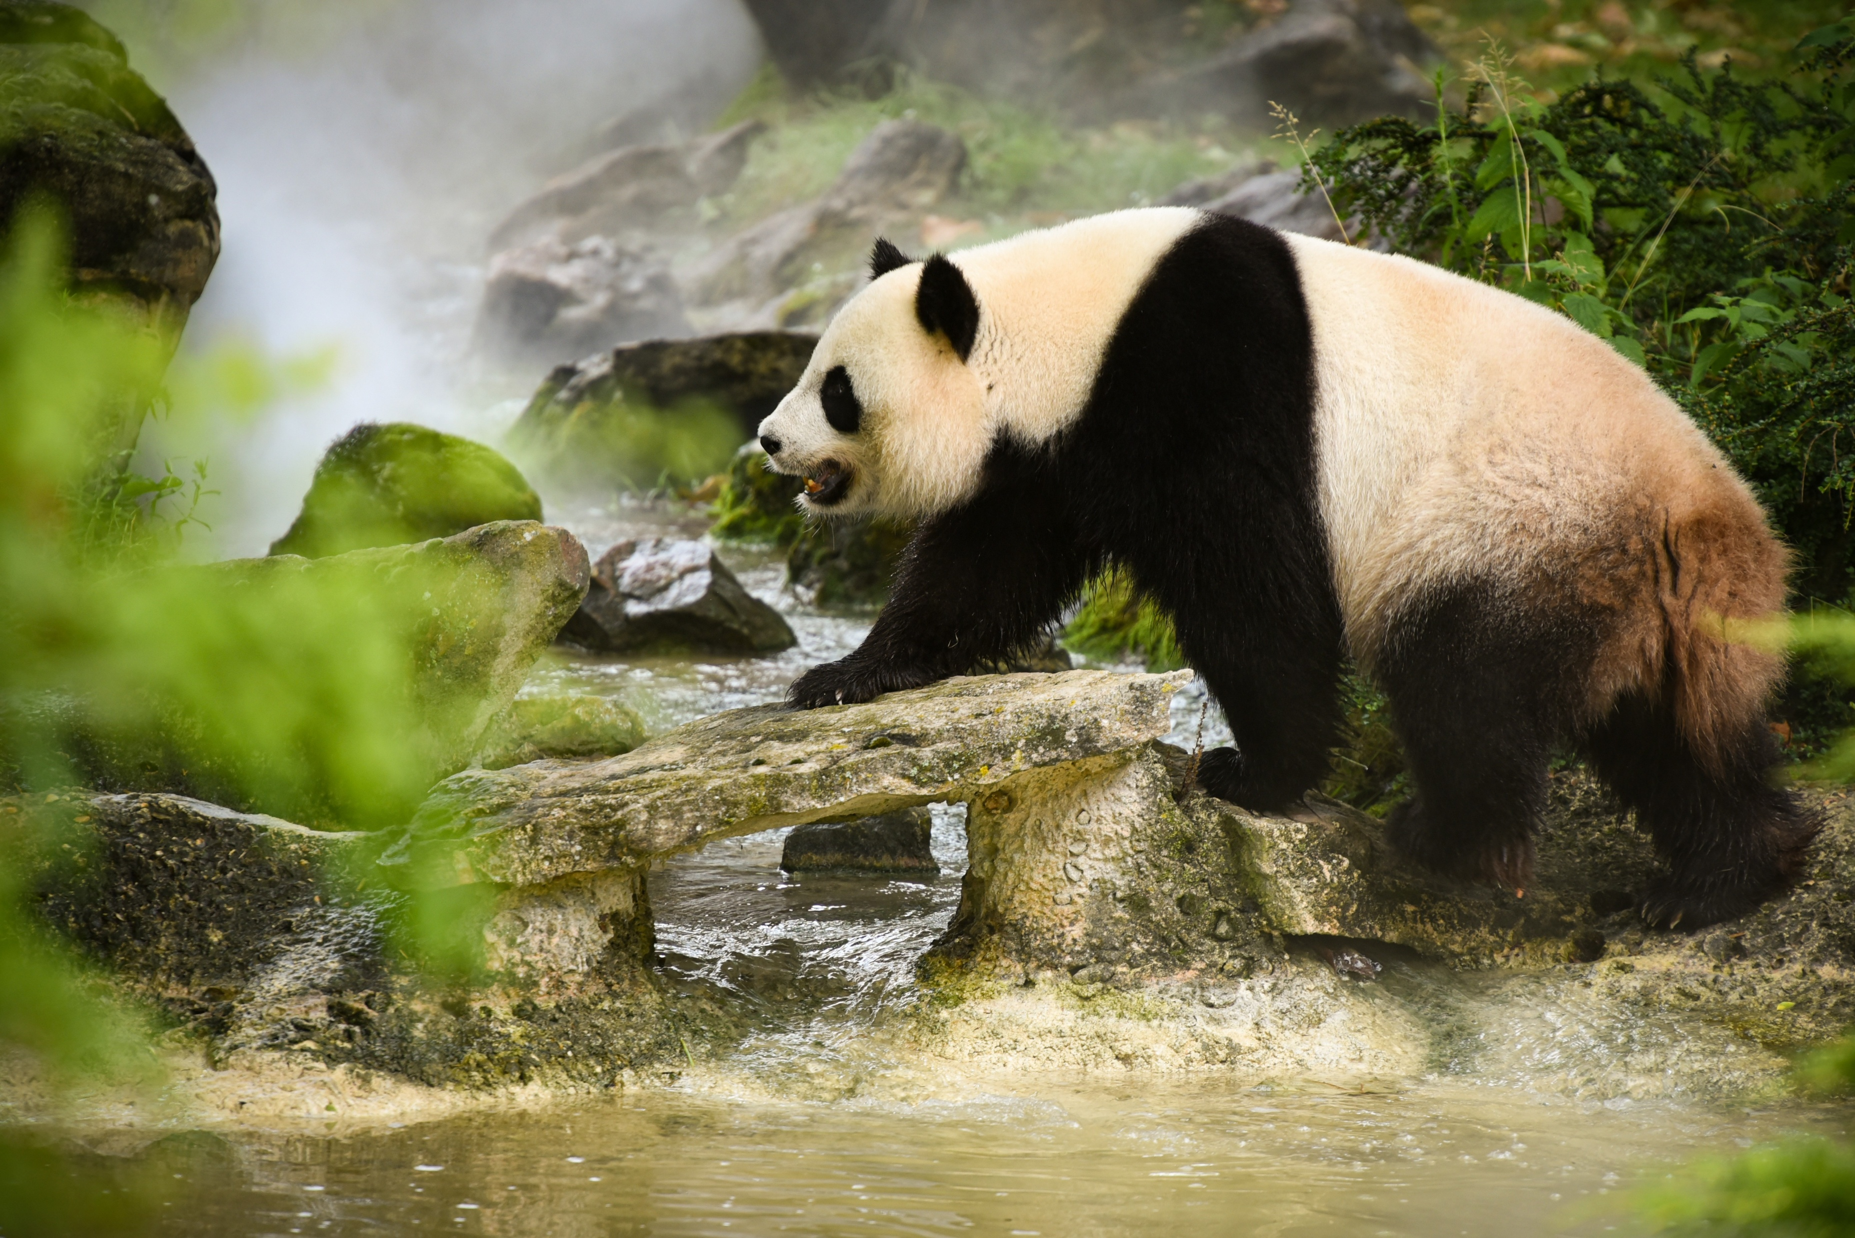
READING
NOW I KNOW
LET’S THINK
LET’S DO THIS

Slide 8
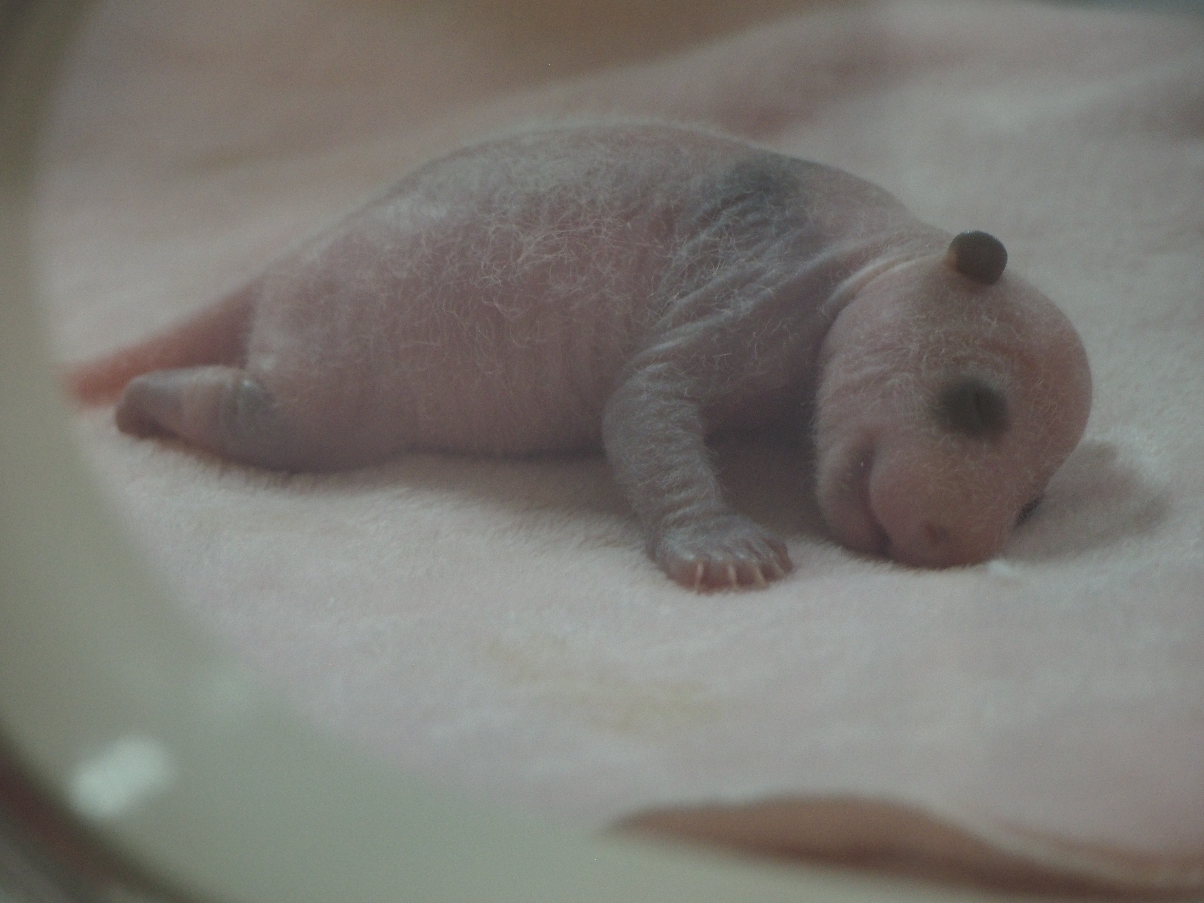
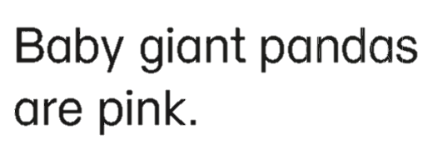
READING
NOW I KNOW
LET’S THINK
LET’S DO THIS

Slide 9
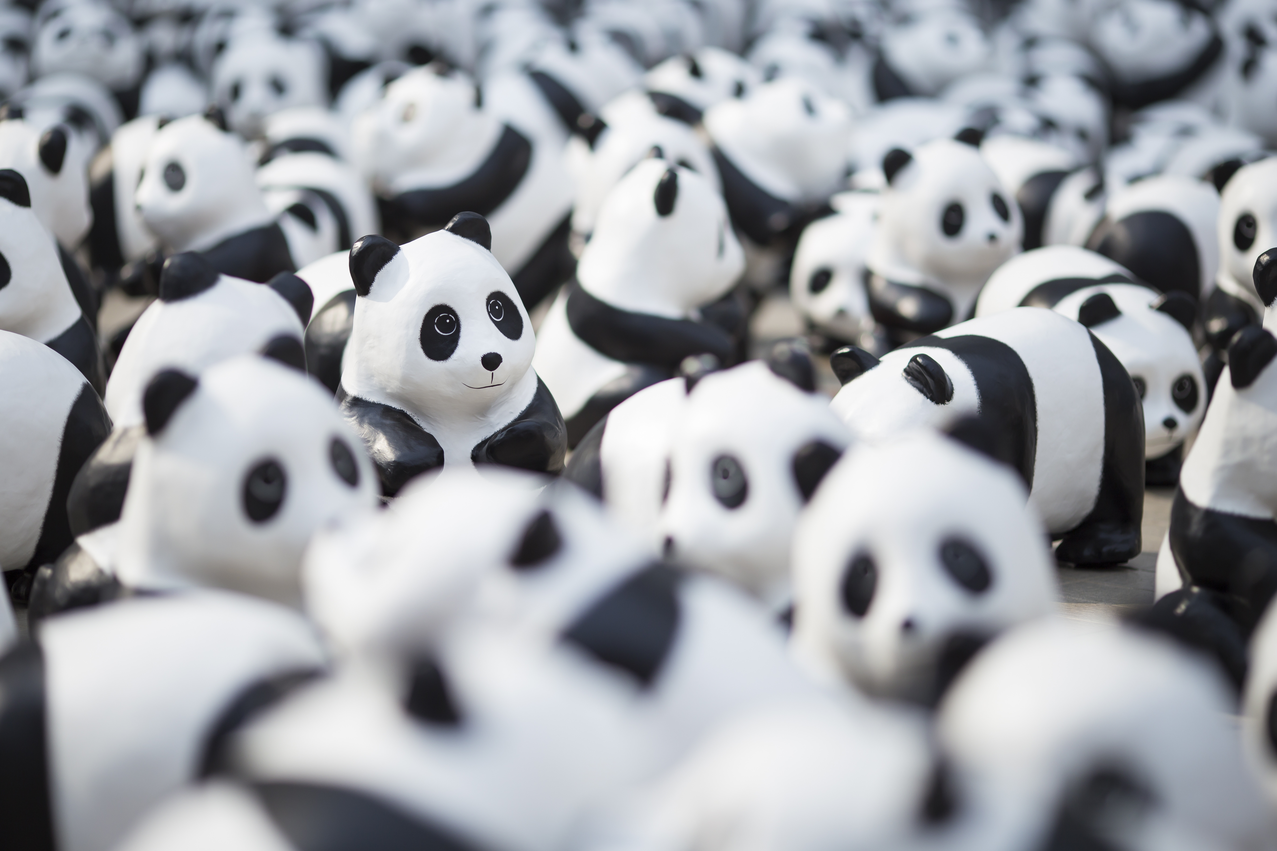

READING
NOW I KNOW
LET’S THINK
LET’S DO THIS

Slide 10
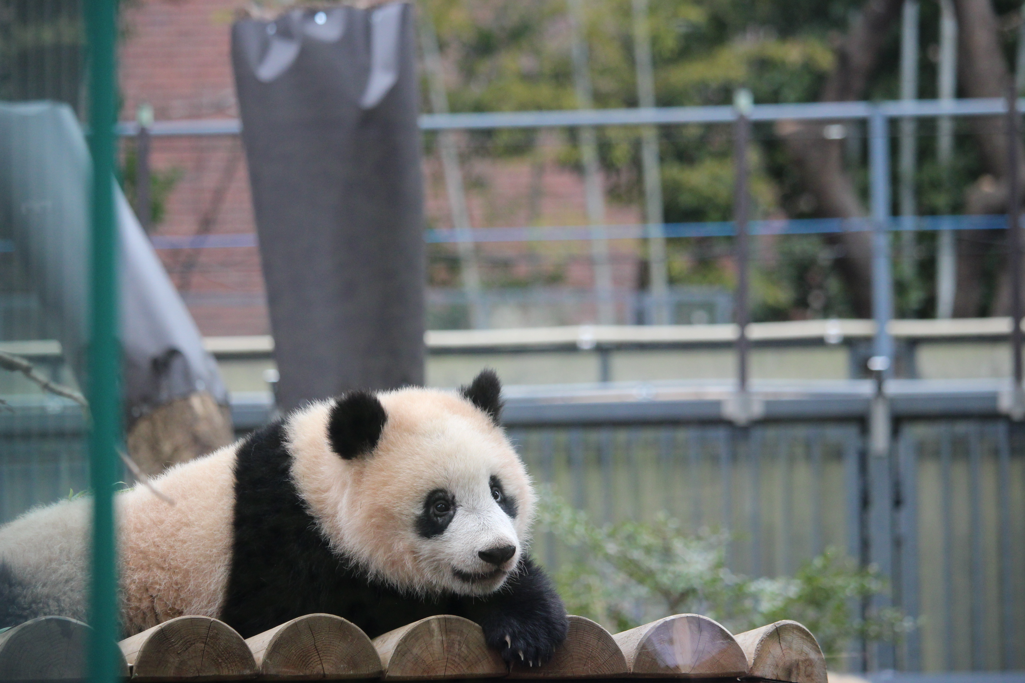
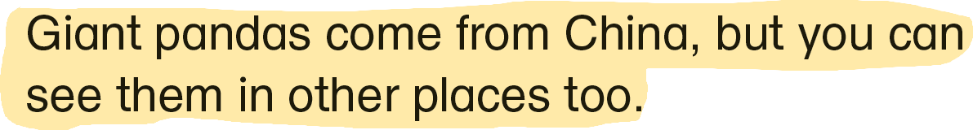
READING
NOW I KNOW
LET’S THINK
LET’S DO THIS

Slide 11
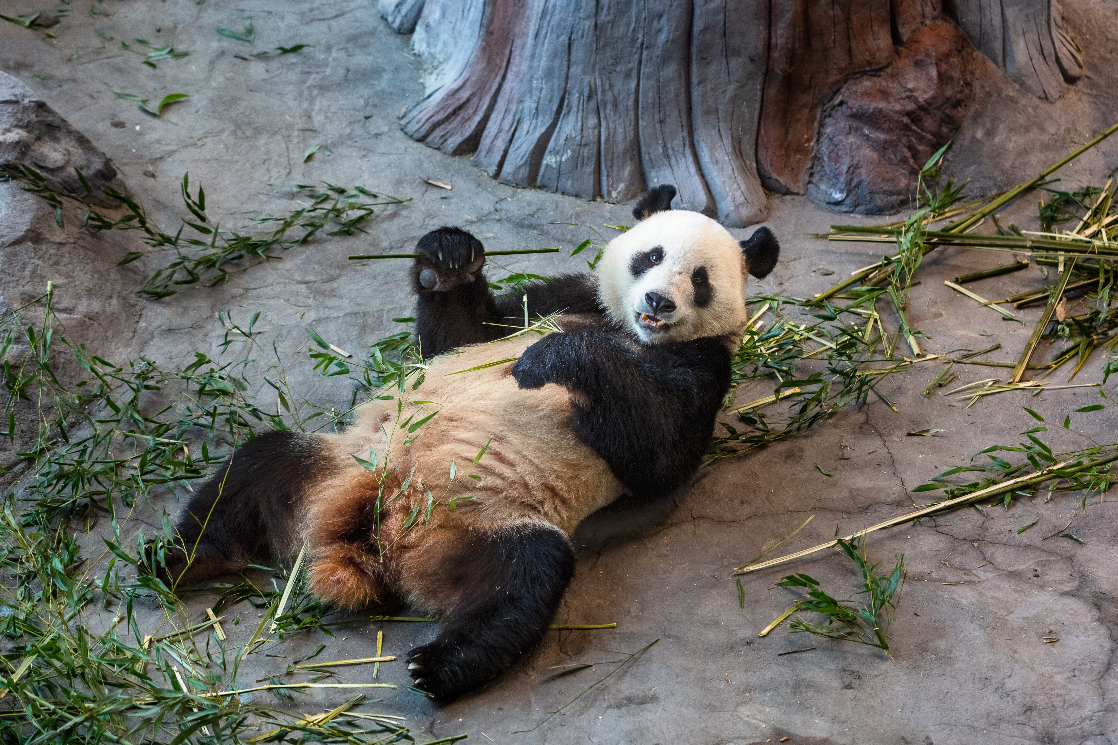
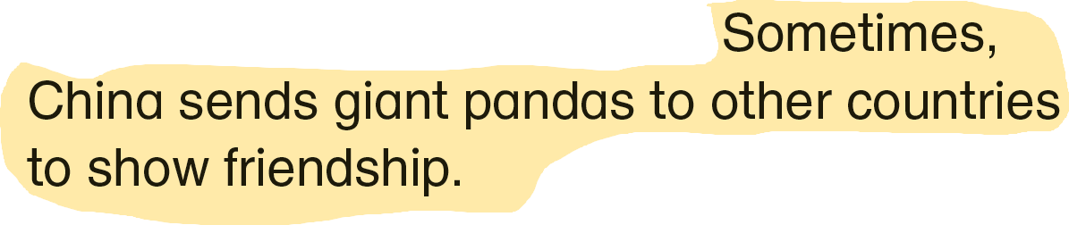
READING
NOW I KNOW
LET’S THINK
LET’S DO THIS

Slide 12
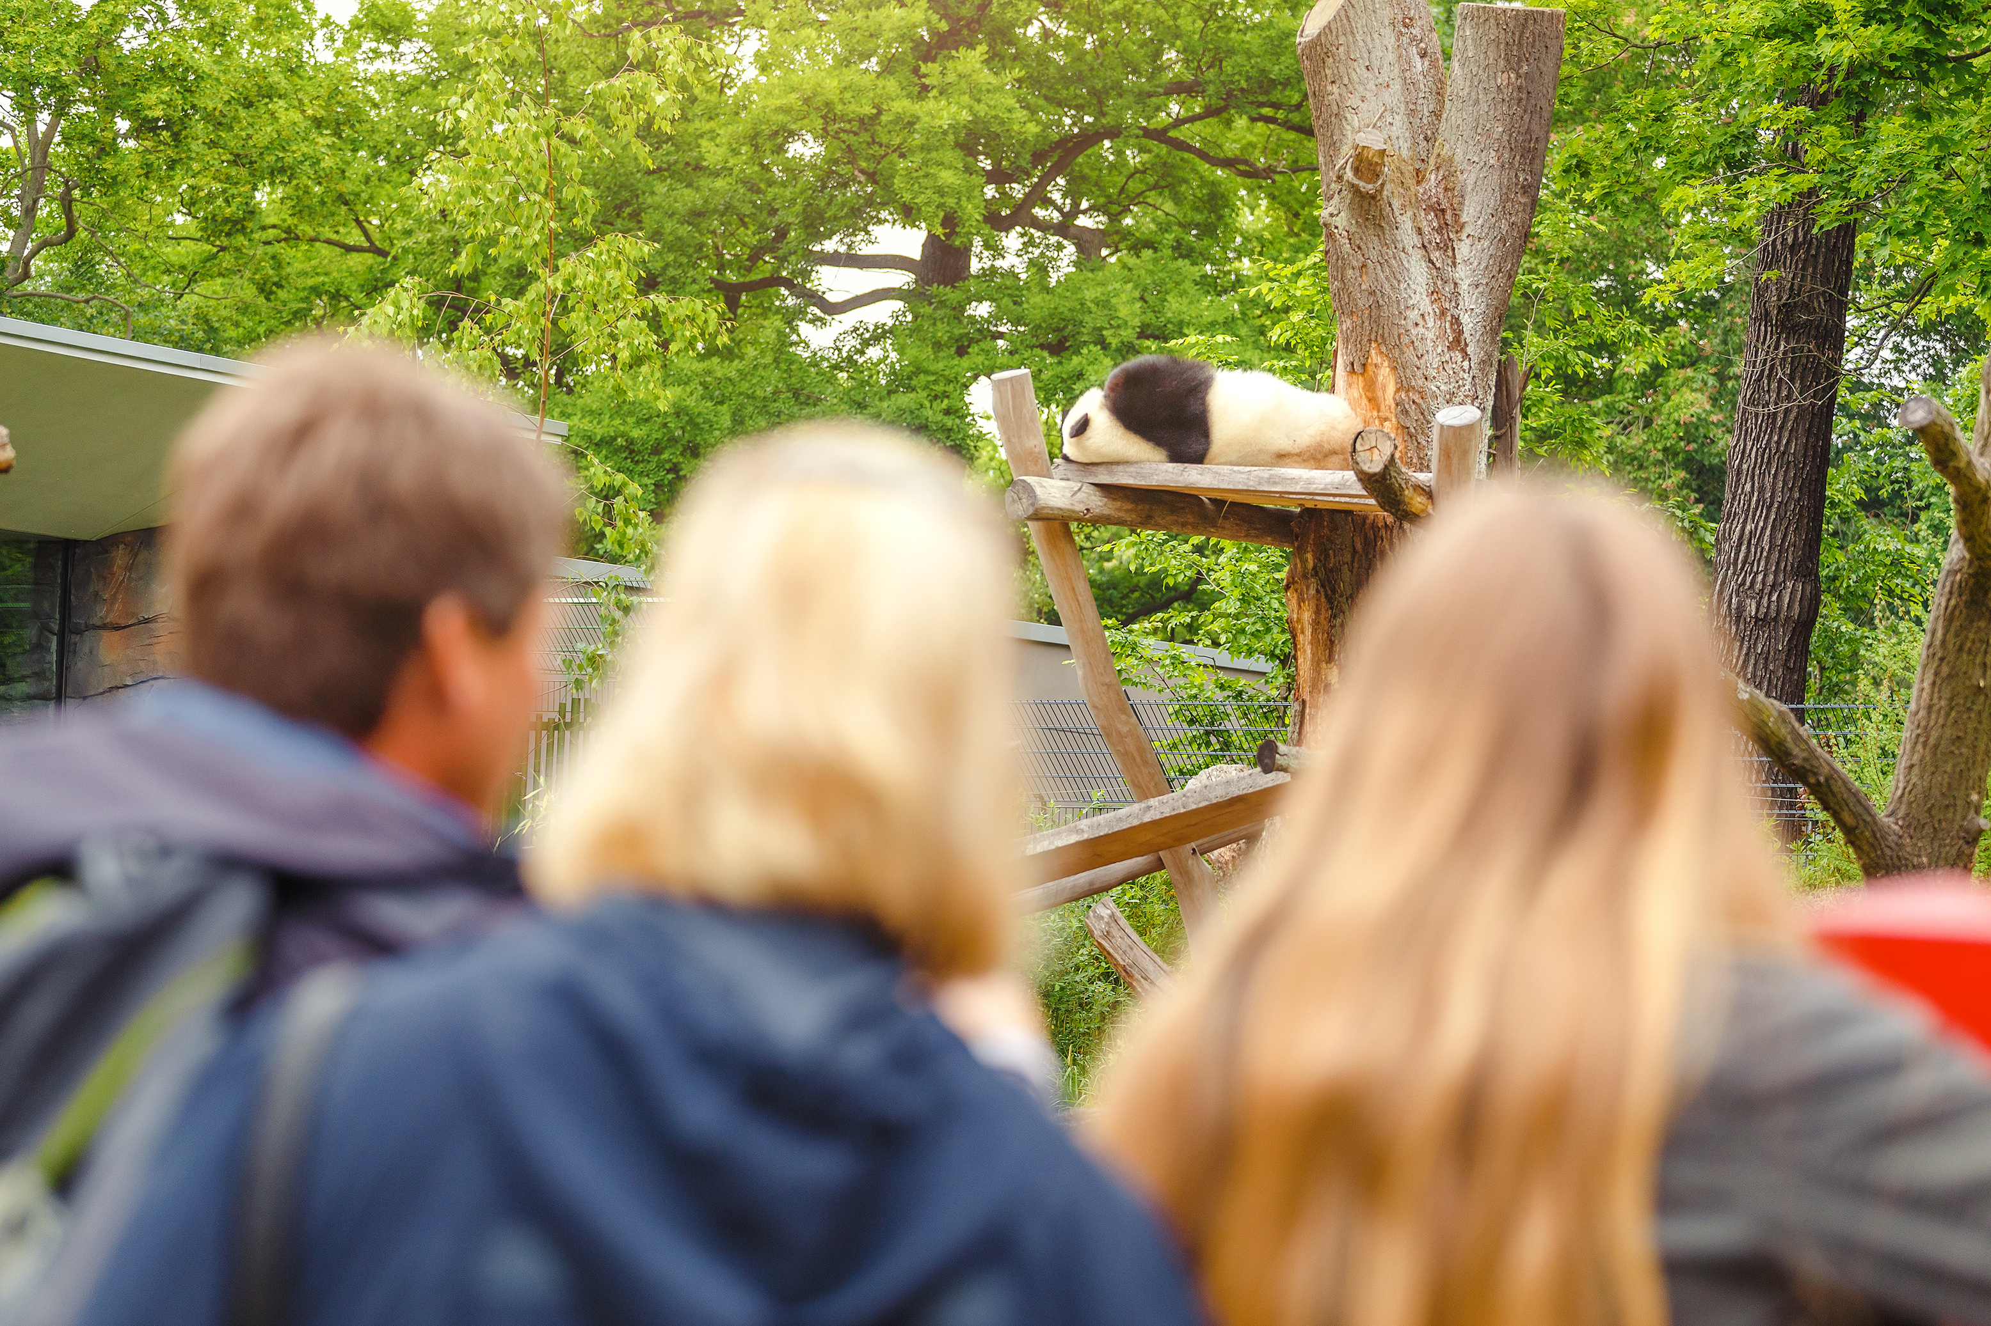
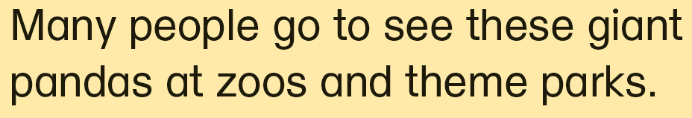
READING
NOW I KNOW
LET’S THINK
LET’S DO THIS

Slide 13

READING
NOW I KNOW
LET’S THINK
LET’S DO THIS

Slide 14
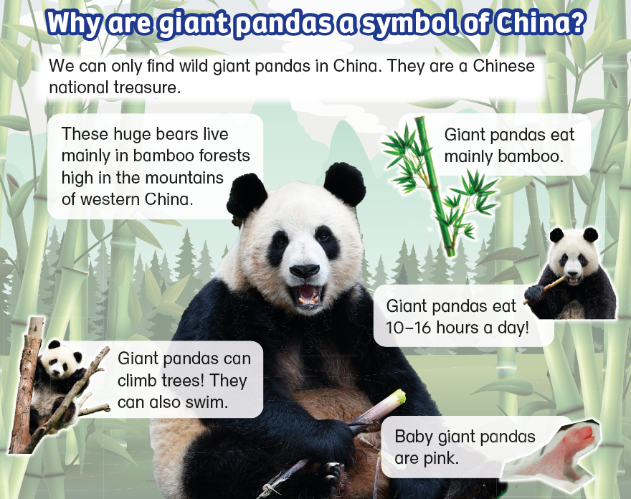
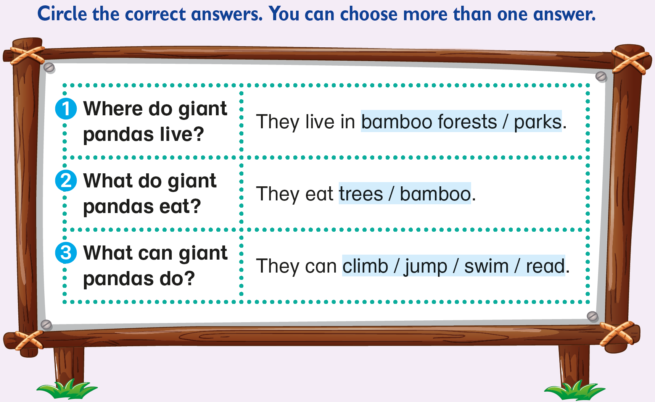


READING
NOW I KNOW
LET’S THINK
LET’S DO THIS

Slide 15
READING
NOW I KNOW
LET’S THINK
LET’S DO THIS

Slide 16
READING
NOW I KNOW
LET’S THINK
LET’S DO THIS

Slide 17

5 Try using different leaves.
READING
NOW I KNOW
LET’S THINK
LET’S DO THIS

Slide 18


Leaves are different in shape and size.
How else are they different?
READING
NOW I KNOW
LET’S THINK
LET’S DO THIS

Slide 19




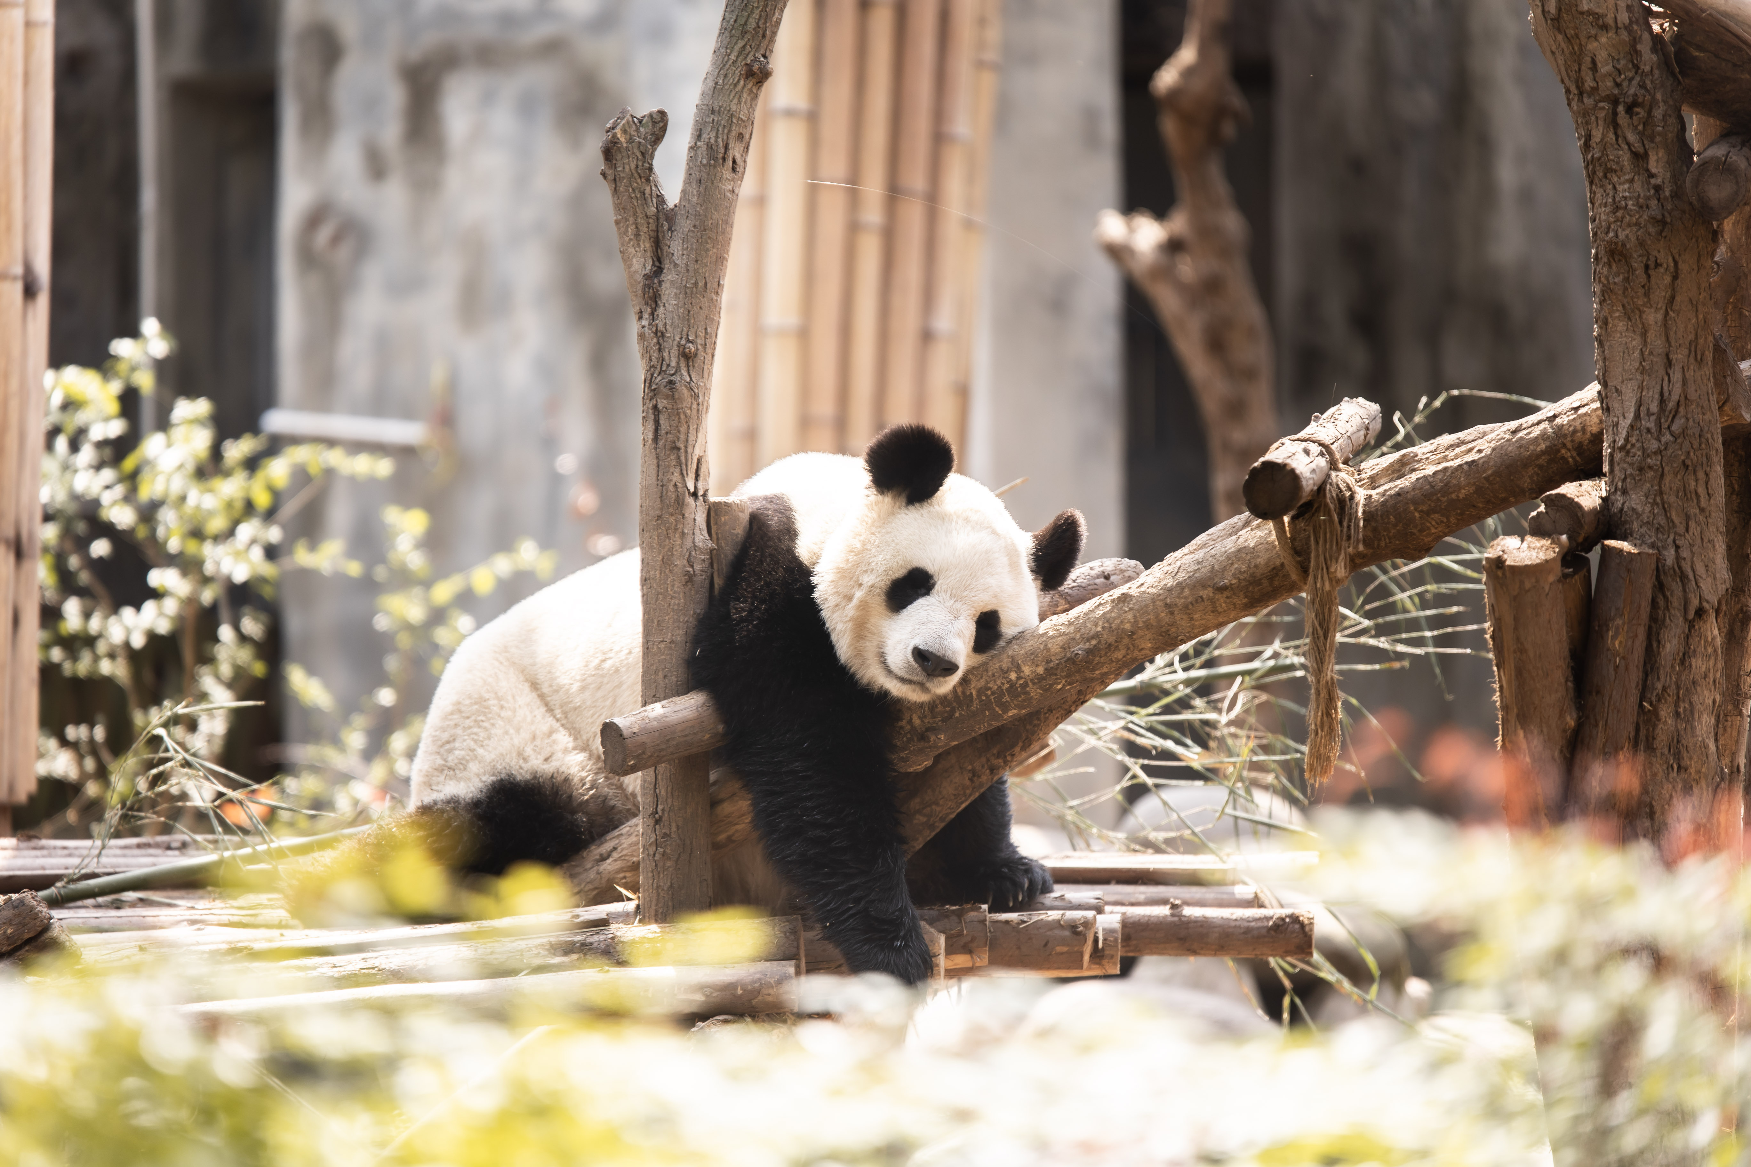
Panda stories
Panda art
5 Try using different leaves.
Panda posters
Panda dress-up day
Visit pandas
READING
NOW I KNOW
LET’S THINK
LET’S DO THIS

Slide 20

READING
NOW I KNOW
LET’S THINK
LET’S DO THIS

Slide 21
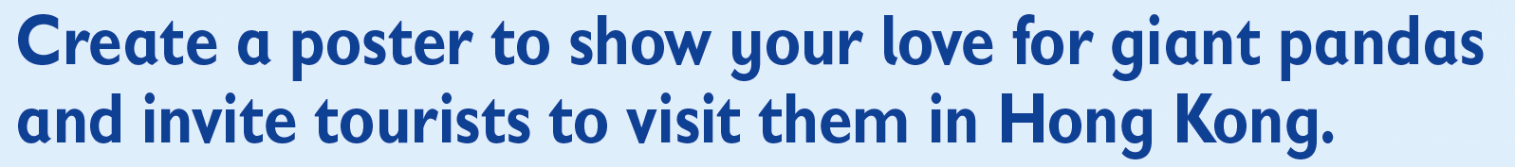
READING
NOW I KNOW
LET’S THINK
LET’S DO THIS

Slide 22
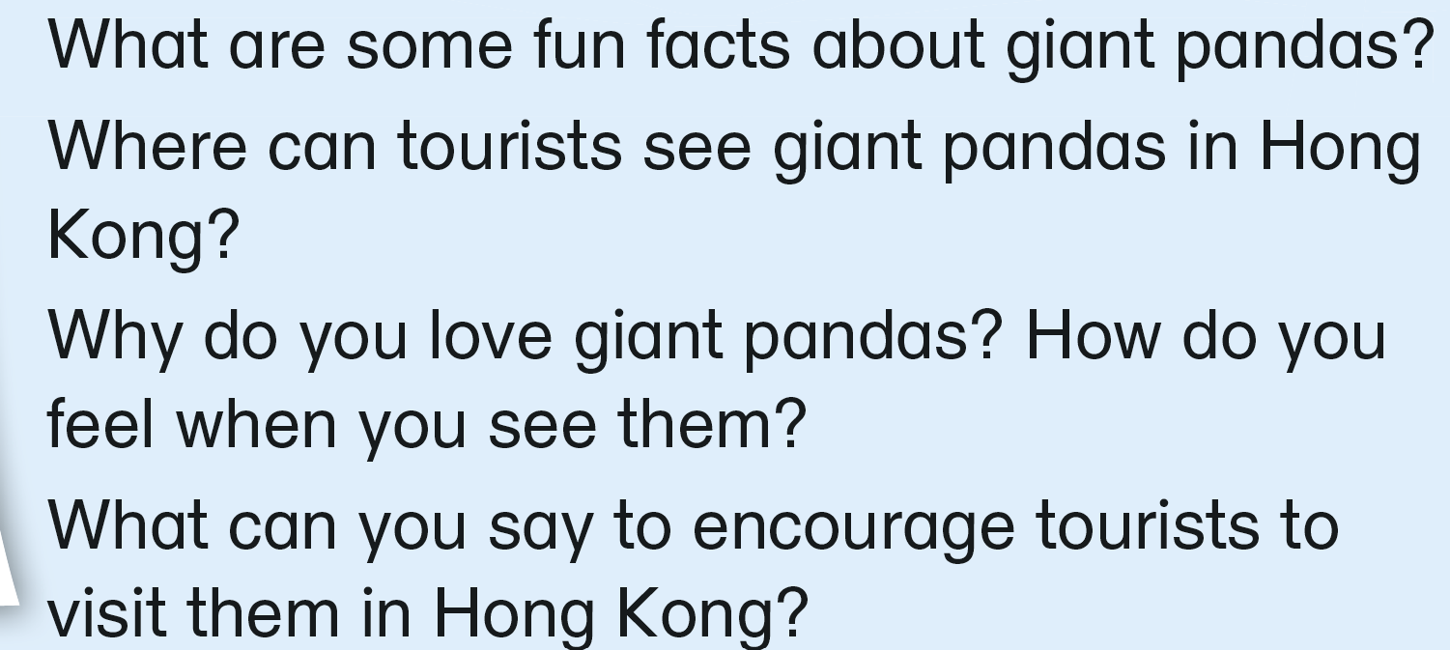

Let’s think about what we can write on the poster!
Pandas have black and white fur.
What do pandas look like?
What do they eat?
What do they do all day?
Choose 1 or 2 questions to answer.
READING
NOW I KNOW
LET’S THINK
LET’S DO THIS

Slide 23
Let’s think about what we can write on the poster!
Pandas have black and white fur.
Is there a special place or park where they live?
People can see pandas at Ocean Park.
READING
NOW I KNOW
LET’S THINK
LET’S DO THIS

Slide 24
Let’s think about what we can write on the poster!
Use the adjectives you learnt to talk about:
The reason why you like that animal, e.g. cute, lovely
Your feelings when you see an animal that you like, e.g. happy, excited
Pandas have black and white fur.
People can see pandas at Ocean Park.
Pandas are cute.
I am happy to see them.
READING
NOW I KNOW
LET’S THINK
LET’S DO THIS

Slide 25
Let’s think about what we can write on the poster!
Pandas have black and white fur.
Imagine you are talking to someone who has never seen a giant panda. What would you say to make them want to visit Hong Kong to see the pandas?
People can see pandas at Ocean Park.
Pandas are cute.
I am happy to see them.
Come visit them!
They are a symbol of China.
READING
NOW I KNOW
LET’S THINK
LET’S DO THIS

Slide 26


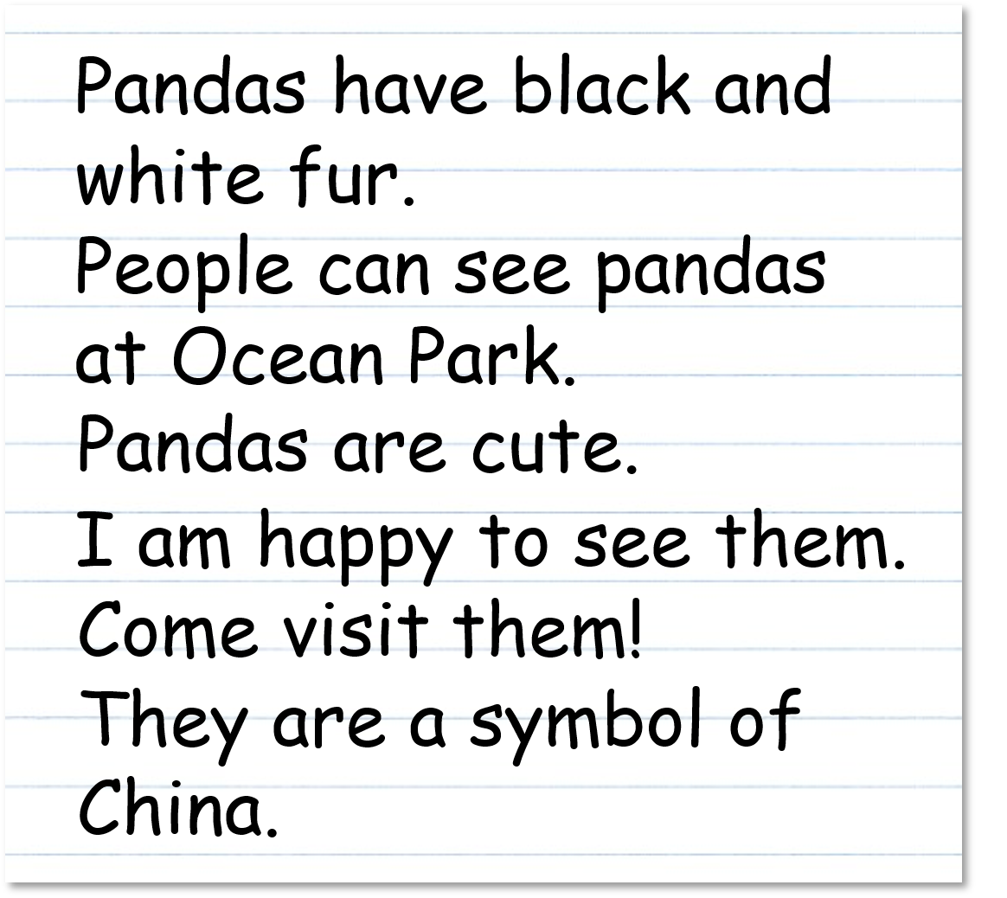

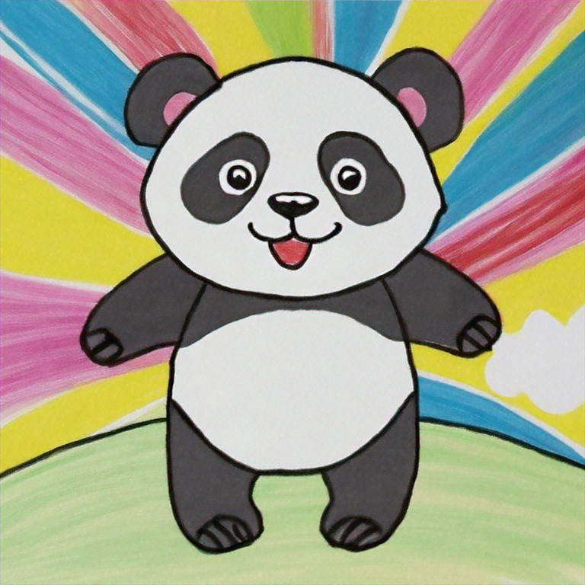
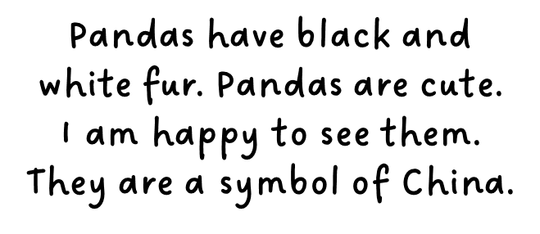
Now let’s add what we wrote onto our poster!
Write an interesting title for the poster.
✓
✓
Then draw a picture of a giant panda to attract people.
✓
✓
✓
✓
Finally, write about pandas here.
READING
NOW I KNOW
LET’S THINK
LET’S DO THIS

Slide 27
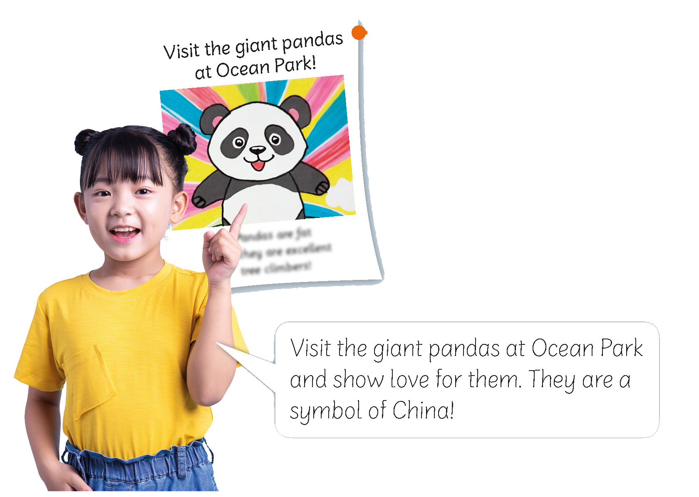
You can share your poster with your class!
READING
NOW I KNOW
LET’S THINK
LET’S DO THIS

Slide 29
Acknowledgements
We would like to thank the following organisations and people for permission to use their images and video:
Alina Mosinyan / stock.adobe.com
Amelie Koch / 123RF
AUFORT Jérome / stock.adobe.com
Bbu Kurkovva / Shutterstock
Bbu Kurkovva / Shutterstock
bigkai / Shutterstock
BlueRingMedia / Shutterstock
chendongshan / stock.adobe.com
chendongshan / stock.adobe.com
Credit line is not needed
Daniel X D / Shutterstock
Dany Kurniawan / Shutterstock
dreamblack46 / stock.adobe.com
EdNurg / stock.adobe.com
eyetronic / stock.adobe.com
Hubba Bubba / stock.adobe.com
Mapodile M./peopleimages.com / stock.adobe.com
Mus Illustrations / stock.adobe.com
Nami735 / stock.adobe.com
natrot / stock.adobe.com
snupdo / stock.adobe.com
sokko_natalia / stock.adobe.com
Teeramet Thanomkiat / 123RF
TEGUH / stock.adobe.com
Timeimage / stock.adobe.com
WENN Rights Ltd / Alamy Stock Photo
wusuowei / stock.adobe.com
Zach / stock.adobe.com

