Slide 1
Chapter 4
Design a zoo and write about it

Slide 2
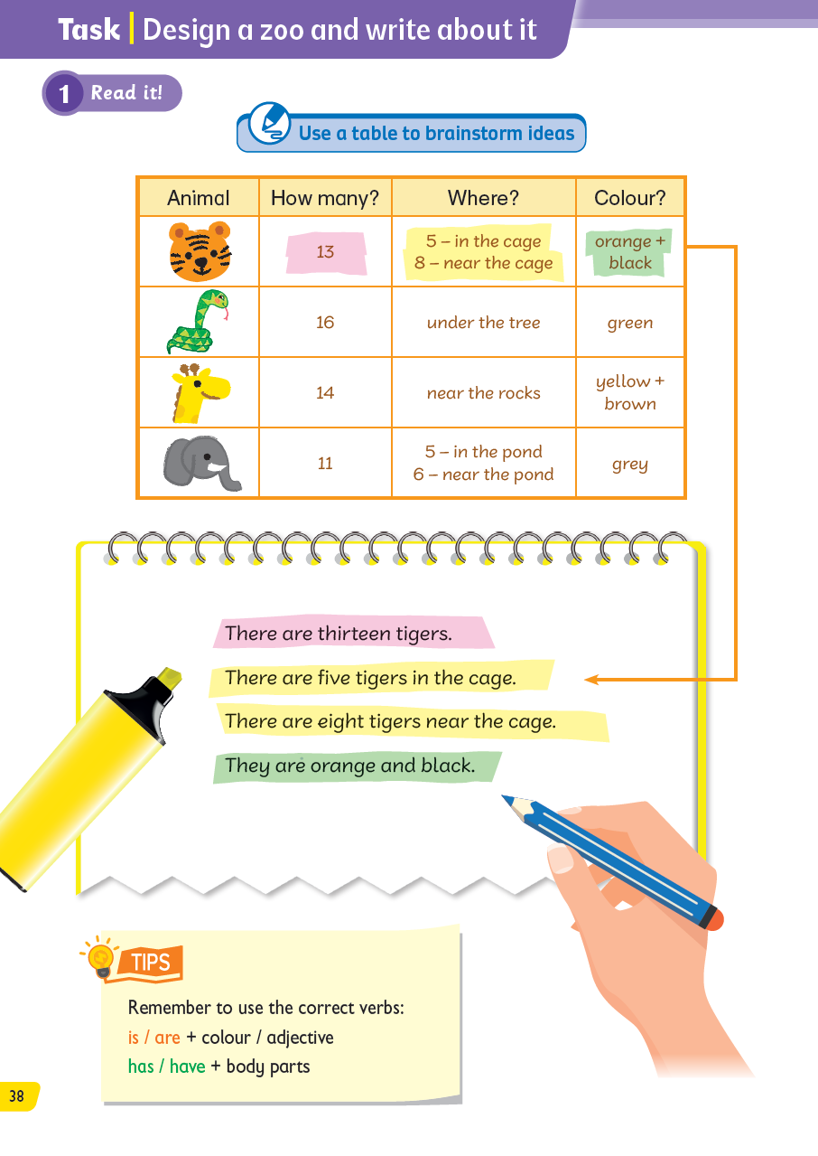
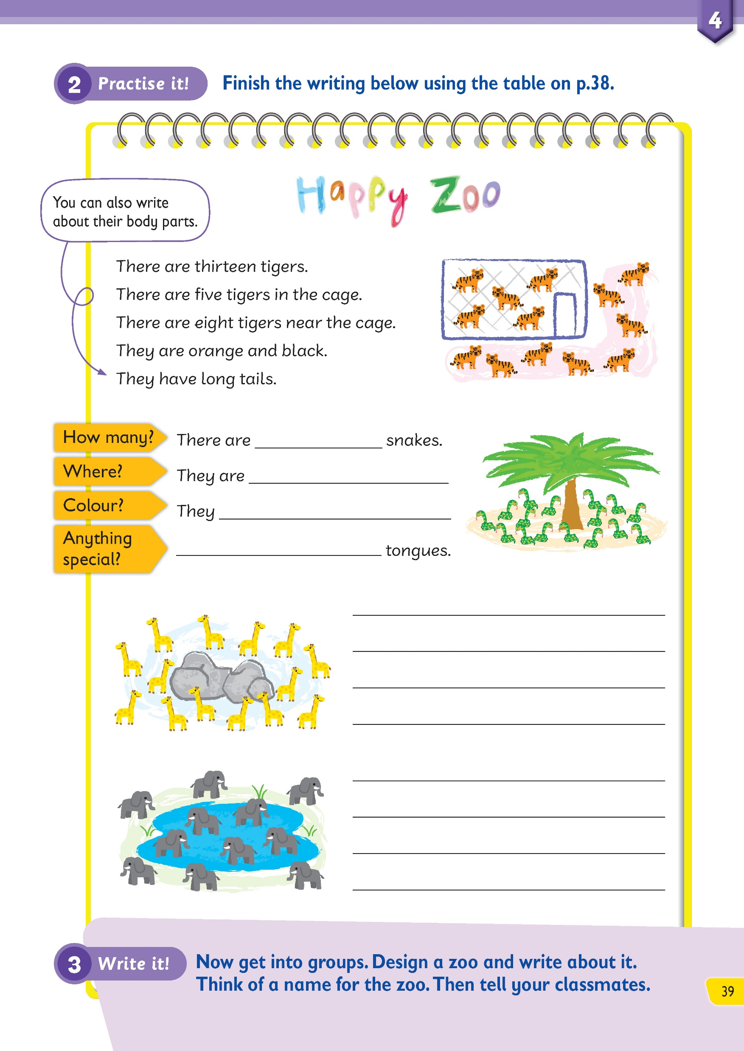
In this chapter, we learnt about lots of animals. In this lesson, we will design a zoo and write about the animals!

Slide 3
What can we write about? Let’s look at some tips!

Slide 4
We can use the table to help us think about what to write.

Slide 5
Let’s look at the information about the animals in the zoo.

Slide 6
What animals can I have in the zoo?

Slide 7
How many of them?

Slide 8
Where are they?

Slide 9
What colour are they?

Slide 10
Now we can write about tigers!

Slide 11
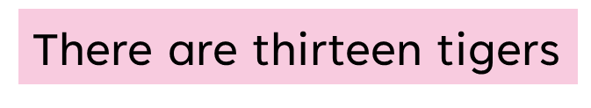

How many tigers are there?

Slide 12
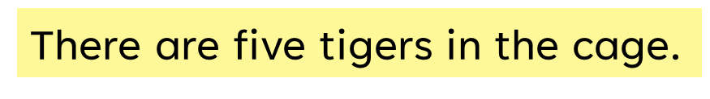
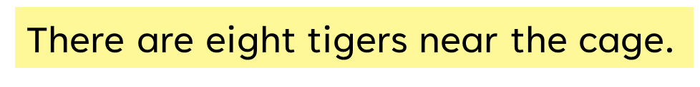

Where are they?

Slide 13
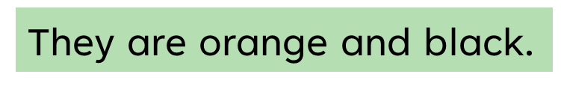

Where are they?

Slide 14

Pay attention to the verb used in these sentences.

Slide 15
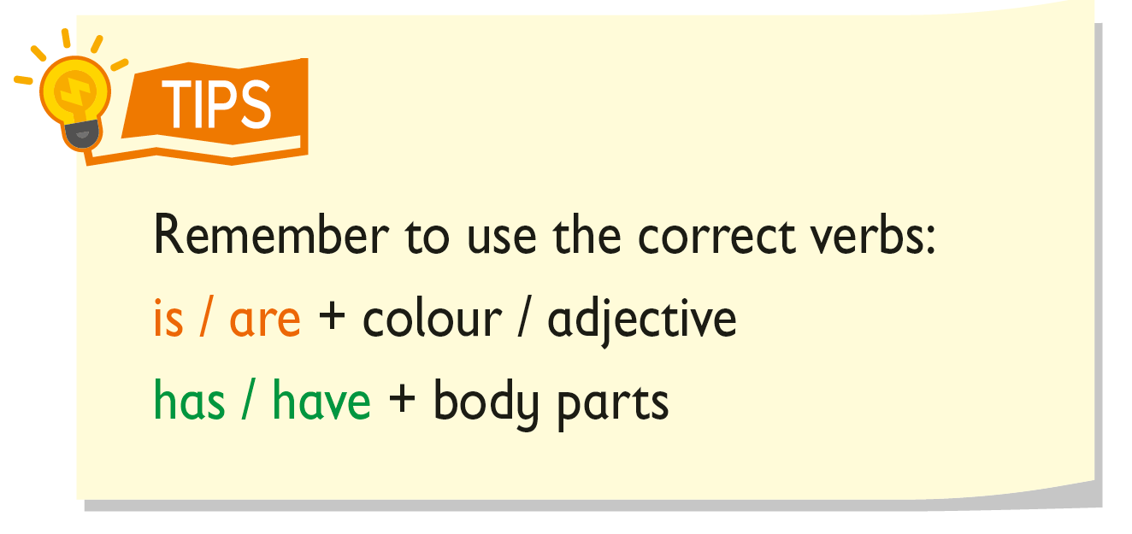



We use ‘is’ and ‘are’ with colours or adjectives.
We use ‘has’ and ‘have’ with body parts.

Slide 16

Let’s write about the zoo.

Slide 17
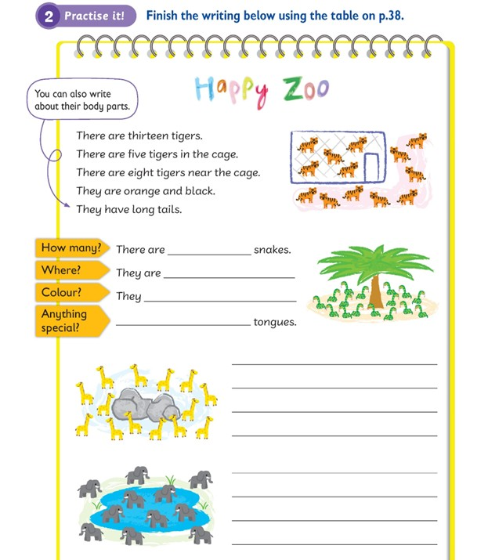
First, we think of a name for the zoo.
Here, the zoo is called ‘Happy Zoo’.

Slide 18


Use the information in the table to help you write.
You can also add your own idea about their body parts.

Slide 19
Let’s finish the next part.

Slide 20
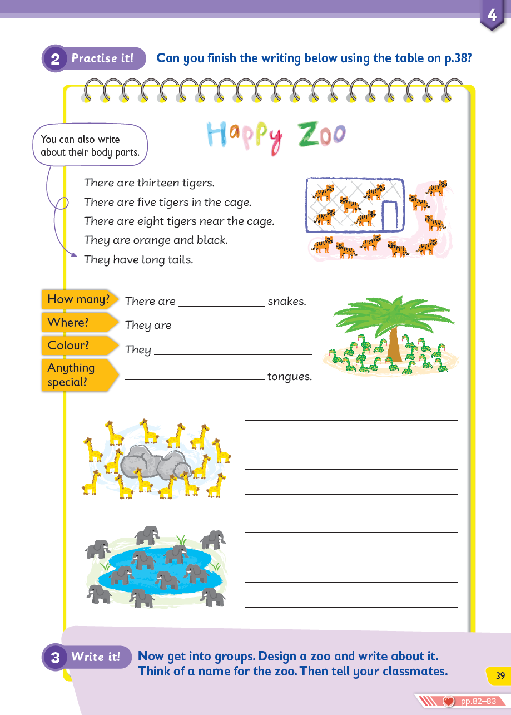
How many snakes are there?
Where are they?
16 / sixteen
under the tree.

Slide 21

What colour are they?
Do we use ‘are’ or ‘have’ after ‘They’ here?
16 / sixteen
under the tree.
are green.

Slide 22

Do we use ‘it’ or ‘they’ to start the last sentence?
Do we use ‘are’ or ‘have’ to talk about body parts?
16 / sixteen
under the tree.
are green.

Slide 23
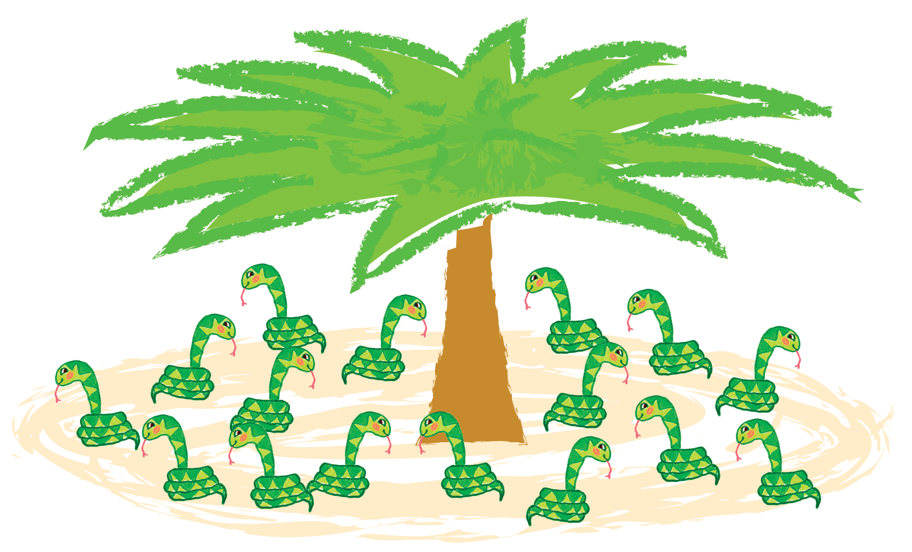
Look at the picture.
Are the tongues long or short?

Slide 24
Let’s complete the last sentence.
16 / sixteen
under the tree.
are green.
They have long

Slide 25
Now let’s complete the descriptions of the giraffes and elephants.

Slide 26
How many giraffes are there? Where are they?
There are 14 / fourteen giraffes.
They are near the rocks.

Slide 27
What colours are they?
What is special about their body parts?
There are 14 / fourteen giraffes.
They are near the rocks.
They are yellow and brown. / They are brown and yellow.
They have long necks. / They have long legs. / They have long tails. / They have small ears. / They have small eyes.

Slide 28
How many elephants are there?
Where are they?
There are 11 / eleven elephants.
There are five elephants in the pond.
There are six elephants near the pond.

Slide 29
What colours are they?
What is special about their body parts?
There are 11 / eleven elephants.
There are five elephants in the pond.
There are six elephants near the pond.
They are grey.
They have big ears. / They have long trunks. / They have long teeth. / They have big legs.

Slide 30
Now it is your turn to design your own zoo and write about some amazing animals.

Slide 31
First, fill in the table about the animals in the zoo.
Animal | How many? | Where? | Colour? | Additional information

Slide 32
You can put down additional information about the animals in the last column.
Animal | How many? | Where? | Colour? | Additional information
e.g. the animals’ body parts, what they eat.

Slide 33
Do you remember what kind of information is in each column?
Animal | How many? | Where? | Colour? | Additional information

Slide 34
Do you remember what kind of information is in each column?
Animal | How many? | Where? | Colour? | Additional information
What animal can you have in the zoo?

Slide 35
Do you remember what kind of information is in each column?
Animal | How many? | Where? | Colour? | Additional information
How many of them?

Slide 36
Do you remember what kind of information is in each column?
Animal | How many? | Where? | Colour? | Additional information
Where are they?

Slide 37
Do you remember what kind of information is in each column?
Animal | How many? | Where? | Colour? | Additional information
What colour are they?

Slide 38
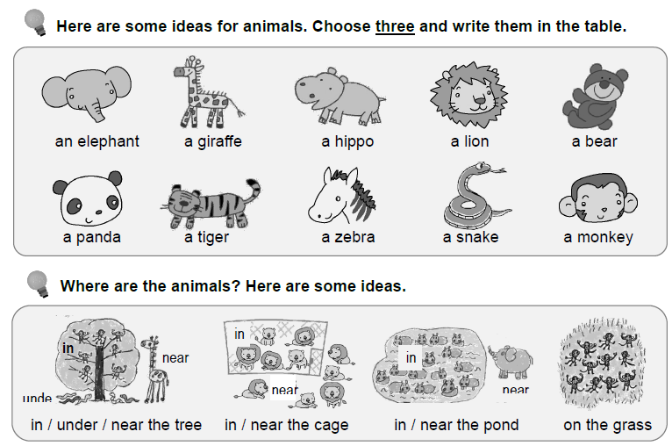
You can use these words in the Task Sheet to help you:

Slide 39
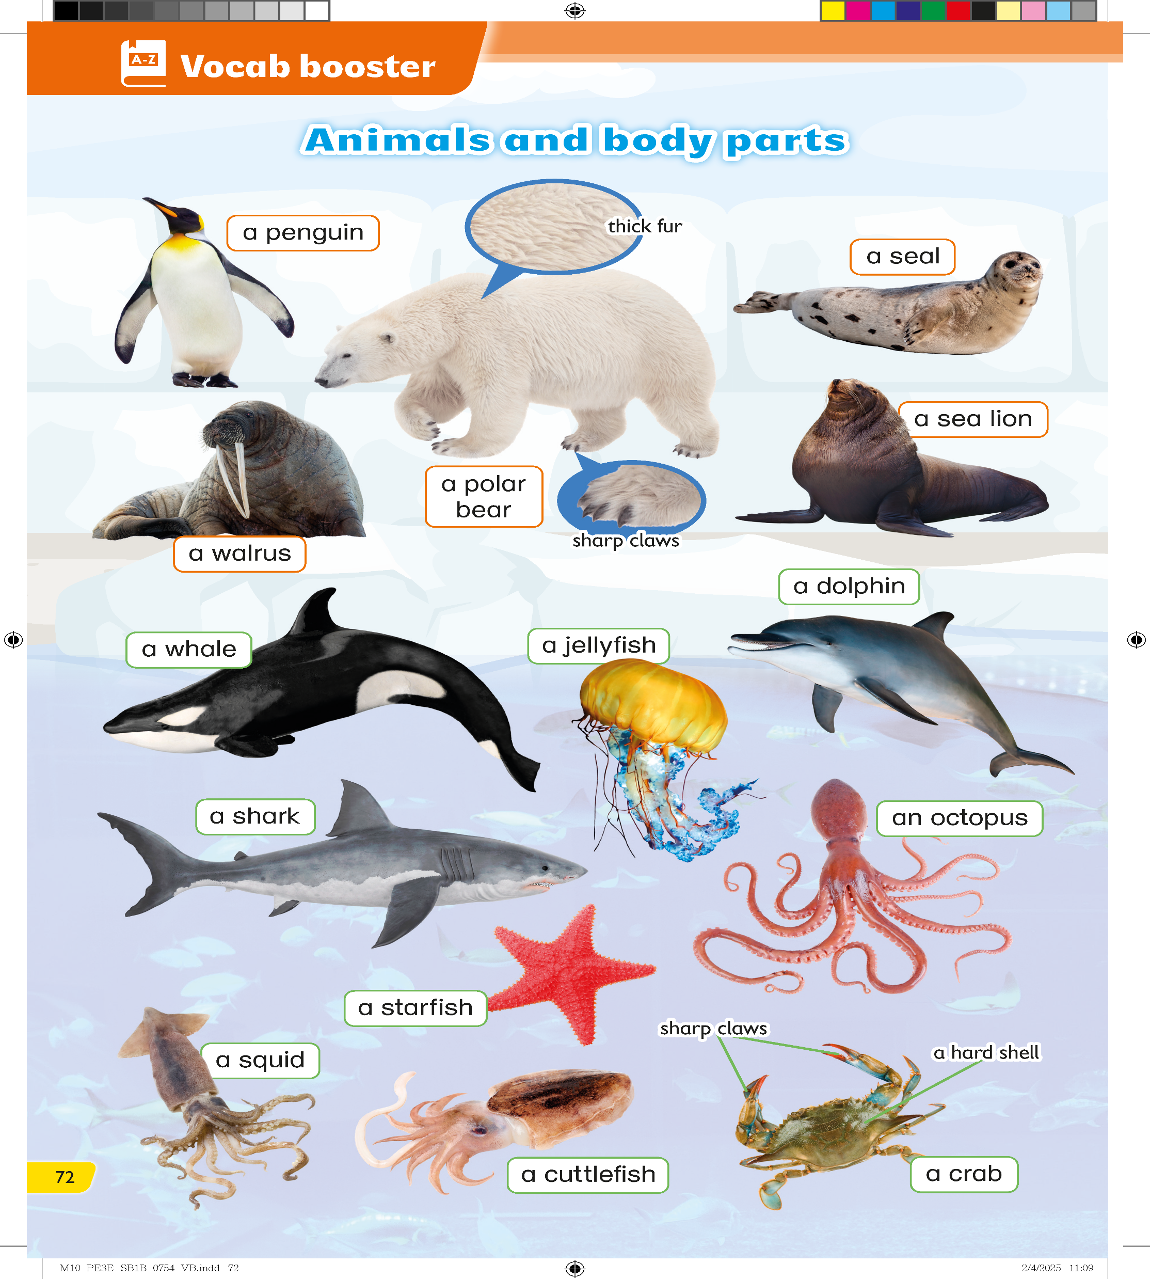
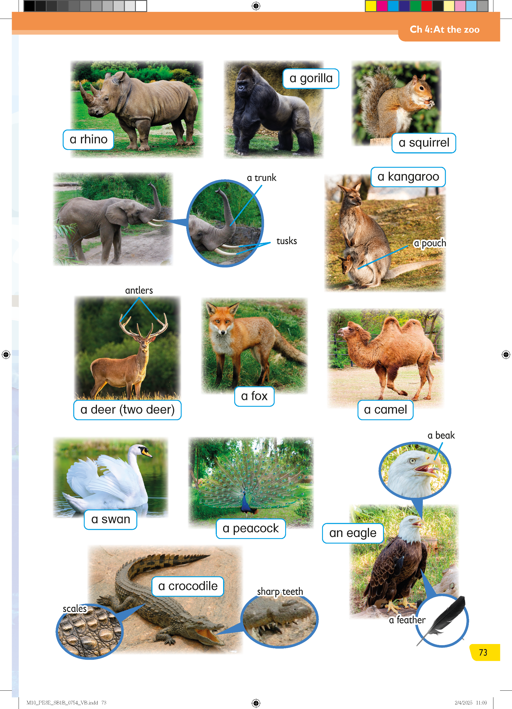
You can also use the words from the Vocab Booster section.

Slide 40
Now you can start writing about your zoo.
Think of a fun name for your zoo.
Name of your zoo: ____________

Slide 41
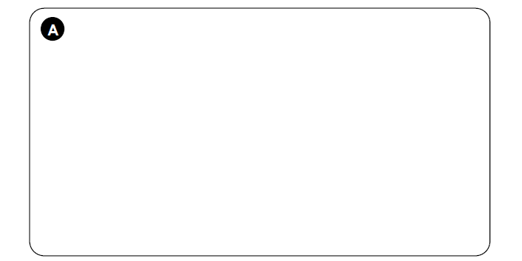

Then draw pictures of the animals.
Name of your zoo: ____________

Slide 42
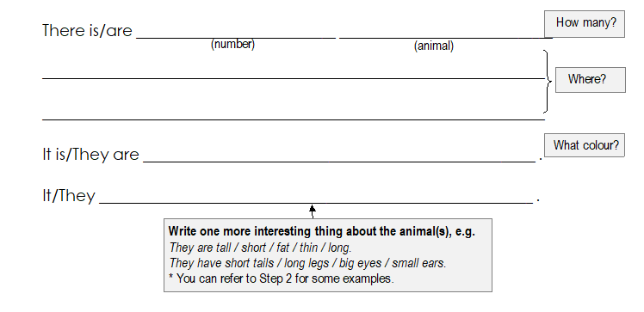
Finally, write about them in the Task Sheet using the information in the table.
Write at least three sentences.

Slide 43
Remember to use the correct verbs:

Slide 44
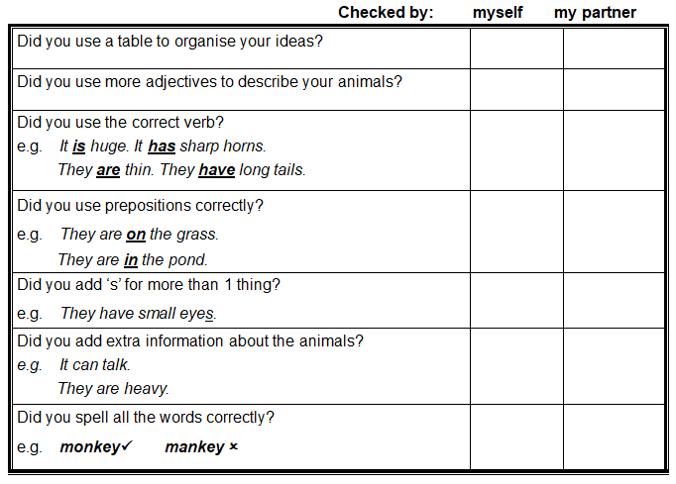
Check and revise your writing.

Slide 46
Acknowledgements
We would like to thank the following organisations and people for permission to use their images:
bimserd / Shutterstock
Christian Musat / Shutterstock
Dmitry Abduraimov / Shutterstock
Dolores M. Harvey / Shutterstock
Feng Yu / Shutterstock
g images.com / Shutterstock
Gert Very / 123RF
GN.Studio / Shutterstock
Helmut Hirt / Shutterstock
Ian Rentoul / Shutterstock
Igor Dmitriev / 123RF
ILYA AKINSHIN / Shutterstock
islavicek / Shutterstock
JIANG HONGYAN / Shutterstock
kazumi miyamoto / Shutterstock
Kit Leong / Shutterstock
Kletr / Shutterstock
Mariola Anna S / Shutterstock
Mats Brynolf / Shutterstock
Mindok / Shutterstock
nadtytok / Shutterstock
Nerthuz / Shutterstock
PhotoSky / Shutterstock
s99 / Shutterstock
scooperdigital / Shutterstock
SiiKA Photo / Shutterstock
Sonya illustration / stock.adobe.com
tikisada / Shutterstock
volkova natalia / Shutterstock
WildMedia / Shutterstock
YG Studio / stock.adobe.com
zhengzaishuru / Shutterstock
Zloneg / Shutterstock

