Slide 1
Chapter 4
Posters

Slide 2
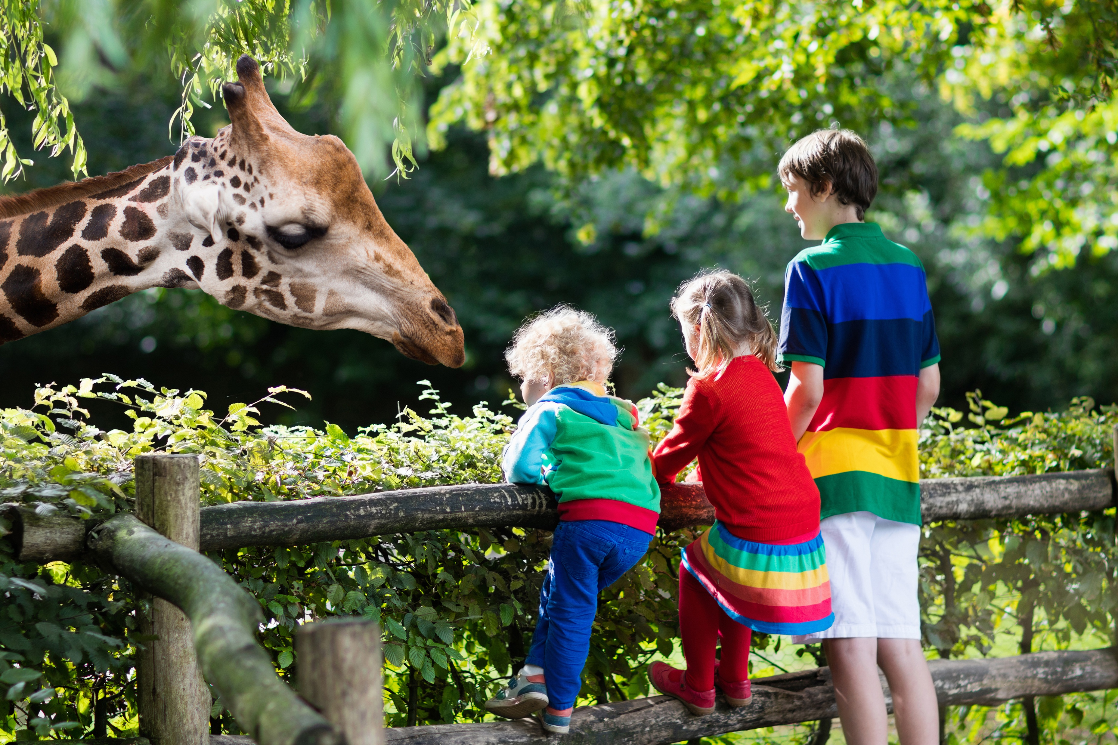
Do you like going to a zoo?
What animals can you find at a zoo?

Slide 3
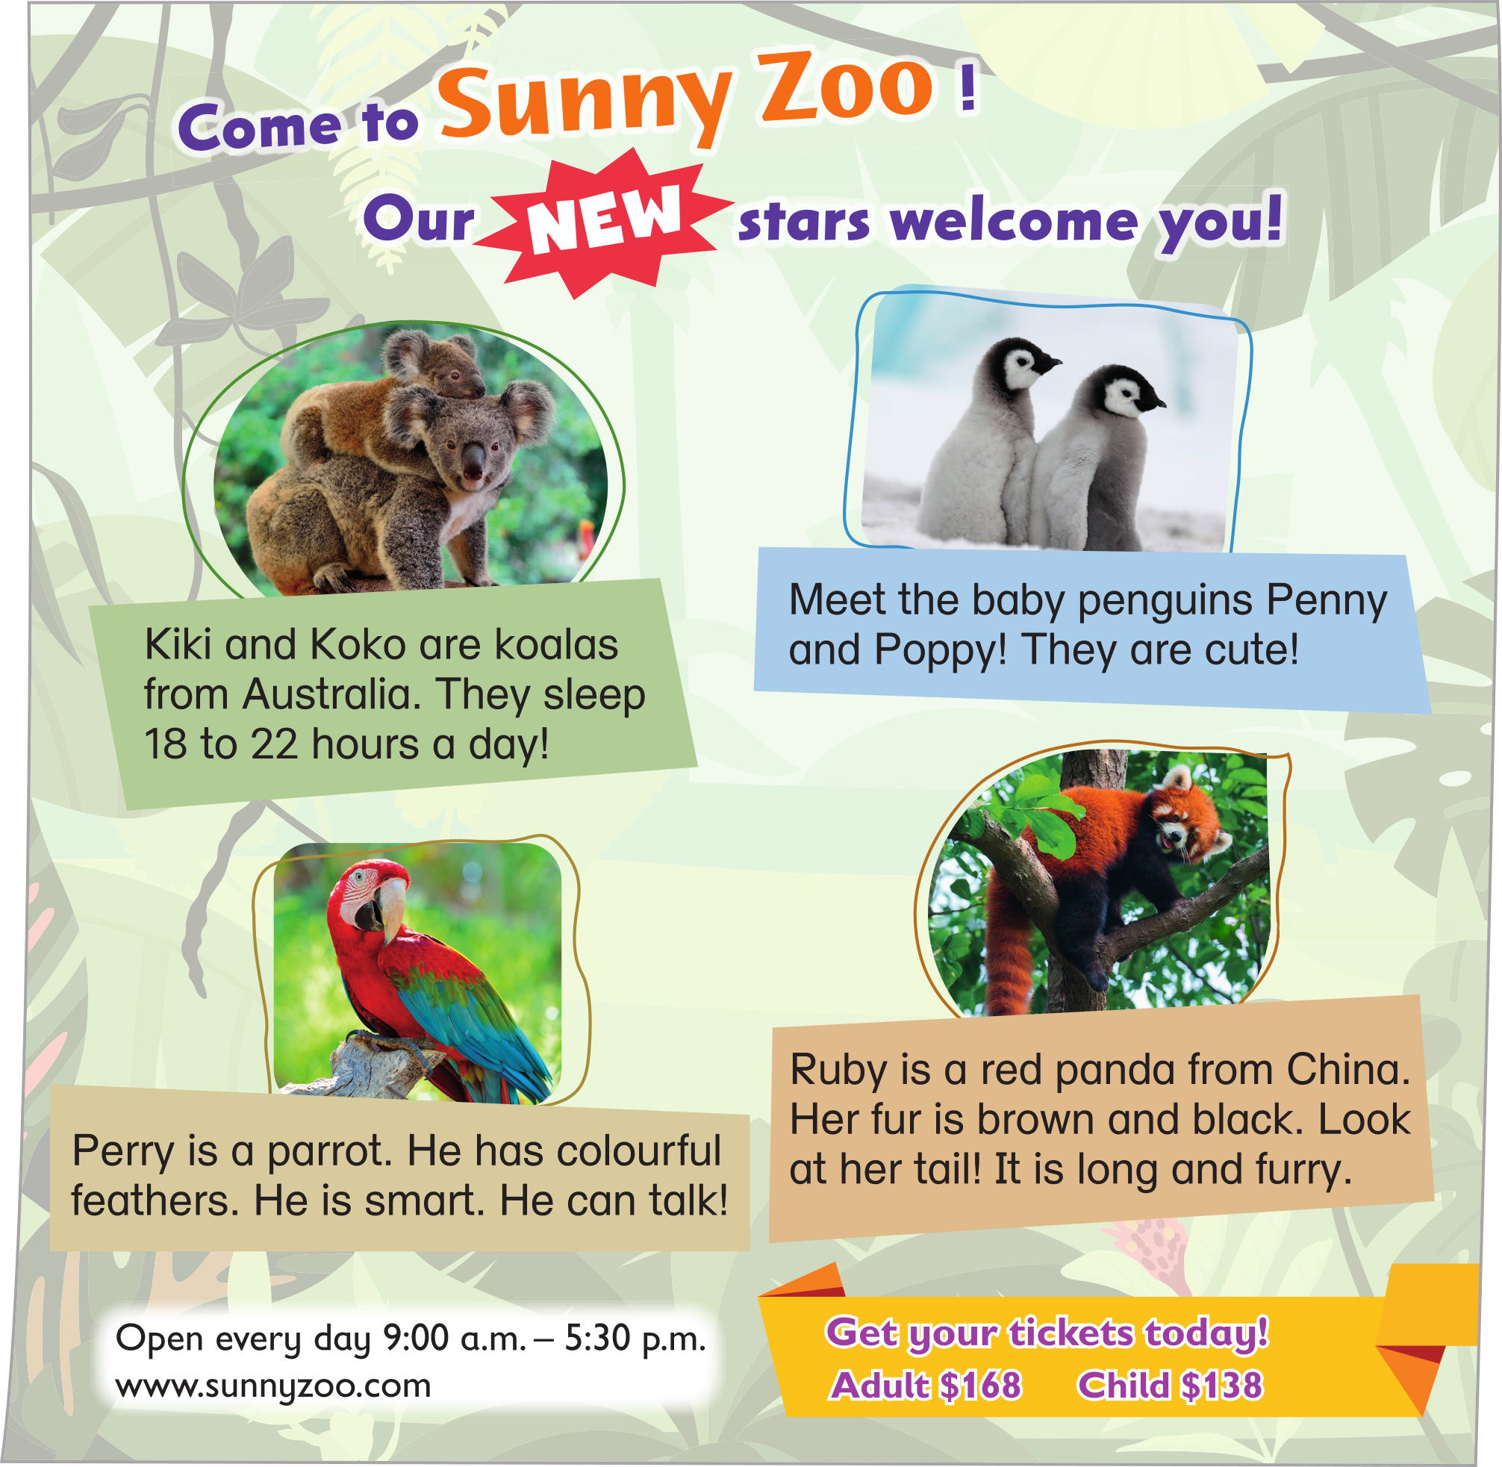
Today, we are going to read a poster about a zoo.

Slide 4

A poster is a large sheet of paper.
People often put it on a wall.

Slide 5
It may give us information about a place.
Like this poster, it gives us information about a zoo.

Slide 6
To attract readers, a poster usually has a big heading.
Big heading to attract readers

Slide 7
What is the name of the zoo?
Big heading to attract readers

Slide 8
Why does Sunny Zoo put up this poster?
Big heading to attract readers

Slide 9
It wants people to come and see its new stars!
Big heading to attract readers

Slide 10


Read the heading out loud.
Pay attention to the last word of each sentence.
Big heading to attract readers

Slide 11
Do they rhyme (have the same ending sound)?
Big heading to attract readers

Slide 12
The heading has rhyming words. It is catchy (easy to remember).
Big heading to attract readers

Slide 13
A poster often has pictures to get readers’ attention.
The zoo puts the pictures of its new stars on the poster.
Big heading to attract readers
Pictures to get readers’ attention

Slide 14
Let’s find out who the new stars are!
Big heading to attract readers
Pictures to get readers’ attention

Slide 15
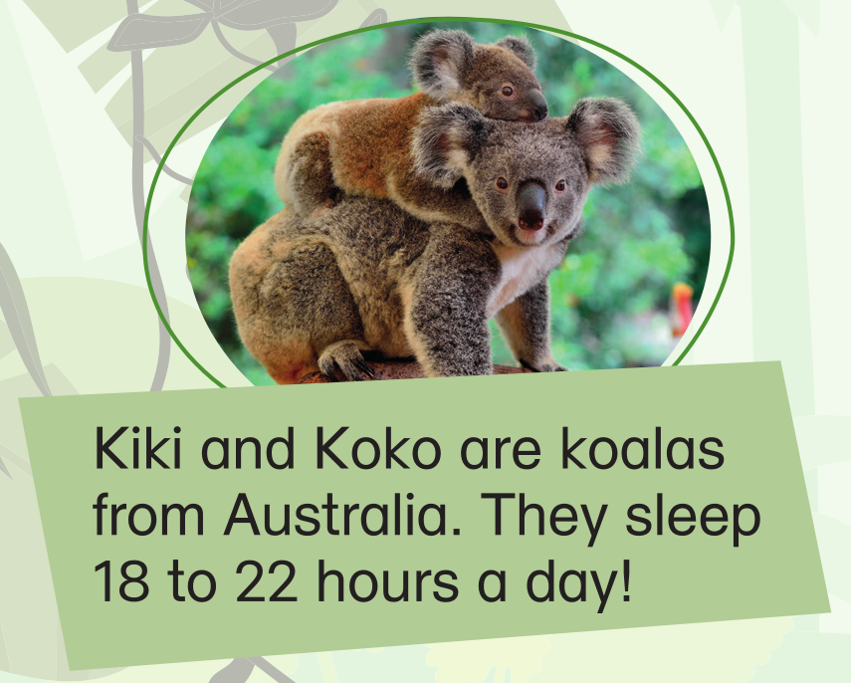
Who are Kiki and Koko?
Big heading to attract readers
Pictures to get readers’ attention

Slide 16
Where are they from?
Big heading to attract readers
Pictures to get readers’ attention

Slide 17
How many hours do they sleep every day?
Big heading to attract readers
Pictures to get readers’ attention

Slide 18
Wow, they sleep a lot.
How many hours do you sleep a day?
Big heading to attract readers
Pictures to get readers’ attention

Slide 19
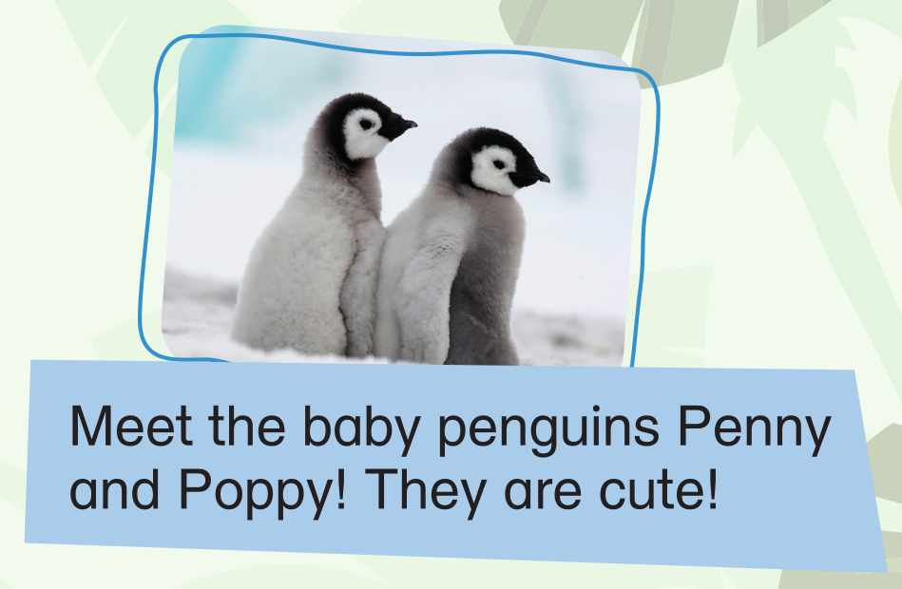
Who are Penny and Poppy? Are they birds?
Big heading to attract readers
Pictures to get readers’ attention

Slide 20
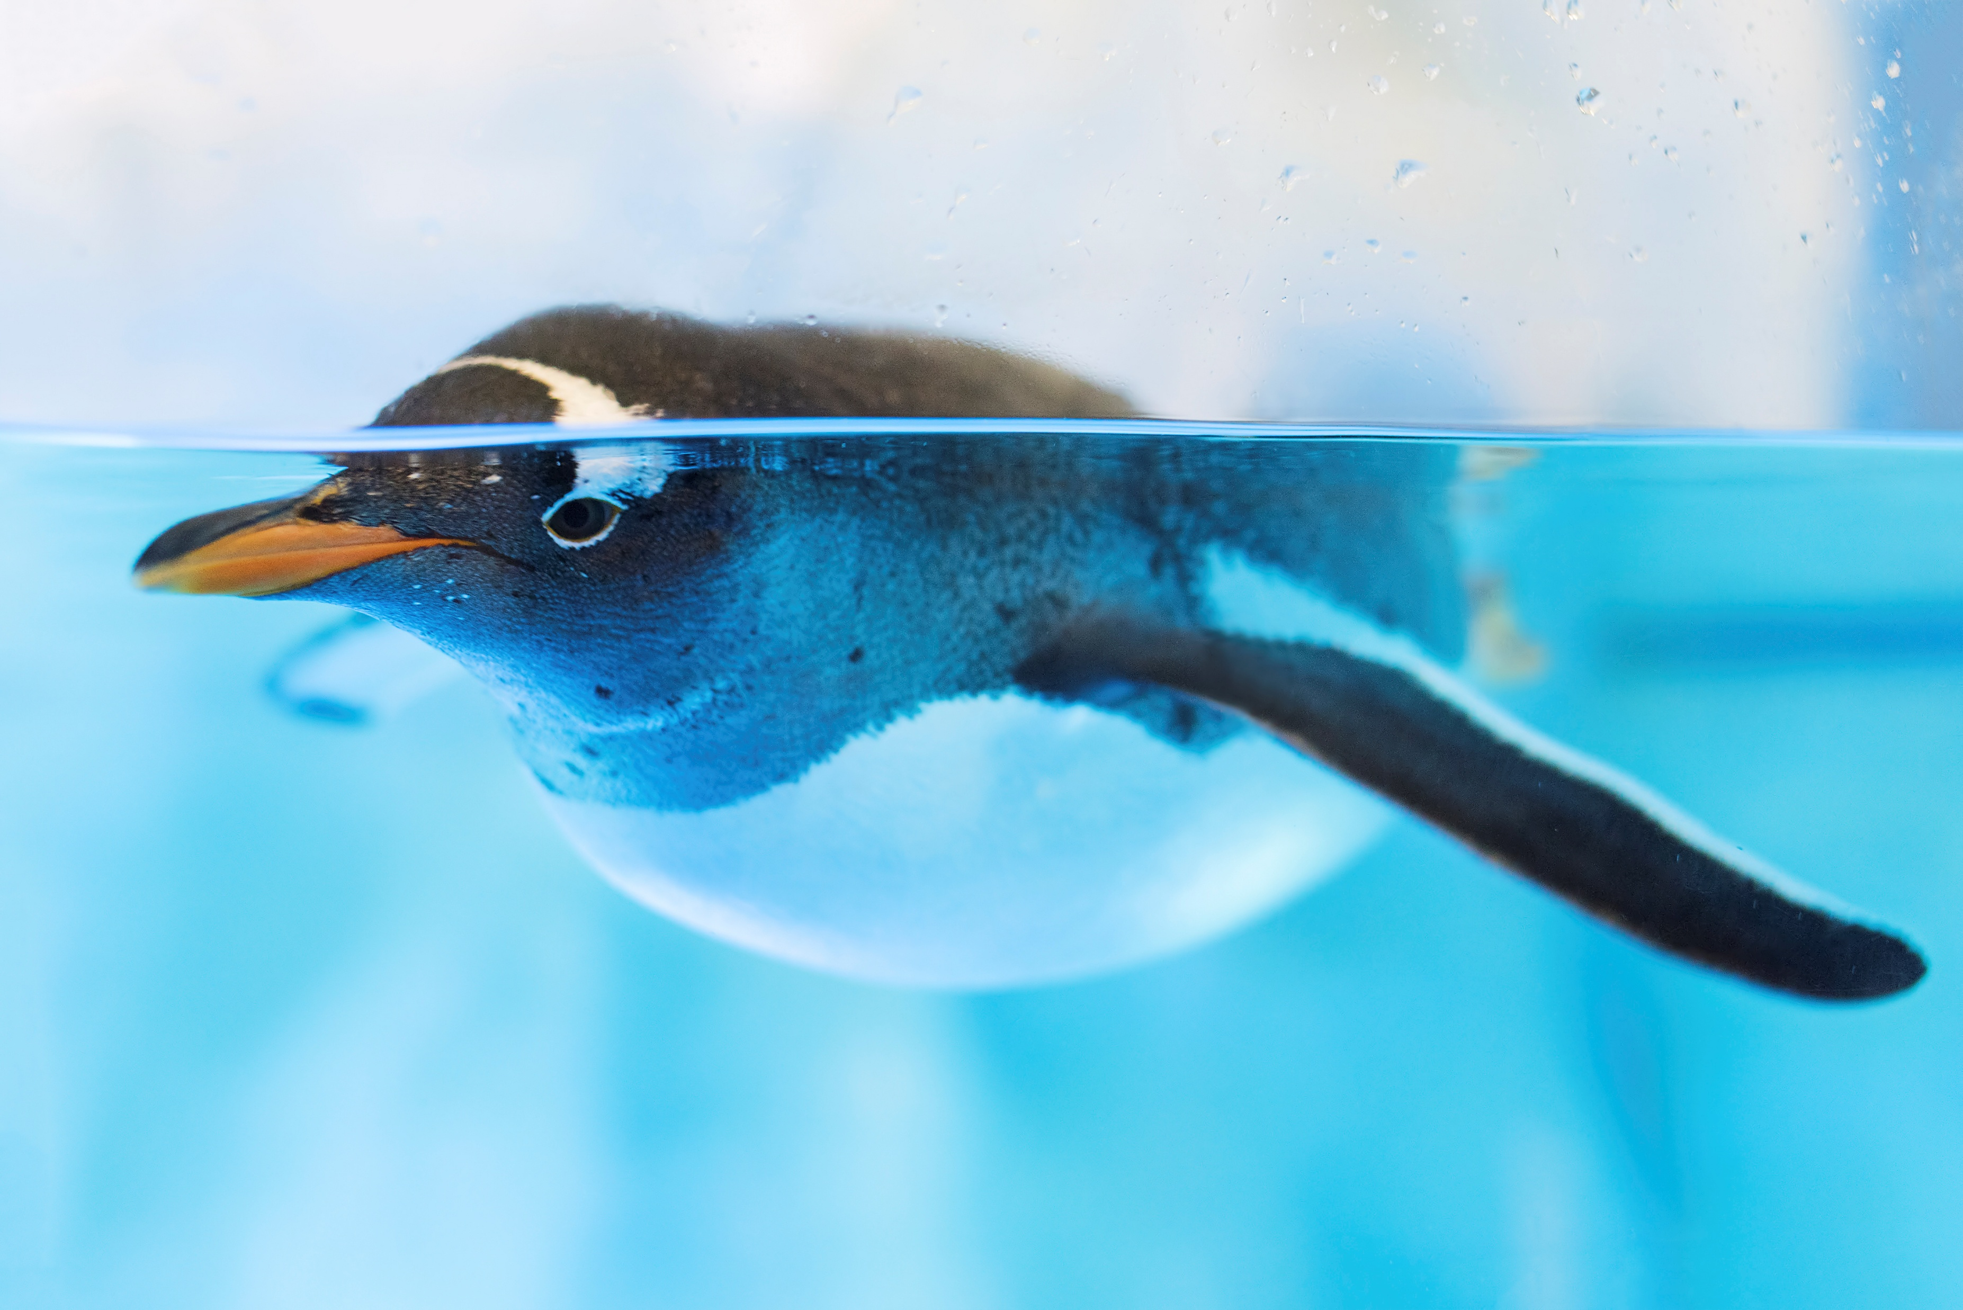

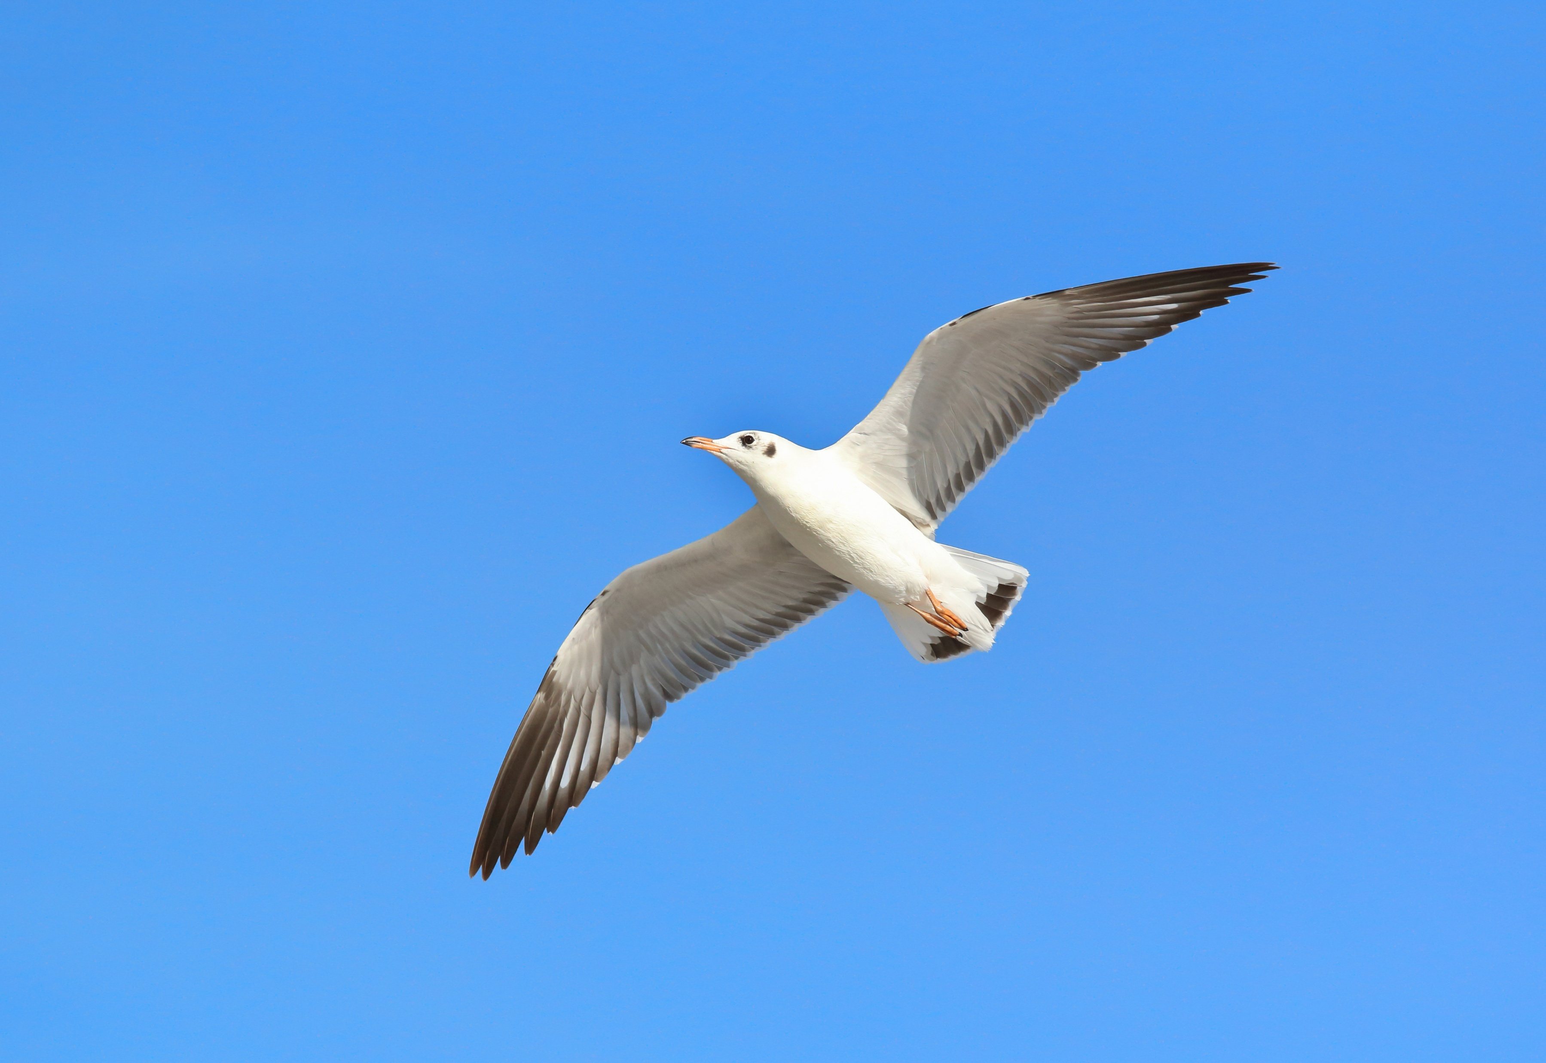

Penguins are birds. They can swim, but they cannot fly.
Big heading to attract readers
Pictures to get readers’ attention

Slide 21
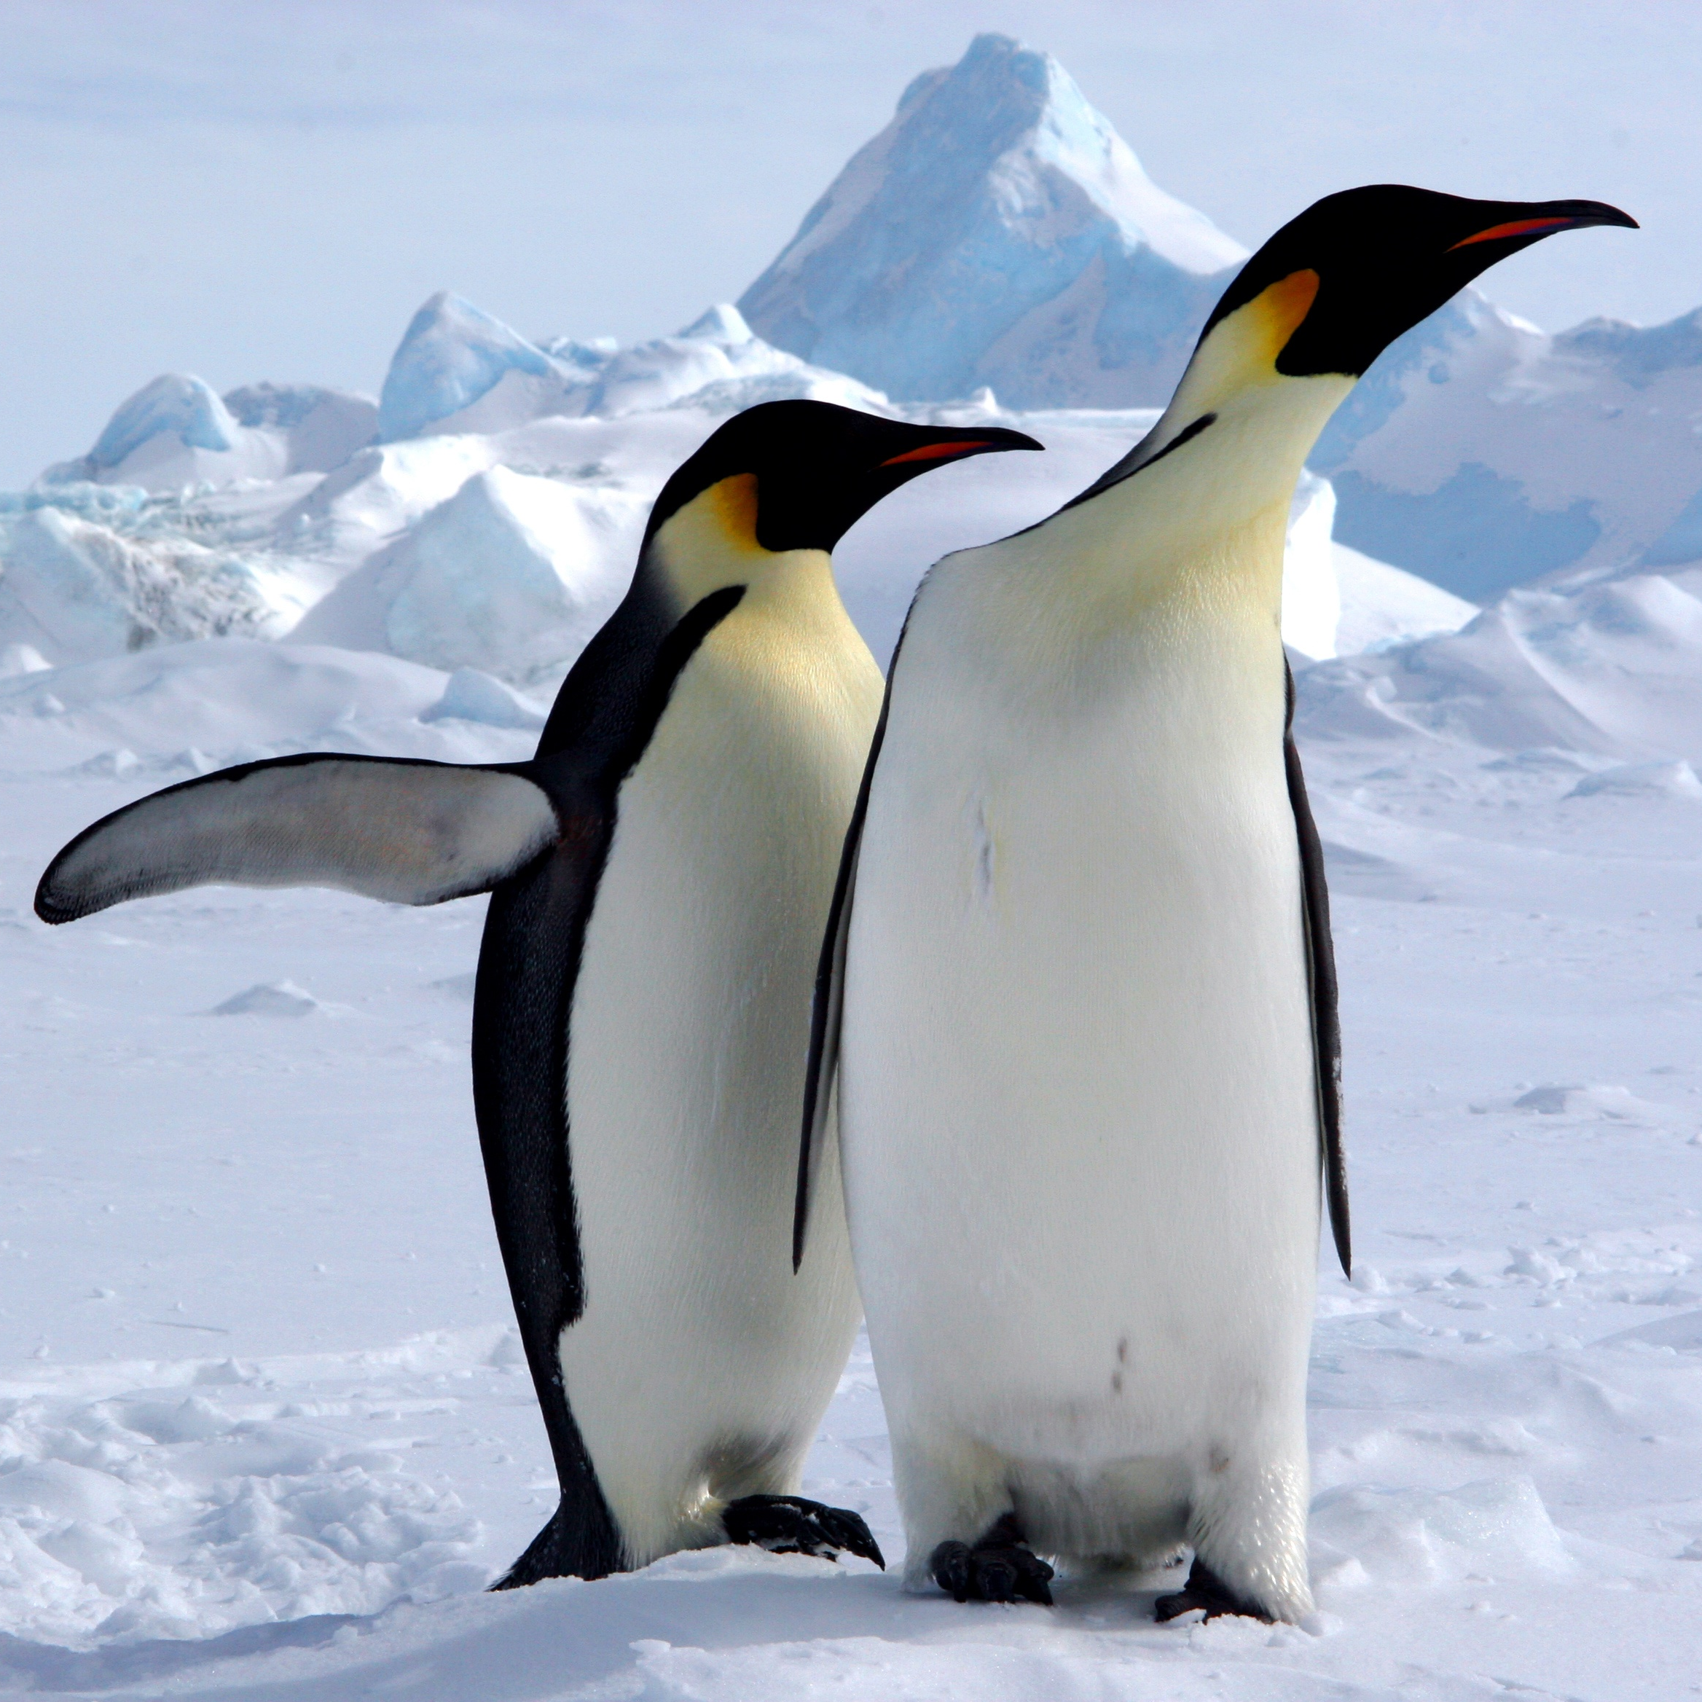
When the baby penguins grow up, they will look like this.
Big heading to attract readers
Pictures to get readers’ attention

Slide 22
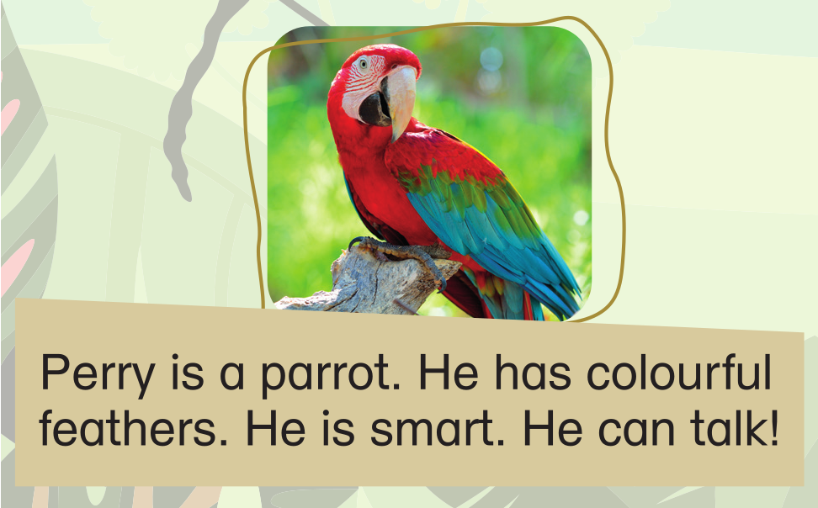
Who is Perry? Is he a bird?
Big heading to attract readers
Pictures to get readers’ attention

Slide 23
A parrot is a bird.
Big heading to attract readers
Pictures to get readers’ attention

Slide 24
Birds have feathers, not hair. Perry has colourful feathers.
Big heading to attract readers
feathers
Pictures to get readers’ attention

Slide 25
Perry is smart. What can he do?
Big heading to attract readers
Pictures to get readers’ attention

Slide 26
A parrot can talk (by copying what we say).
Big heading to attract readers
Hello!
Pictures to get readers’ attention

Slide 27

Let’s watch an online video of a talking parrot!
Big heading to attract readers
Pictures to get readers’ attention

Slide 28
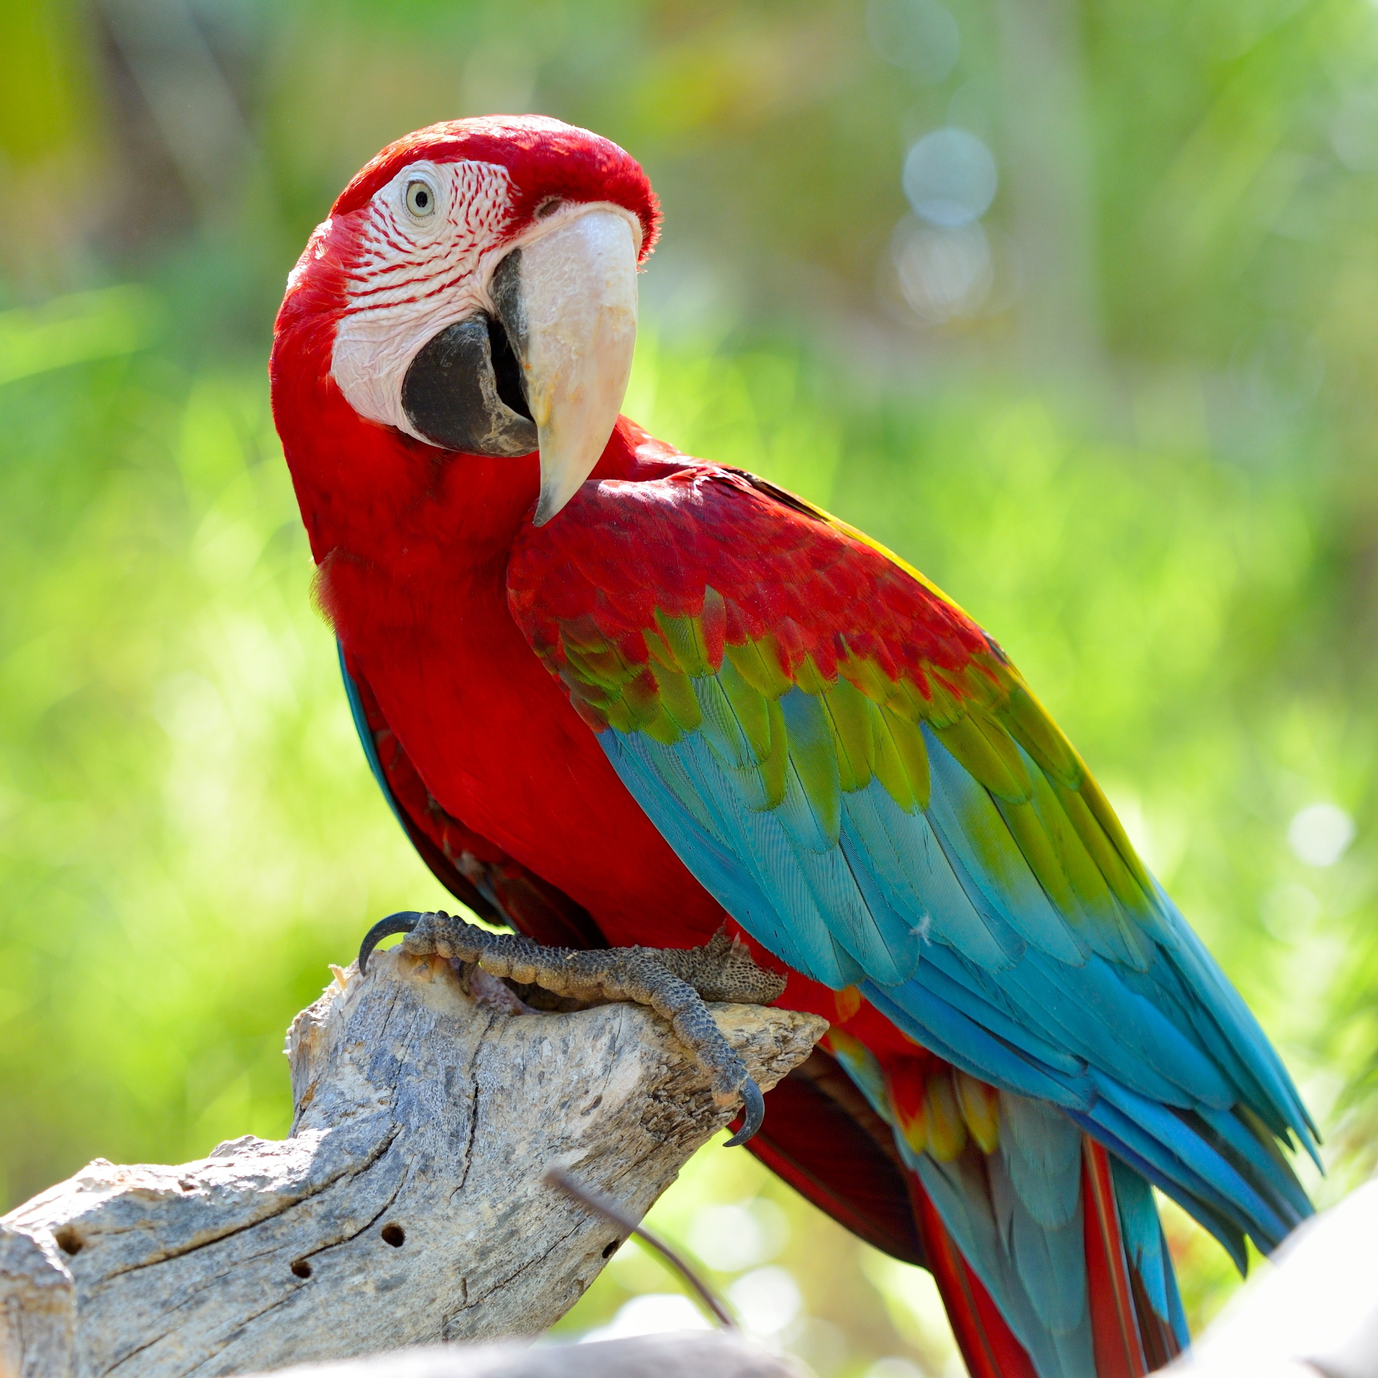
What does the parrot say in the video?
Big heading to attract readers
Hi!
How are you?
Hi bird!
Pictures to get readers’ attention

Slide 29
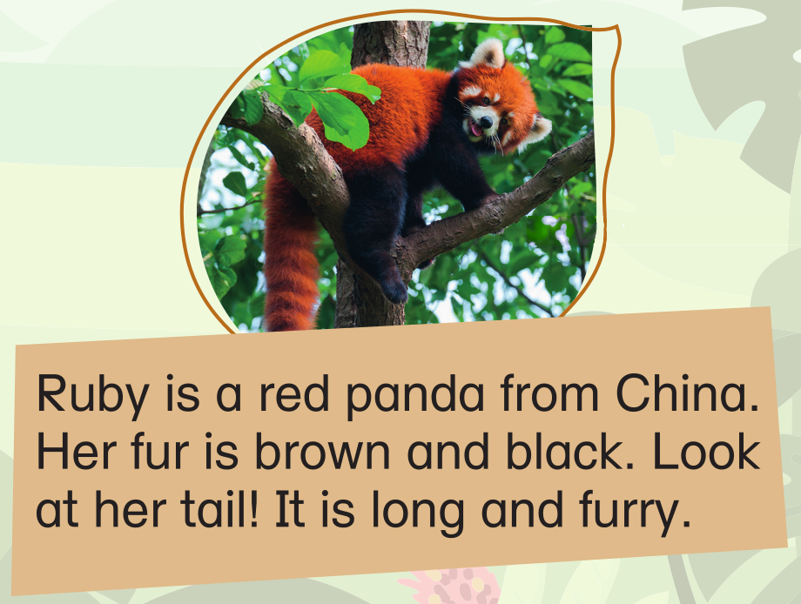
What is Ruby?
Big heading to attract readers
Pictures to get readers’ attention

Slide 30
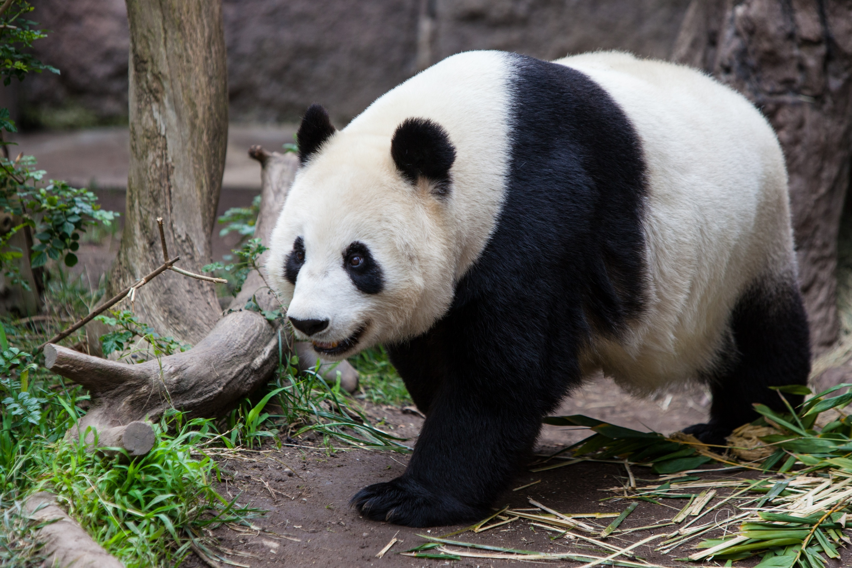
Hmm, Ruby is a panda from China,
but doesn’t a panda look like the picture on the left?
Big heading to attract readers
vs
Pictures to get readers’ attention

Slide 31
A giant panda is big. It is black and white.
A red panda is small. It is brown and black.
Big heading to attract readers
vs
Pictures to get readers’ attention
giant panda

Slide 32

We need tickets to get in the zoo.
How much are the tickets?
Big heading to attract readers
Pictures to get readers’ attention

Slide 33
The poster also includes details of the zoo.
Big heading to attract readers
Pictures to get readers’ attention
Details of the zoo

Slide 34

When is the zoo open?
Big heading to attract readers
Pictures to get readers’ attention
Details of the zoo

Slide 35
What can you do if you want to find more information?
You can visit the website of the zoo.
Big heading to attract readers
Pictures to get readers’ attention
Details of the zoo

Slide 36
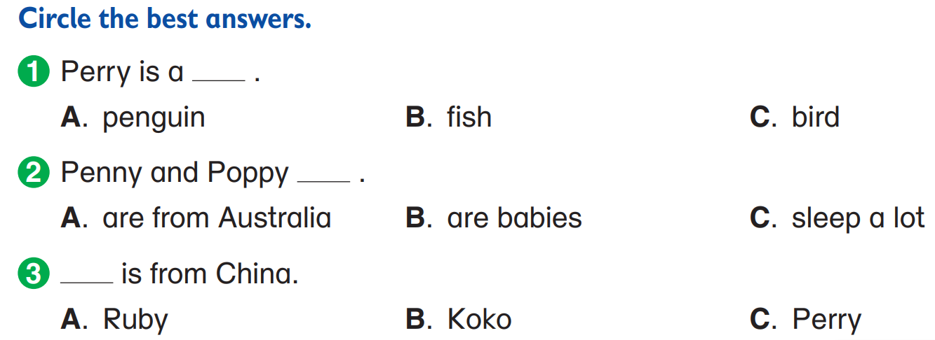


Now, let’s answer some questions.
A parrot is a bird.

Slide 37
Now, let’s answer some questions.

Slide 38
Now, let’s answer some questions.

Slide 40
Acknowledgements
We would like to thank the following organisations and people for permission to use their images:
aaltair / Shutterstock
Alizada Studios / Shutterstock
Audrey (AI) / stock.adobe.com
Bernard Breton / 123RF
Charles Bergman / Shutterstock
Chris Putnam / 123RF
famveldman / 123RF
Hung Chung Chih / Shutterstock
Kmannn / Shutterstock
Macrovector / stock.adobe.com
Passakorn Umpornmaha / Shutterstock
Vitalii Krasnoselskyi / 123RF
Yiu Tung Lee / 123RF

