Slide 1

Chapter 4
Ask someone to keep quiet

Slide 2
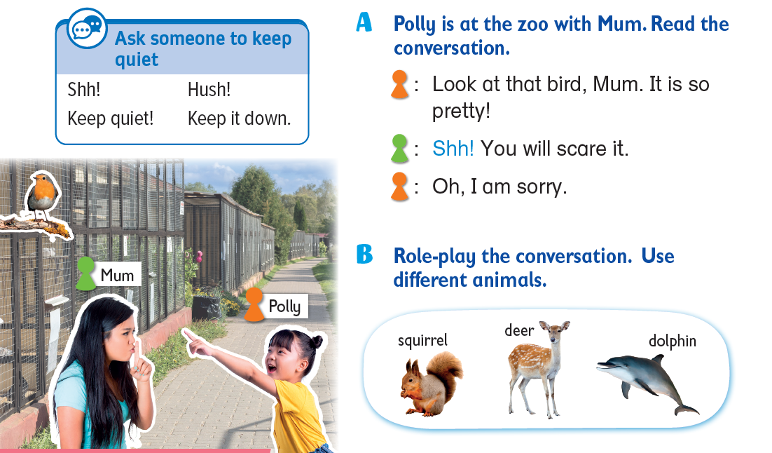
Today, we are going to learn how to ask other to keep quiet!

Slide 3
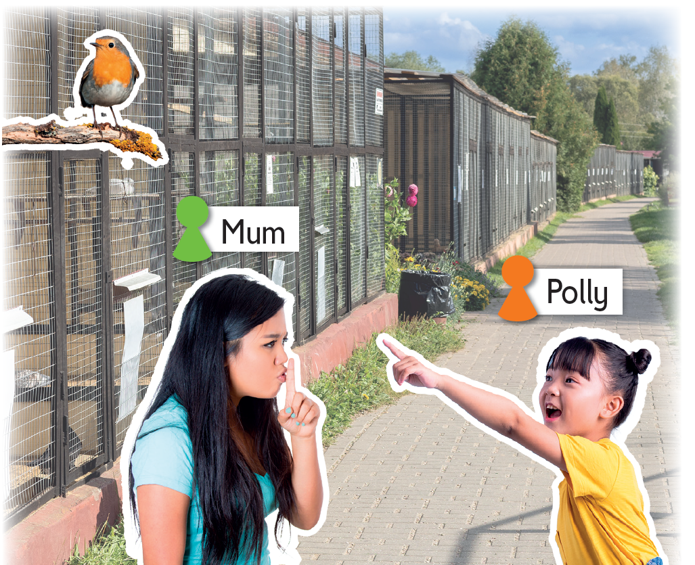
Look! Here is a girl called Polly and her mum.
They are at the zoo.

Slide 4
Polly is looking at a bird. What do they say?
Let’s listen!

Slide 5


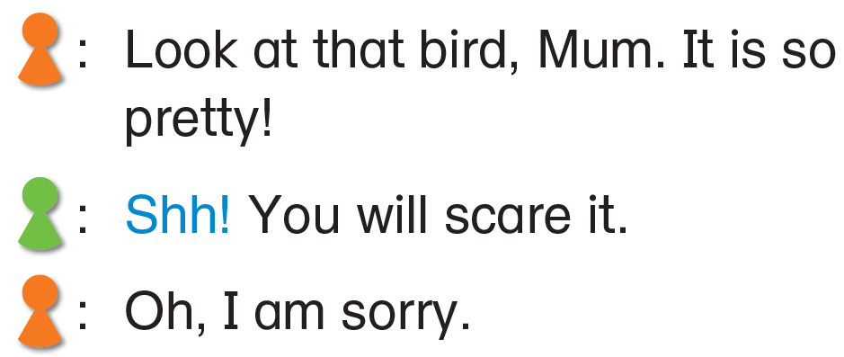
Polly thinks the bird is pretty. She is excited.
Is she LOUD or quiet?

Slide 6
Polly is loud! Is it good to make a noise at the zoo?
It will scare the bird!

Slide 7
We can use this expression to ask others to be quiet.

Slide 8
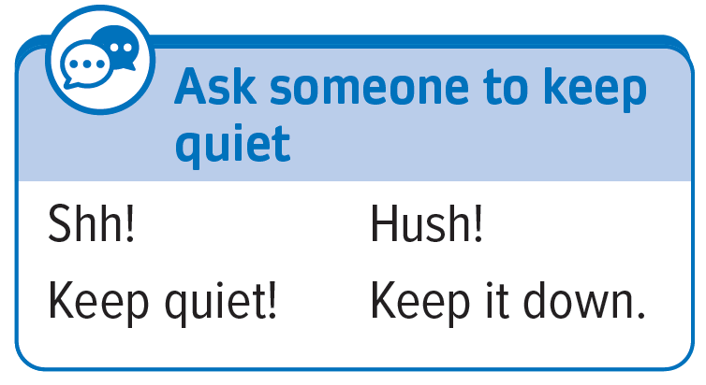
We can also say …

Slide 9
Let’s practise these expression.
Shh! You will scare it.
Hush! You will scare it.
Keep quiet! You will scare it.
Keep it down. You will scare it.

Slide 10
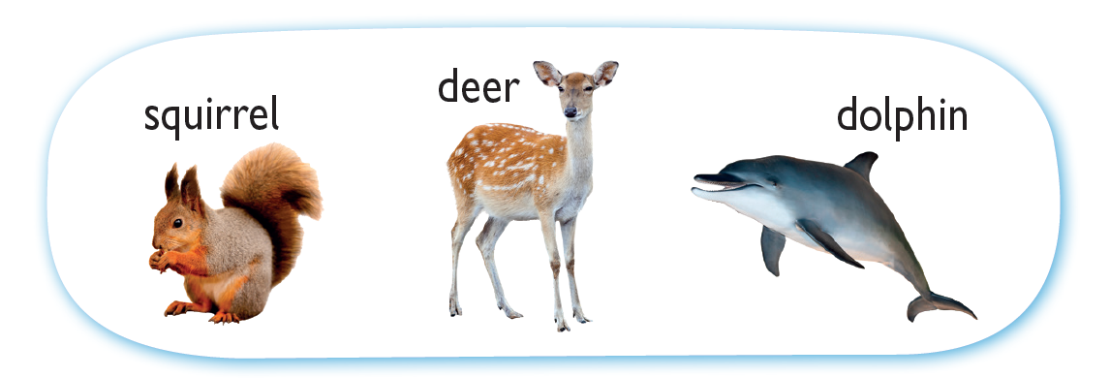
Let’s role-play the conversation using different animals.

Slide 11
Let’s role-play the conversation using different animals.

Slide 13
Acknowledgements
We would like to thank the following organisations and people for permission to use their images:
Allinone / Shutterstock
JAH / stock.adobe.com
nelik / Shutterstock
pathdoc / Shutterstock
SiiKA Photo / Shutterstock
TimeImage Production / Shutterstock
Александр Лебедько / stock.adobe.com

