Slide 1


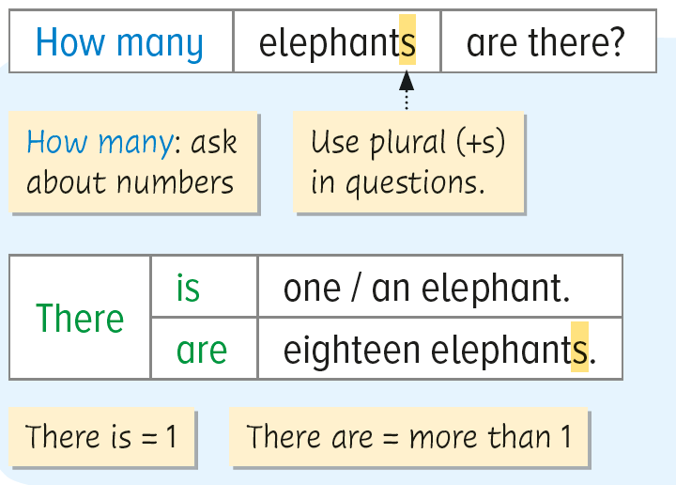
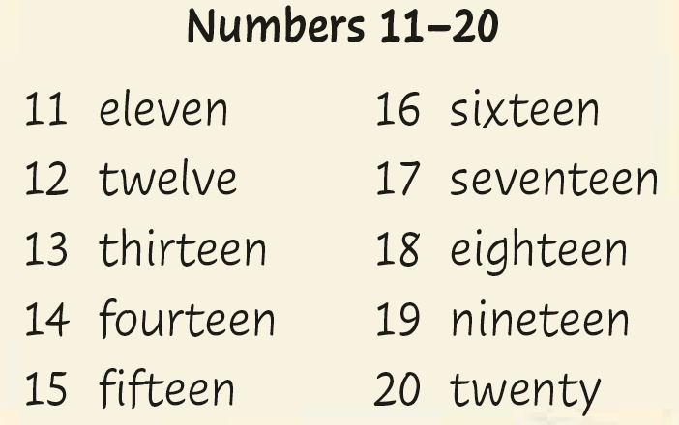
Chapter 4

Slide 2
Grammar 1
In this part, you will learn:
to ask questions about numbers.
to use There is / are to talk about the number of animals.

Slide 3
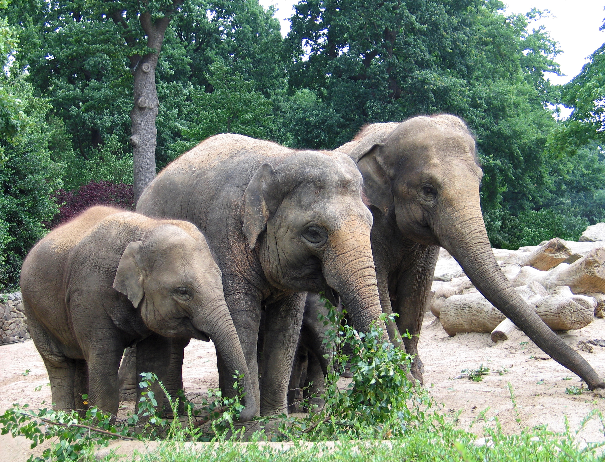

How many …?
Cindy and her mum and dad are at the zoo. They want to know the number of elephants there. What can they say?
How many elephants are there?

Slide 4

How many …?
Correct! We can use How many to ask about the number of things.
How many elephants are there?
We always use the plural (+s) in the question.

Slide 5
How many …?
So how many elephants are there? Let’s count!
3
How many elephants are there?
2
are
there
1
There
are
three elephants.

Slide 6
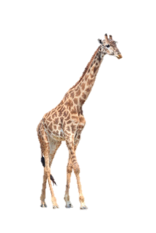
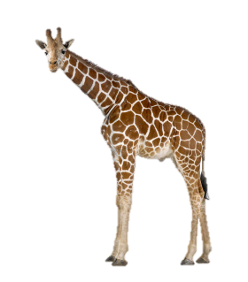
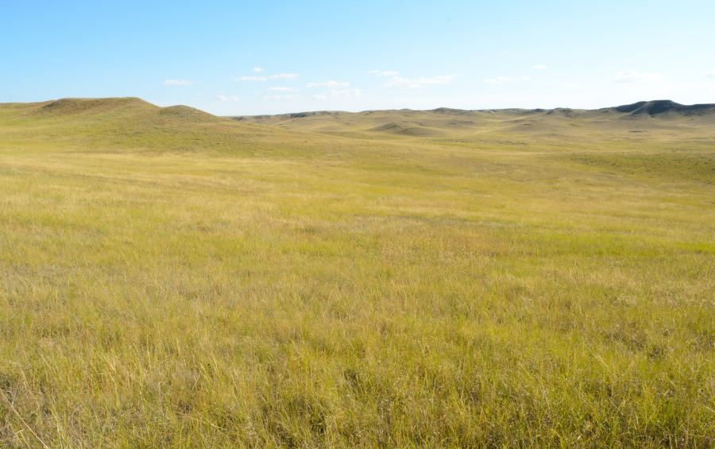
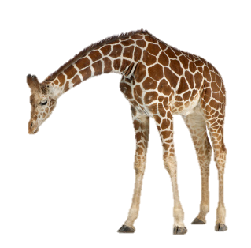
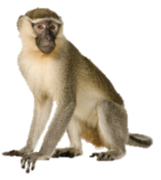
How many …?
Now Cindy is looking at some other animals. Let’s help her count.
A:
B:
How many giraffes are there?
There are eleven giraffes.
3
6
2
4
1
8
10
7
5
9
11

Slide 7
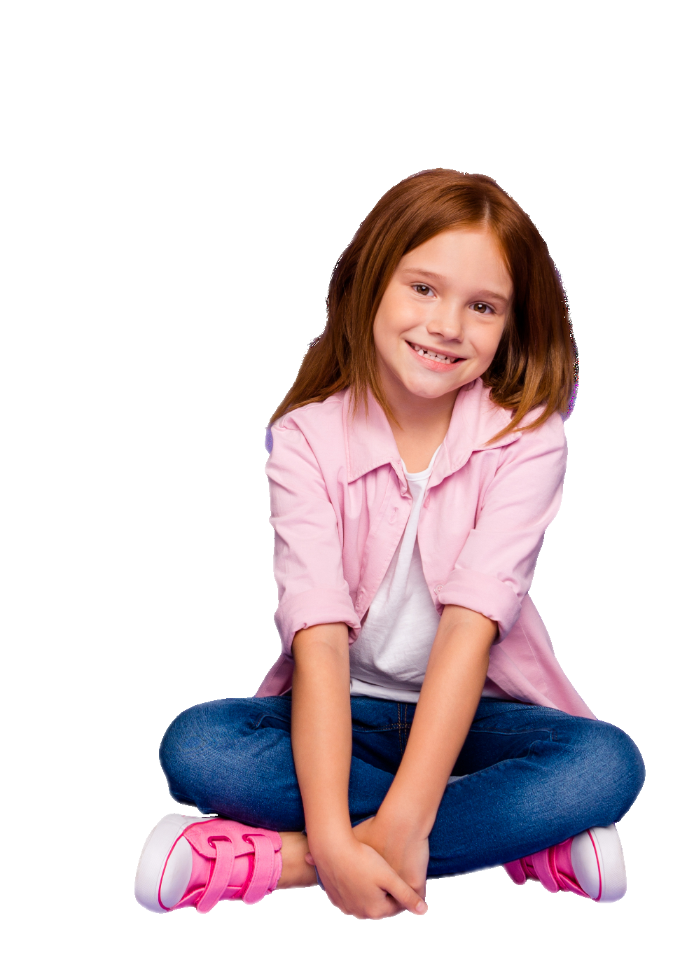
How many …?
Now Cindy is looking at some other animals. Let’s help her count.
What about the number of monkeys?

Slide 8
How many …?
Now Cindy is looking at some other animals. Let’s help her count.
A:
B:
How many monkeys are there?
There is one monkey.
Just one!

Slide 9
How many …?
Now Cindy is looking at some other animals. Let’s help her count.
A:
B:
How many monkeys are there?
There is one monkey.
Or: There is a monkey.
Just one!

Slide 10
How many …?
Now Cindy is looking at some other animals. Let’s help her count.
A:
B:
How many monkeys are there?
There is one monkey.
We still use the plural in the question when there is only one animal!
Or: There is a monkey.
We use There is when there is only one.

Slide 11

How many …?
Now Cindy is looking at some other animals. Let’s help her count.
A:
B:
How many monkeys are there?
There is one monkey.
Or: There is a monkey.
Let’s look for more animals around!

Slide 12

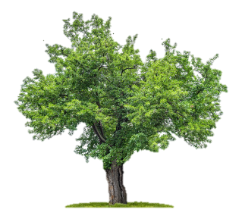
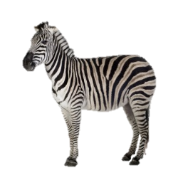

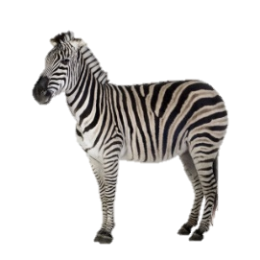

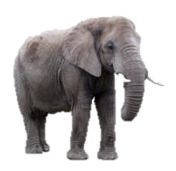



How many …?
A:
B:
A:
B:
How many zebras are there?
There are fifteen zebras.
How many elephants are there?
There is an / one elephant.
There have …
There has …
15
1

Slide 13

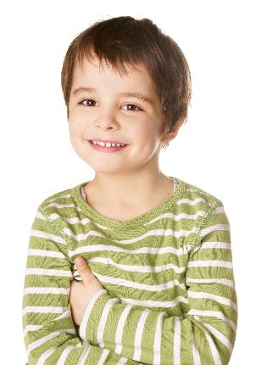

Quick check
1. Fill in the blank.
Miss Lam : How many books are there?
Student : ________ five books.
There are

Slide 14
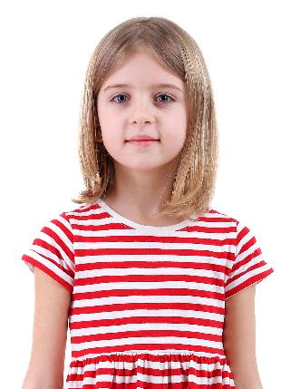
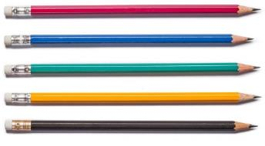
Quick check
2. Fill in the blanks.
Miss Lam : ________ pencils are there?
Student : ______________ pencils.
How many
There are fifteen
15

Slide 15
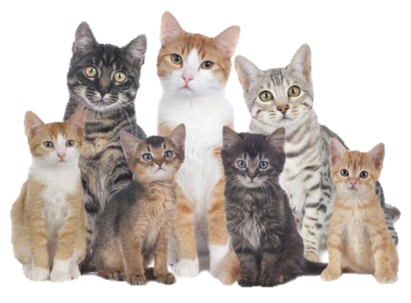
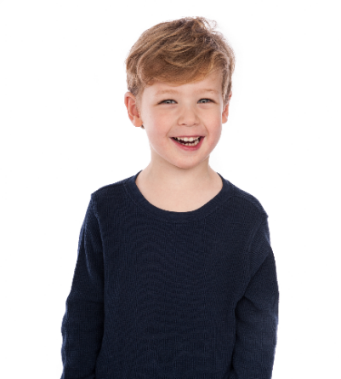
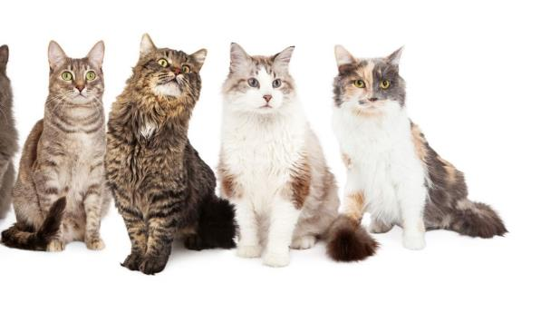
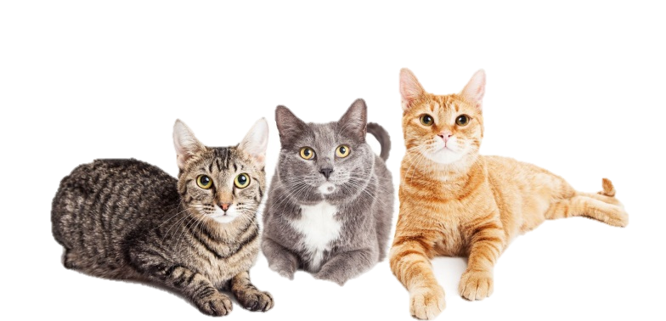
Quick check
3. Fill in the blanks.
How many cats
Miss Lam : _____________ are there?
Student : ____________________
There are fourteen cats.
14

Slide 16
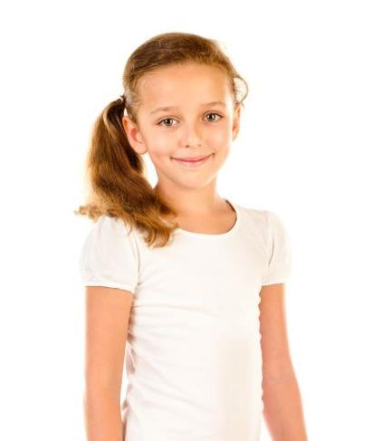
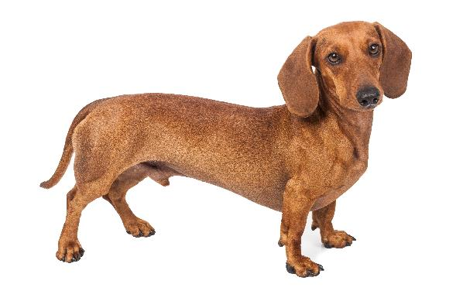
Quick check
4. Fill in the blanks.
How many dogs
Miss Lam : _____________ are there?
Student : ______________
There is one dog.
Or: There is a dog.

Slide 17

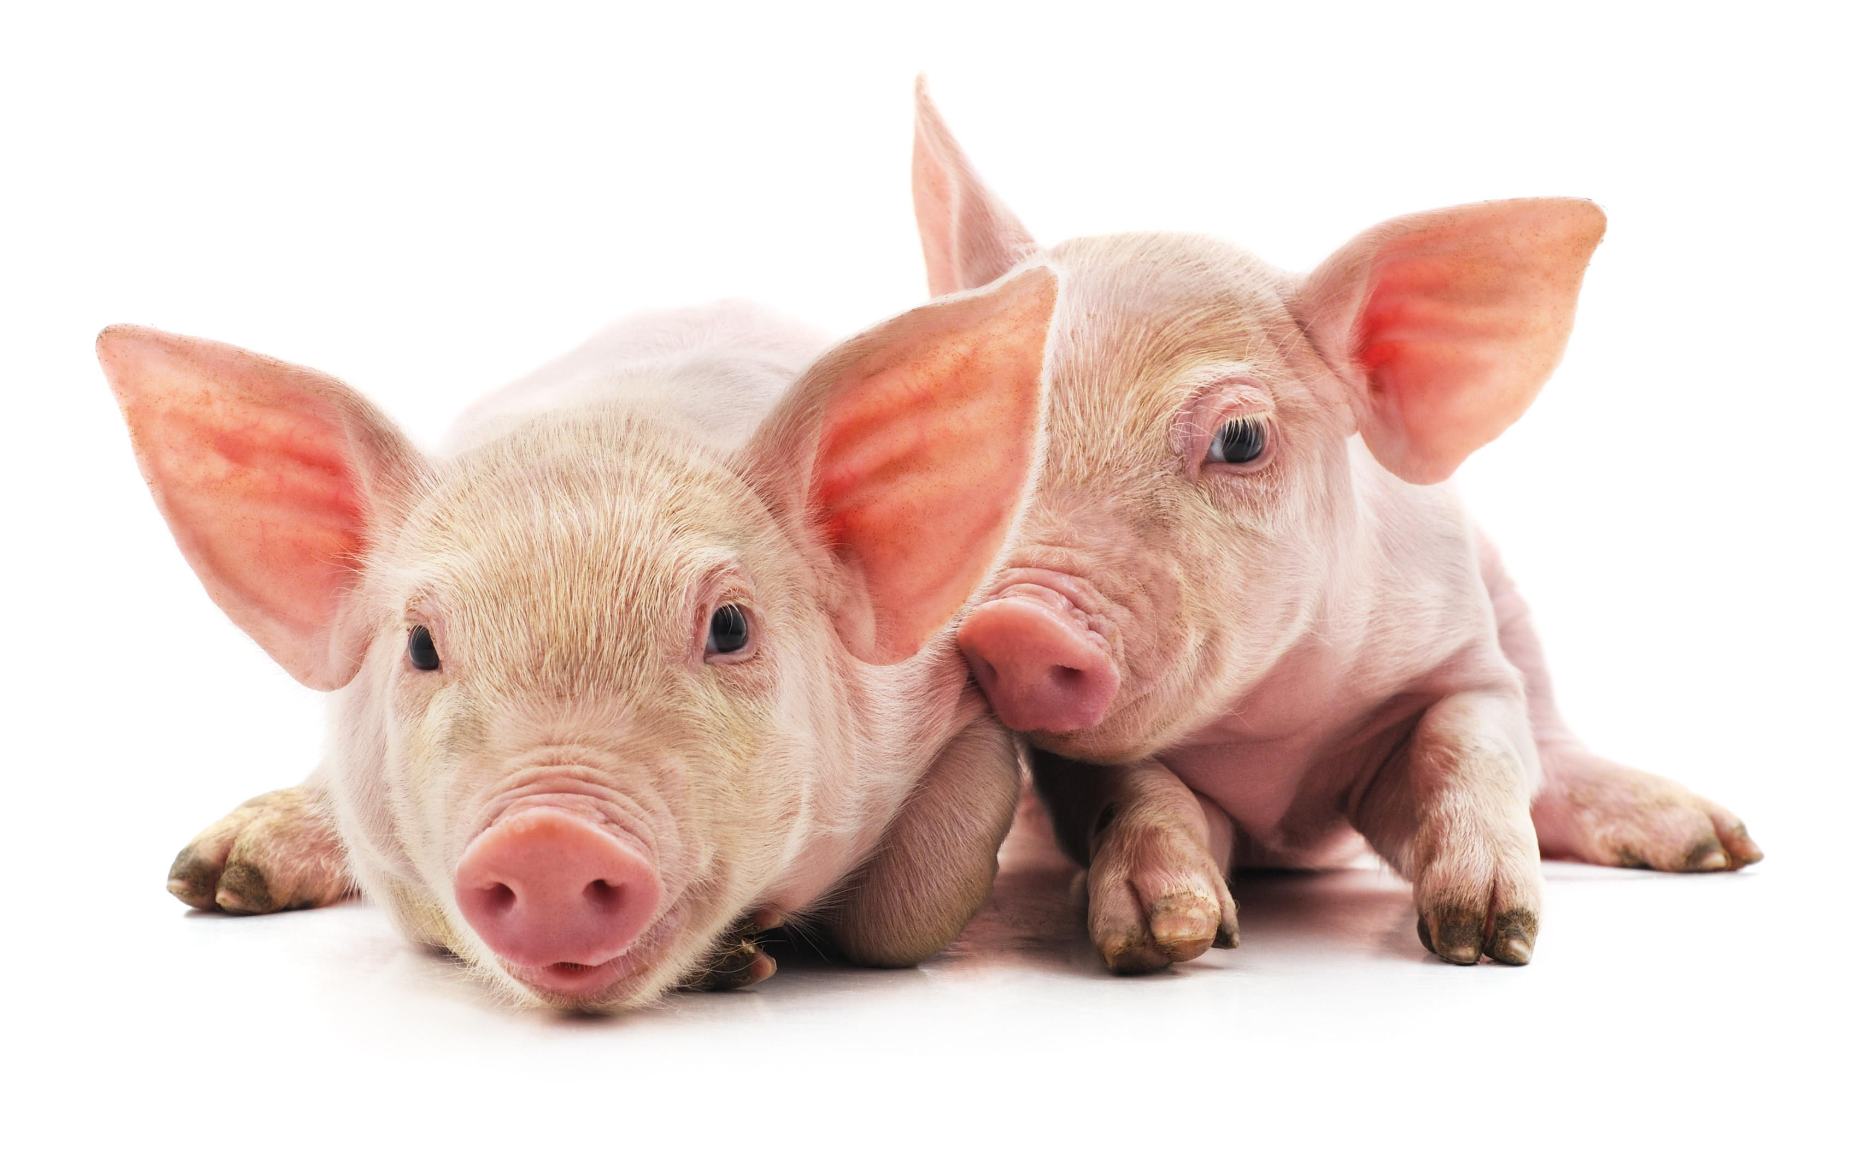
Quick check
5. Complete what Miss Lam and the student say with ‘How many’.
Miss Lam : ____________________ ?
Student : __________________
How many pigs are there
There are two pigs.

Slide 18

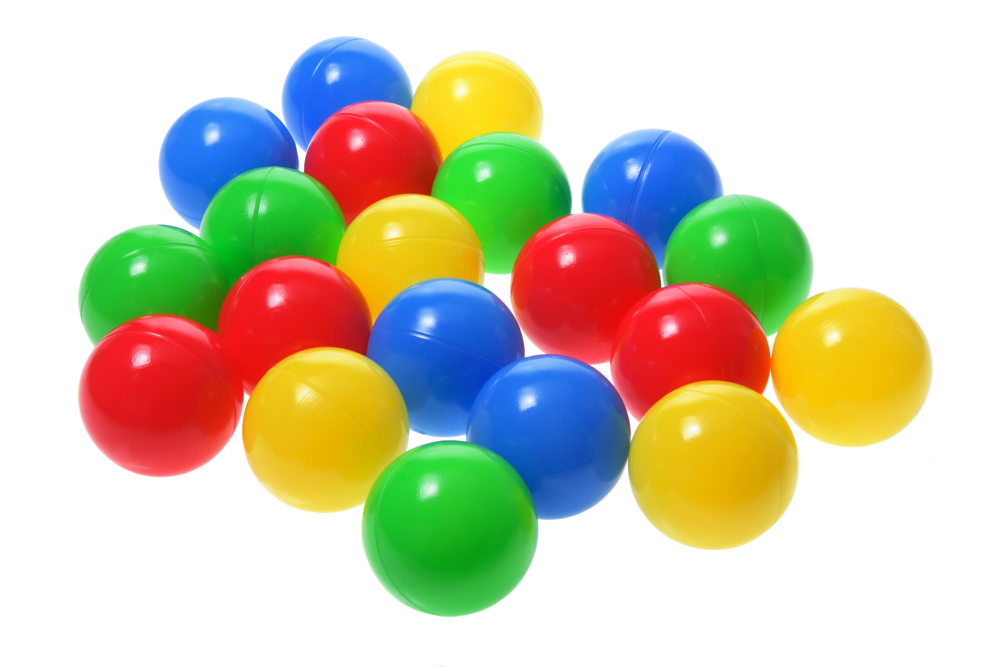
Quick check
6. Complete what Miss Lam and the student say with ‘How many’.
Miss Lam : _______________________ ?
Student : ___________________
How many balls are there
There are twenty balls.
20

Slide 19
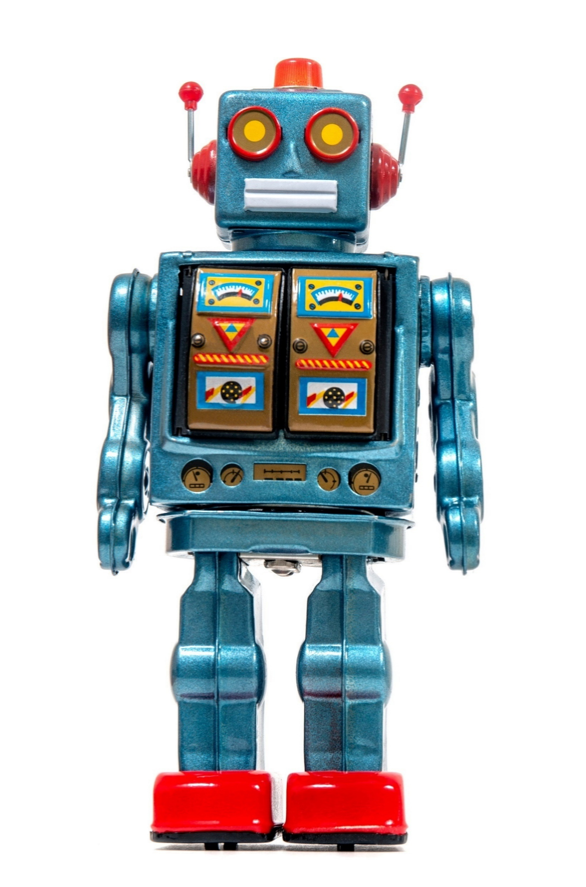

Quick check
7. Complete what Miss Lam and the student say with ‘How many’.
Miss Lam : ______________________ ?
Student : __________________
How many robots are there
There is one robot.
Or: There is a robot.

Slide 21
Acknowledgements
We would like to thank the following organisations and people for permission to use their images:
Andrii_M / Shutterstock
absolutimages / Shutterstock
Africa Studio / Shutterstock
Anastasia Shilova / Shutterstock
Be Good / Shutterstock
cyo bo / Shutterstock
deagreez / stock.adobe.com
Eric Isselee / Shutterstock
fotomatrix / stock.adobe.com
GongTo / Shutterstock
Gonzalo Calle Asprilla / 123RF
leungchopan / Shutterstock
LIGHTFIELD STUDIOS / stock.adobe.com
Louis-Photo / stock.adobe.com
Mauro Rodrigues / stock.adobe.com
peopleimages.com / stock.adobe.com
Picture Partners / stock.adobe.com
Quang Ho / Shutterstock
redlinevector / 123RF
Richard Peterson / Shutterstock
SLP_London / Shutterstock
Susan Schmitz / Shutterstock
ventura / stock.adobe.com
voren1 / stock.adobe.com
Zack Frank / Shutterstock
zerbor / 123RF

