Slide 1
Chapter 4
Practice Answer Key

Slide 2
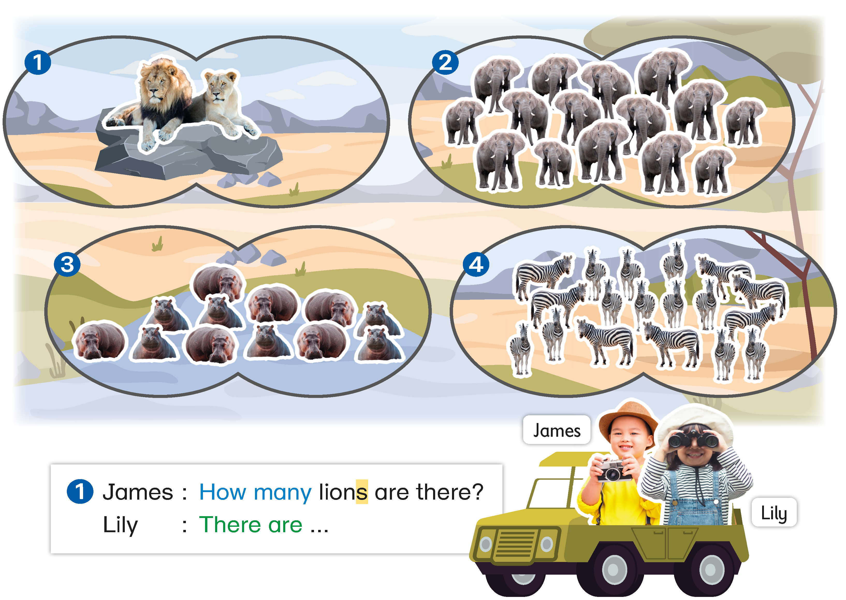
The children are counting the animals in a safari park. Finish what they say.

Slide 3
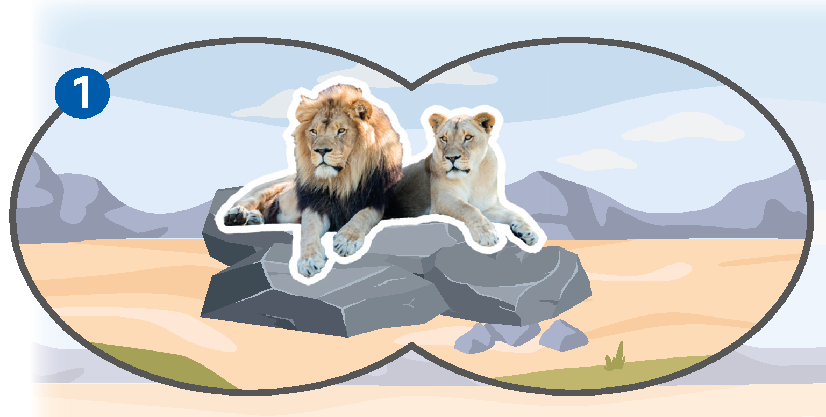
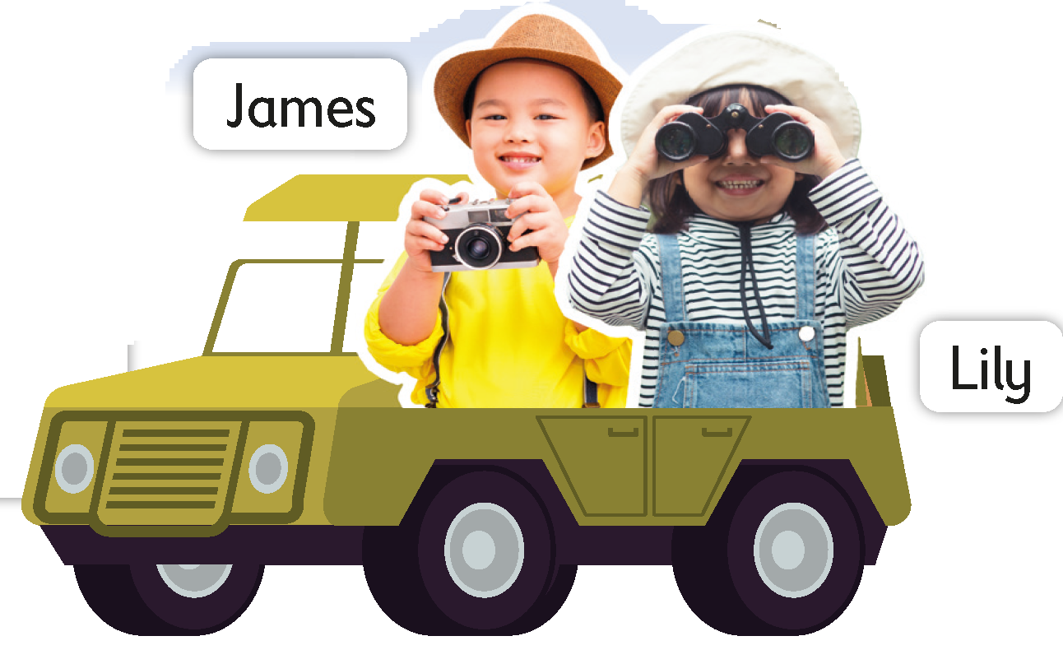


Here is an example.
Lions?
1
2
James: How many lions are there?
Lily : There are two lions.

Slide 4

Now you try.

Slide 5
The children are counting the animals in a safari park. Finish what they say.
Lions?
1
2
James: How many lions are there?
Lily : There are two lions.

Slide 6
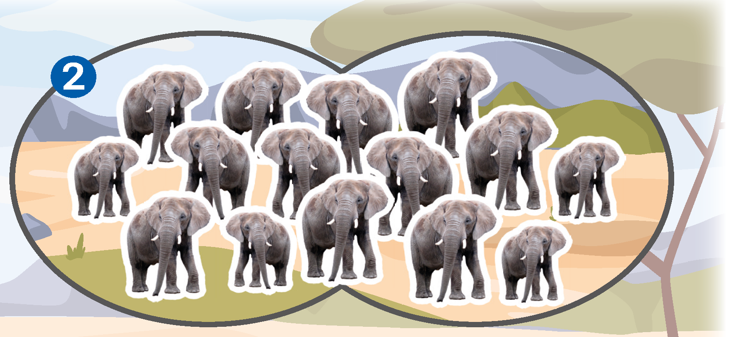

The children are counting the animals in a safari park. Finish what they say.
2
3
5
Elephants?
4
6
7
9
8
10
1
13
15
11
12
14
James: How many elephants are there?
Lily : There are fifteen elephants.

Slide 7
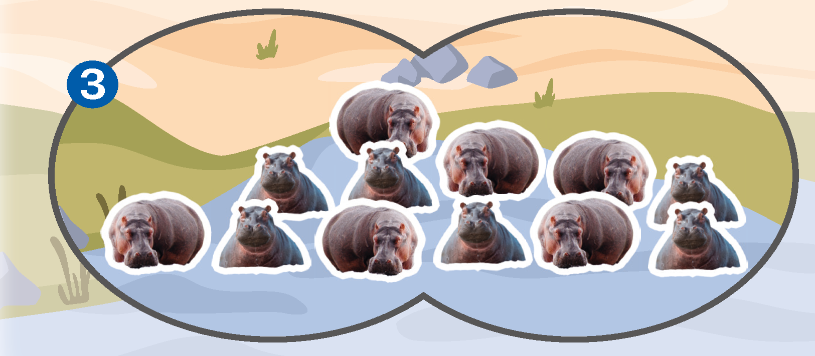
The children are counting the animals in a safari park. Finish what they say.
3
Hippos?
4
5
2
6
12
1
11
10
9
8
7
James: How many hippos are there?
Lily : There are twelve hippos.

Slide 8
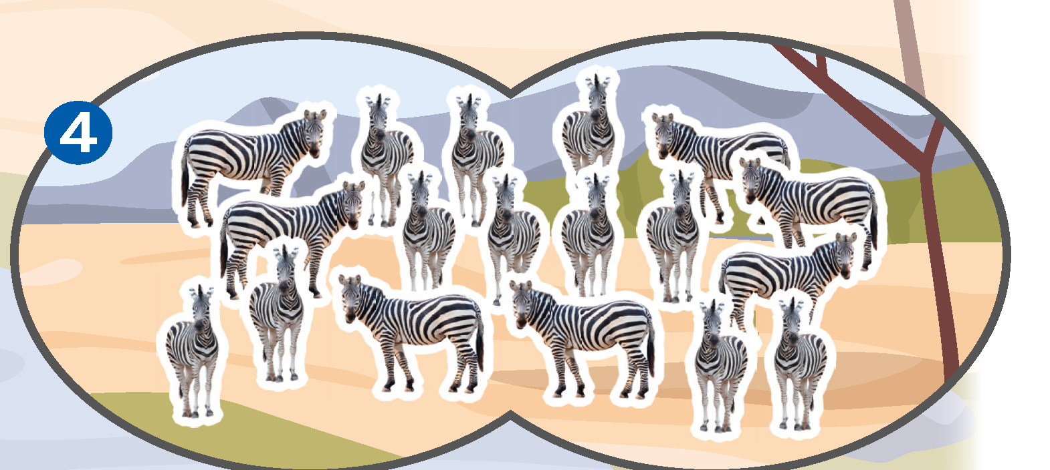
The children are counting the animals in a safari park. Finish what they say.
2
3
4
1
5
Zebras?
6
7
8
9
10
11
12
14
15
16
13
17
18
James: How many zebras are there?
Lily : There are eighteen zebras.

Slide 10
Acknowledgements
We would like to thank the following organisations and people for permission to use their images:
Adwo / Shutterstock
Anan Kaewkhammul / Shutterstock
Andrii_M / Shutterstock
FAMILY STOCK / Shutterstock
Image Source Trading Ltd / Shutterstock
Jan Martin Will / Shutterstock
Jeka / Shutterstock
Jeka / Shutterstock
mojoeks / Shutterstock
Richard Peterson / Shutterstock
Sabelskaya / Shutterstock
Sensvector / Shutterstock
vilax / Shutterstock
Warut Chinsai / Shutterstock

