Slide 1
Chapter 4
Animals and body parts

Slide 2

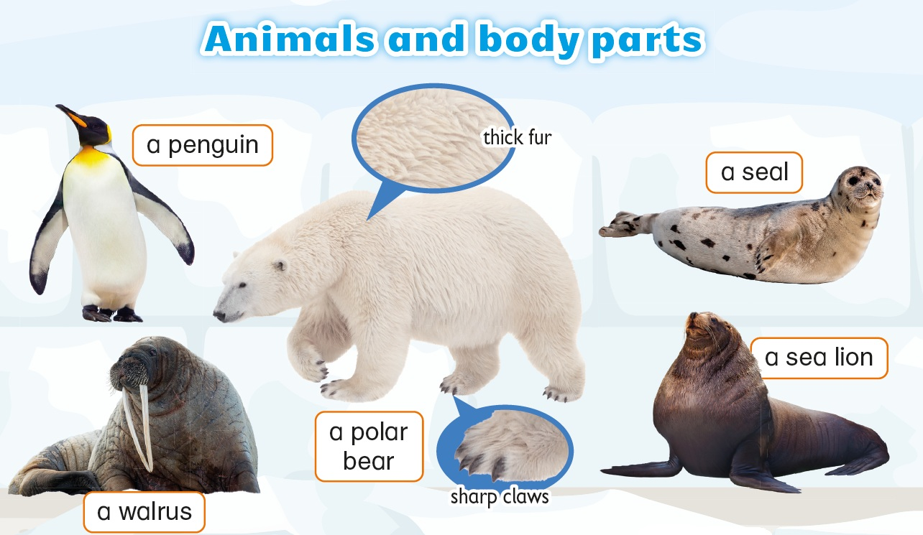


Slide 3
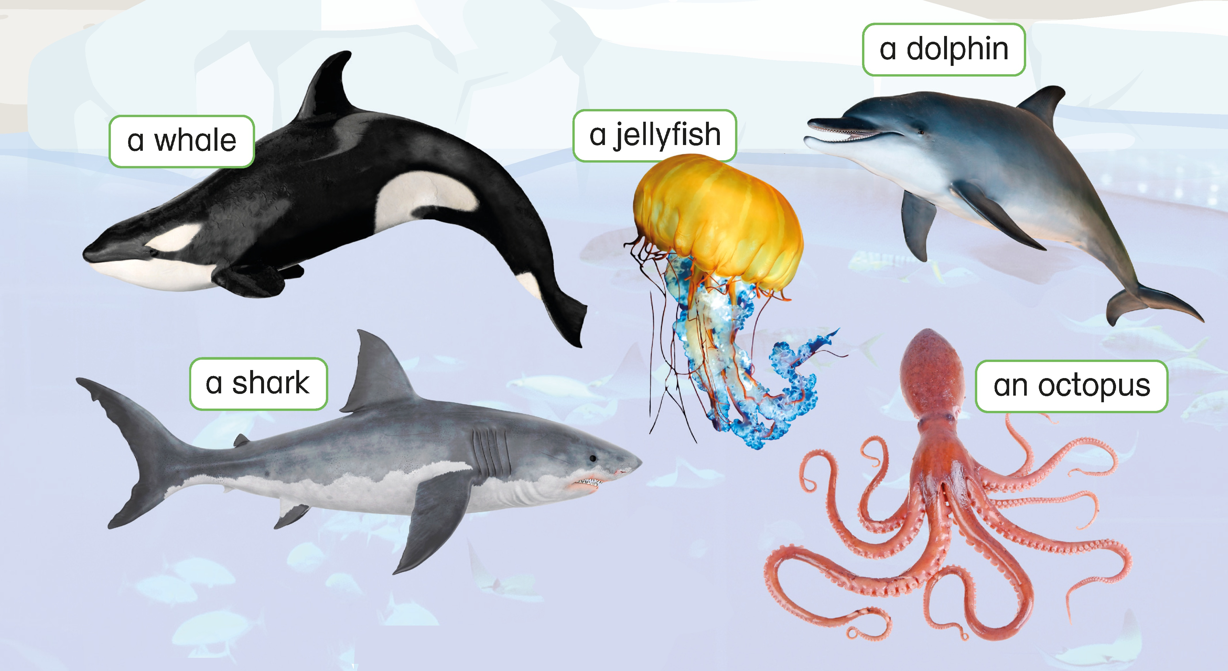


Slide 4
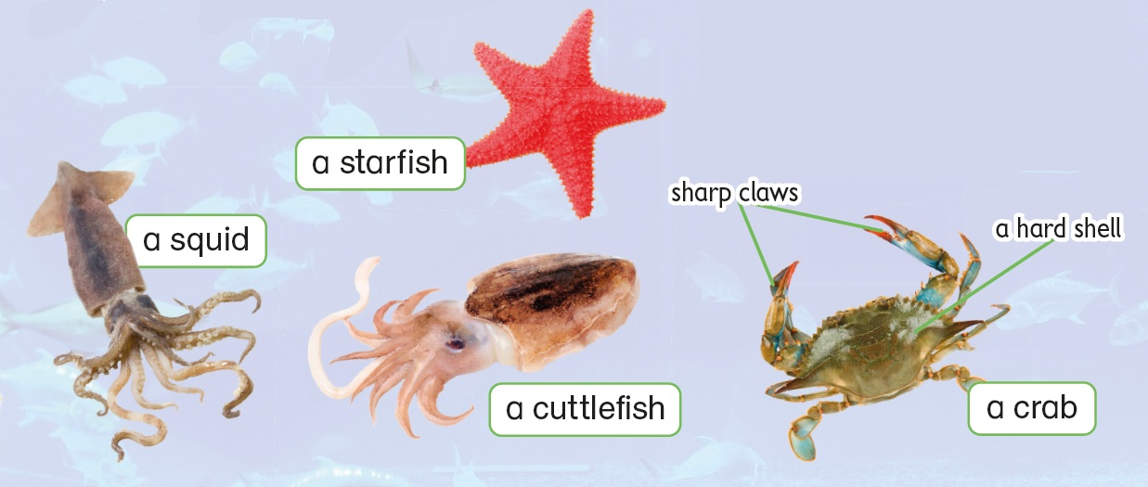

Slide 5
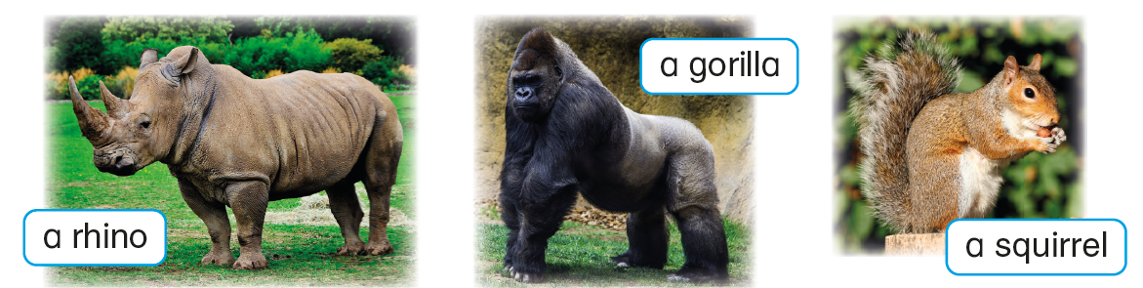

Slide 6
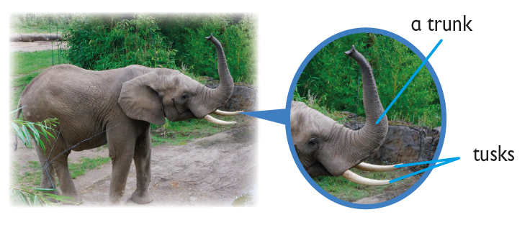

Slide 7
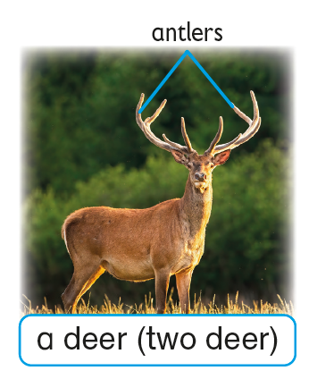
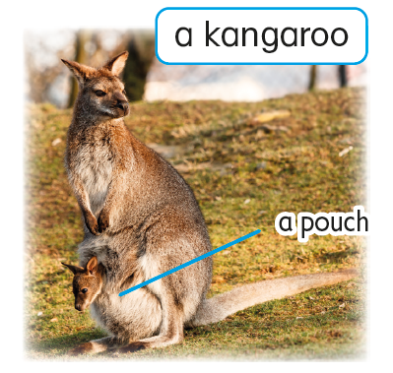

Slide 8
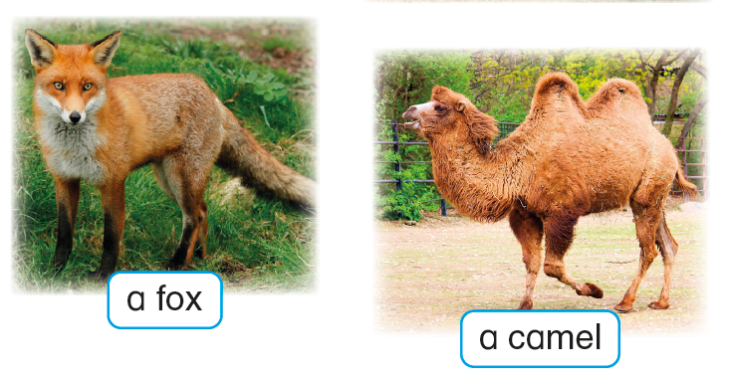

Slide 9
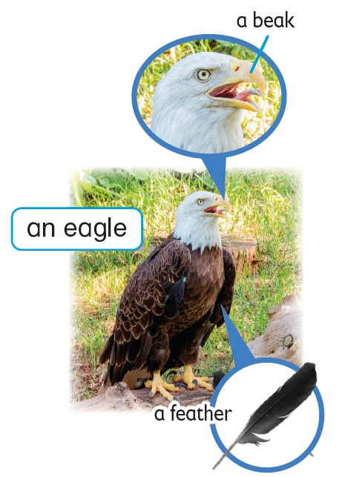
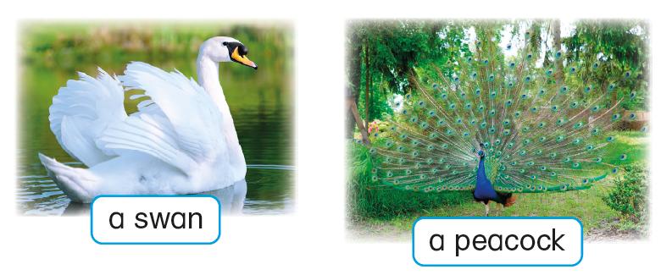

Slide 10
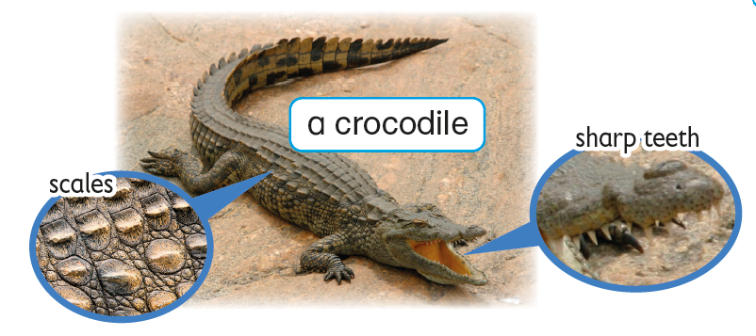

Slide 12
Acknowledgements
We would like to thank the following organisations and people for permission to use their images:
bimserd / Shutterstock
Christian Musat / Shutterstock
Dmitry Abduraimov / Shutterstock
Dolores M. Harvey / Shutterstock
Feng Yu / Shutterstock
g images.com / Shutterstock
Gert Very / 123RF
GN.Studio / Shutterstock
Helmut Hirt / Shutterstock
Ian Rentoul / Shutterstock
Igor Dmitriev / 123RF
ILYA AKINSHIN / Shutterstock
islavicek / Shutterstock
JIANG HONGYAN / Shutterstock
Kit Leong / Shutterstock
Kletr / Shutterstock
Mariola Anna S / Shutterstock
Mats Brynolf / Shutterstock
Mindok / Shutterstock
nadtytok / Shutterstock
Nerthuz / Shutterstock
PhotoSky / Shutterstock
s99 / Shutterstock
scooperdigital / Shutterstock
SiiKA Photo / Shutterstock
volkova natalia / Shutterstock
WildMedia / Shutterstock
zhengzaishuru / Shutterstock
Zloneg / Shutterstock

