Slide 1


Chapter 4
Law-abidingness
Follow the rules

Slide 2
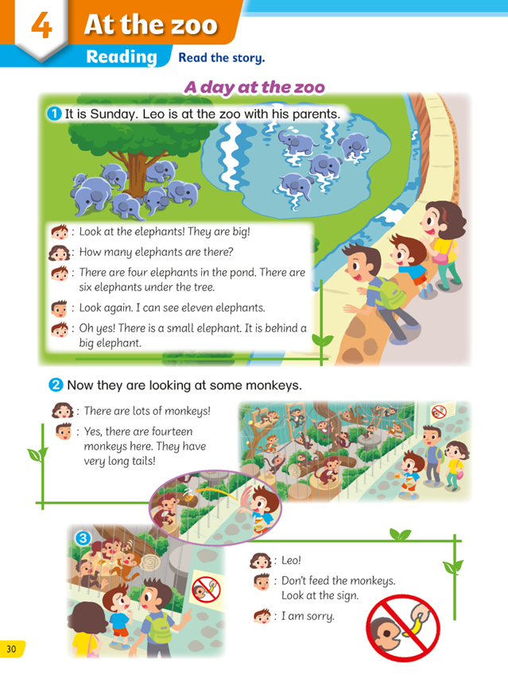
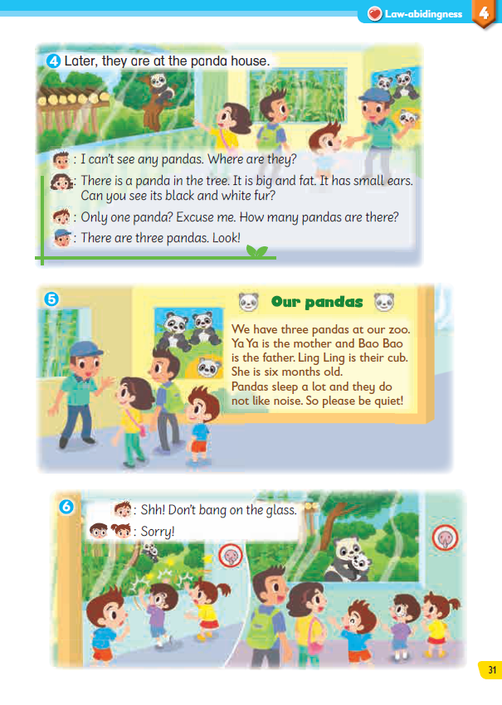
Do you remember what happens in the story?

Slide 3
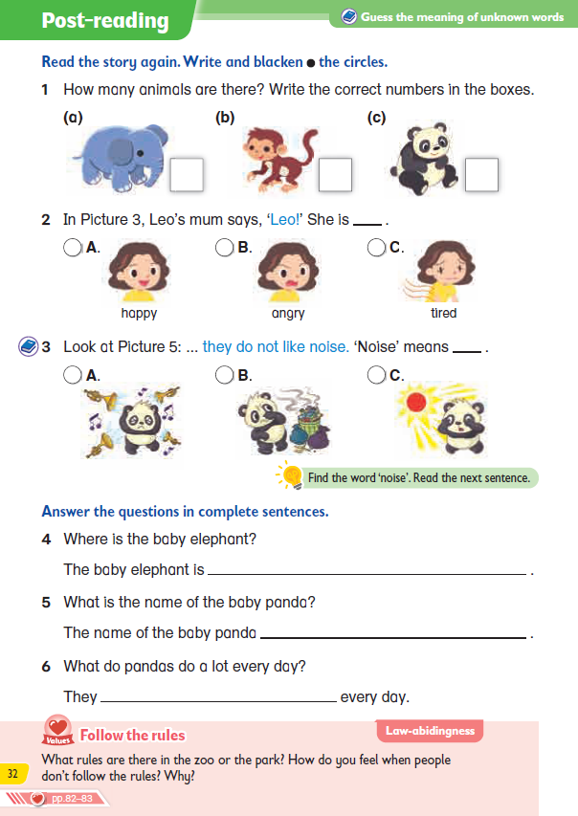
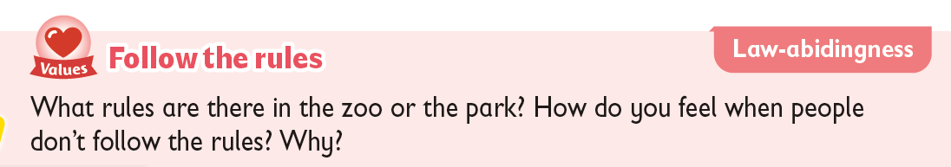
What is the story trying to teach us?

Slide 4

How does the story teach us to follow the rules?
Let’s find out!

Slide 5
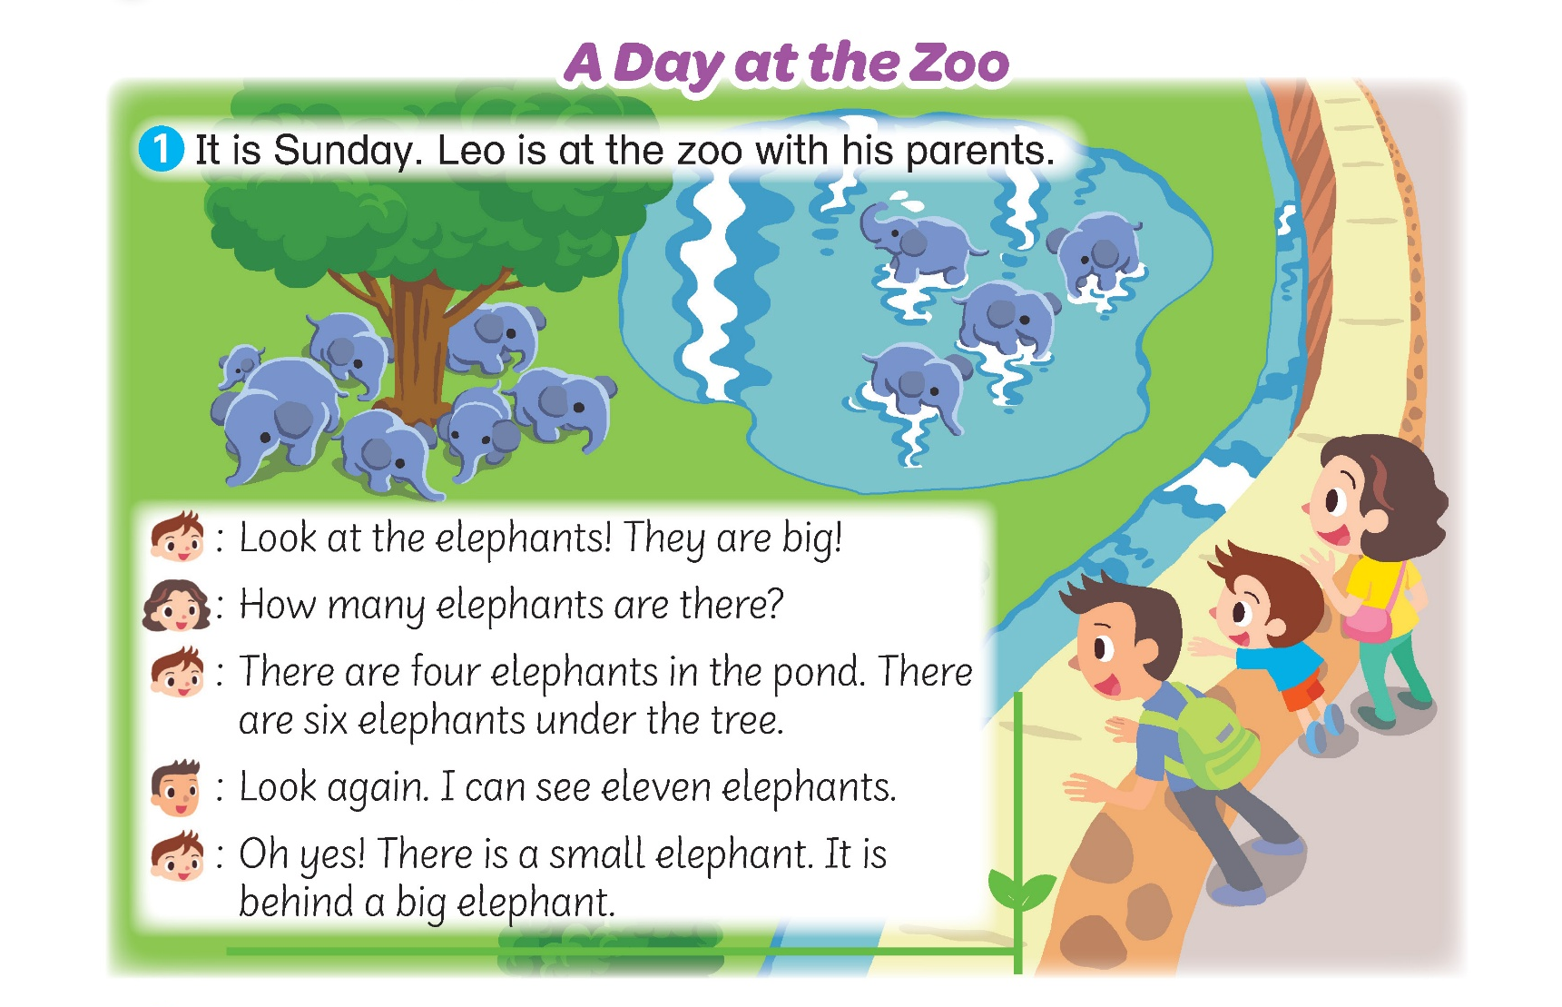
Where are Leo and his family?
They are at the zoo.

Slide 6
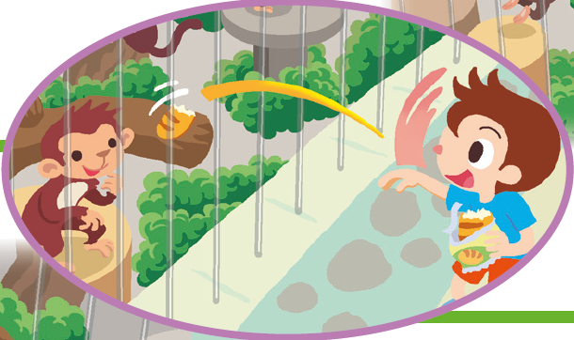
What is Leo trying to do?
He is trying to feed some monkeys.

Slide 7
Can he do that?
NO!

Slide 8
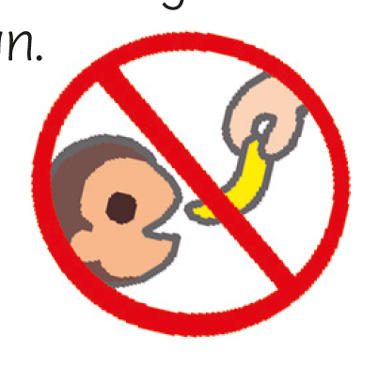
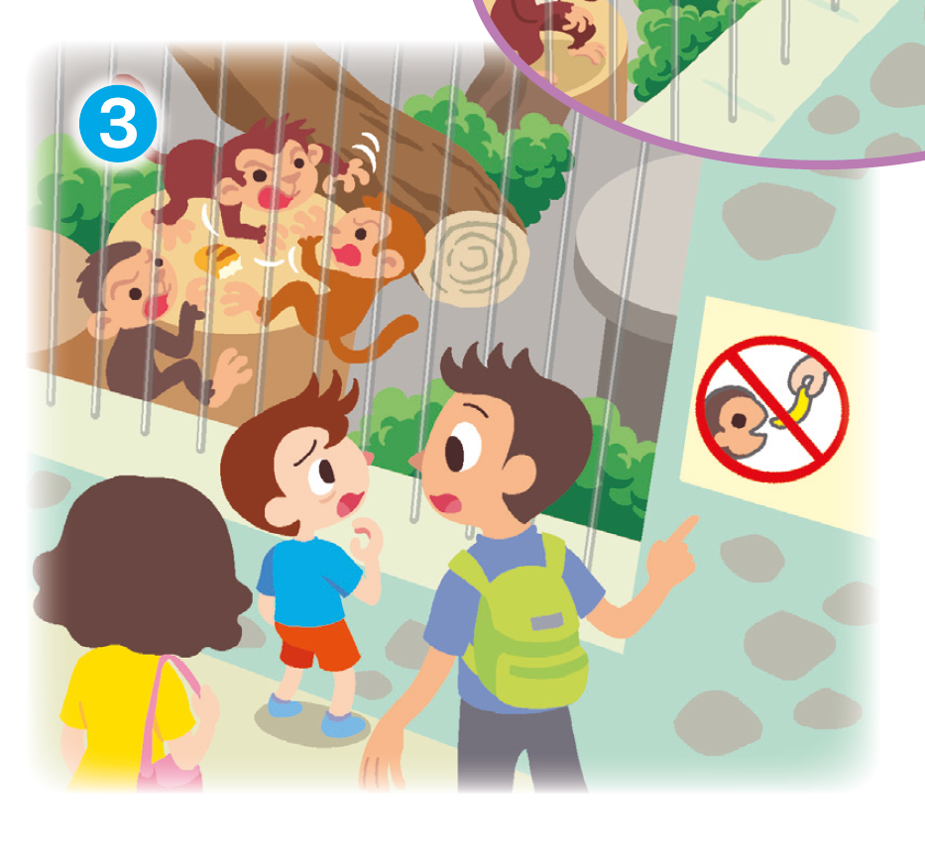
Why not?
There is a sign. It means ‘Don’t feed the monkeys’ !

Slide 9
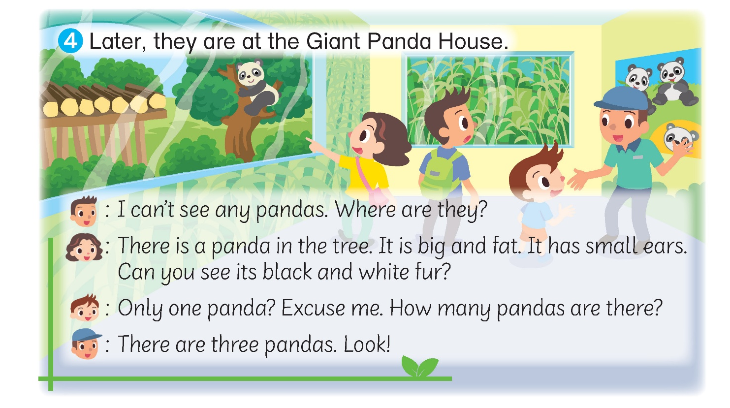
Next, they go to the Giant Panda House.

Slide 10
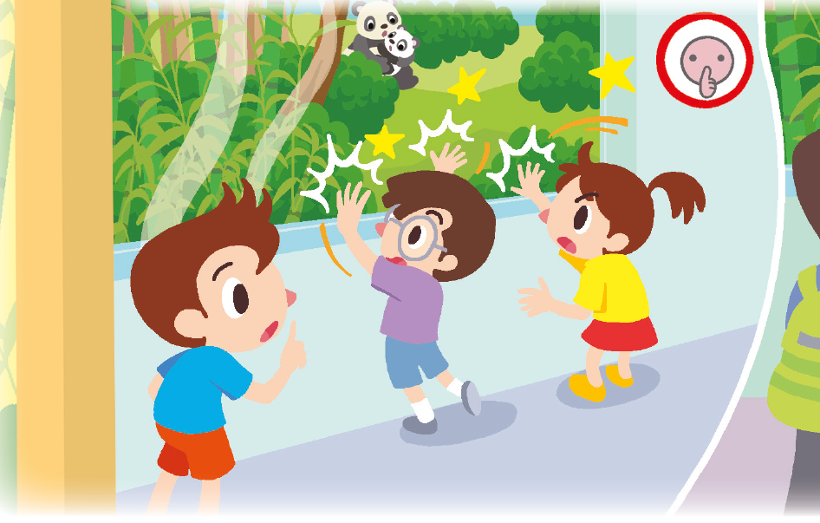
What happens there?
Some children are banging on the glass.

Slide 11

Why can’t they do that?
There is a ‘Keep quiet’ sign!

Slide 12
In the story, Leo and the children make a mistake. They don’t follow the rules the zoo!
What may happen when people don’t follow the rules?
Let’s find out!

Slide 13
What may happen if the monkeys eat Leo’s food?
Monkey become sick?
Leo gets hurt?
What may happen if the children keep banging on the window?
Glass may break? Pandas scared?

Slide 14
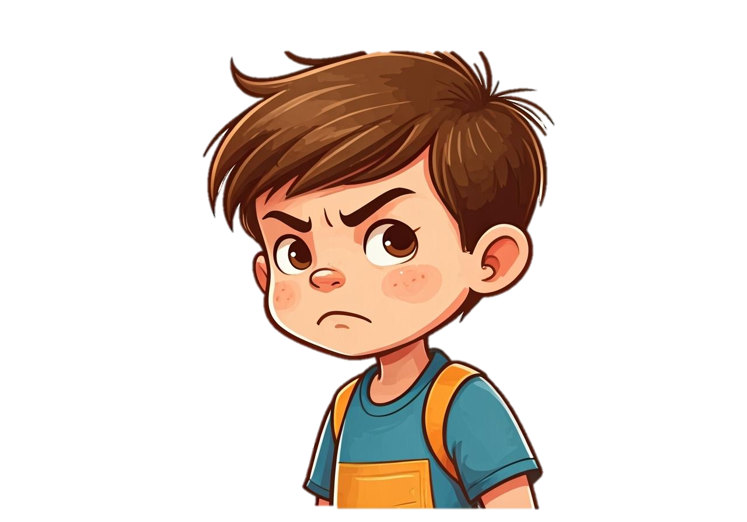
How do you feel when people don’t follow the rules?
Angry? Unhappy?
What can you say to remind other people to follow the rules?
Please … / Can you …?

Slide 15



The rules help keep the animals safe and happy. They also protect us.
Can you think of more rules in the zoo?

Slide 16
Remember to follow the rules the next time we visit the zoo!

Slide 17

Other than the zoo, we also follow rules at the school!
Let’s look at the following situation.

Slide 18
Let’s learn from Leo and the children it the story.
Remember to follow the rules no matter where we are. They protect us and help make the world a better place for everyone!

Slide 19
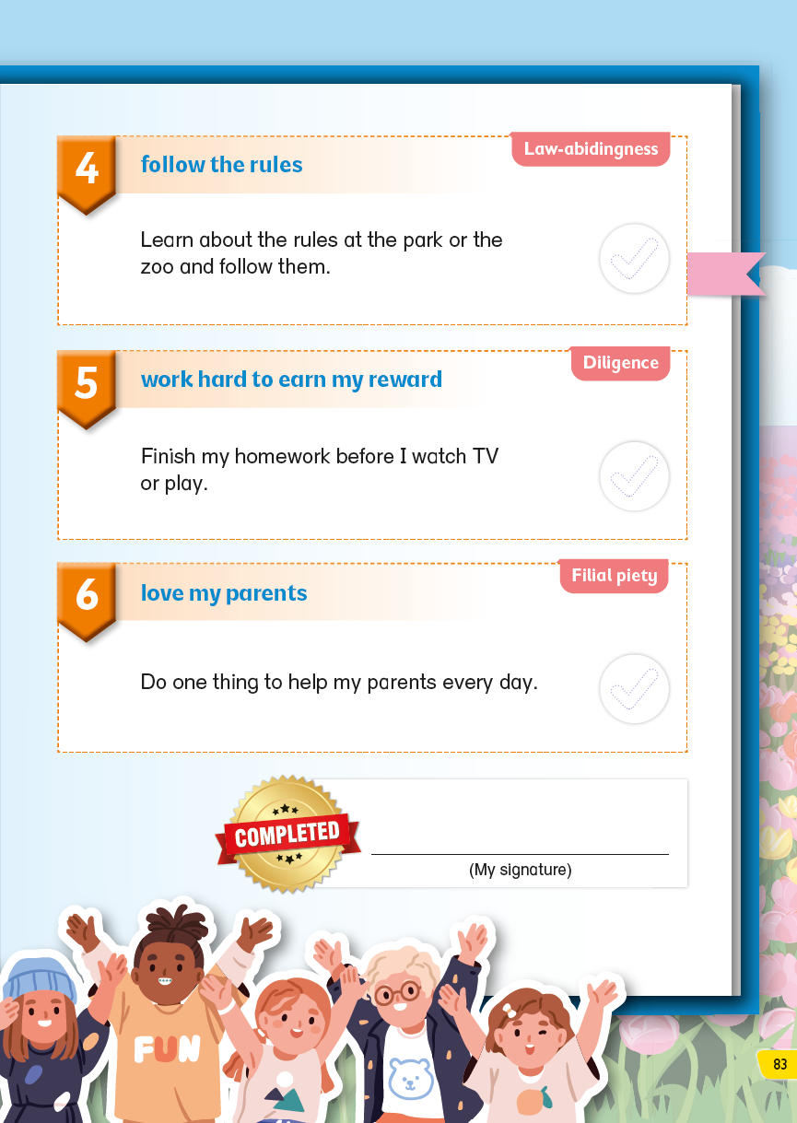
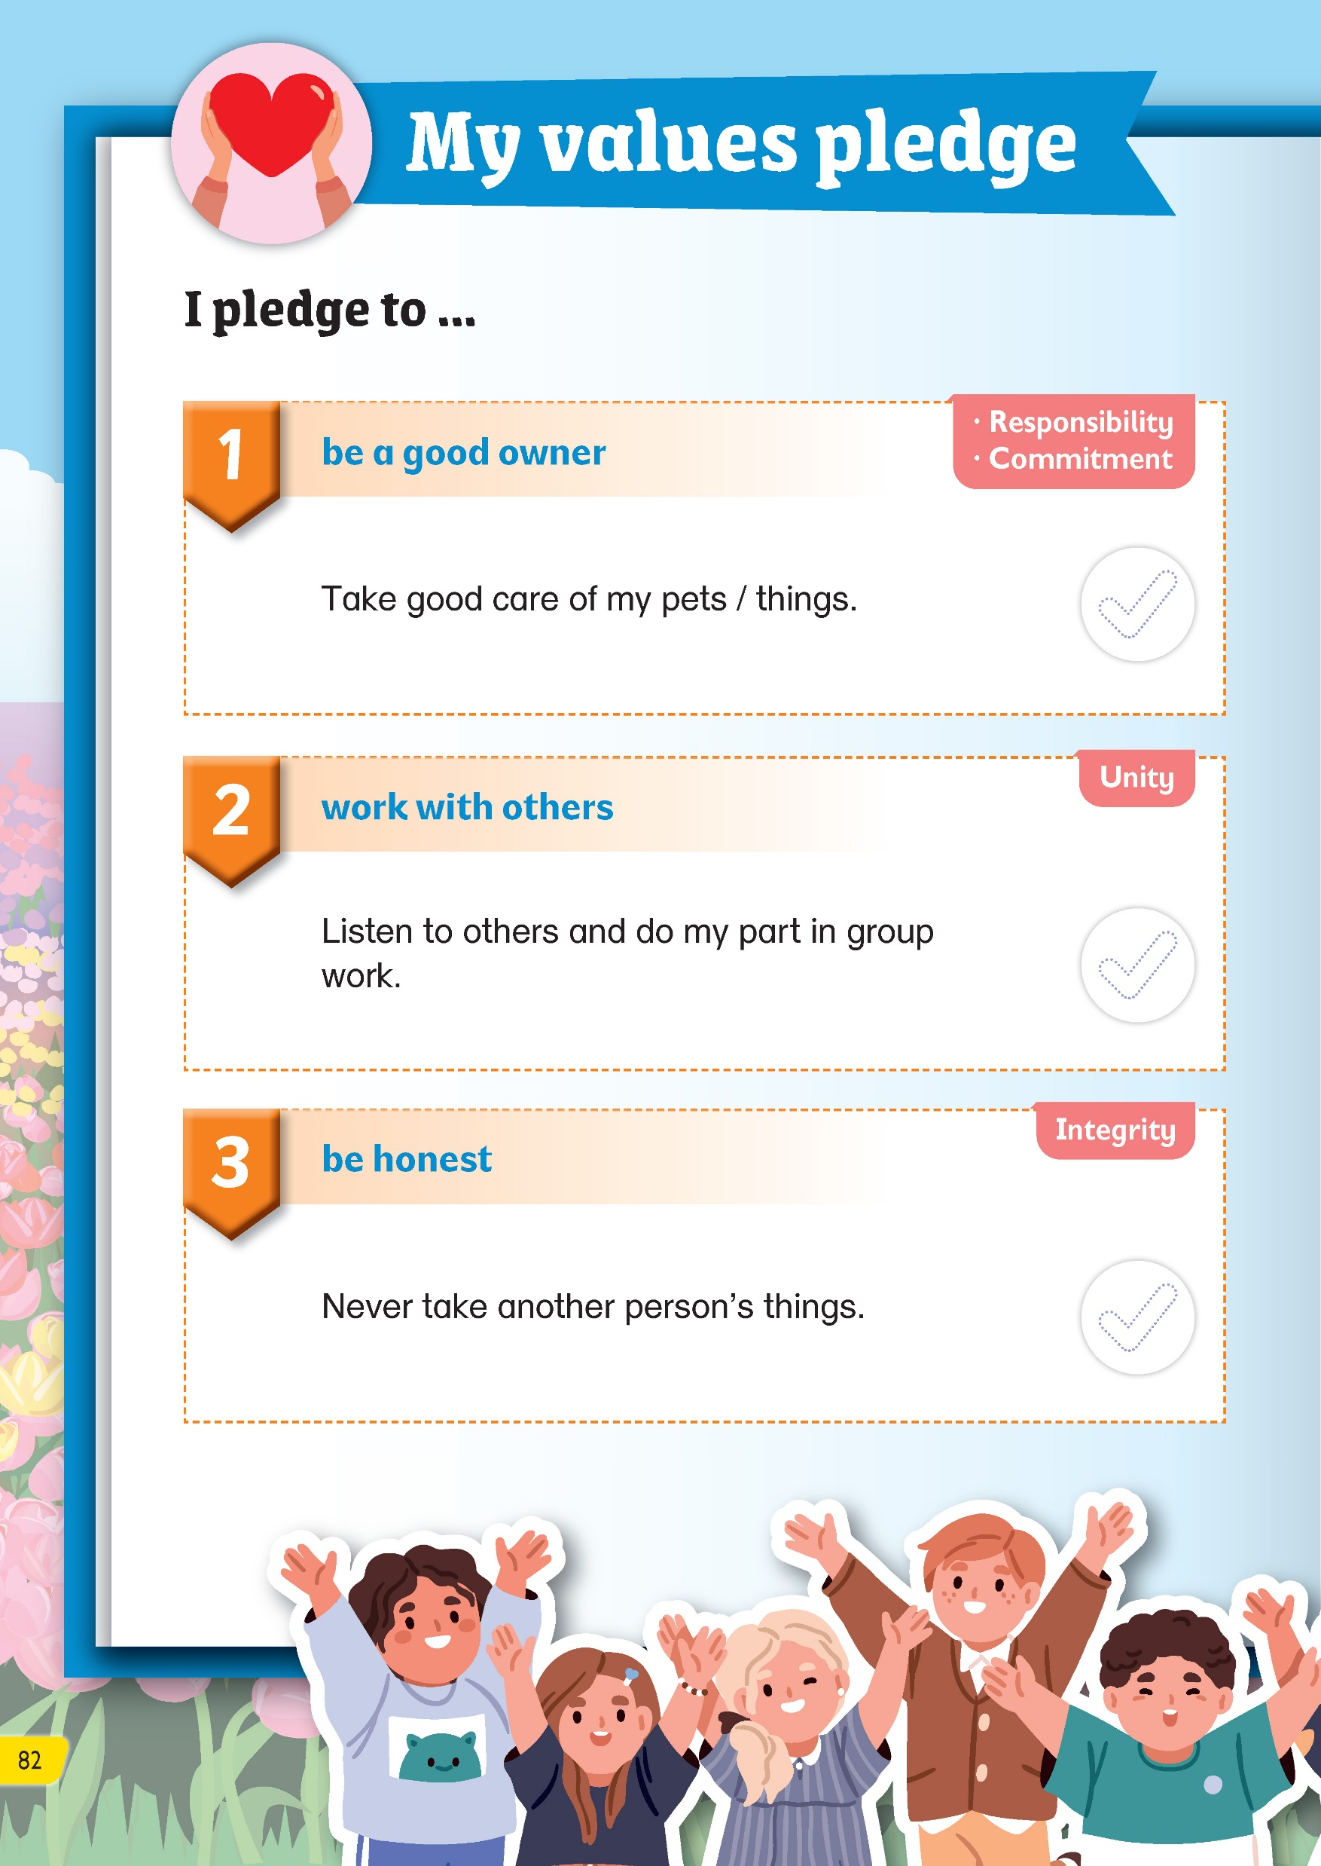
Don’t forget to complete My values pledge!
✓
.

Slide 21
Acknowledgements
We would like to thank the following organisations and people for permission to use their images:
Aquir / stock.adobe.com
Bilal Sirrullah / Shutterstock
blacklight_trace / stock.adobe.com
Good Studio / stock.adobe.com
Only Best PNG's (AI) / stock.adobe.com
solthanya / stock.adobe.com

