Slide 1
Chapter 4
Guess the meaning of unknown words

Slide 2
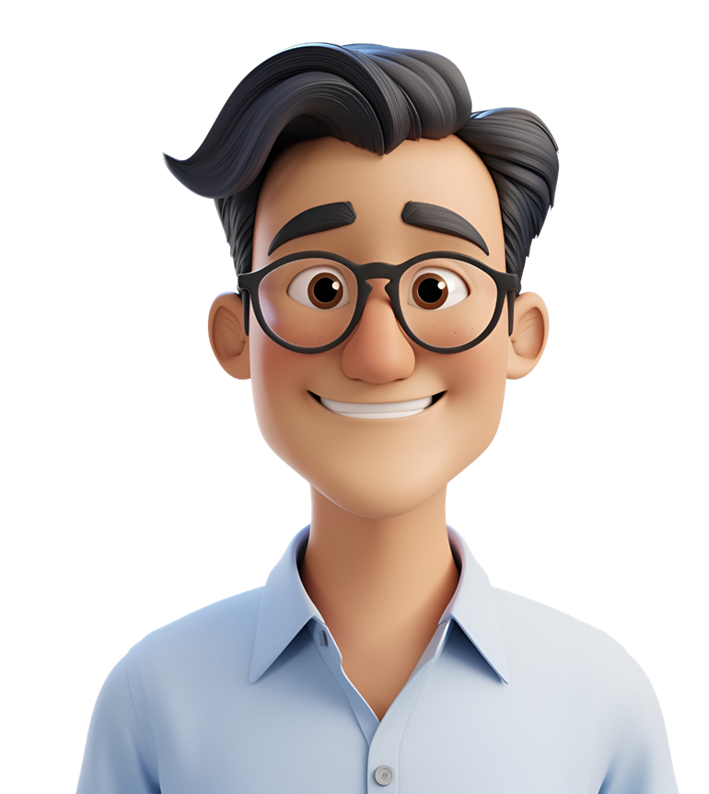
Sometimes when we read, we see words that we don’t know.
We can use clues from the sentences or pictures to help us.

Slide 3
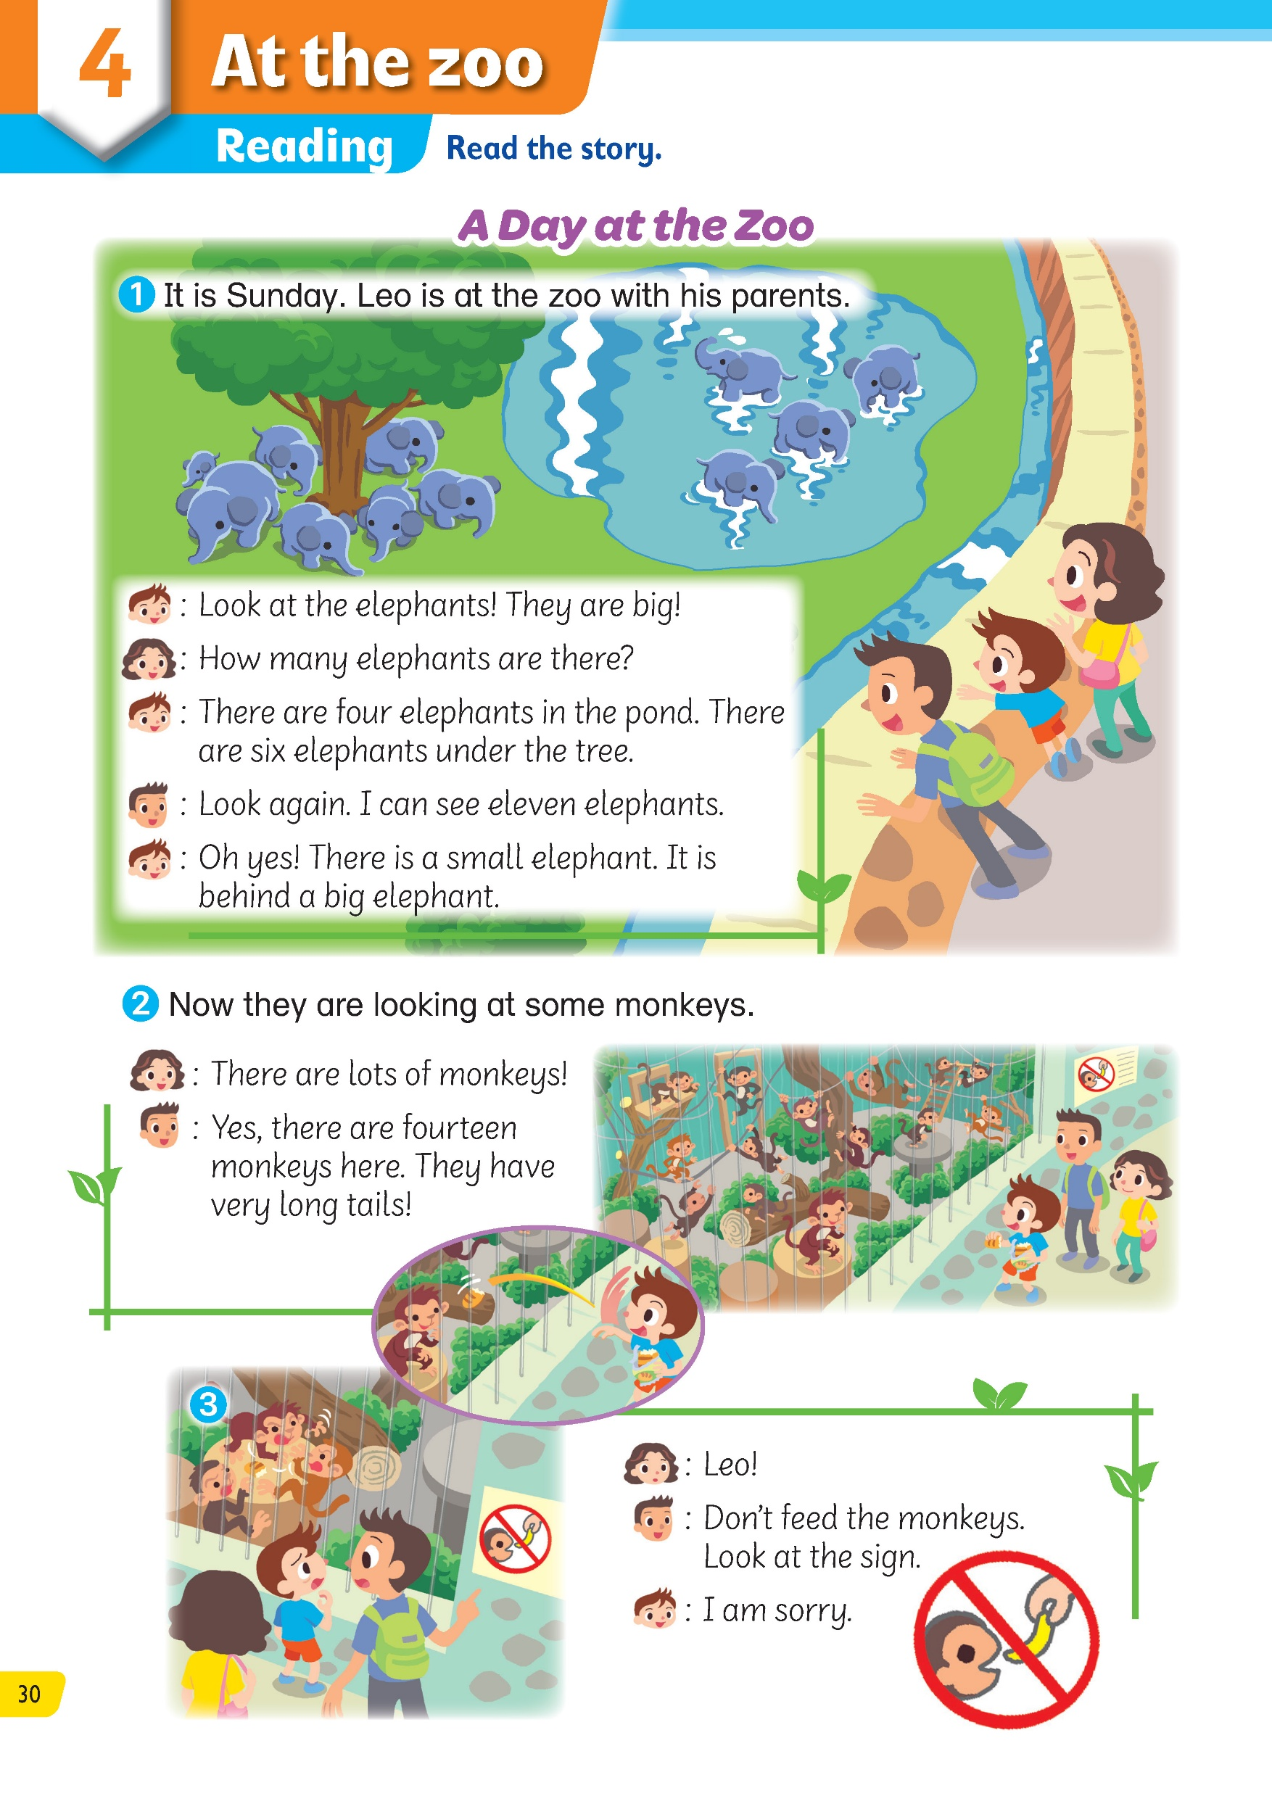
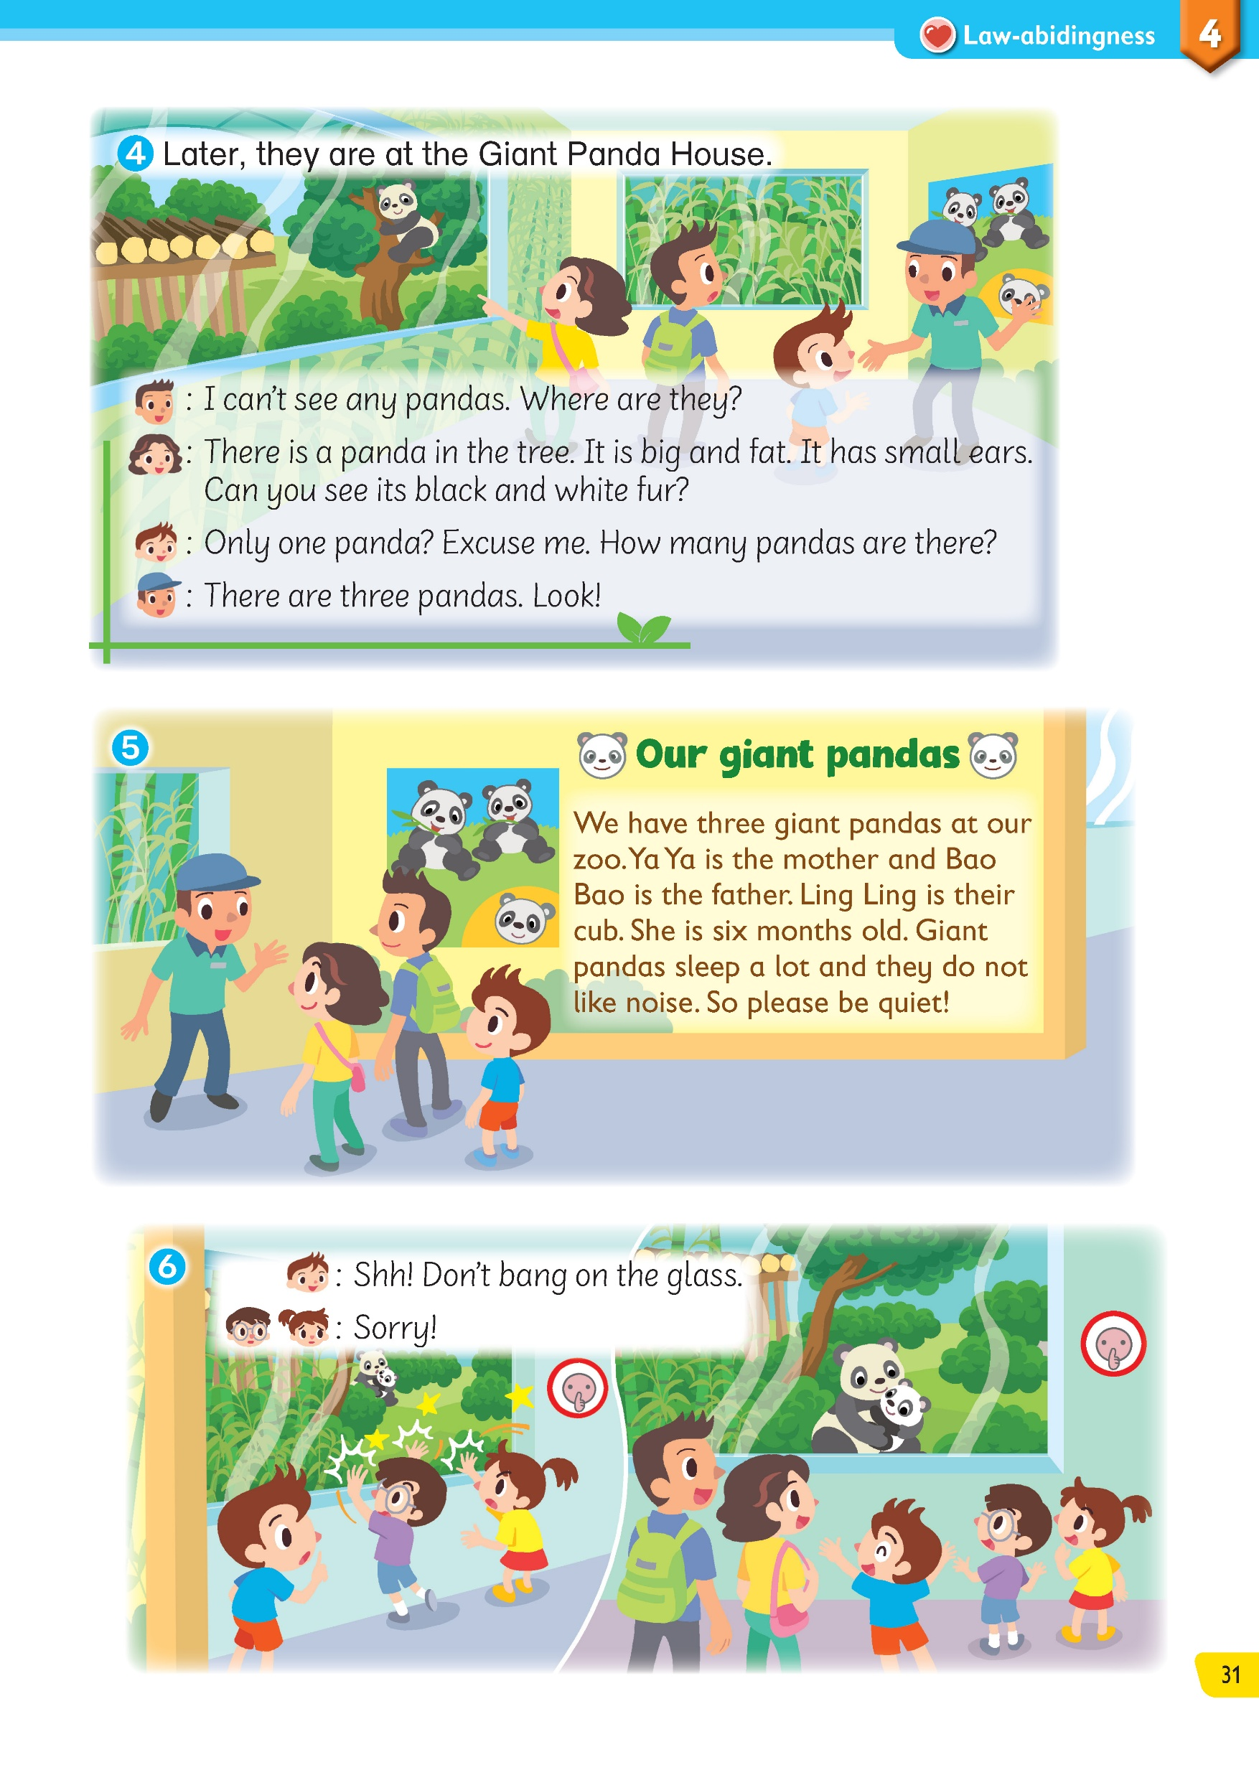
Let’s read the story in Reading.

Slide 4
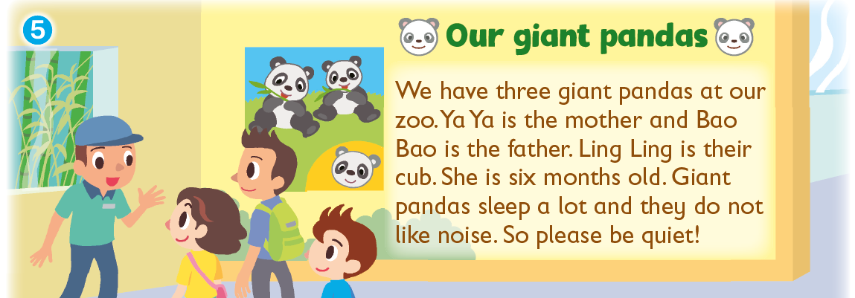

Read the text in Picture 5. What is a cub?
Ya Ya and Bao Bao are parents. We can guess that Ling Ling is their baby. She is six months old.
Read the sentences before and after.

Slide 5

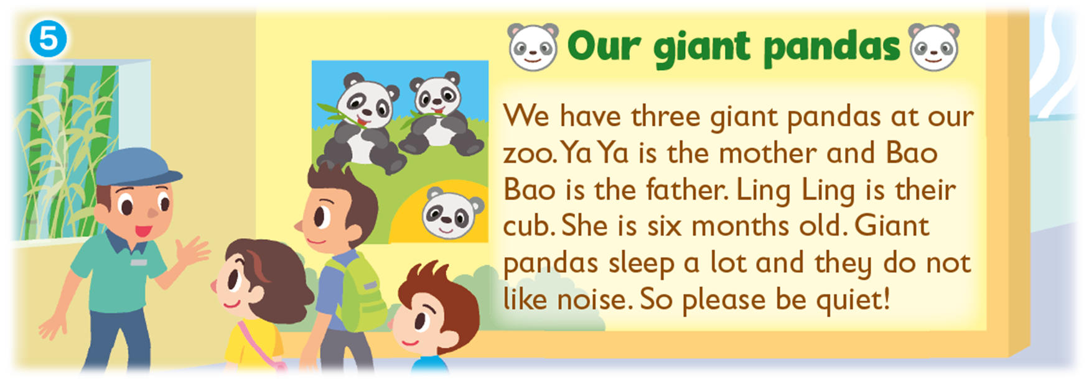
You can also look at the picture for clues.

Slide 6
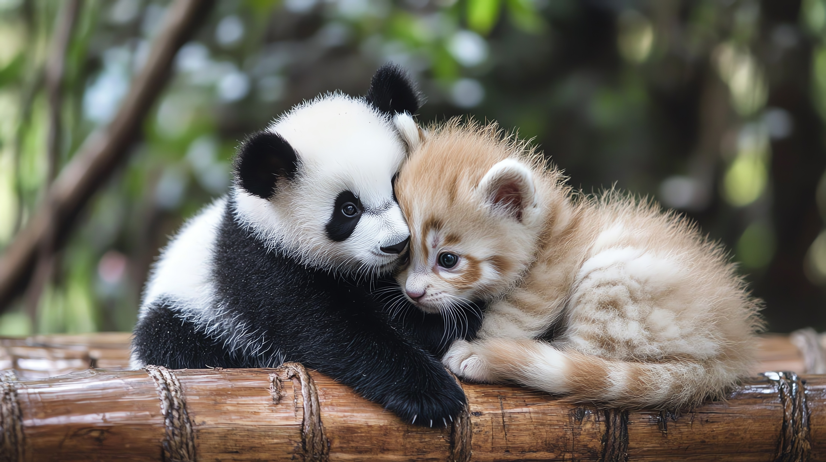
What is a cub?
A cub is a baby animal.

Slide 7

Read the text in Picture 5 again.
What does ‘noise’ mean?
Read the sentence again and also the sentence after.

Slide 8
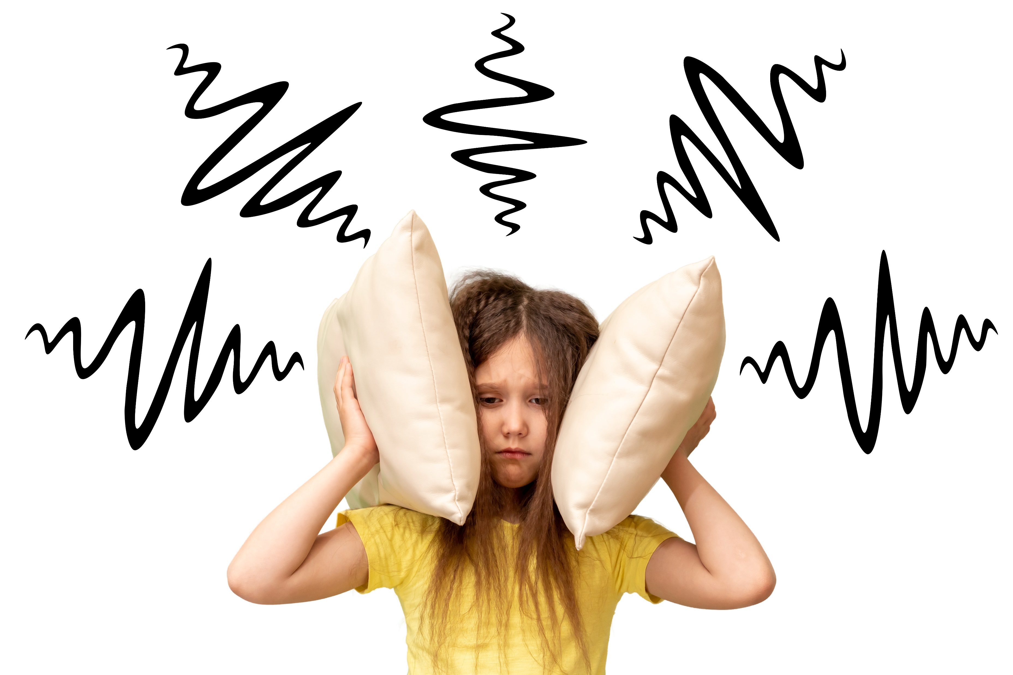
What does ‘noise’ mean?
Can you sleep when others talk loudly?

Slide 9
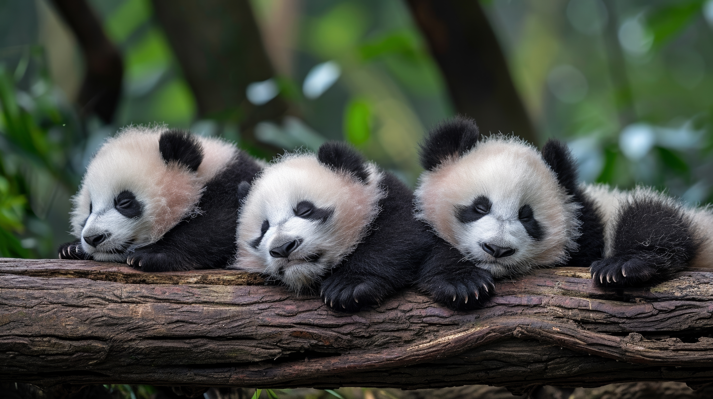
What does ‘noise’ mean?
Just like us, pandas sleep better when it is quiet. They don’t like noise, or loud sounds!

Slide 10
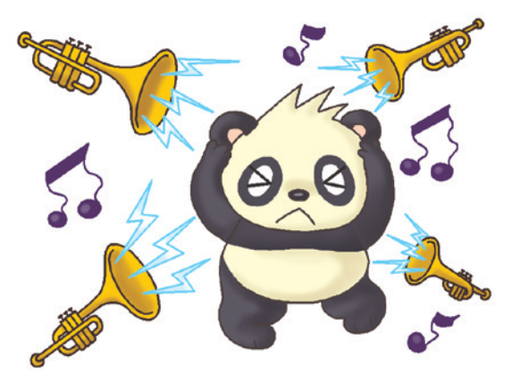
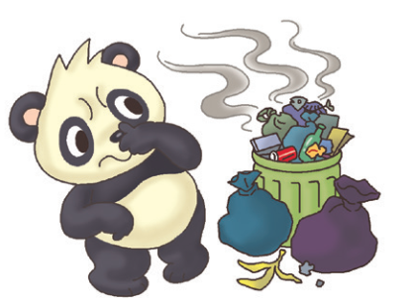
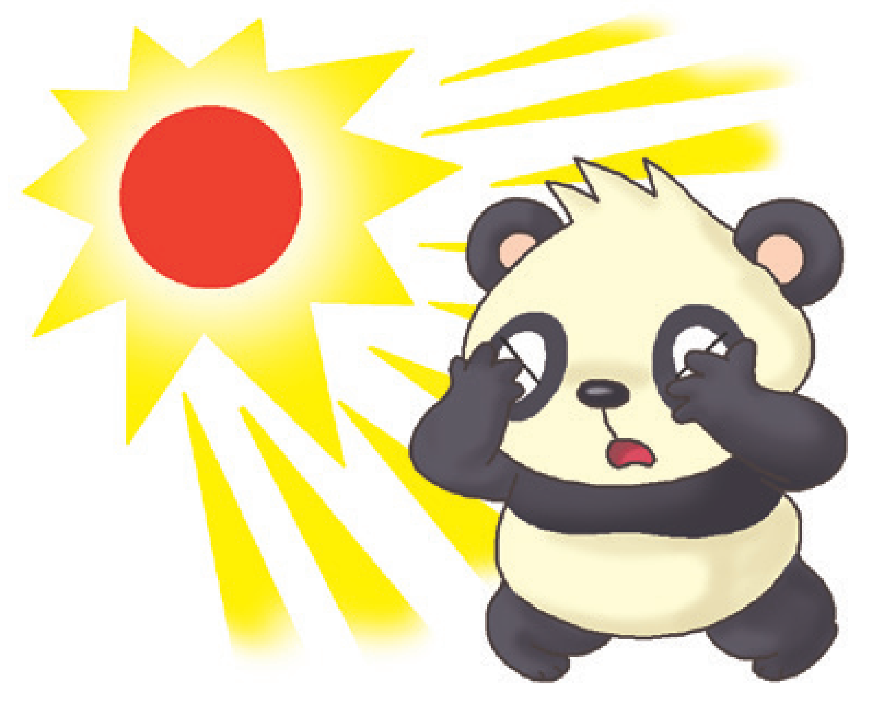
Look at Picture 5: … they do not like noise. ‘Noise’ means ___ .
A.
B.
C.

Slide 11
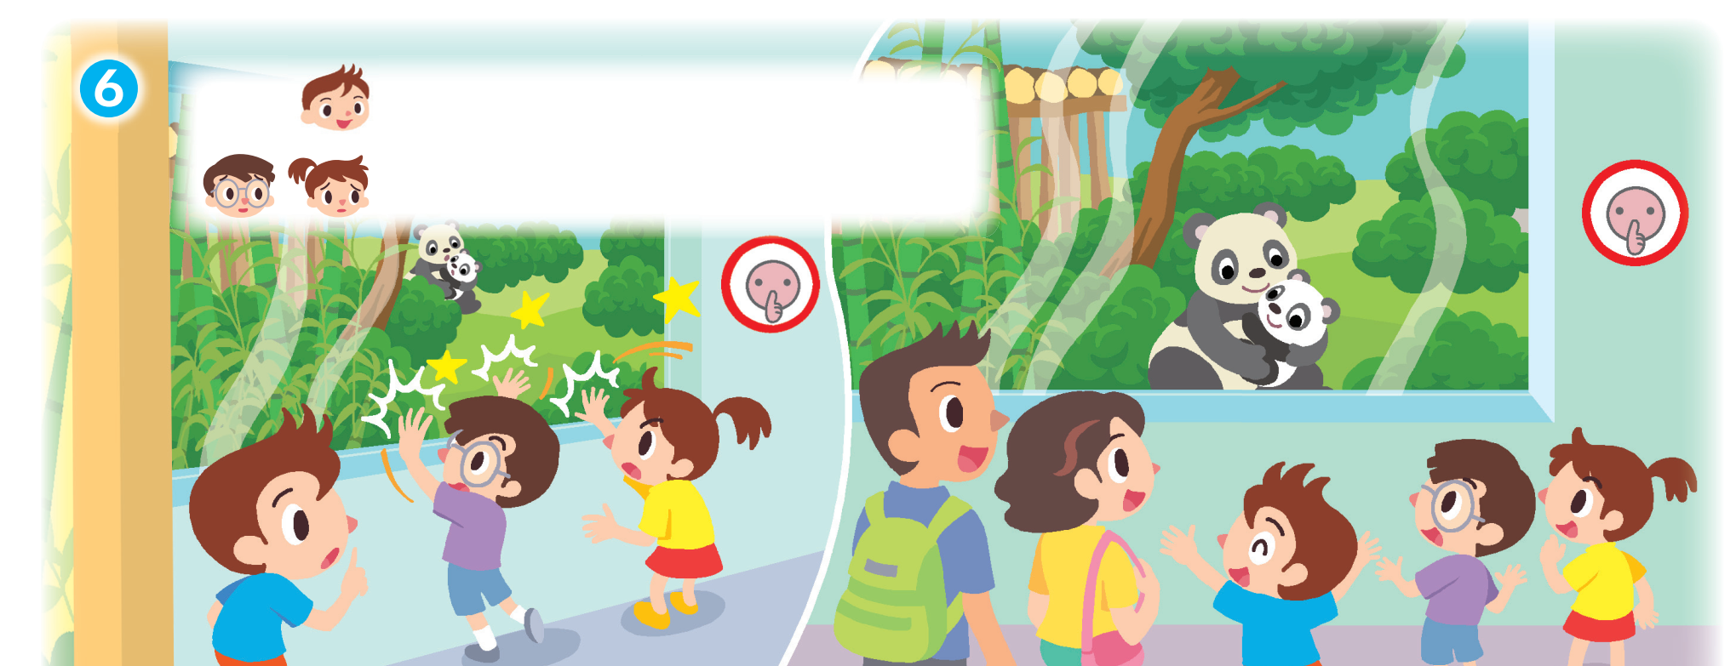
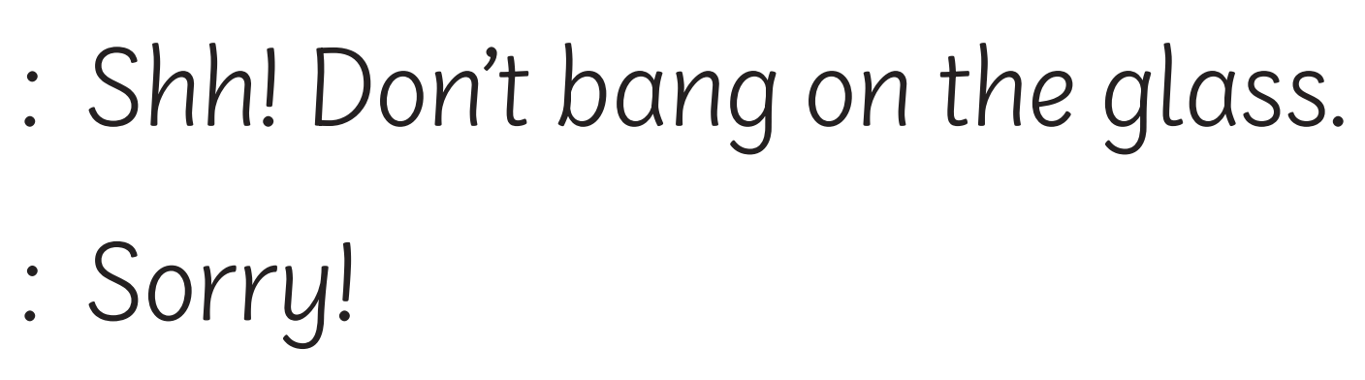
In Picture 6, what does ‘bang’ mean?
Look at the picture. What are the two children doing?
To bang something means to hit something hard.

Slide 12
When we see words that we don’t know, we can try to guess their meaning from
the sentences before and after, and
the pictures.

Slide 14
Acknowledgements
We would like to thank the following organisations and people for permission to use their images:
artisticco / stock.adobe.com
barrirret / stock.adobe.com
Colorfuel Studio / stock.adobe.com
Eric Isselée / stock.adobe.com
famveldman / stock.adobe.com
iconicbestiary / stock.adobe.com
Meraupindo / Shutterstock
nicoletaionescu / stock.adobe.com
producer / stock.adobe.com
Tony Campbell / stock.adobe.com
Wandering Bear / stock.adobe.com
Татьяна Шанахина / stock.adobe.com

