Slide 1
Chapter 4
Post-reading
At the zoo

Slide 2
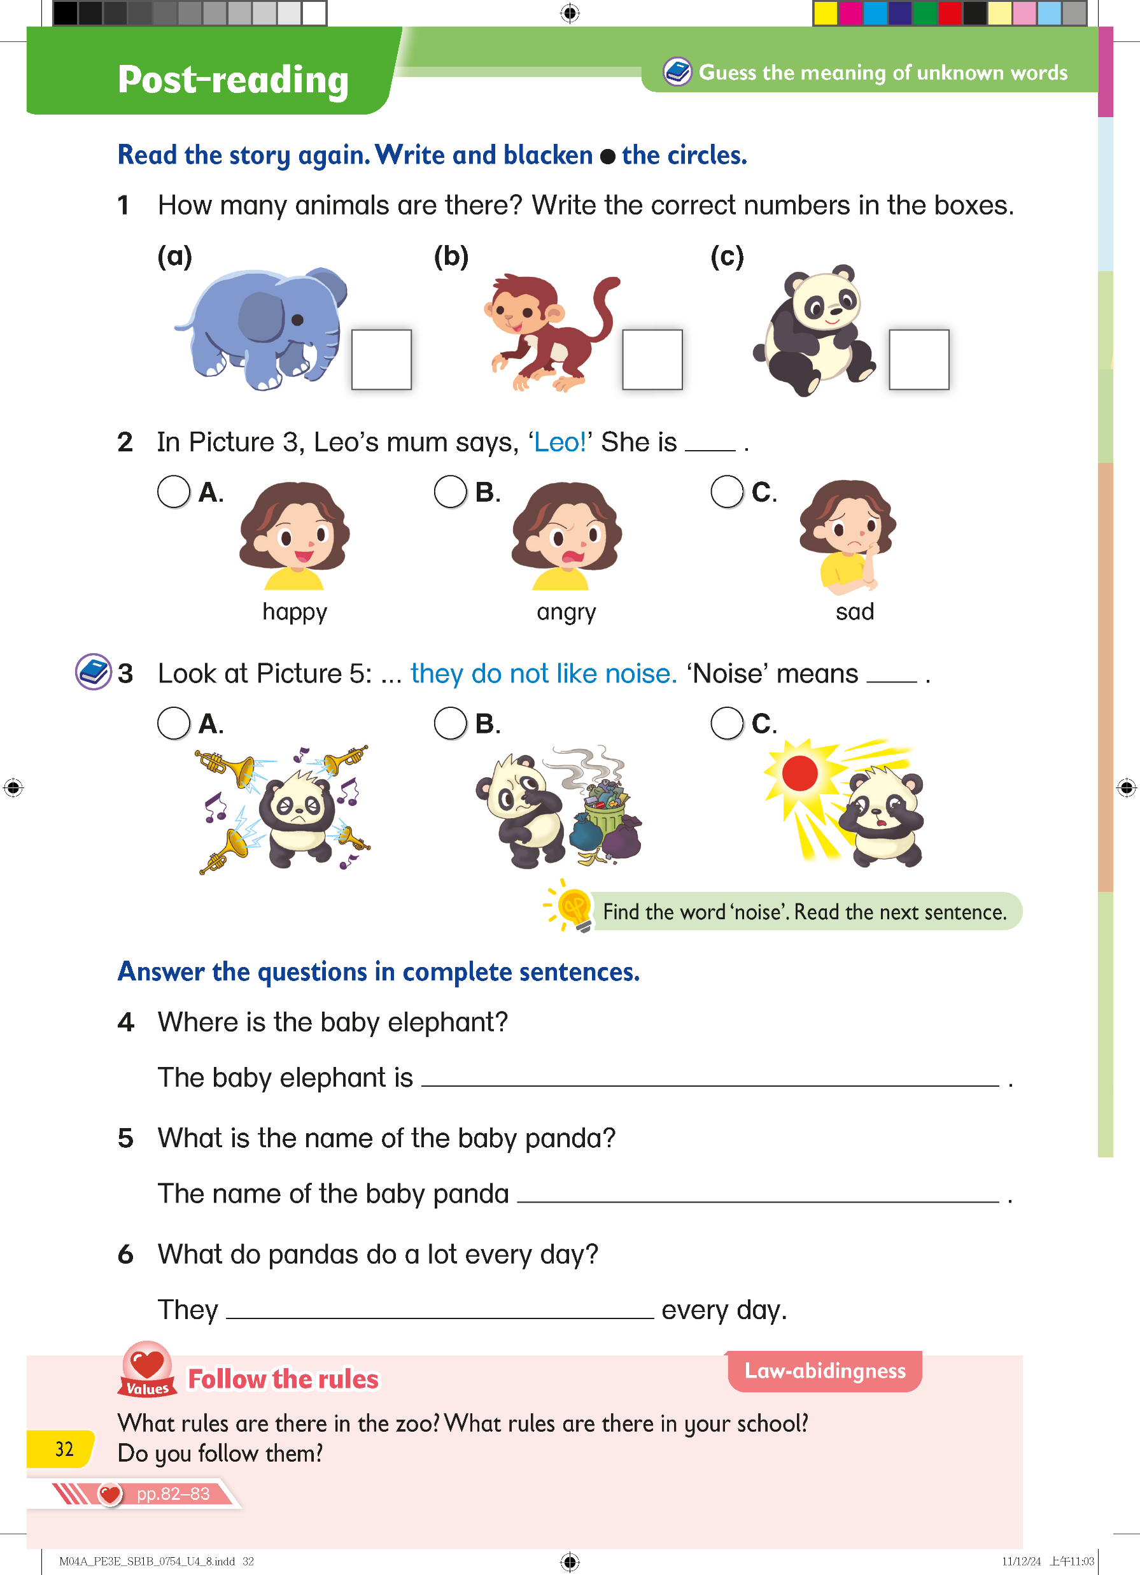


Read the story again. Write the correct numbers.
11
14
3

Slide 3
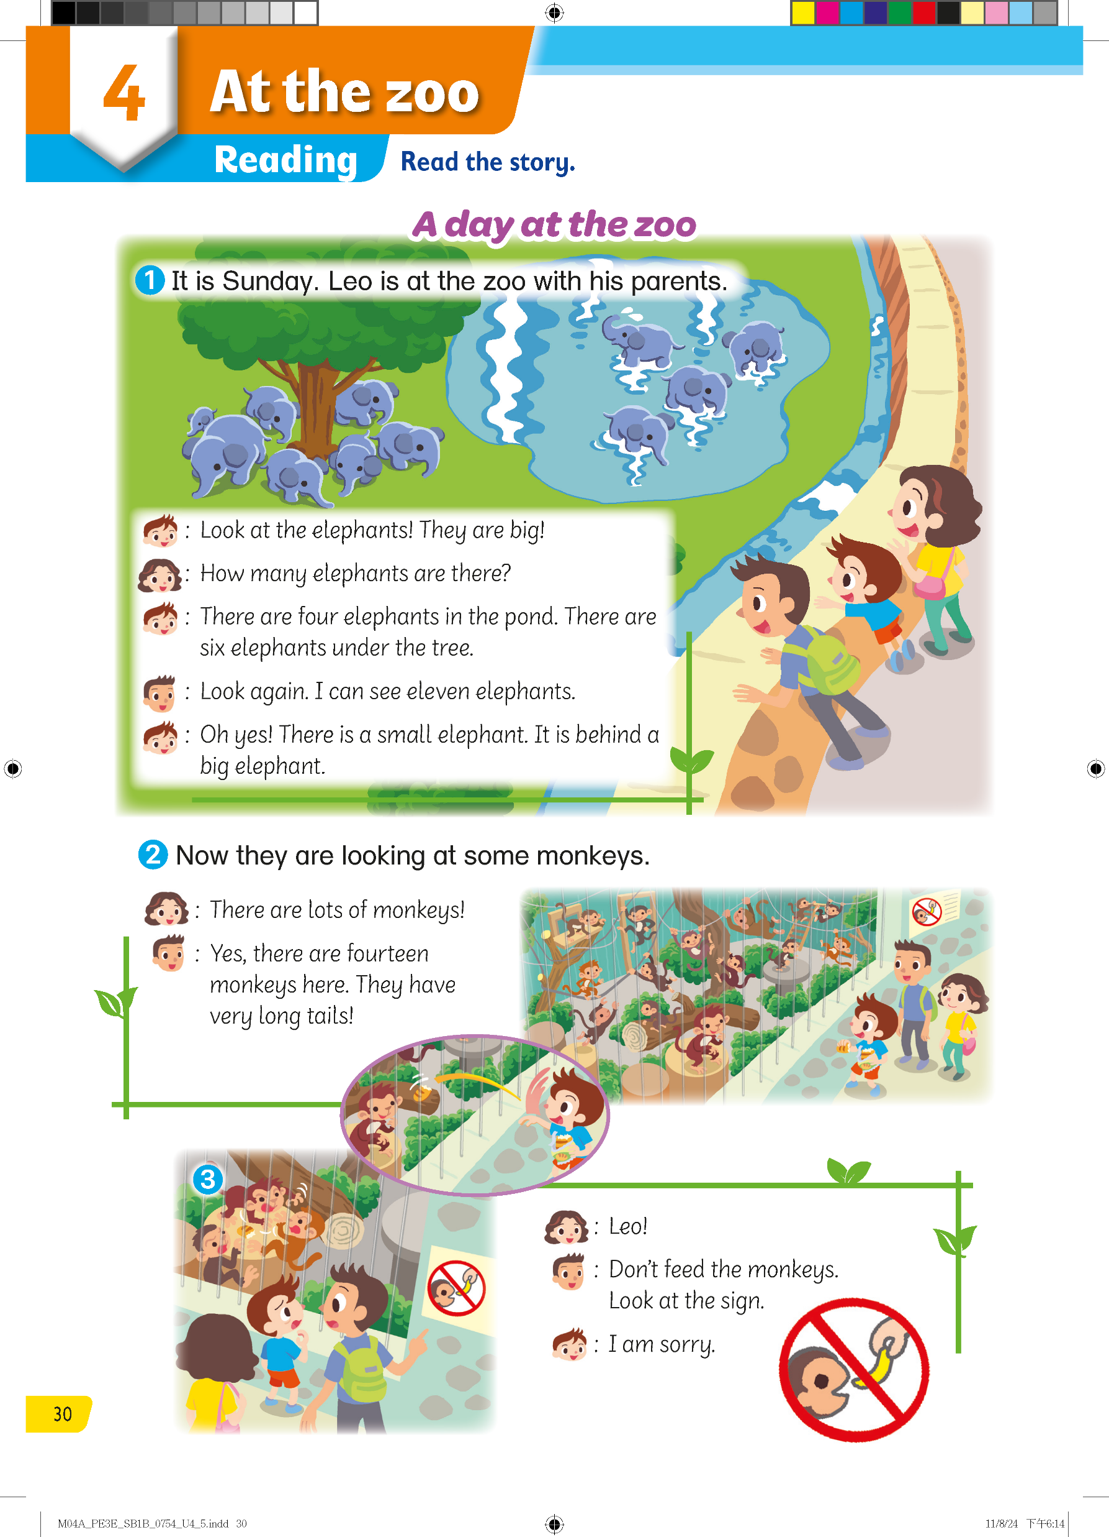



4
+ 6
+ 7
= ?
Go back to Q1

Slide 4
Go back to Q1

Slide 5
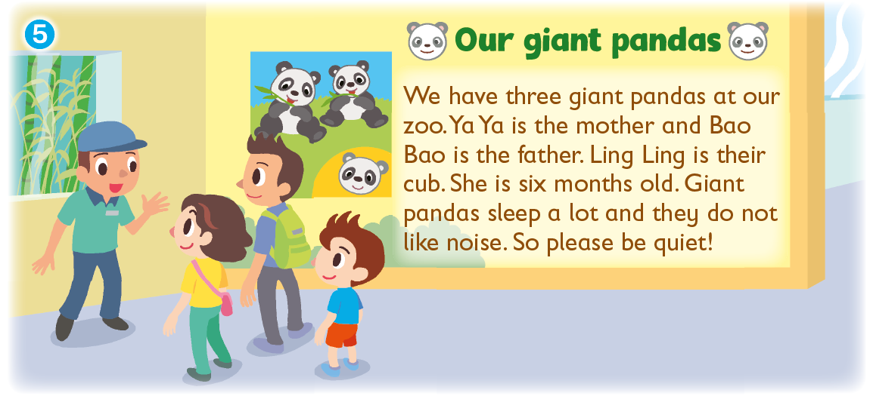
Go back to Q1

Slide 6
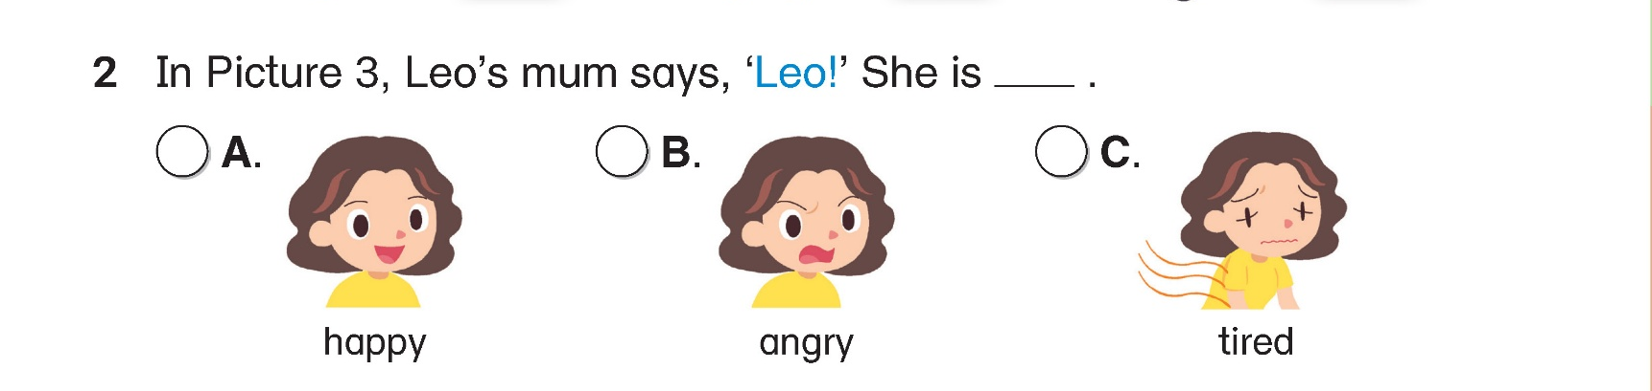
Read the story again. Blacken  the circle.

Slide 7
In Picture 3, Leo's mum is angry because Leo is not following the rules at the zoo.
Go back to Q2

Slide 8
Read the story again. Blacken  the circle.

Slide 9
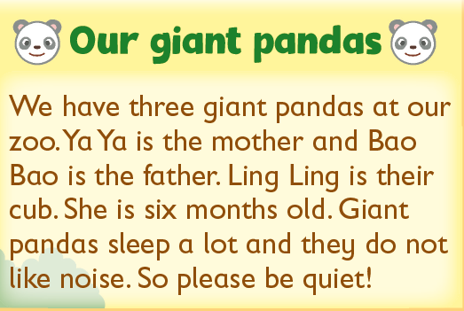

When visitors at the zoo are asked to be quiet, it’s because loud noises can make the pandas feel uncomfortable. In Option A, you can see a panda that is upset because of loud music. This shows why we need to be quiet.
Go back to Q3

Slide 10
Answer the question in a complete sentence.
behind the big elephant

Slide 11

Go back to Q4

Slide 12
Answer the question in a complete sentence.
is Ling Ling

Slide 13
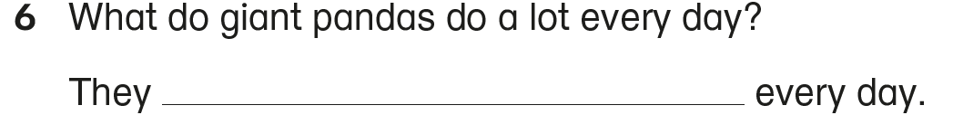
Answer the question in a complete sentence.
sleep a lot

Slide 15
Acknowledgements
We would like to thank the following organisations and people for permission to use their images:
Meraupindo / Shutterstock

