Slide 1
Chapter 4
Post-reading
A day at a zoo

Slide 2
Today we’re going to read a story!
Pre-reading
Reading
After Reading

Slide 3
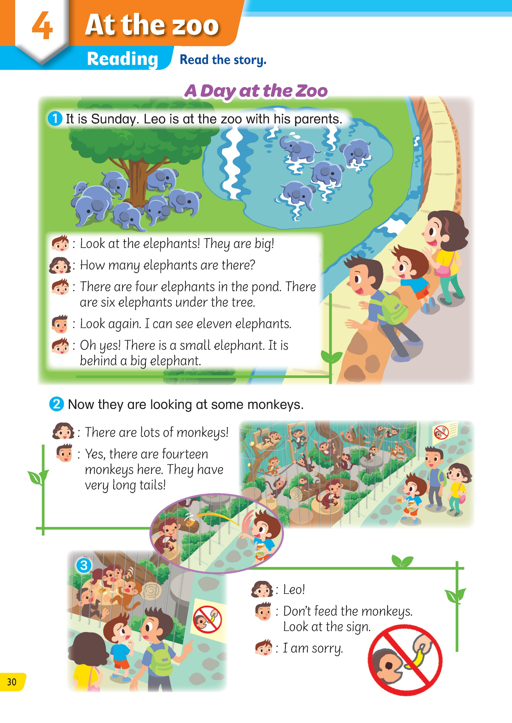
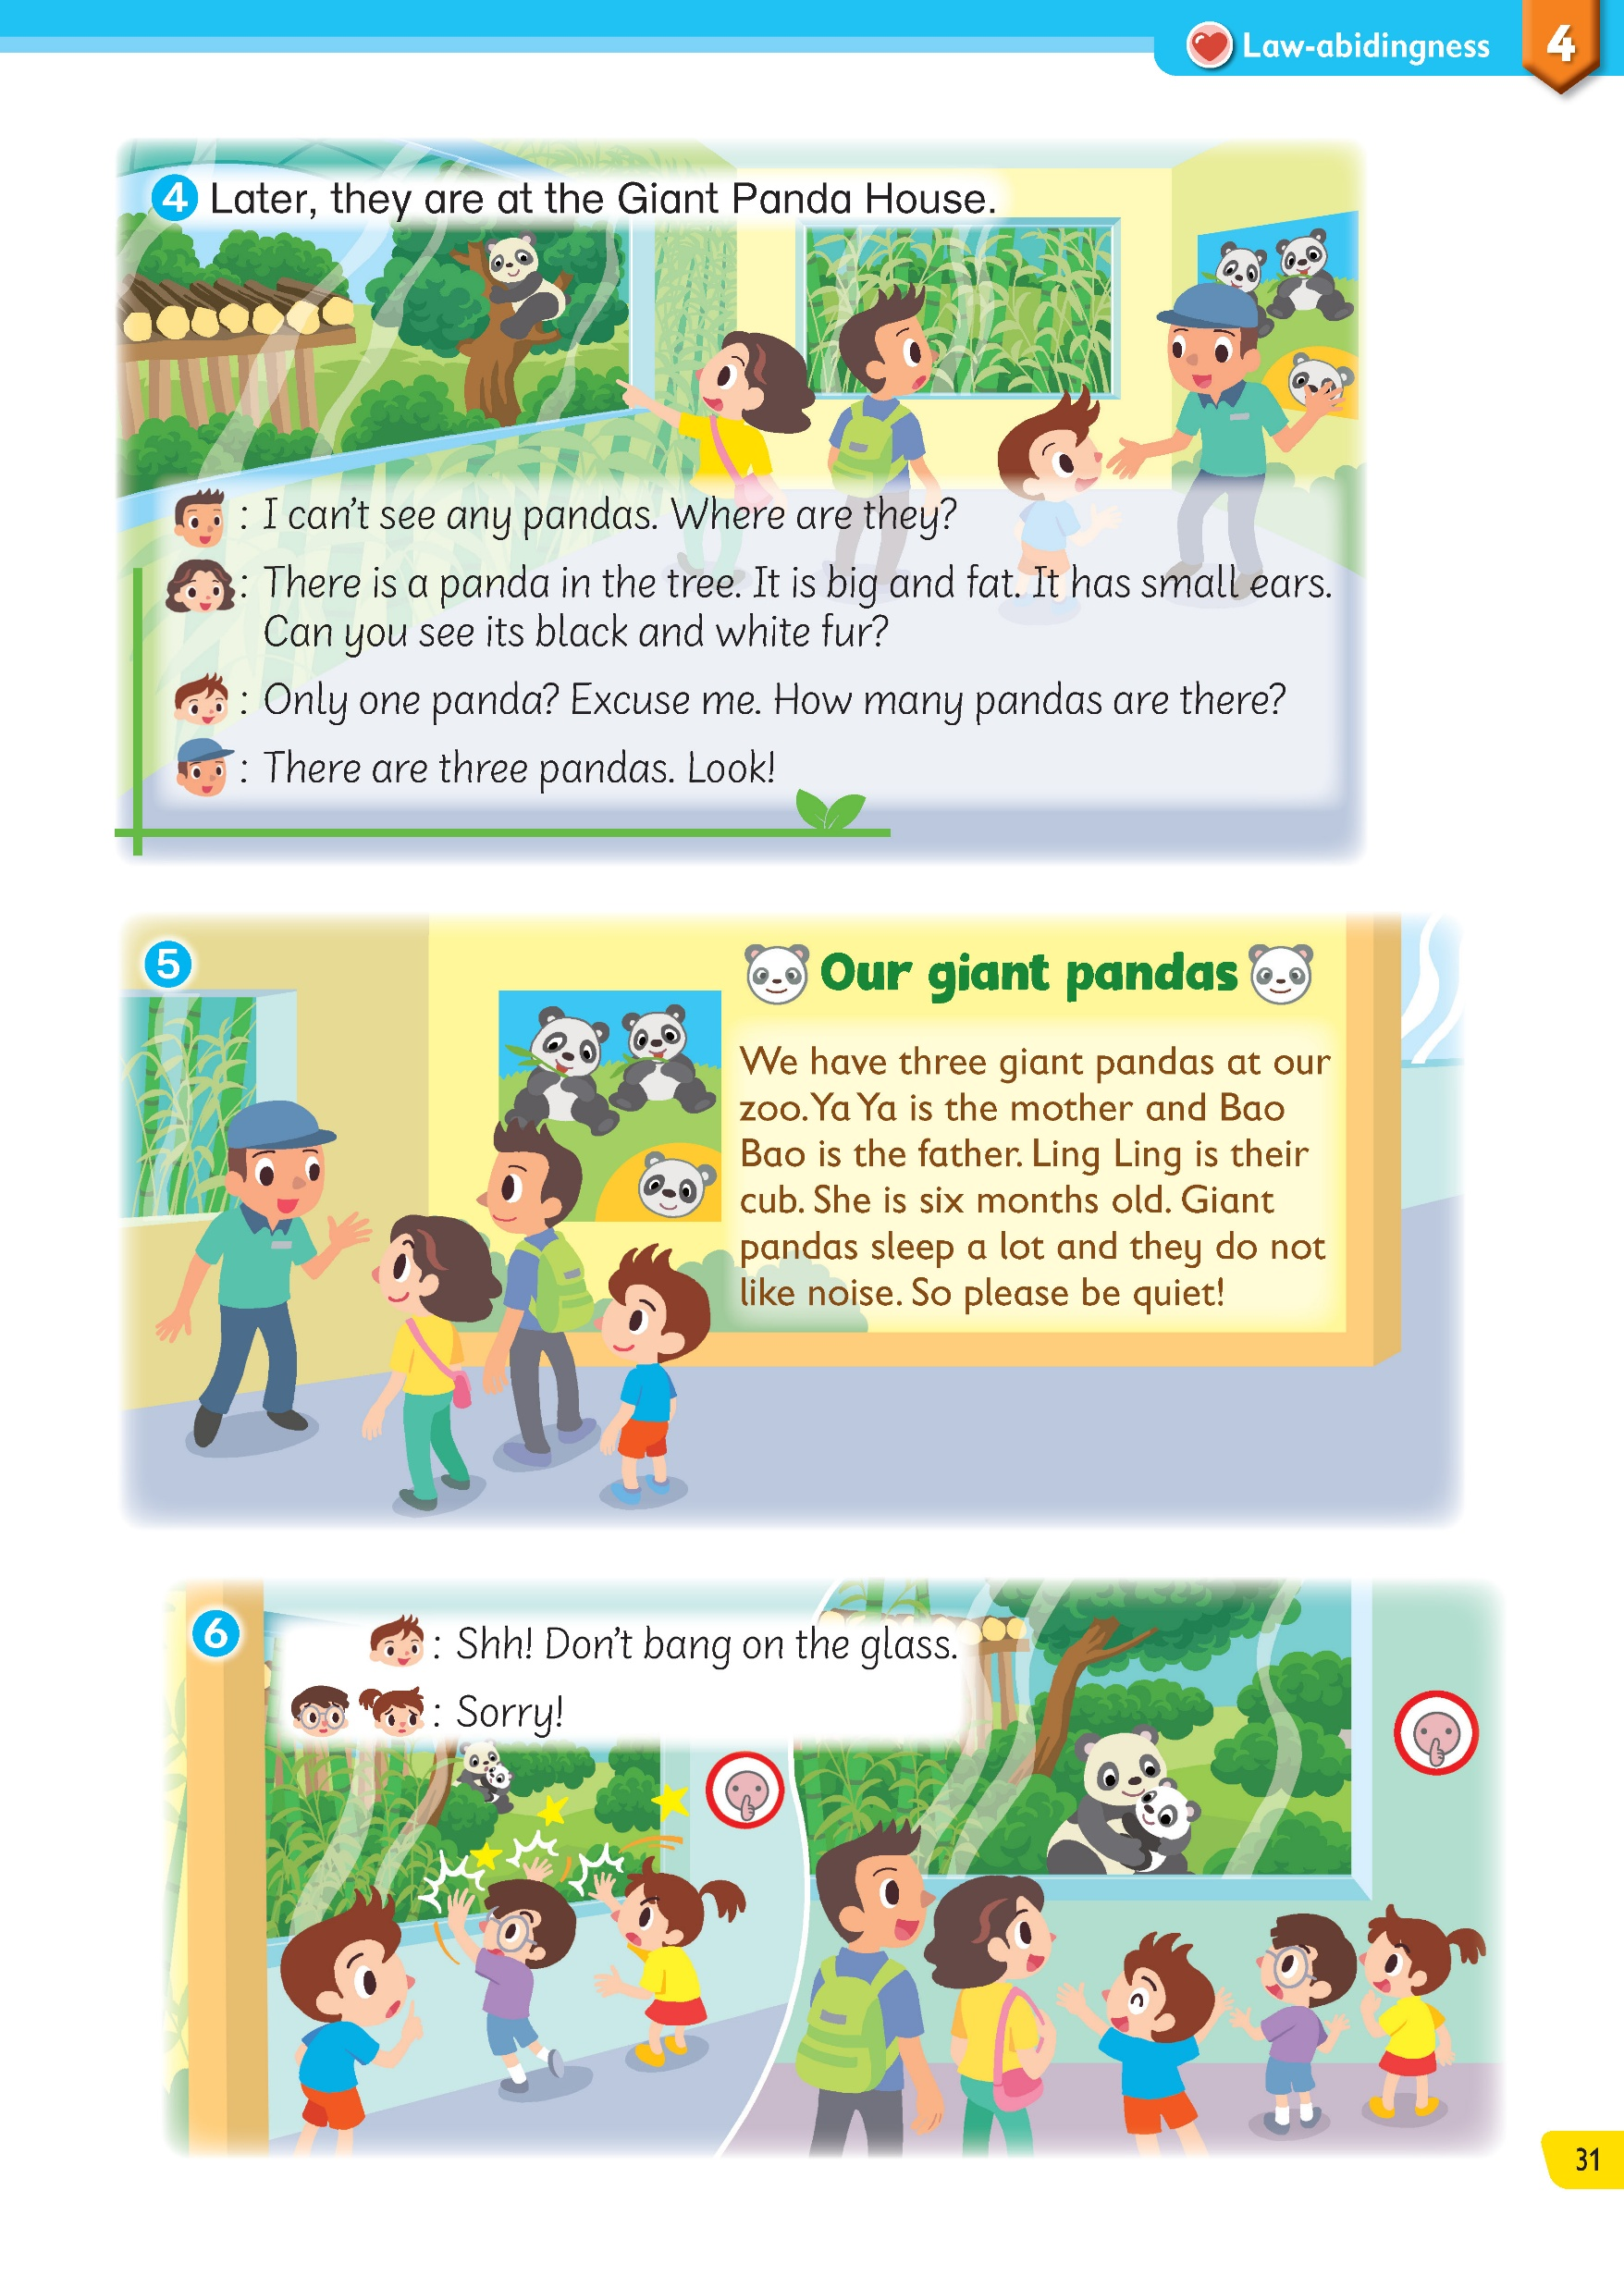

Let’s look at the title of the story.
Pre-reading
Reading
After Reading

Slide 4

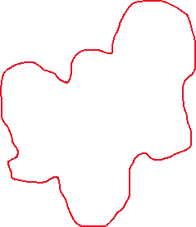
They are Leo and his parents.
Where are they?
Pre-reading
Reading
After Reading

Slide 5
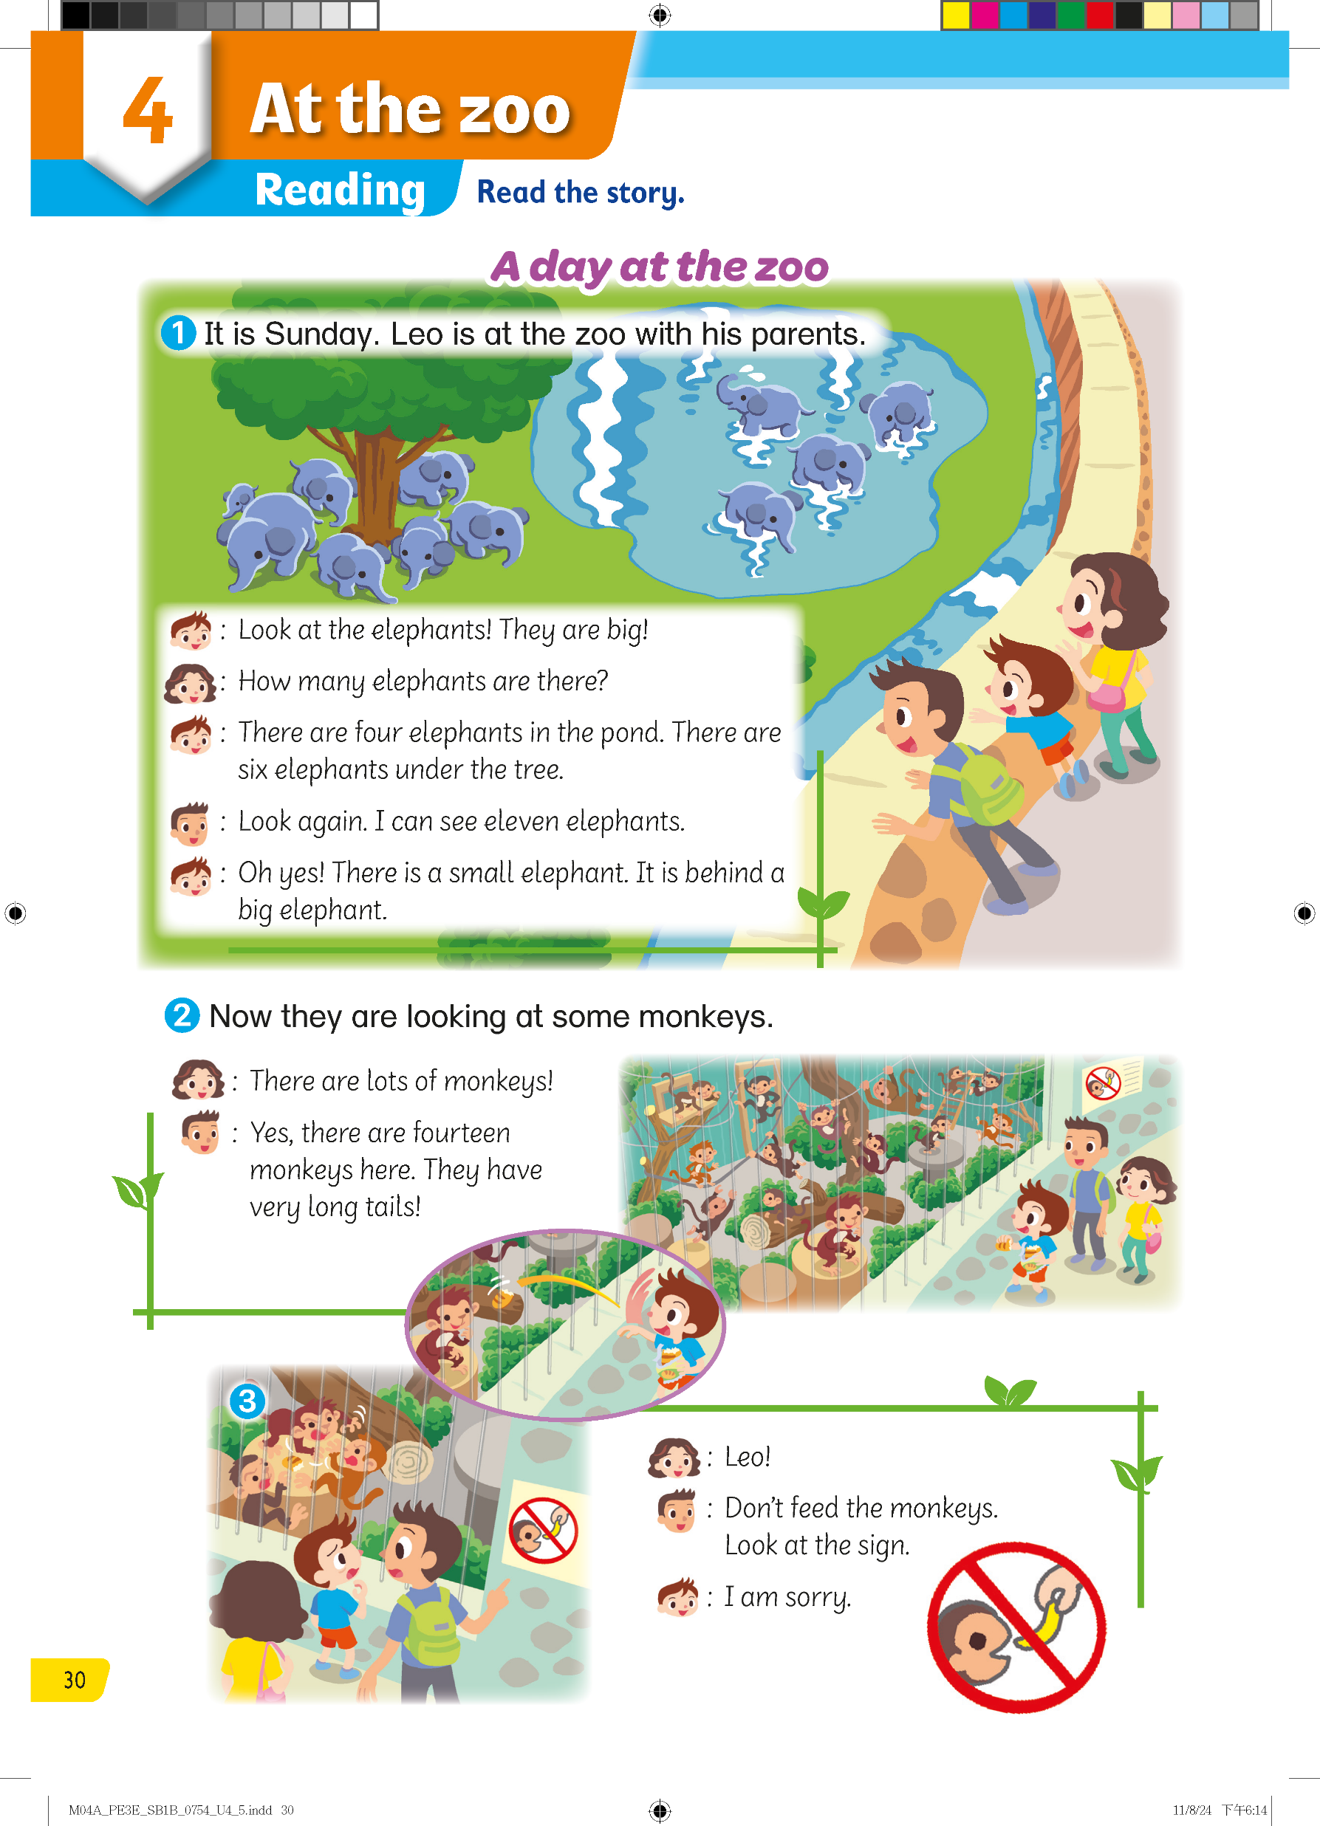
Can you guess?
How do you know?
Pre-reading
Reading
After Reading

Slide 6
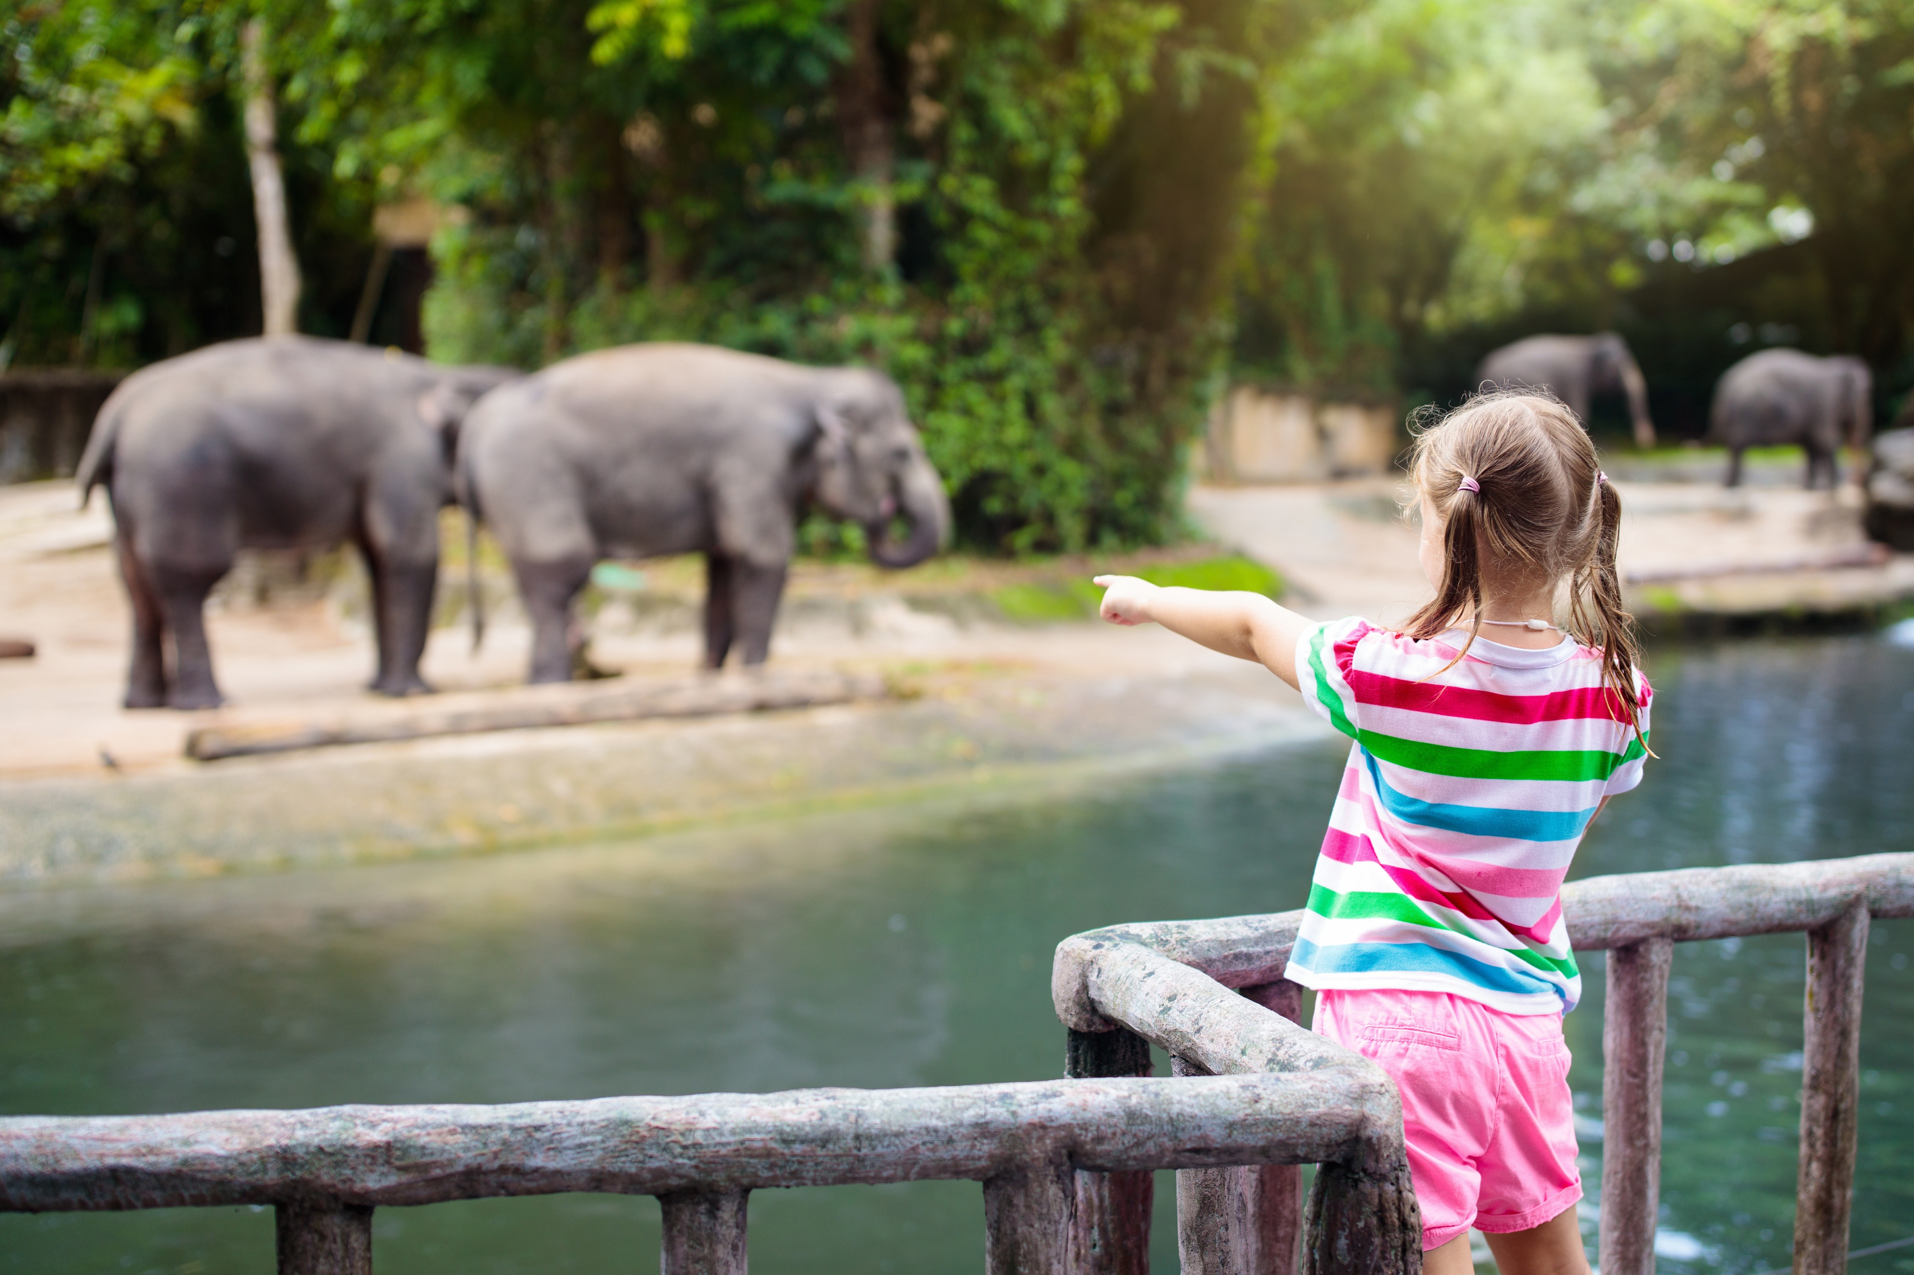
Do you like to go to the zoo?
What animals can we see there?
Pre-reading
Reading
After Reading

Slide 7
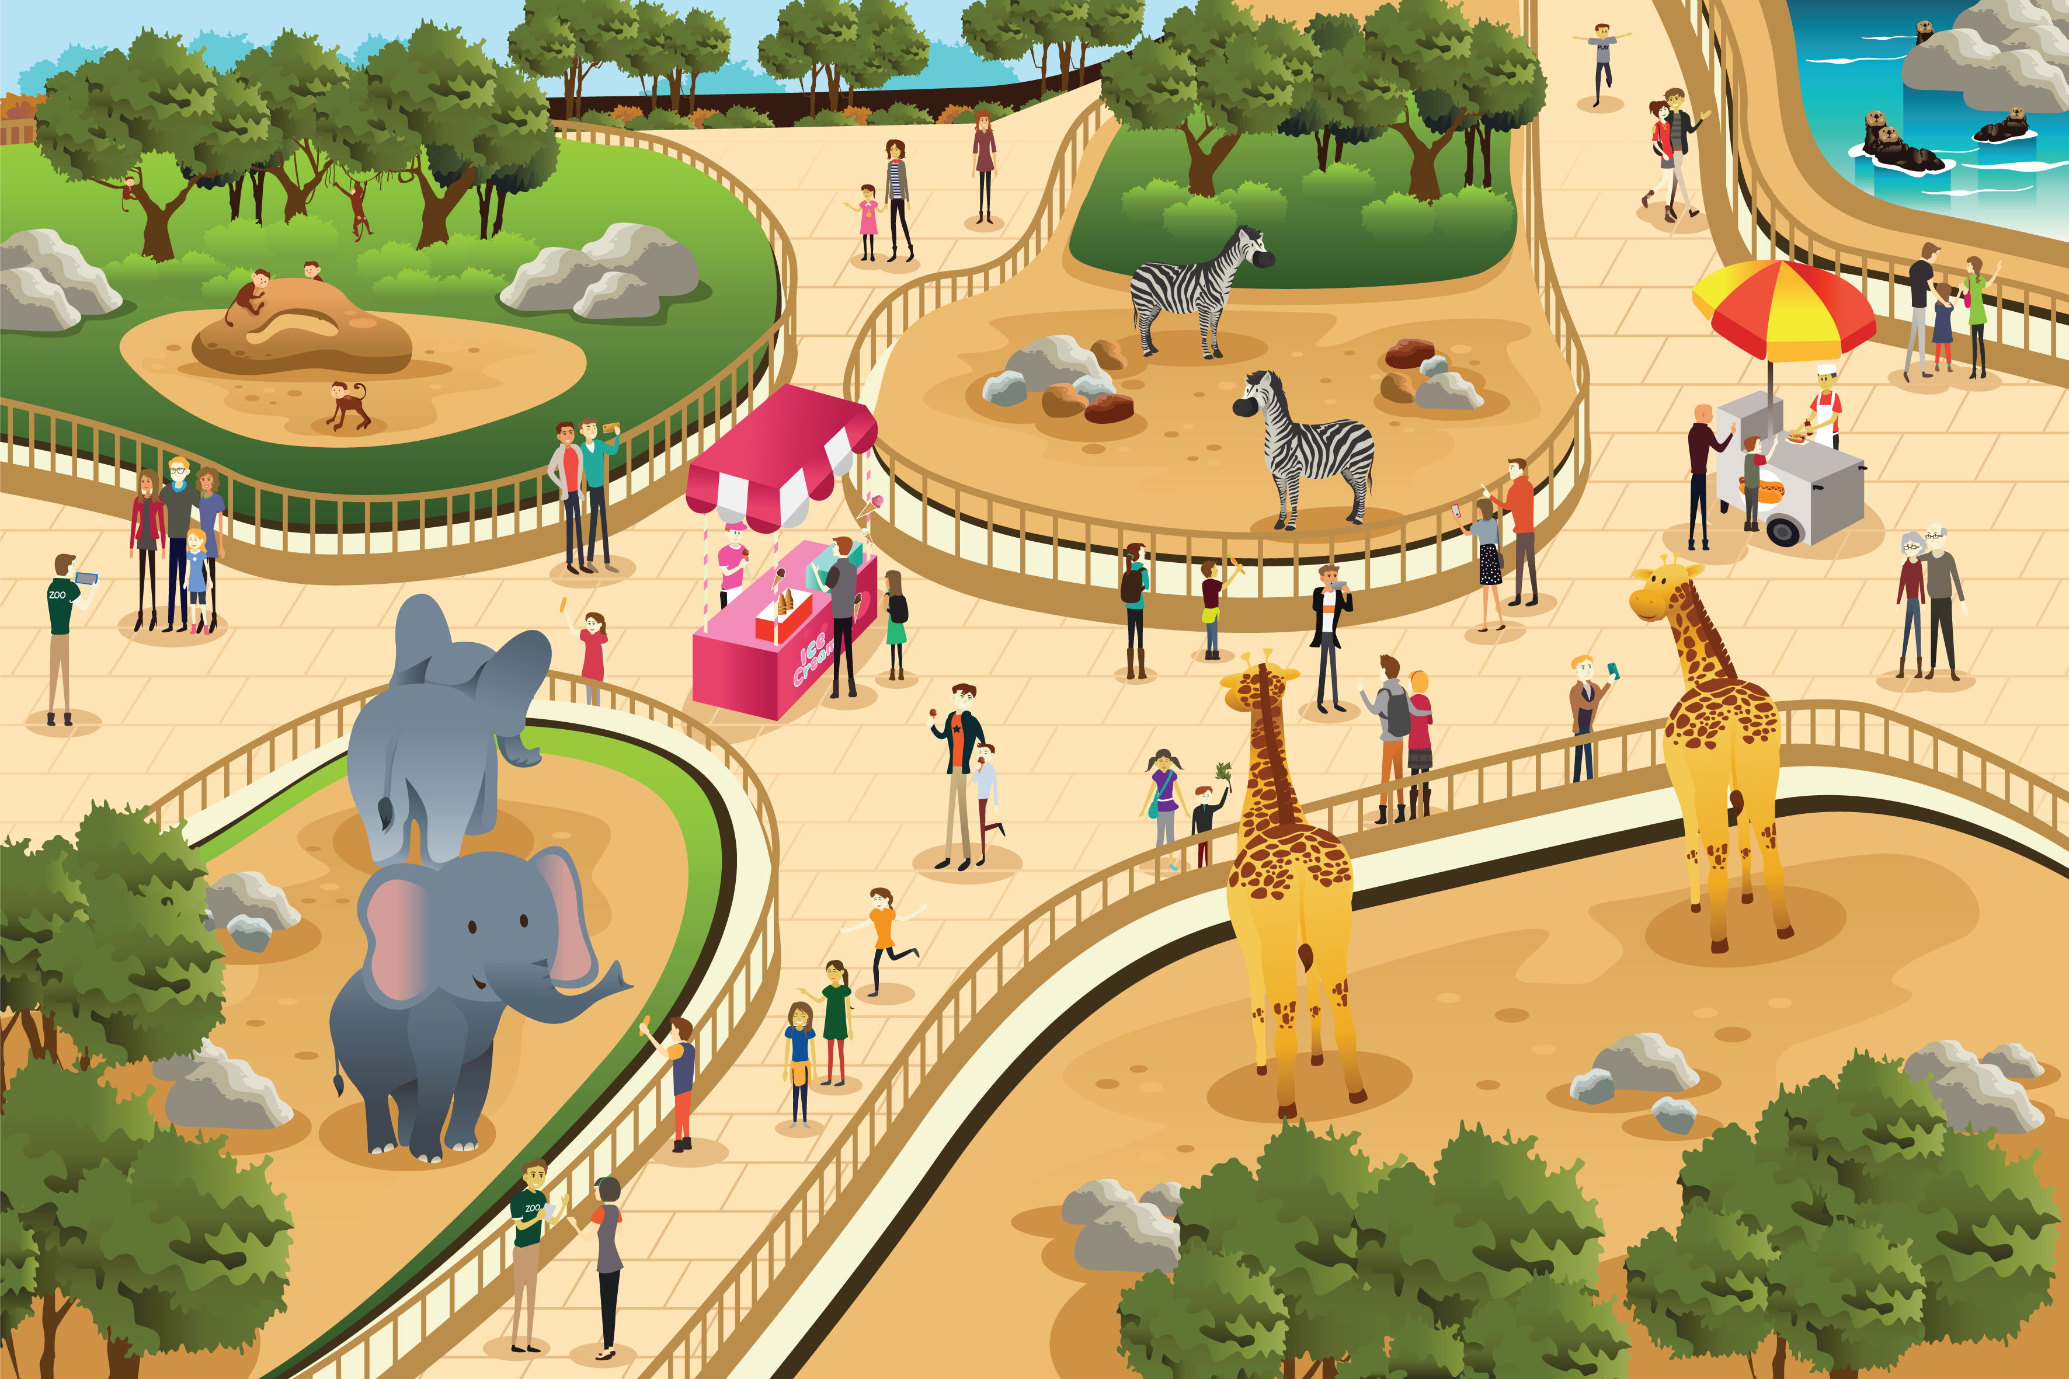
Are there any rules at the zoo?
Pre-reading
Reading
After Reading

Slide 8
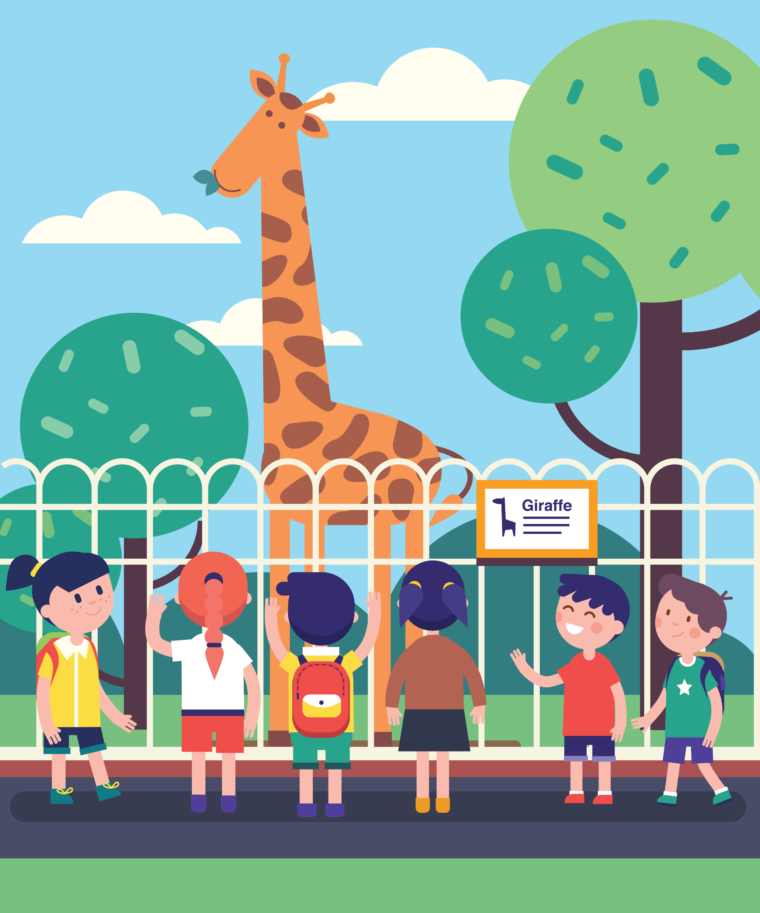
Can you give the animals food?
Can you shout at the animals?
Pre-reading
Reading
After Reading

Slide 9
In this story, Leo learns about some rules at the zoo.
Before we read, let’s look at the story!
Pre-reading
Reading
After Reading

Slide 10
The writer tells the story in a fun way.
Pre-reading
Reading
After Reading

Slide 11

On the left side, we see a face.
This shows us who is talking!
Pre-reading
Reading
After Reading

Slide 12
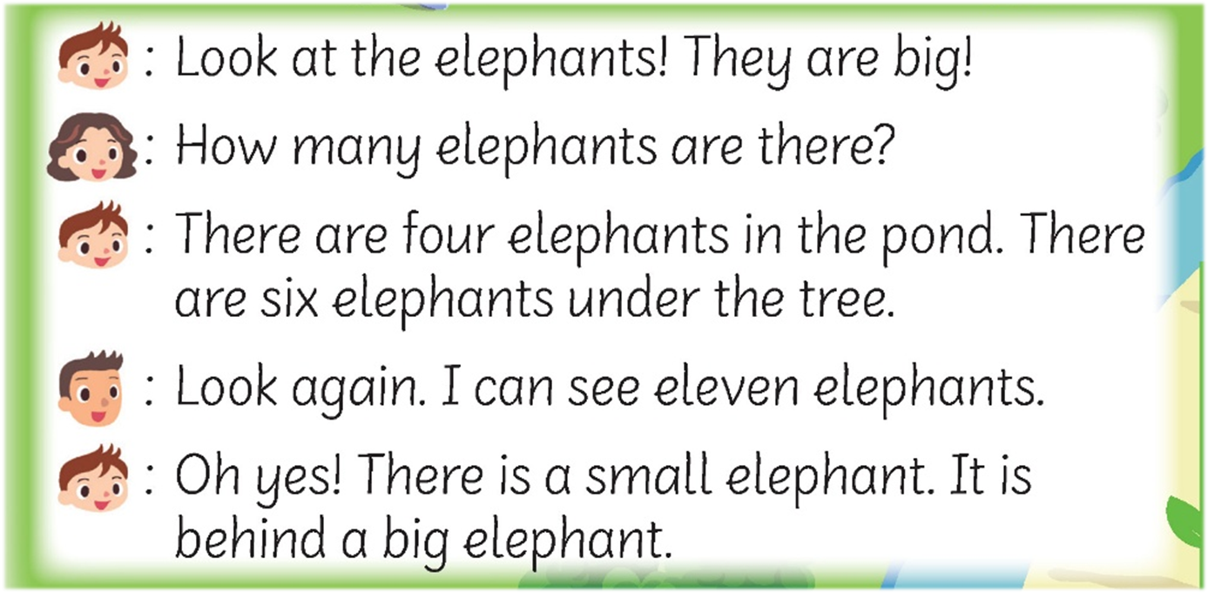
On the right side, we can read what he or she says.
Pre-reading
Reading
After Reading

Slide 13
Are you ready to read about Leo’s day at the zoo?
Pre-reading
Reading
After Reading

Slide 14
Let’s read the story!
Pre-reading
Reading
After Reading

Slide 15

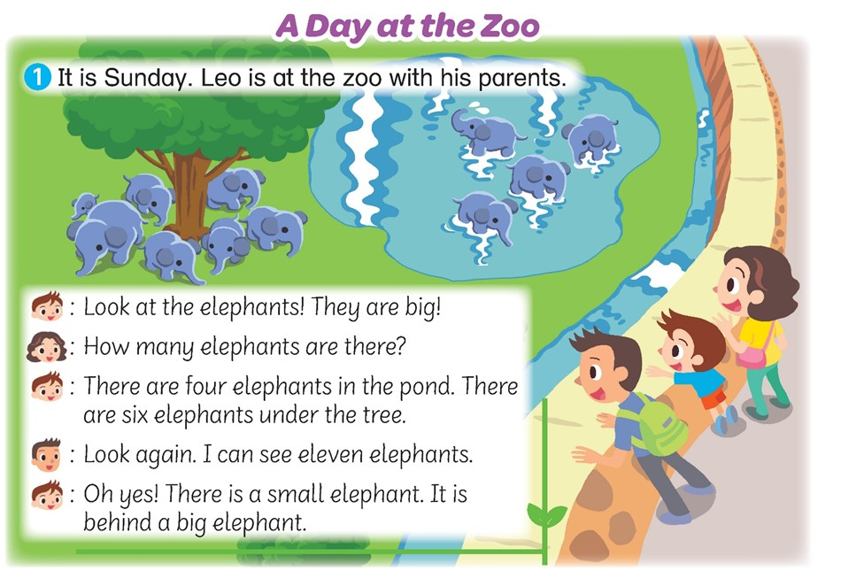

It is Sunday!
Does Leo go to school on Sunday?
Pre-reading
Reading
After Reading

Slide 16
He goes to the zoo with Mum and Dad.
What animals do they see?
Pre-reading
Reading
After Reading

Slide 17
How many are there?
Let’s count them together!
Pre-reading
Reading
After Reading

Slide 18
1, 2, 3, 4. There are four elephants in the pond!
There are seven elephants under the tree.
1
2
6
7
1
3
4
2
5
3
4
Pre-reading
Reading
After Reading

Slide 19
Does Leo count right at first?
How many does he count?
Pre-reading
Reading
After Reading

Slide 20
Dad says, Look again.
Why does he say that?
Pre-reading
Reading
After Reading

Slide 21
What animal do they see next?
There are lots of monkeys!
Pre-reading
Reading
After Reading

Slide 22
How many are there?
Let’s count them together.
10
13
9
14
12
1
2
3
11
8
4
6
5
7
Pre-reading
Reading
After Reading

Slide 23
How many are there?
Let’s count them together.
Pre-reading
Reading
After Reading

Slide 24
Oh no! What does Leo give the monkeys?
Pre-reading
Reading
After Reading

Slide 25
Look at the sign.
Can he do that?
Pre-reading
Reading
After Reading

Slide 26
The sign tells us not to feed the monkeys.
Pre-reading
Reading
After Reading

Slide 27
How does Mum say his name?
Pre-reading
Reading
After Reading

Slide 28
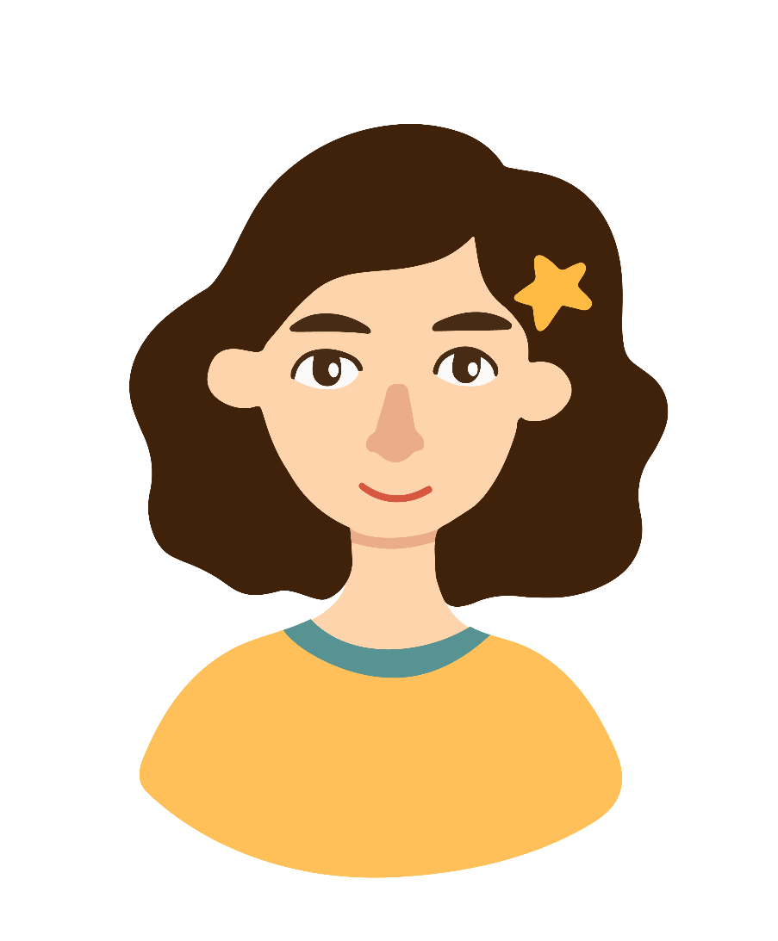

Can you guess which one is the correct answer?
Leo!
Leo!
Pre-reading
Reading
After Reading

Slide 29
Mum says his name angrily because Leo doesn’t follow the rules.
Leo!
Pre-reading
Reading
After Reading

Slide 30

Where do they go next?
How many pandas can Leo, Mum and Dad see?
Pre-reading
Reading
After Reading

Slide 31
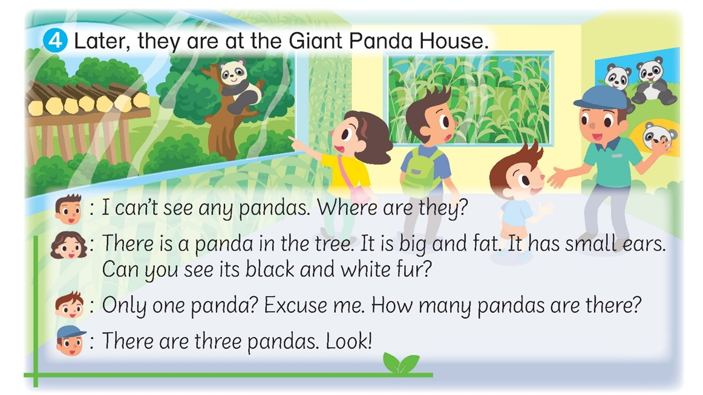
Where is it?
Pre-reading
Reading
After Reading

Slide 32
Do you think Leo wants to see more pandas?
Leo is surprised to see only one.
Pre-reading
Reading
After Reading

Slide 33
Who does he ask about the pandas?
Pre-reading
Reading
After Reading

Slide 34
Who does he ask about the pandas?
Does he work here?
Pre-reading
Reading
After Reading

Slide 35
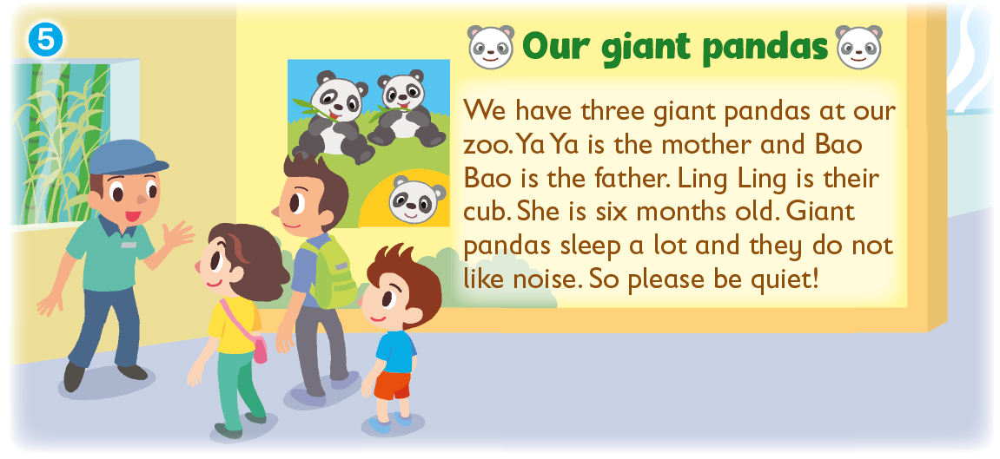
How many pandas live at the zoo?
What are their names?
Pre-reading
Reading
After Reading

Slide 36
How old is Ling Ling?
Is she a baby?
Pre-reading
Reading
After Reading

Slide 37
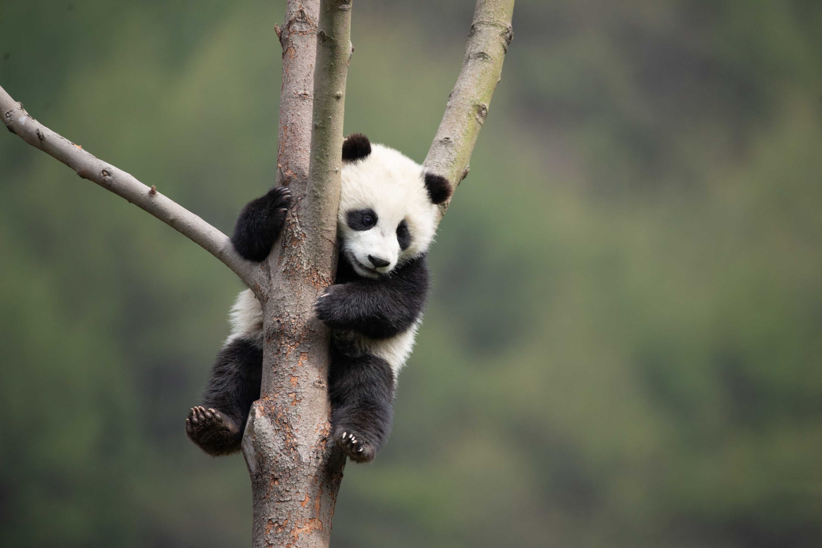
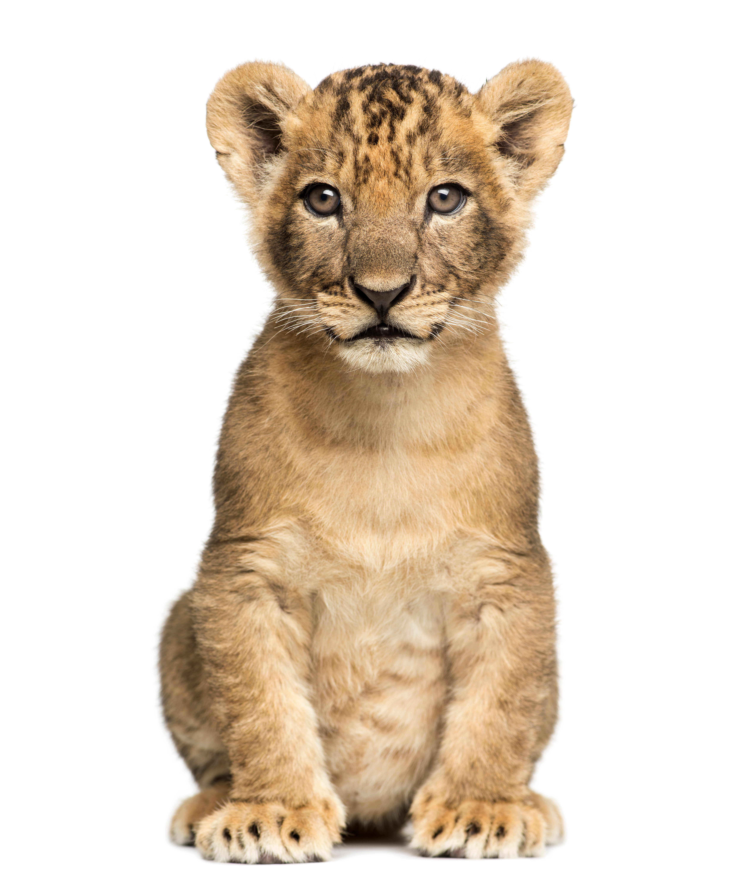
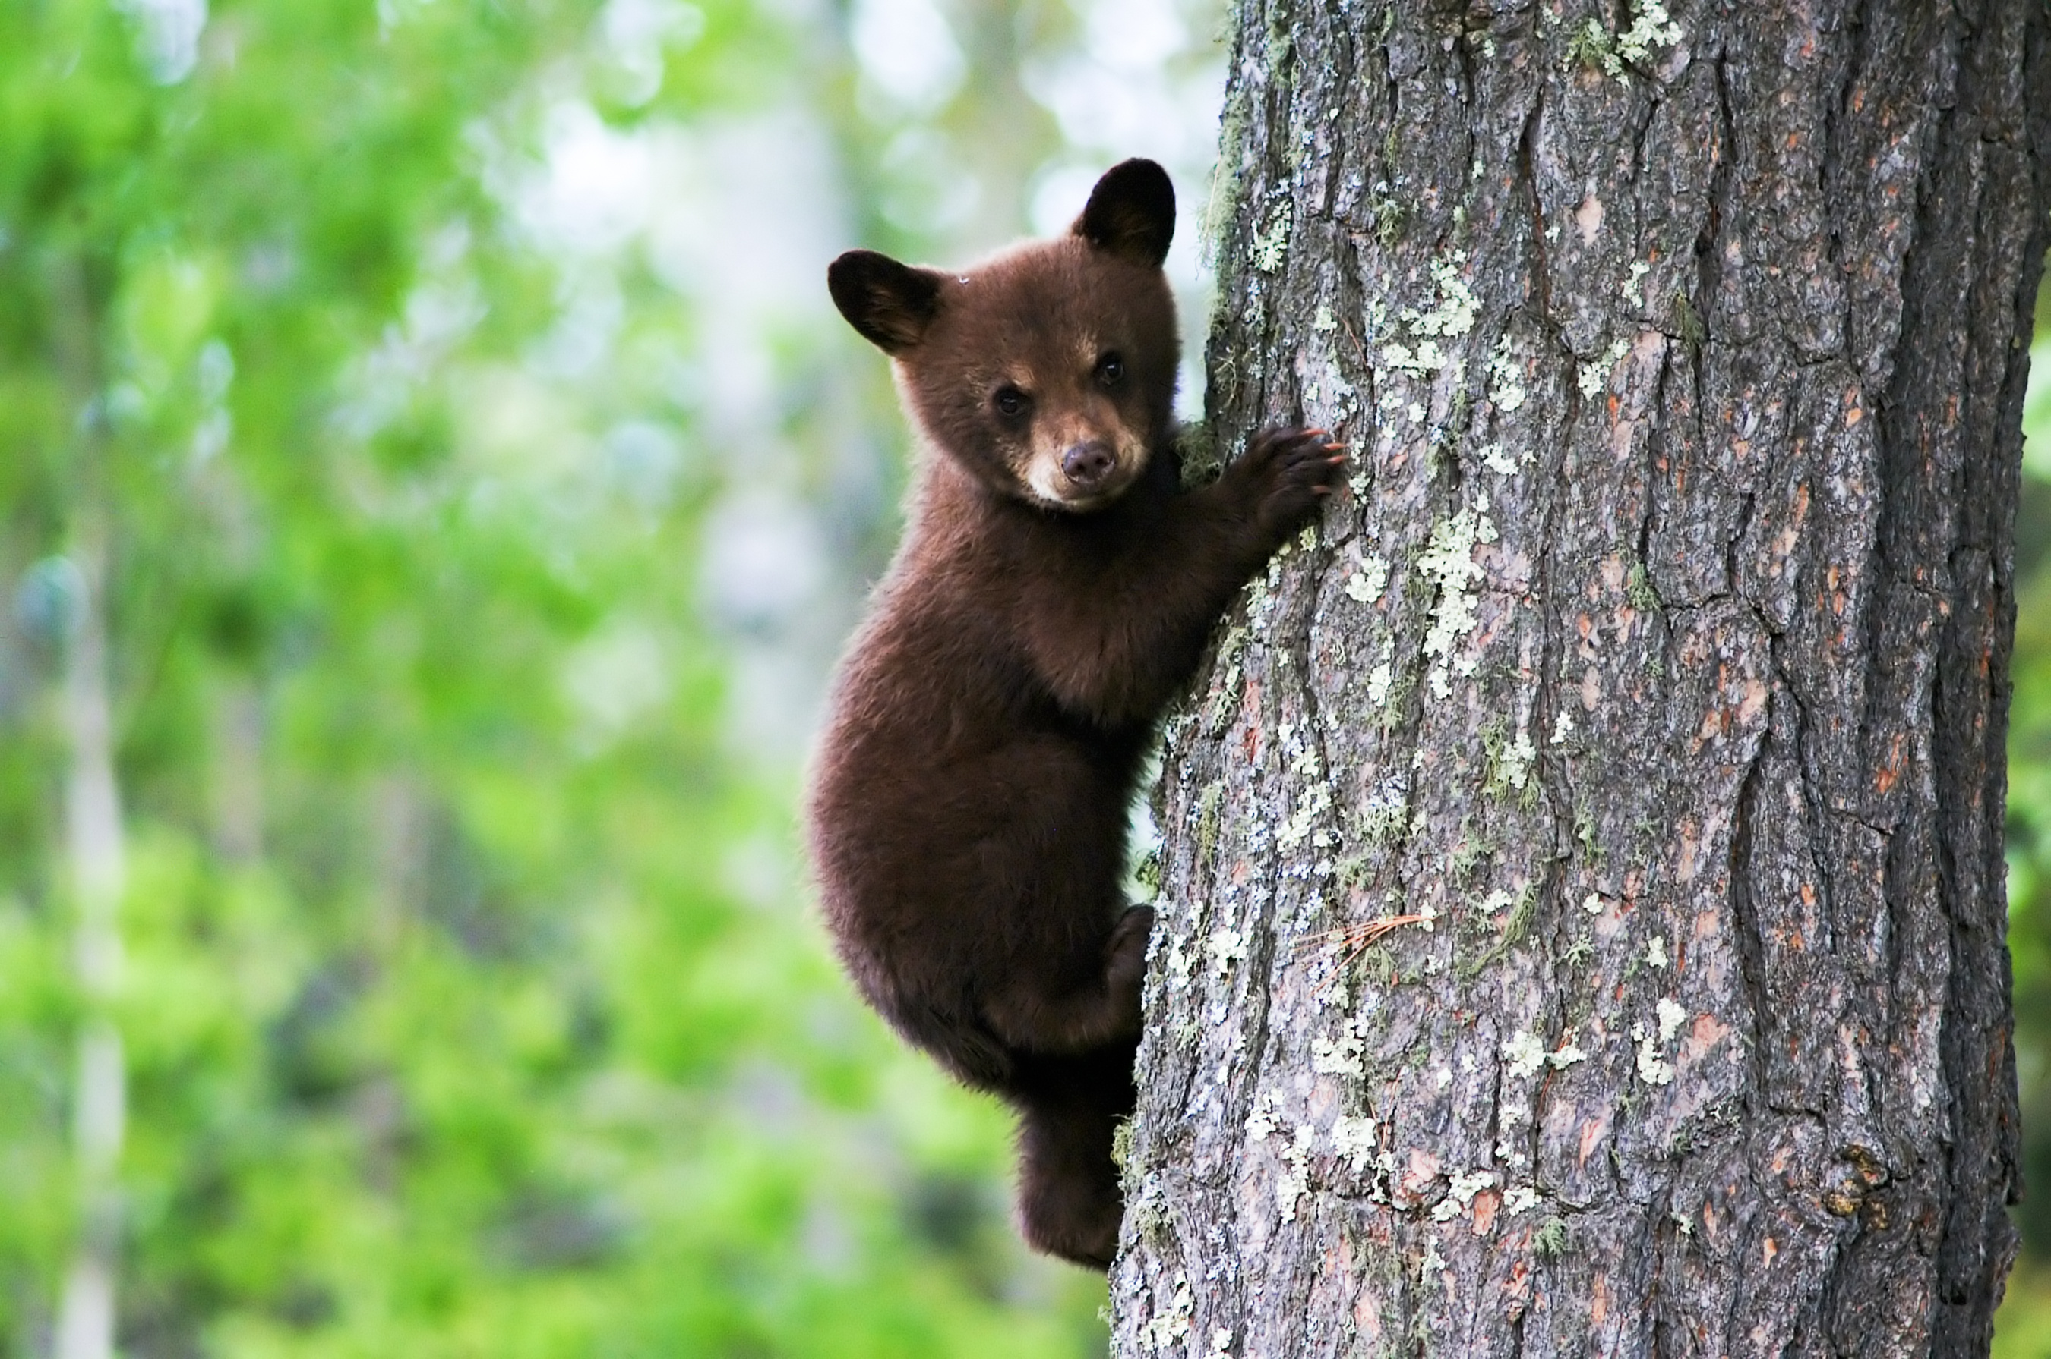
The word ‘cub’ means ‘baby animal’.
Pre-reading
Reading
After Reading

Slide 38
What do pandas do a lot?
What should people do?
Pre-reading
Reading
After Reading

Slide 39
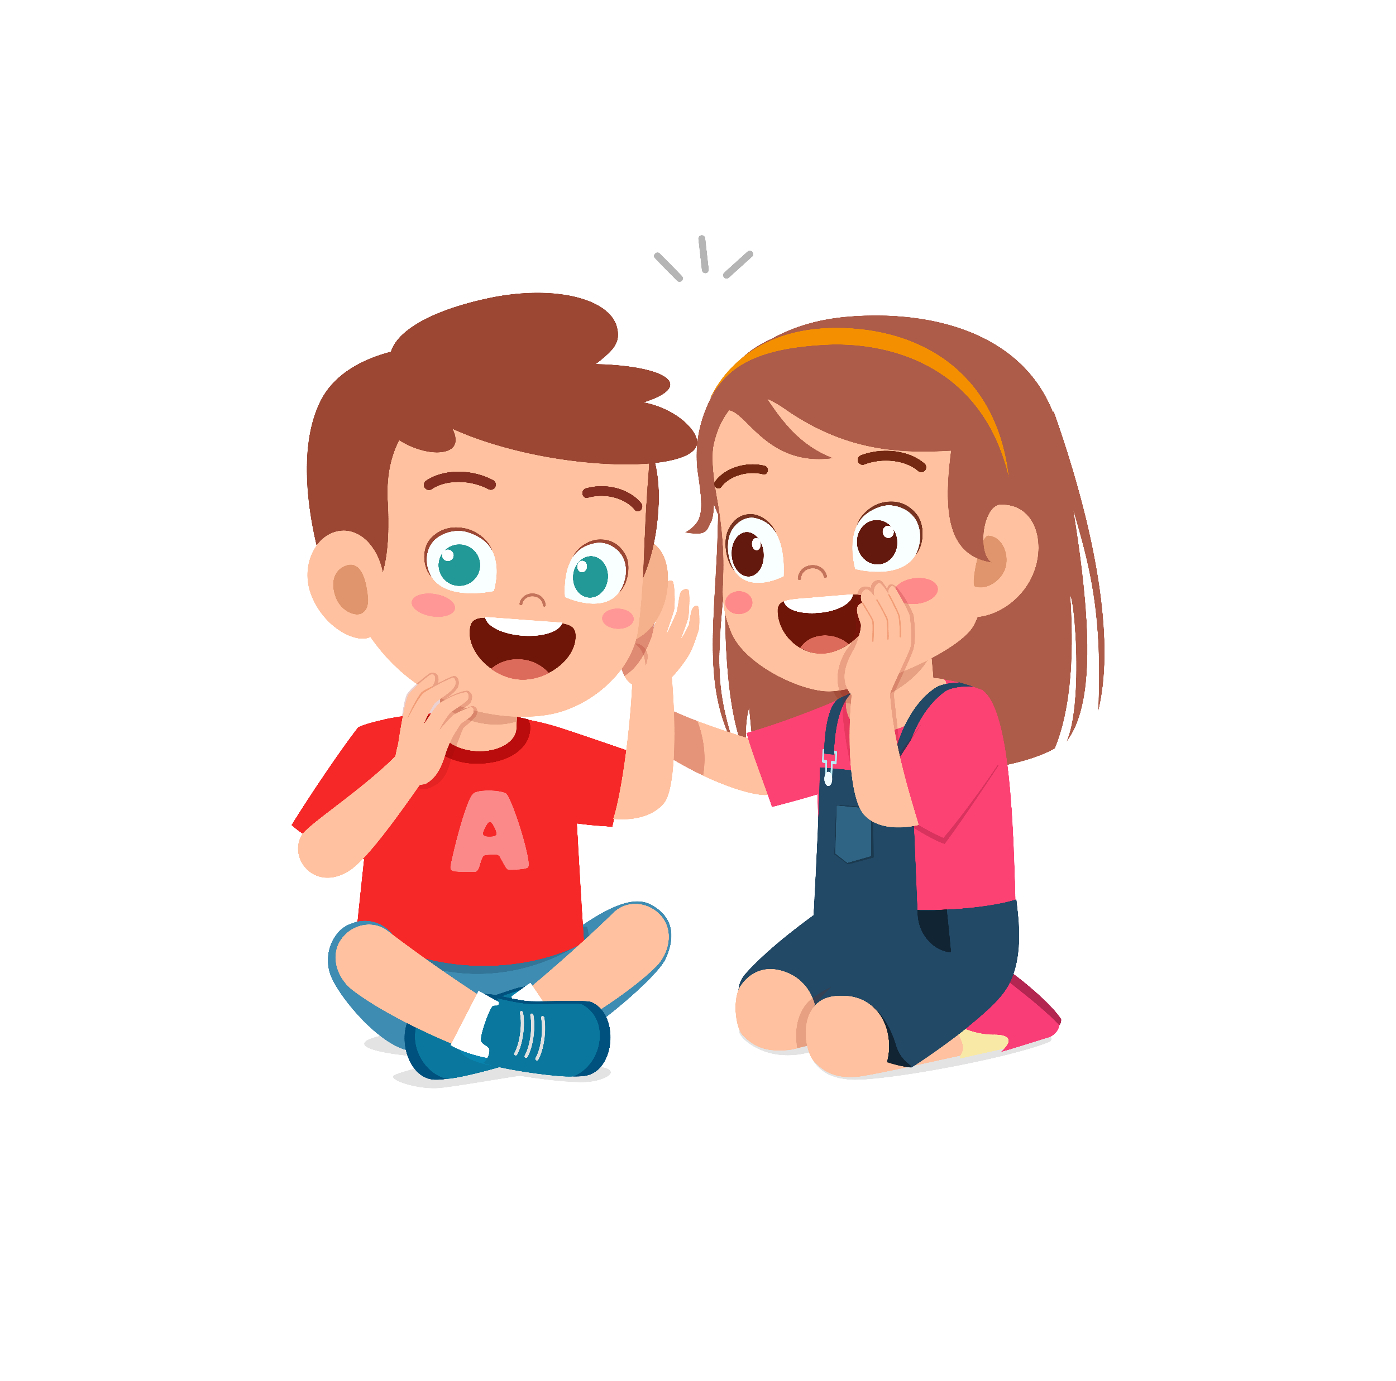
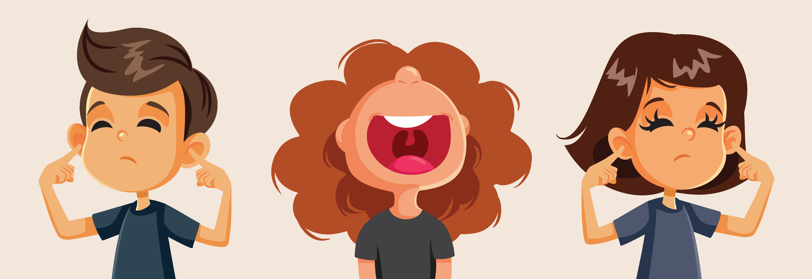
Should they be quiet?
Should they talk loudly?
Pre-reading
Reading
After Reading

Slide 40

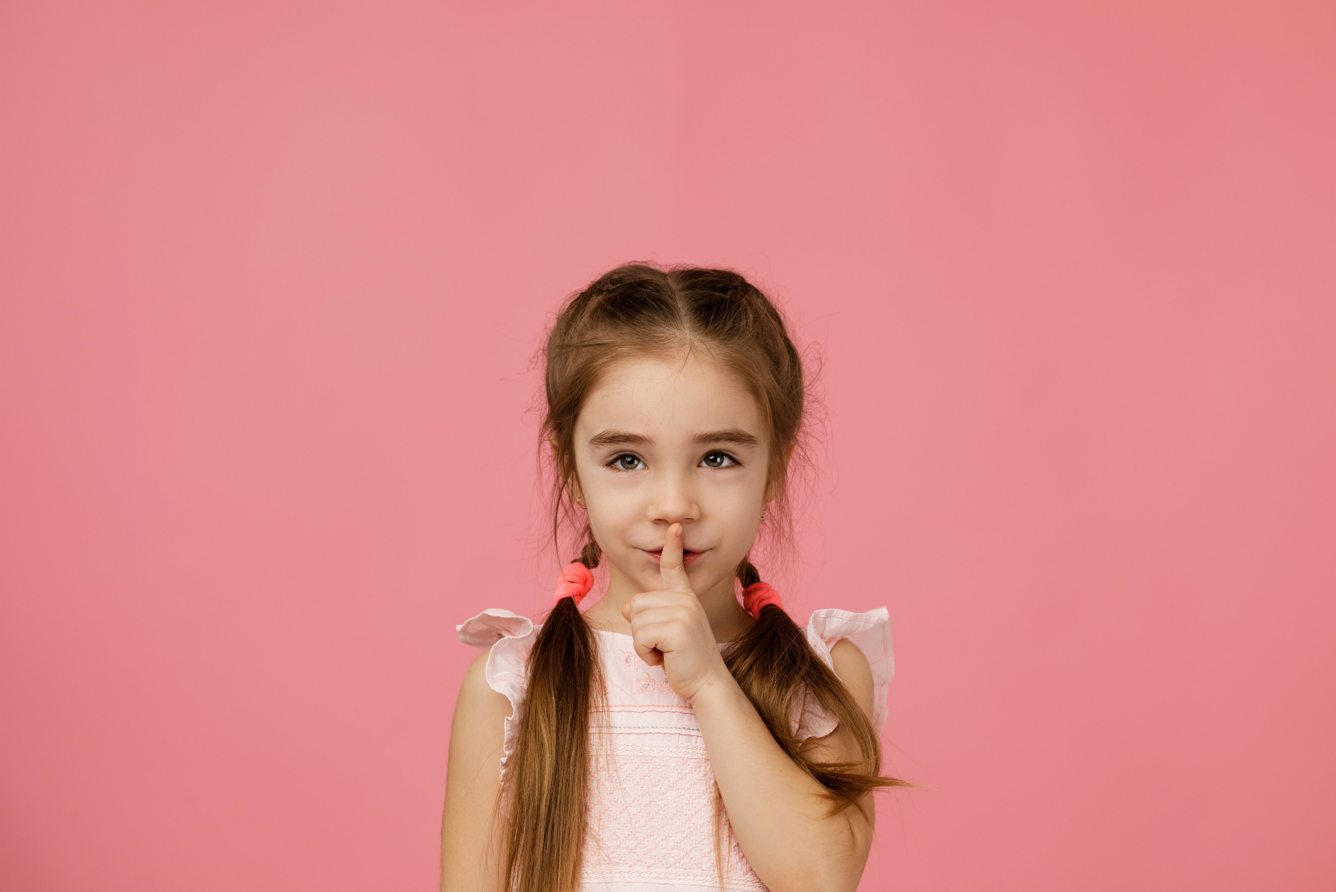
Pandas do not like noise or people talking loudly!
We need to be quiet.
Pre-reading
Reading
After Reading

Slide 41
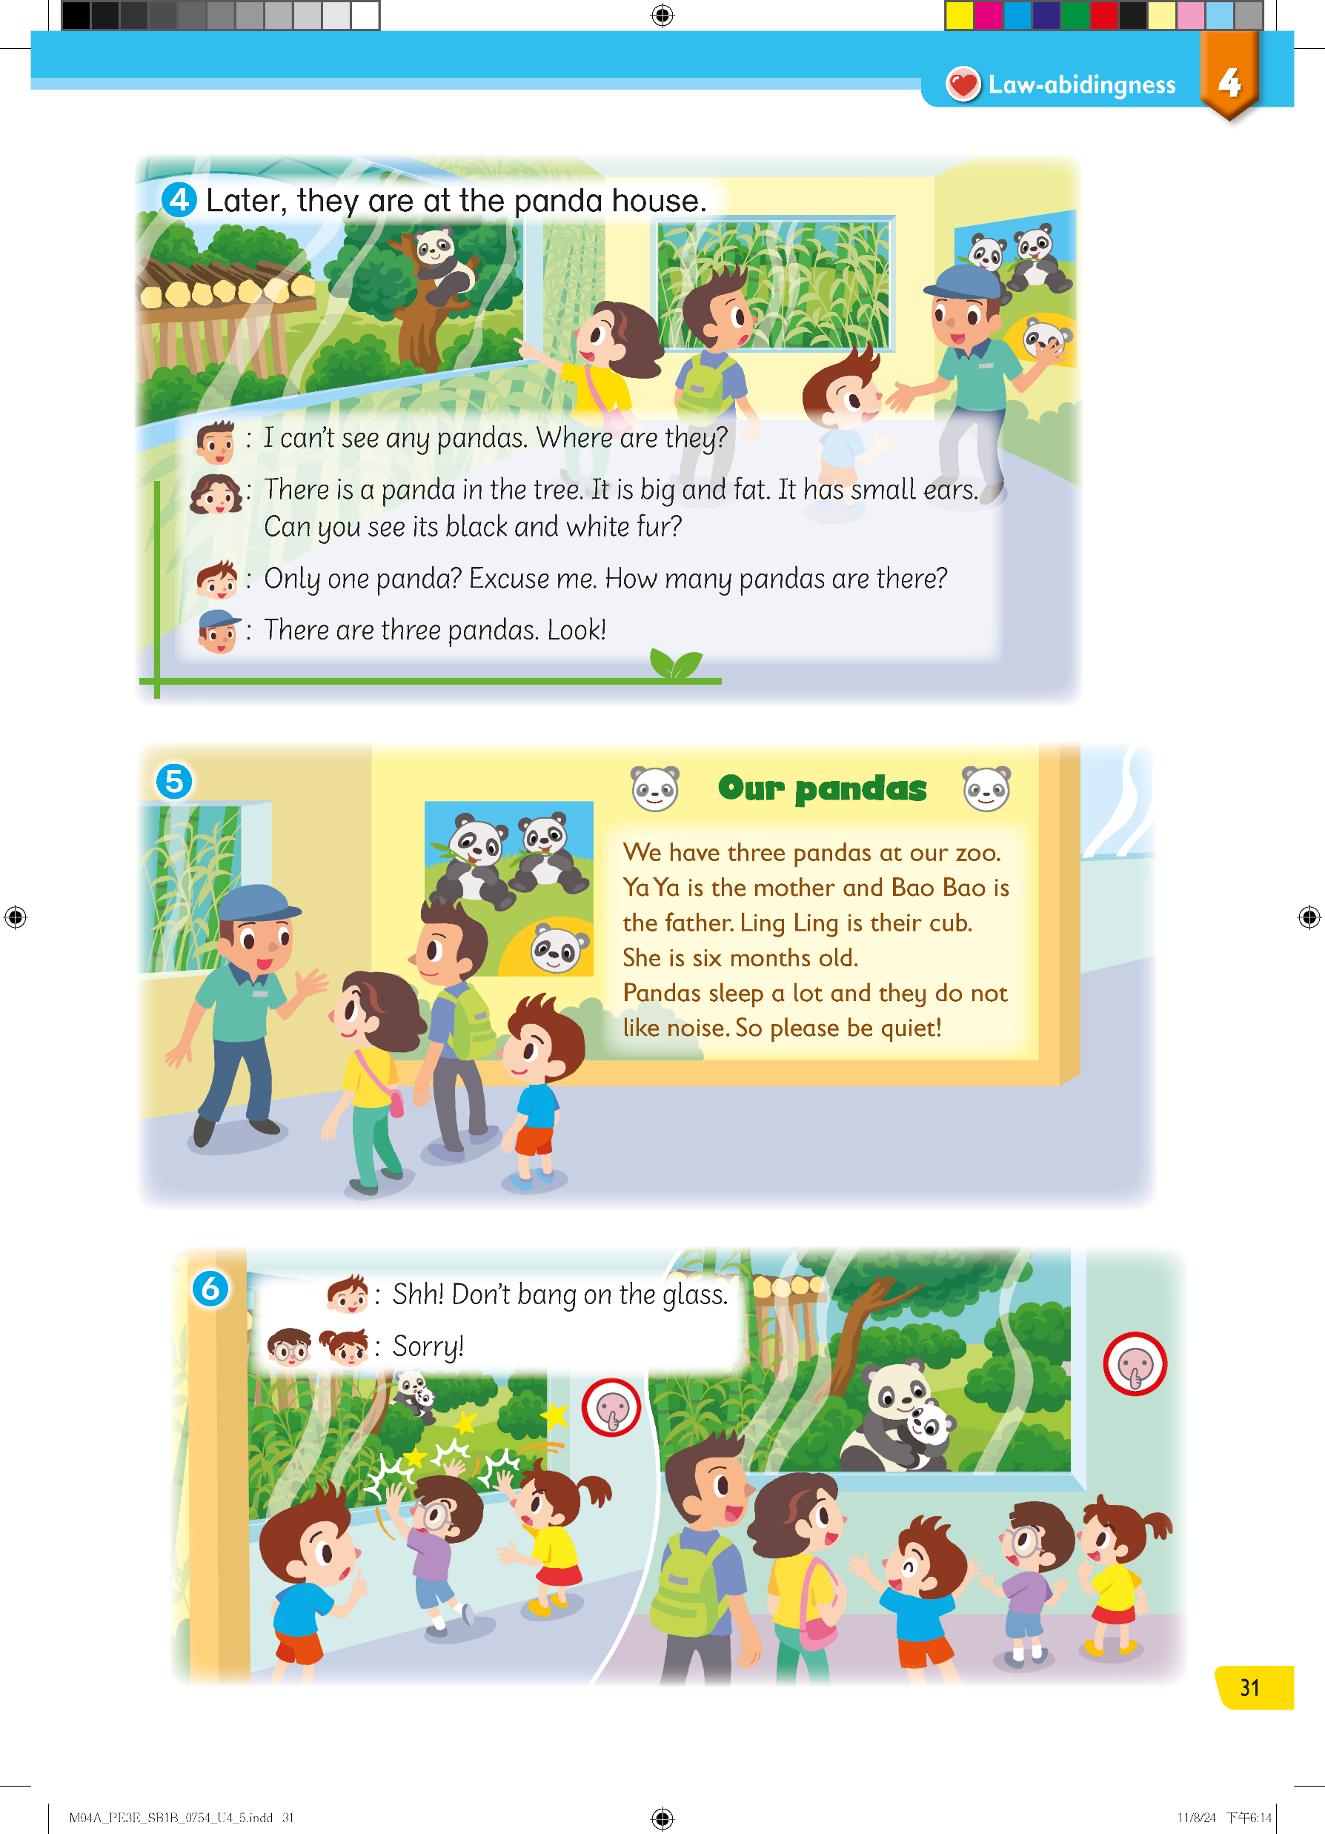
Listen! What is that noise?
Pre-reading
Reading
After Reading

Slide 42
Listen! What is that noise?
Oh! The children bang on the glass.
Pre-reading
Reading
After Reading
5761657

Slide 43
Are they noisy?
What does Leo tell them?
Pre-reading
Reading
After Reading

Slide 44
When we are quiet, the animals are happy.
Pre-reading
Reading
After Reading

Slide 45
Let’s recap the story!
Pre-reading
Reading
After Reading

Slide 46

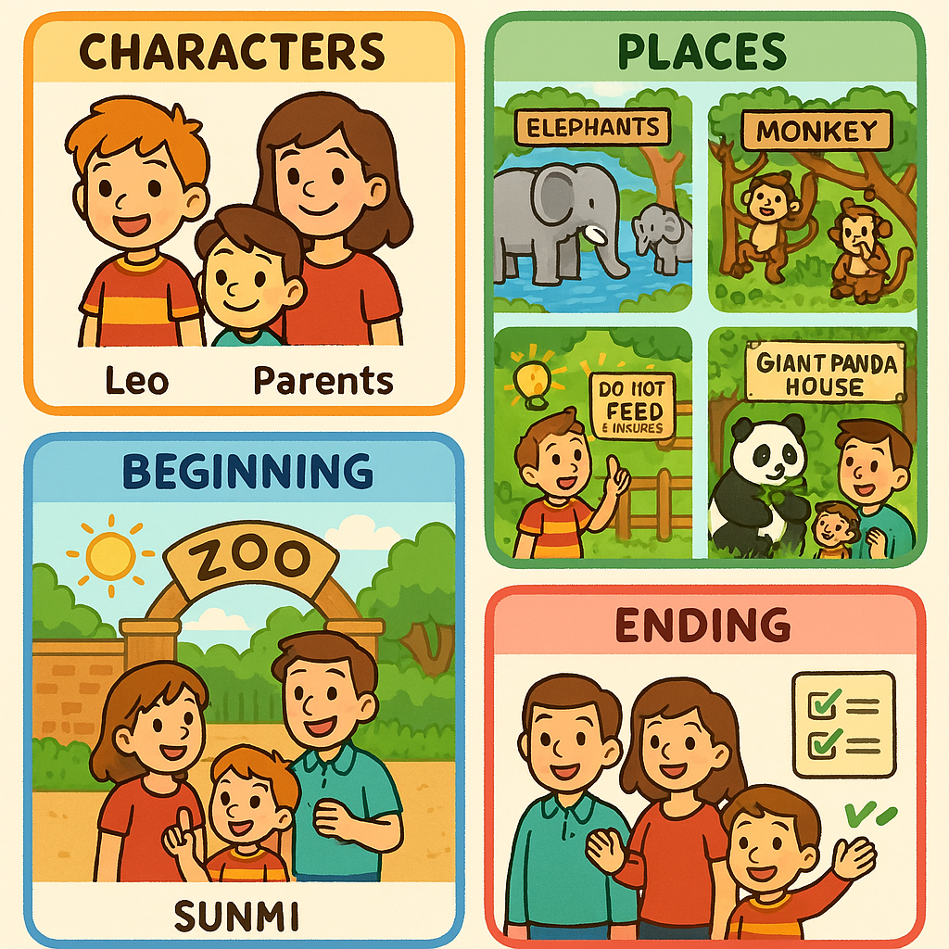


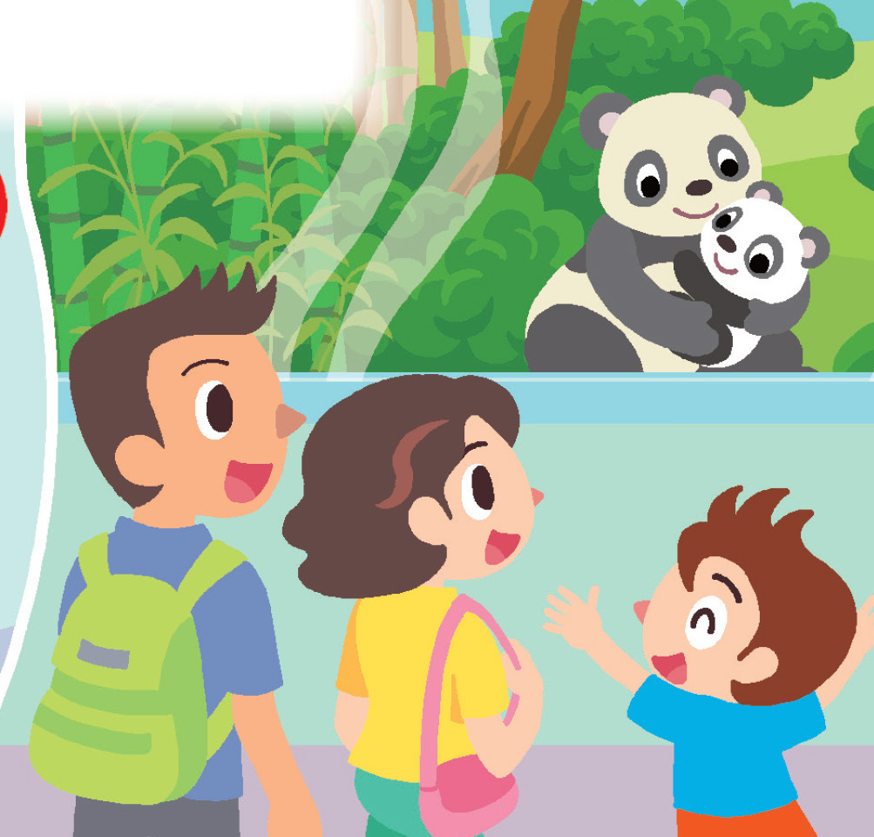
Characters
Places
Middle
Ending
Beginning
They see elephants, monkeys, and pandas.
They count the animals and learn interesting facts.
Leo is reminded not to feed the monkeys and to be quiet near the pandas.
Leo and his family enjoy their visit by following the zoo rules and respecting the animals.
Leo goes to the zoo with his parents on Sunday.
Pre-reading
Reading
After Reading

Slide 48
Acknowledgements
We would like to thank the following organisations and people for permission to use their images and audio:
artisticco / stock.adobe.com
barrirret / stock.adobe.com
Colorfuel Studio / stock.adobe.com
Eric Isselée / stock.adobe.com
famveldman / stock.adobe.com
iconicbestiary / stock.adobe.com
Meraupindo / Shutterstock
nicoletaionescu / stock.adobe.com
pernjakovic / 123RF
producer / stock.adobe.com
Tony Campbell / stock.adobe.com
Wandering Bear / stock.adobe.com
Татьяна Шанахина / stock.adobe.com

