Slide 1
Life cycle of a butterfly

Slide 2
Warm up
Let’s read a science article today!
Warm up
Explore
Activity

Slide 3
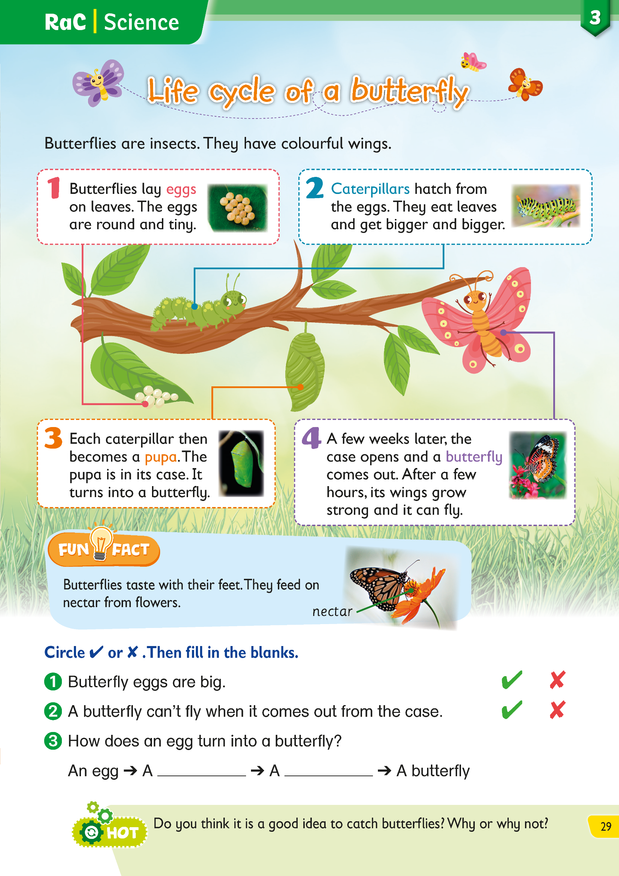
Let’s learn about butterflies today!
Warm up
Explore
Activity

Slide 4
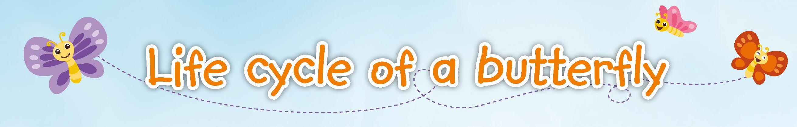


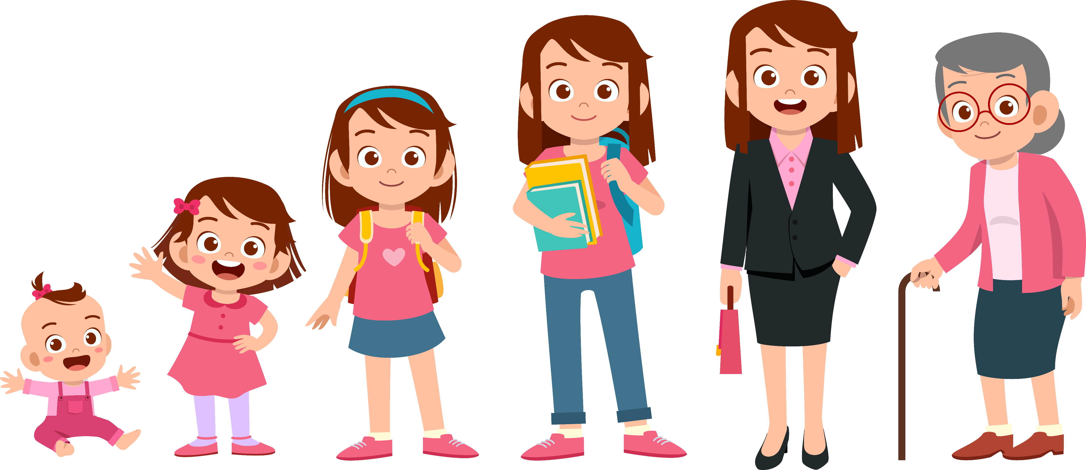
A life cycle is the different stages of life for living things.
Here’s what the life cycle of a human looks like.
What is the title of this article?
This article tells us about the life cycle of a butterfly.
`
Human life cycle
Warm up
Explore
Activity

Slide 5
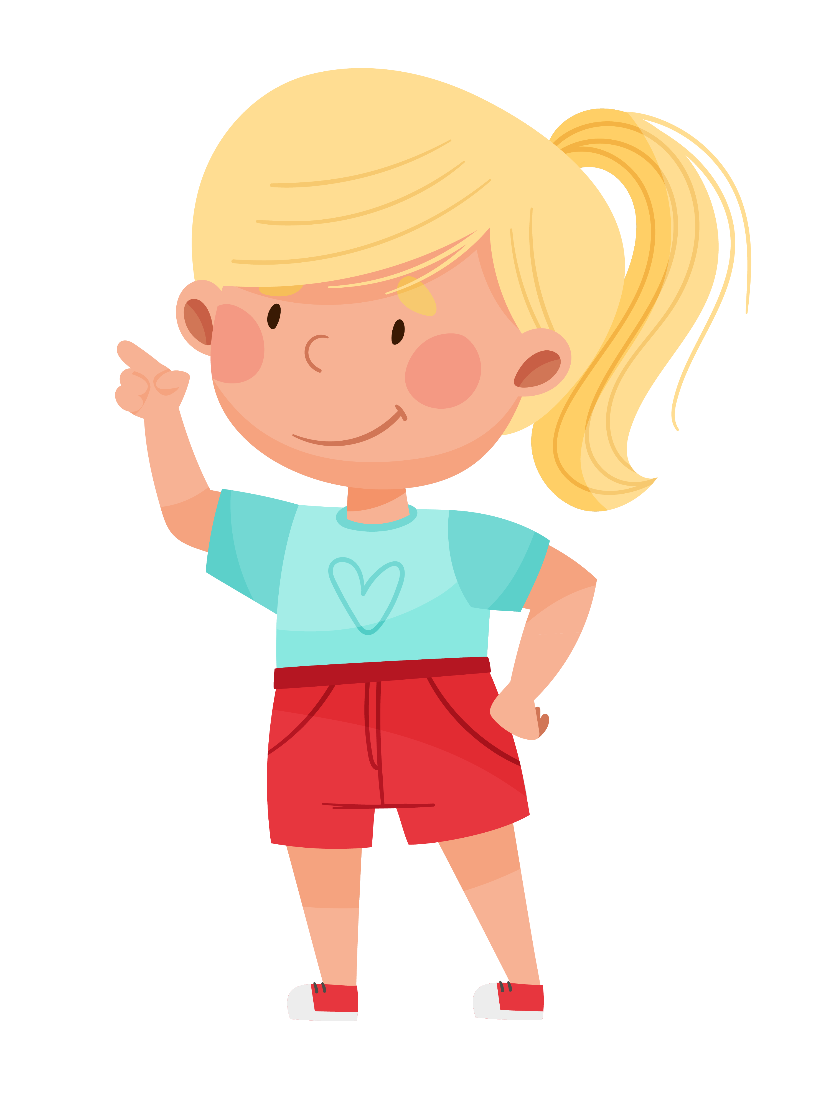
From when a butterfly is born to when it grows up, what happens? Let’s find out!
Warm up
Explore
Activity

Slide 6
Explore
Let’s read the article in detail.
Warm up
Explore
Activity

Slide 7

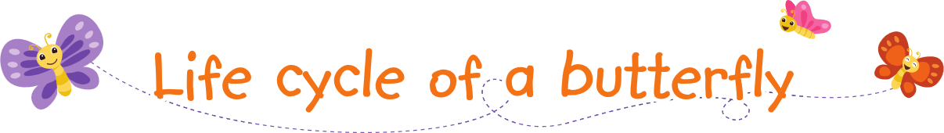
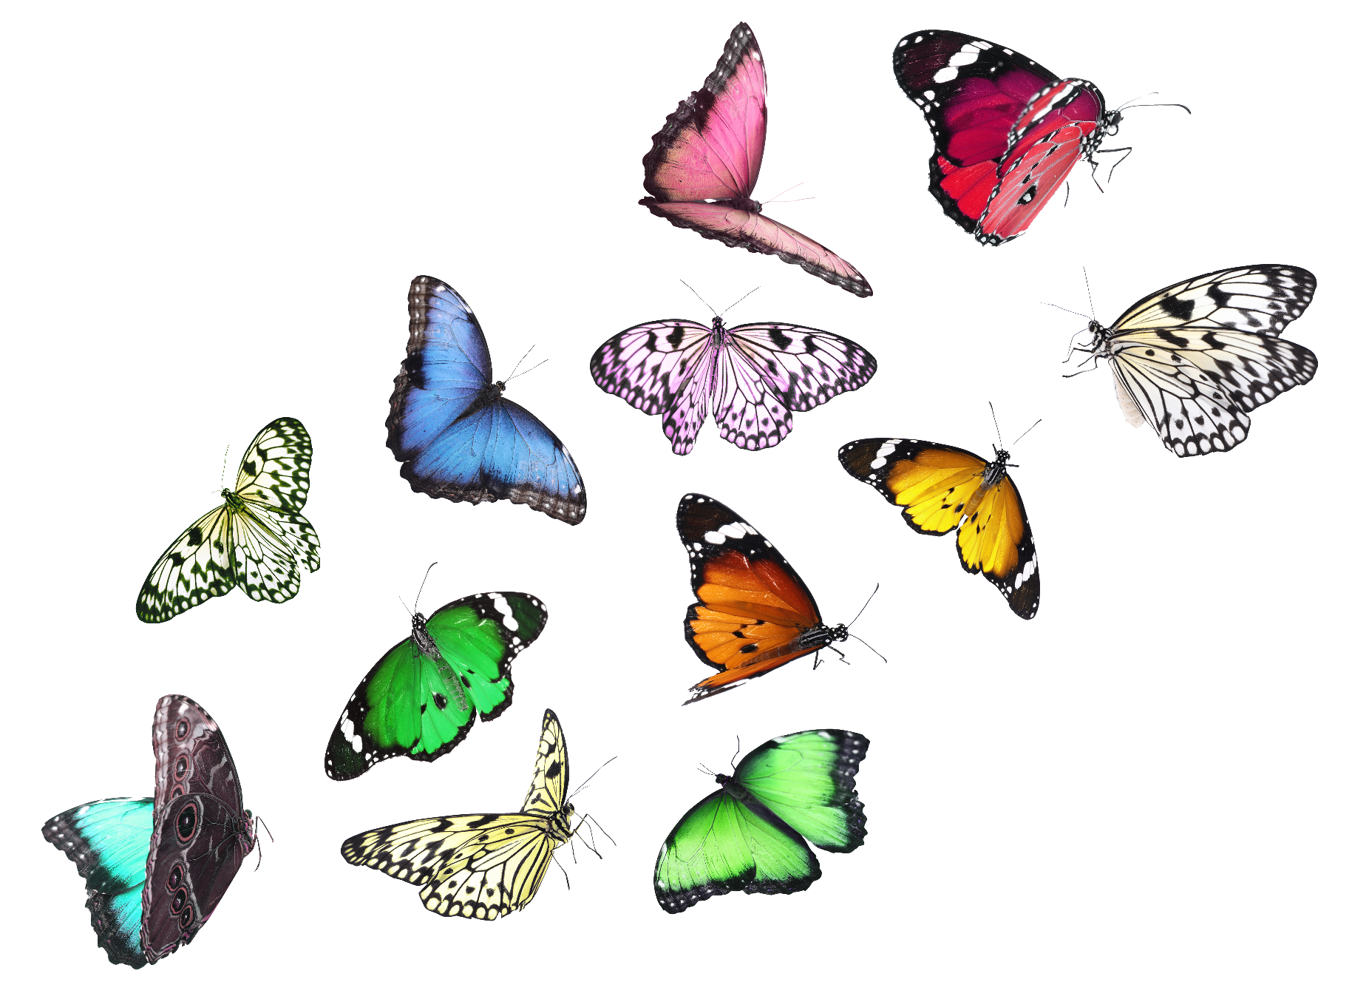

Butterflies are insects. They have colourful wings.
Warm up
Explore
Activity

Slide 8


An insect is a small animal with a three-part body and six legs.
Some insects, like butterflies, have wings. They can fly.
Butterflies are insects. They have colourful wings.
Warm up
Explore
Activity

Slide 9
Butterflies can have many colours.
Do you think they are beautiful? Do you like them?
Butterflies are insects. They have colourful wings.
Warm up
Explore
Activity

Slide 10
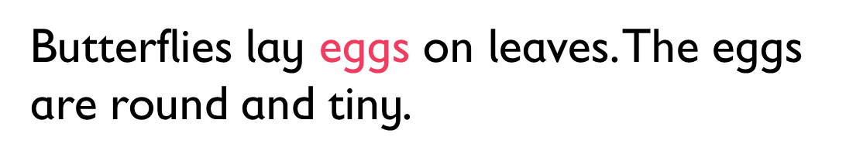
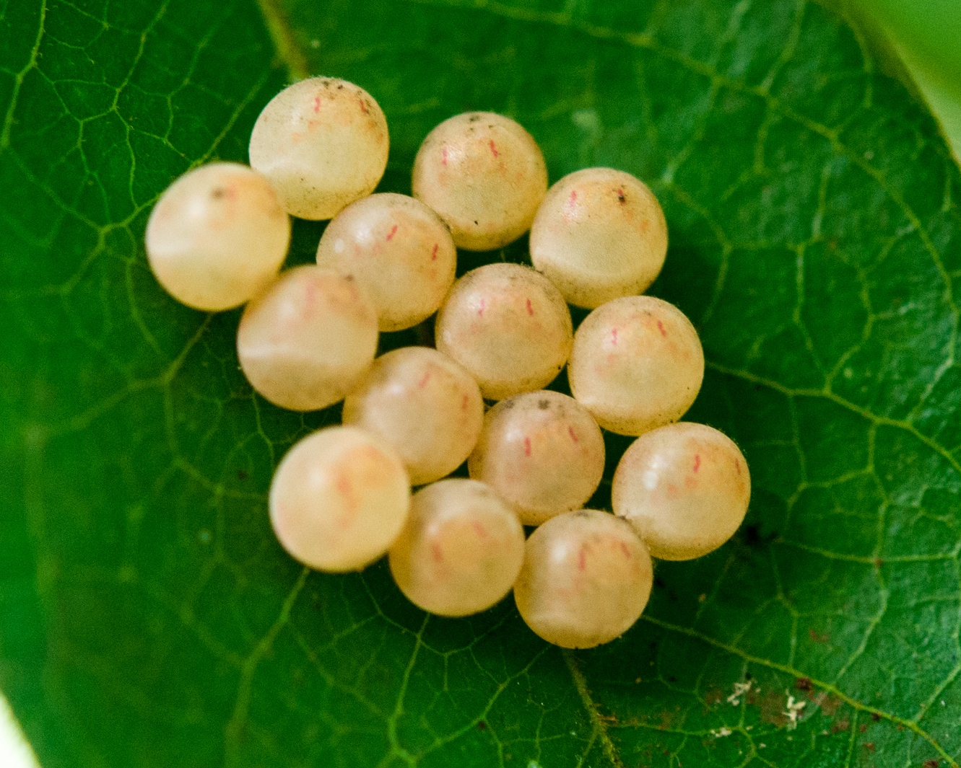

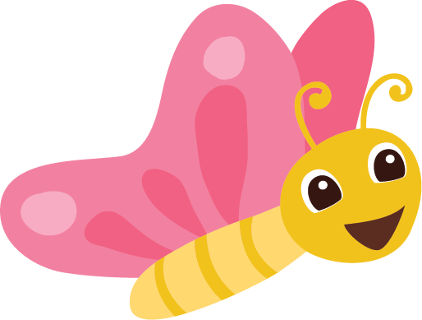

Butterflies lay eggs on leaves. The eggs are round and tiny.
Warm up
Explore
Activity

Slide 11
Mother butterflies do not give birth to babies. They lay eggs.
The babies grow inside the eggs for three to six days.
Then they come out of the eggs.
Butterflies lay eggs on leaves. The eggs are round and tiny.
Warm up
Explore
Activity

Slide 12

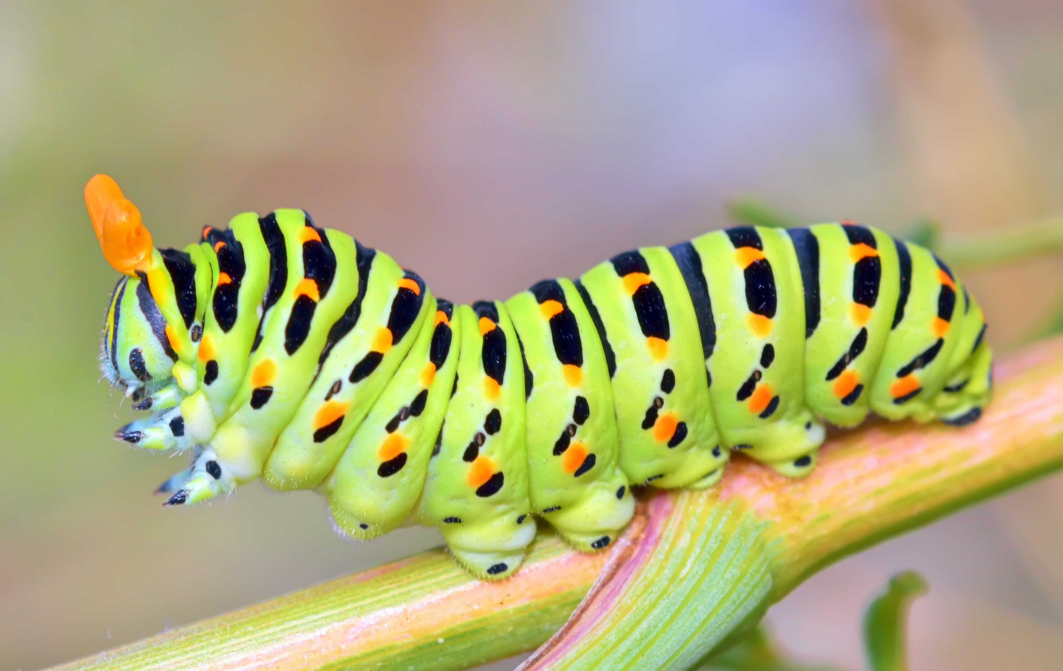

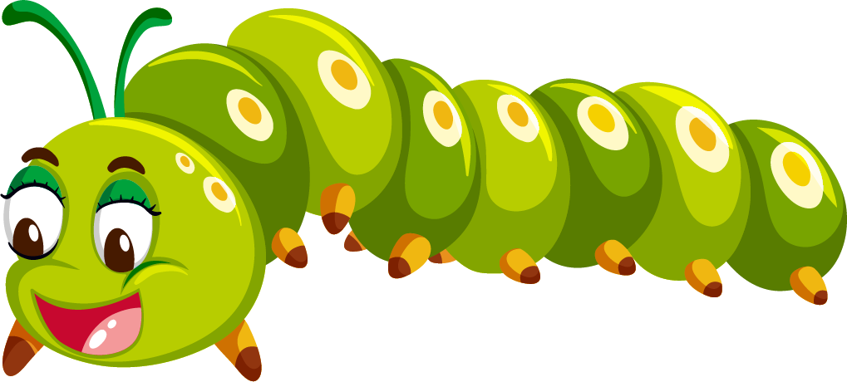

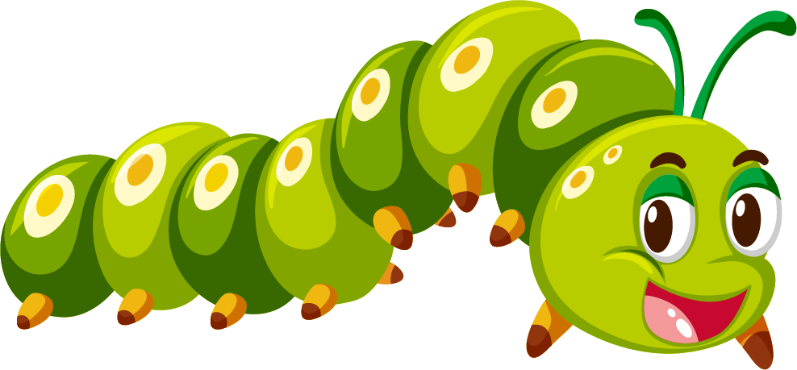

Caterpillars hatch from the eggs. They eat leaves and get bigger and bigger.
Warm up
Explore
Activity

Slide 13

When insects hatch, they come out of their eggs.
Do baby butterflies come out of the eggs?
Caterpillars are like worms. They have many legs.
Do you think caterpillars are beautiful? Do you like them?
Caterpillars hatch from the eggs. They eat leaves and get bigger and bigger.
Warm up
Explore
Activity

Slide 14
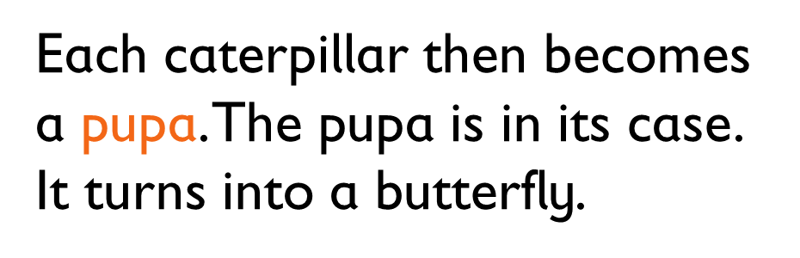

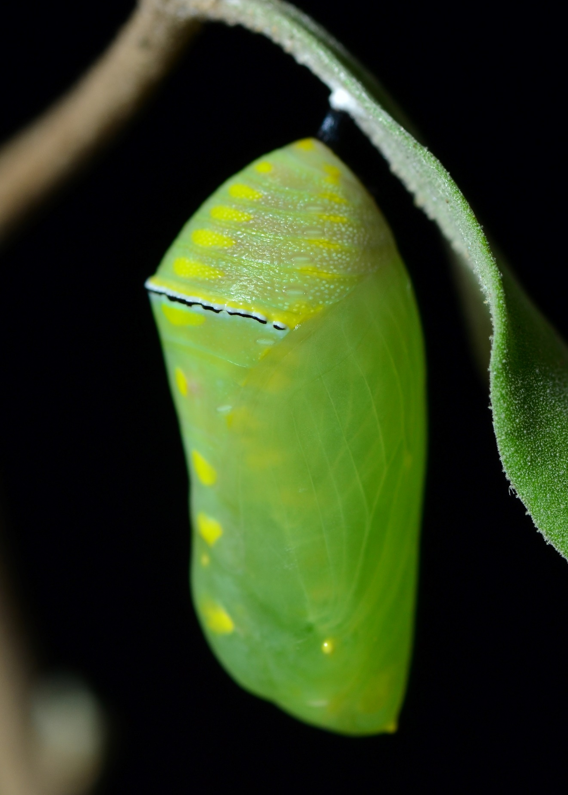

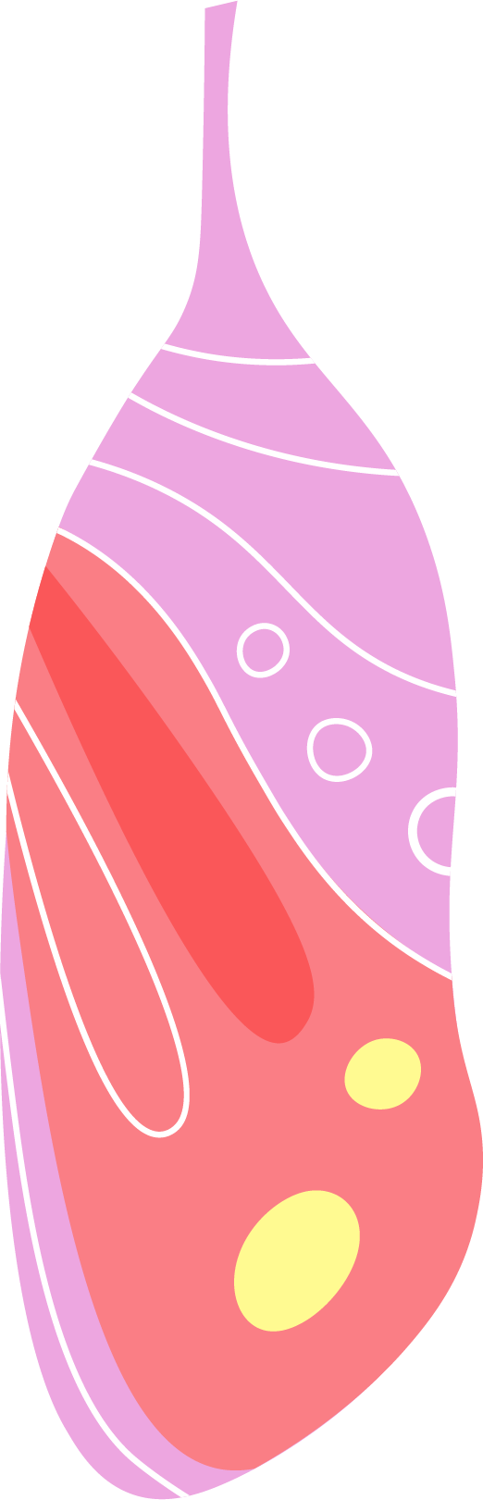
Each caterpillar then becomes a pupa. The pupa is in its case. It turns into a butterfly.
Warm up
Explore
Activity

Slide 15
The pupa cannot move.
The case is hard and it keeps the pupa safe.
Each caterpillar then becomes a pupa. The pupa is in its case. It turns into a butterfly.
Warm up
Explore
Activity

Slide 16
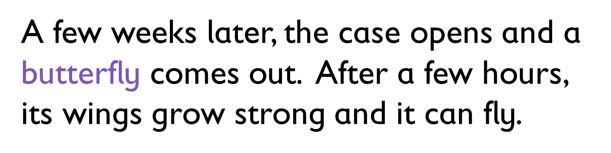

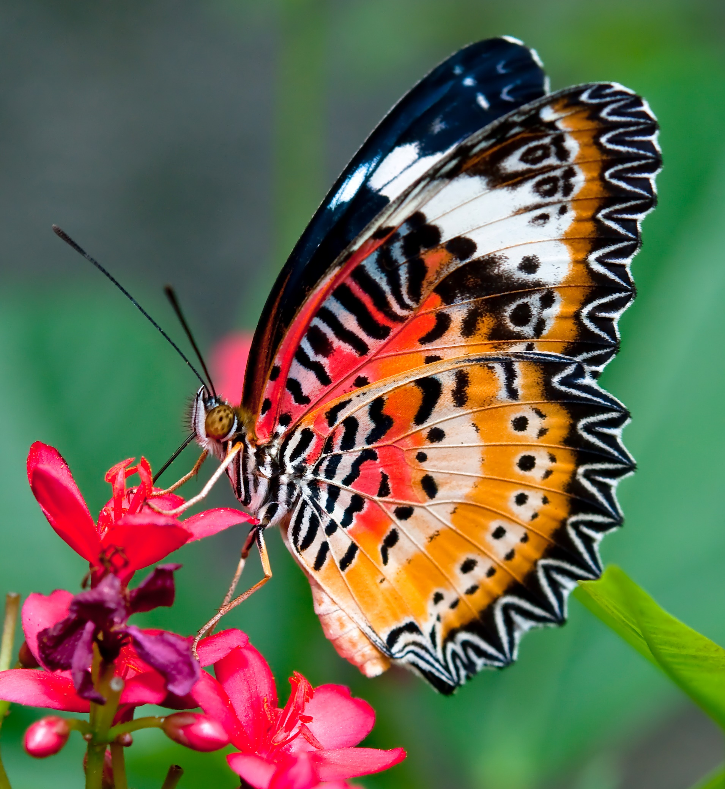

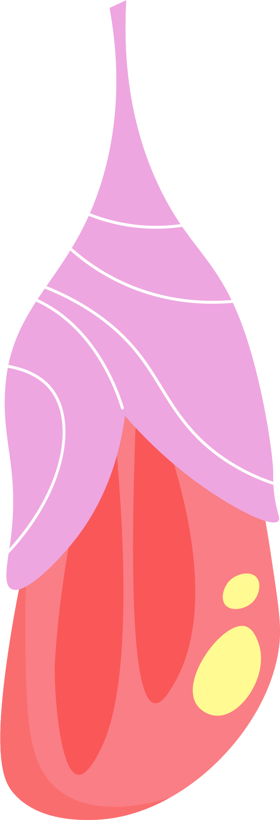

A few weeks later, the case opens and a butterfly comes out. After a few hours, its wings grow strong and it can fly.
Warm up
Explore
Activity

Slide 17
An ugly caterpillar can turn into a beautiful butterfly!
Wow! This is amazing!
A few weeks later, the case opens and a butterfly comes out. After a few hours, its wings grow strong and it can fly.
Warm up
Explore
Activity

Slide 18

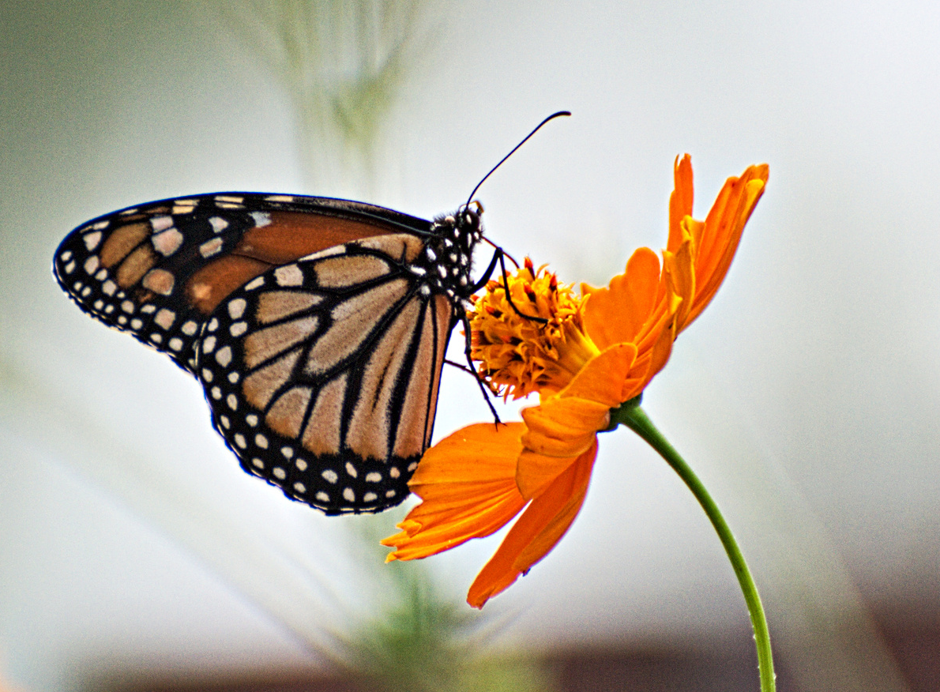


Butterflies taste with their feet. They feed on nectar from flowers.
nectar
Warm up
Explore
Activity

Slide 19
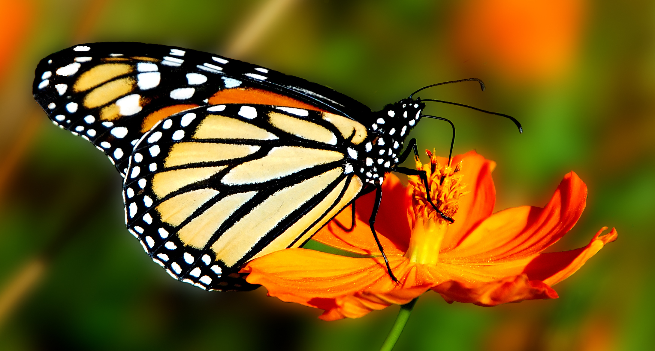

Butterflies taste with their feet.
When they land on a flower, they can taste the flower
to see if it has nectar.
Nectar is a sweet juice that flowers make.
Butterflies use their long, tube-like mouth to drink the nectar.
Butterflies taste with their feet. They feed on nectar from flowers.
nectar
Warm up
Explore
Activity

Slide 20


Do you think it is a good idea to catch butterflies? Why or why not?
Warm up
Explore
Activity

Slide 21
Activity
Now, let’s answer some questions.
Warm up
Explore
Activity

Slide 22
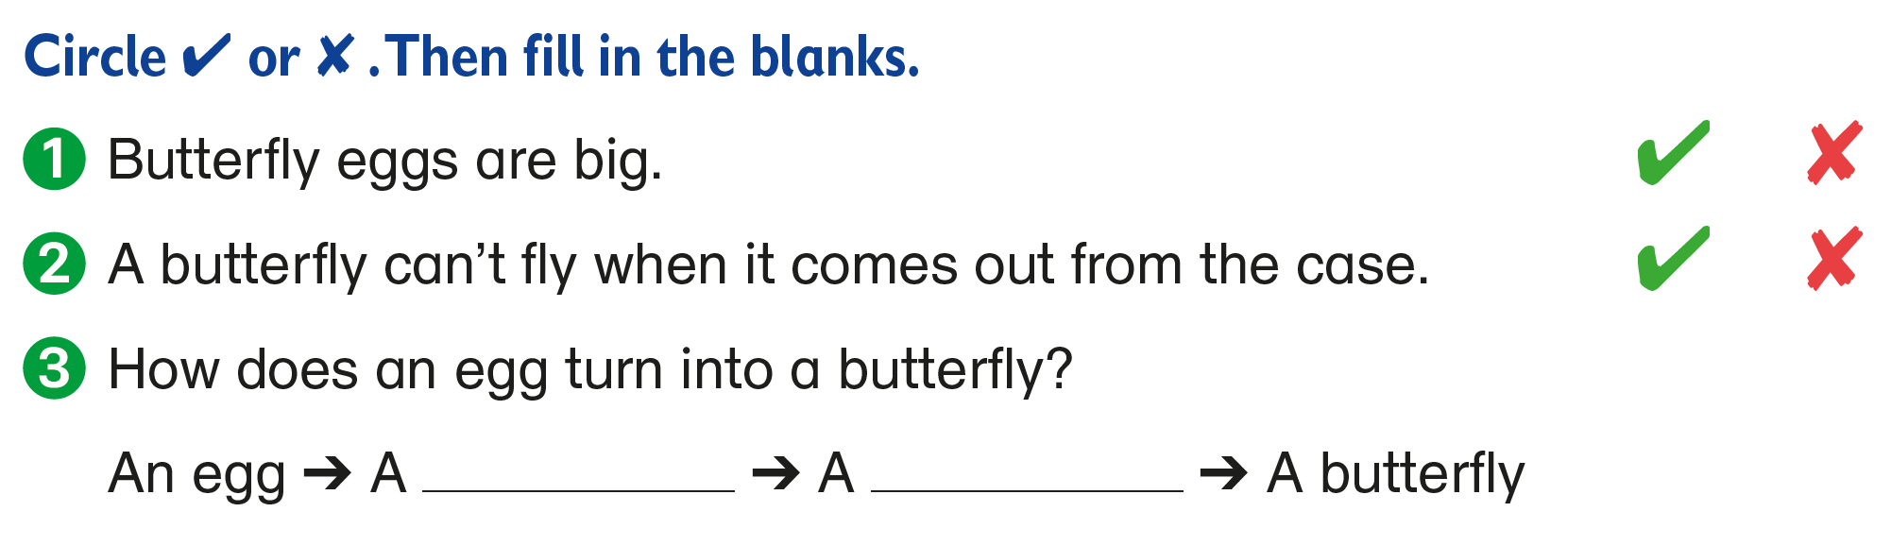


caterpillar
pupa
Warm up
Explore
Activity

Slide 23
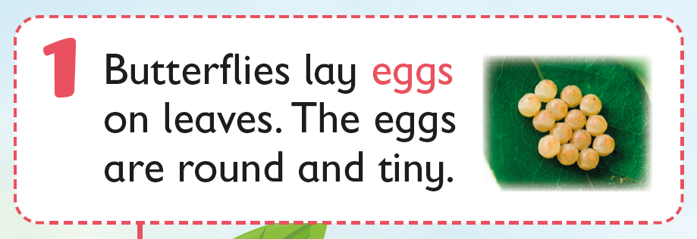


Slide 24
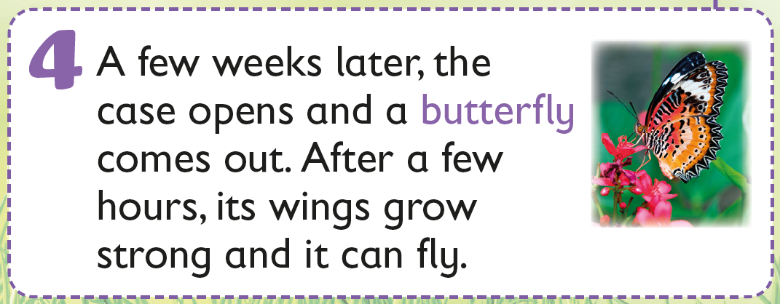

Slide 25
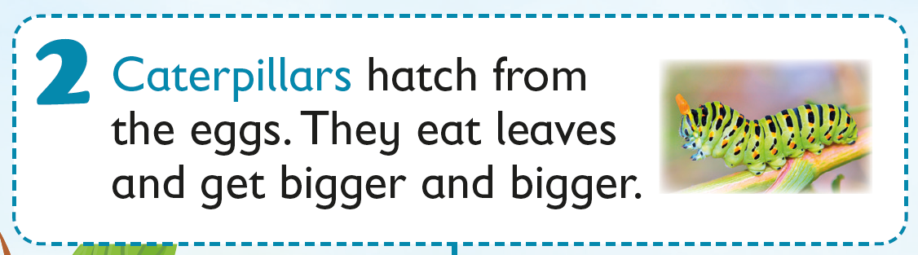
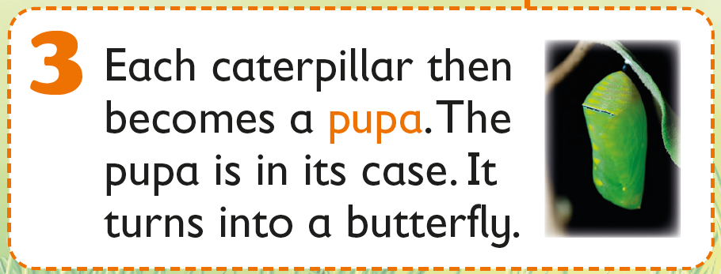

Slide 27
Acknowledgements
We would like to thank the following organisations and people for permission to use their images and audio:
Arvind Balaraman / Shutterstock
blueringmedia / stock.adobe.com
Cbenjasuwan / Shutterstock
Colorfuel Studio / Shutterstock
Dedraw Studio / stock.adobe.com
HappyPictures / Shutterstock
hwongcc / Shutterstock
jordache / Shutterstock
LadadikArt / stock.adobe.com
New Africa / stock.adobe.com
nikidericks / stock.adobe.com
Tartila / Shutterstock
Terdpong / Shutterstock
Thammanoon Khamchalee / Shutterstock
varuna / Shutterstock

