Slide 1
Chapter 6
Activities
International cuisines

Slide 2
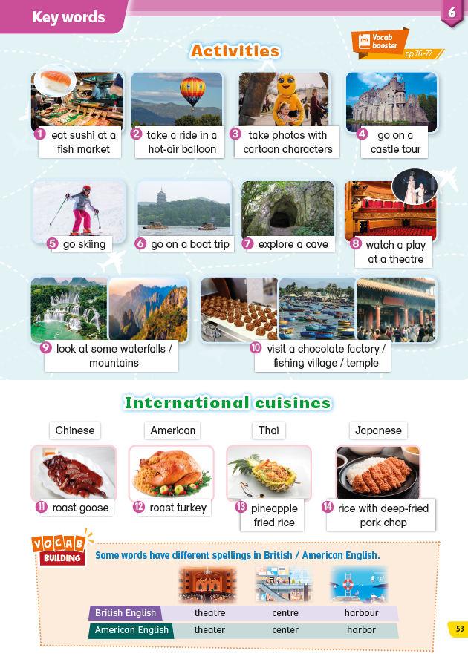

Slide 3


Activities
Vocabulary
Vocab Building
Fun Quiz

Slide 4
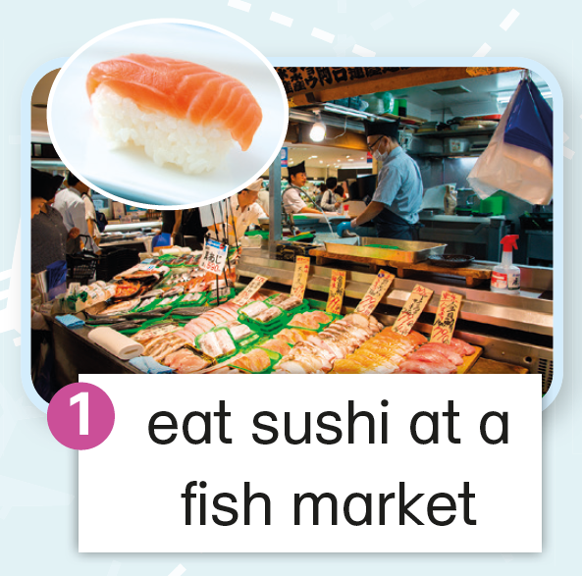
Vocabulary
Vocab Building
Fun Quiz

Slide 5
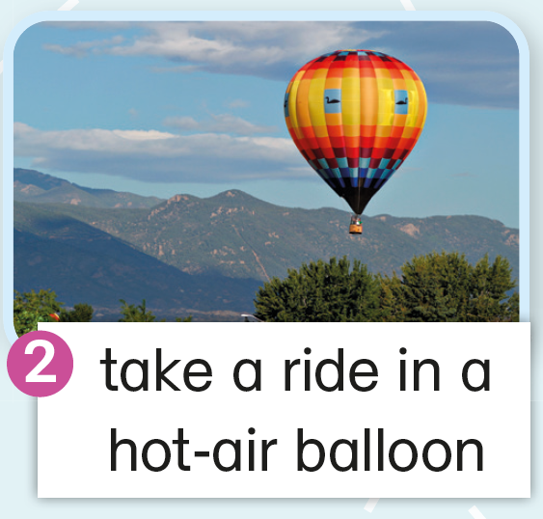

on a hot-air balloon
Vocabulary
Vocab Building
Fun Quiz

Slide 6
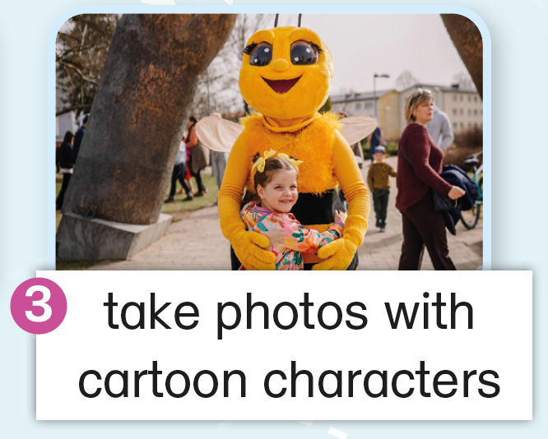
Vocabulary
Vocab Building
Fun Quiz

Slide 7
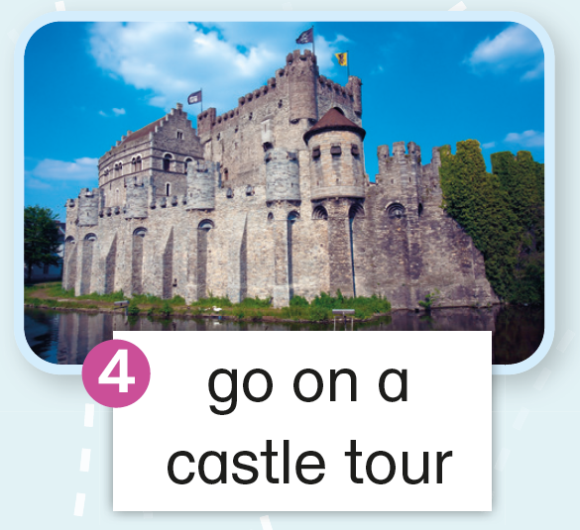
Vocabulary
Vocab Building
Fun Quiz

Slide 8
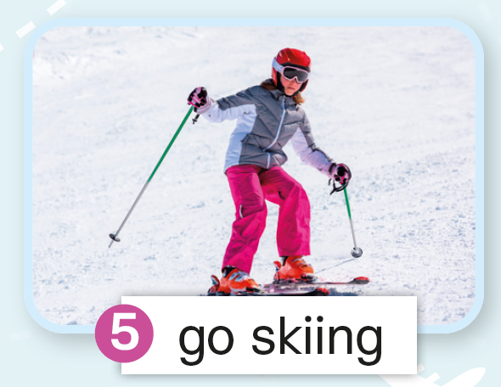
Vocabulary
Vocab Building
Fun Quiz

Slide 9
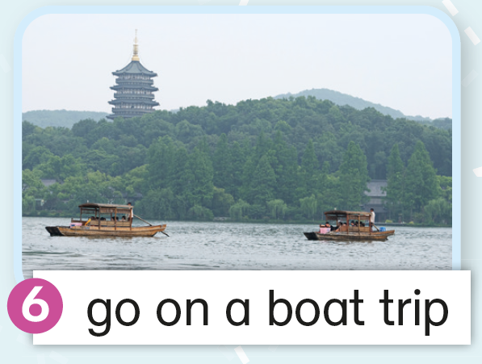
Vocabulary
Vocab Building
Fun Quiz

Slide 10
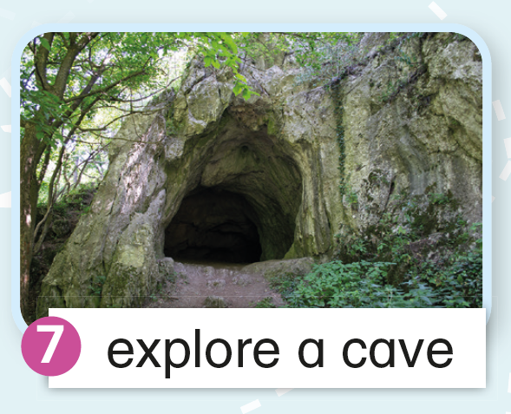
Vocabulary
Vocab Building
Fun Quiz

Slide 11
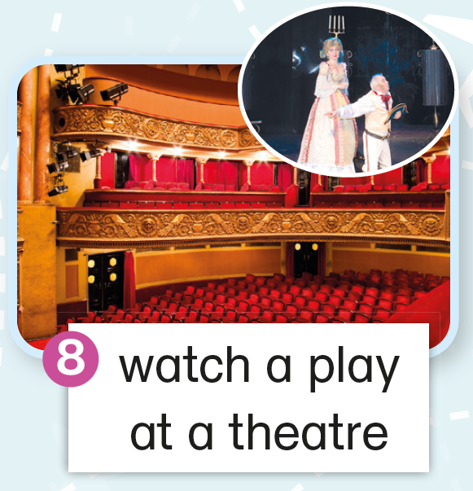
Vocabulary
Vocab Building
Fun Quiz

Slide 12
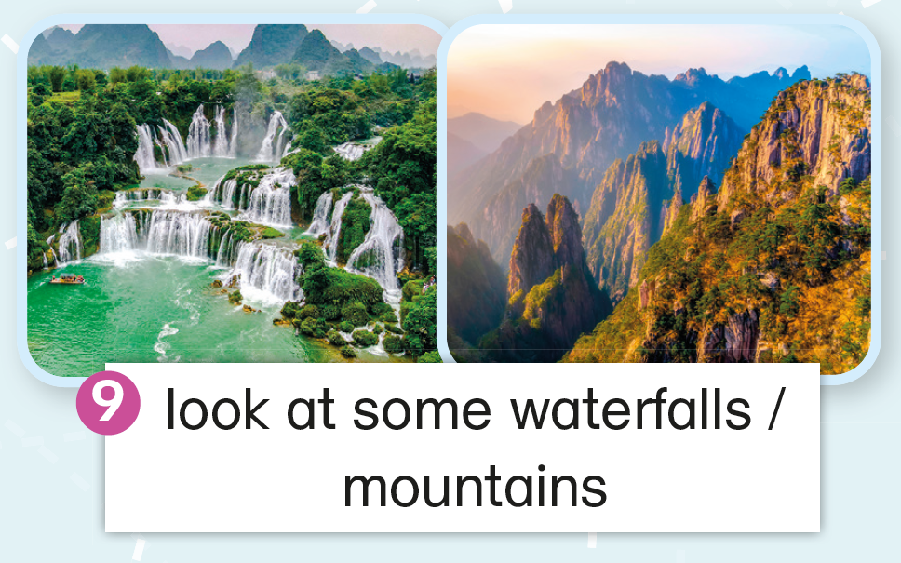
Vocabulary
Vocab Building
Fun Quiz

Slide 13
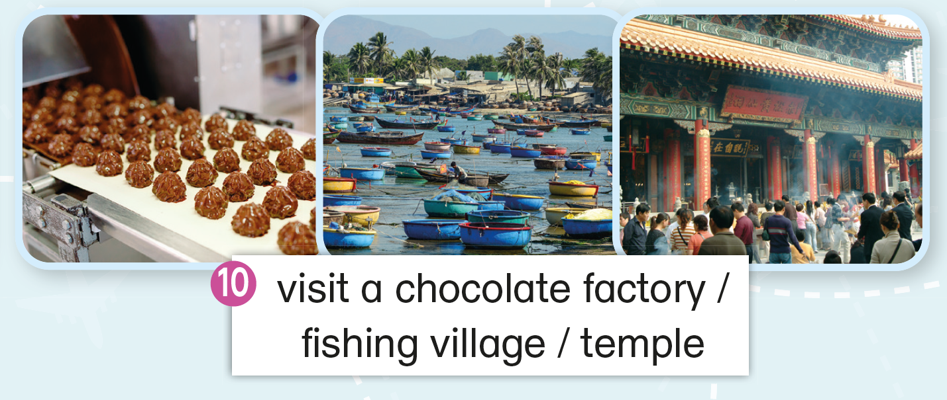
Vocabulary
Vocab Building
Fun Quiz

Slide 14
International cuisines
Vocabulary
Vocab Building
Fun Quiz

Slide 15
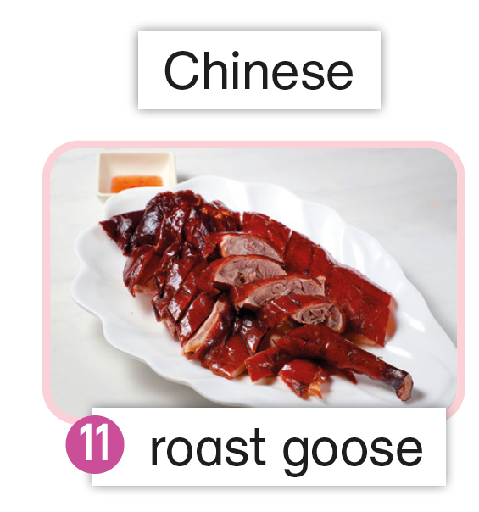
Vocabulary
Vocab Building
Fun Quiz

Slide 16
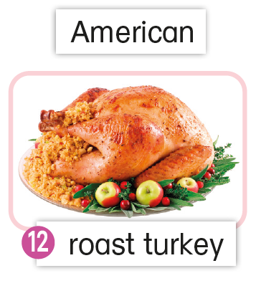
Vocabulary
Vocab Building
Fun Quiz

Slide 17
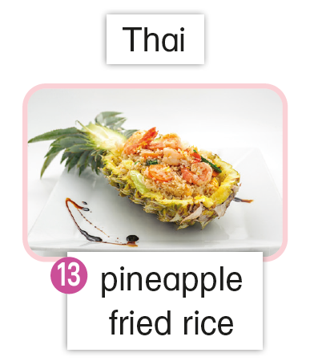
Vocabulary
Vocab Building
Fun Quiz

Slide 18
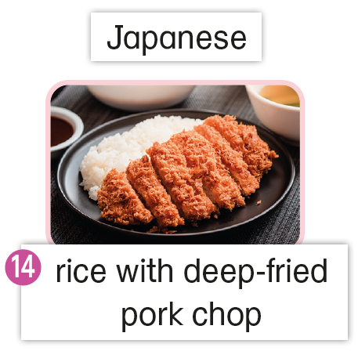
Vocabulary
Vocab Building
Fun Quiz

Slide 19


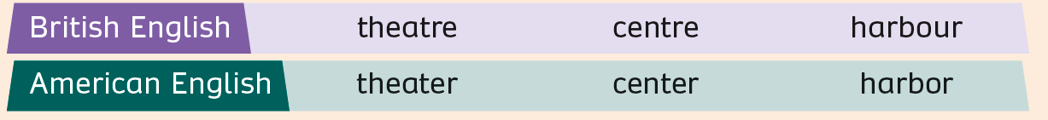
Vocabulary
Vocab Building
Fun Quiz

Slide 20
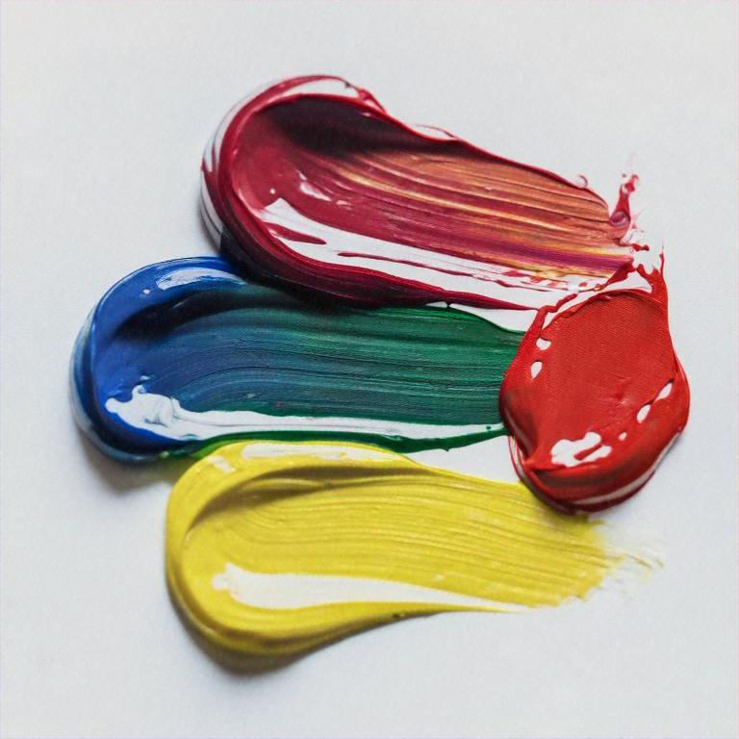

Can you think of more examples?
colour
favourite
color
favorite
Vocabulary
Vocab Building
Fun Quiz

Slide 21
Fun Quiz
Vocabulary
Vocab Building
Fun Quiz

Slide 22
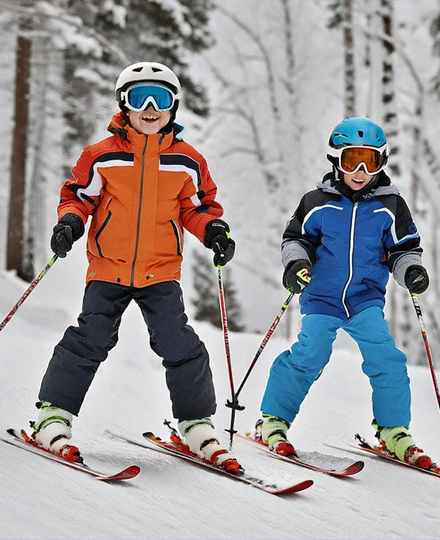

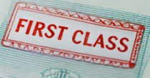
Let’s play a travel board game!
How to play:
Lost passport!
Play in teams. Take turns picking a tile from the board.
If you see a photo, say the correct sentences to win 2 points for your team.
If your team gets the wrong answer, the other team can try to win 2 points.
Be careful! There are some secret tiles!
A
B
Skip a turn!
They went skiing.
Free upgrade!
C
D
Choose
2 tiles!
Vocabulary
Vocab Building
Fun Quiz

Slide 23
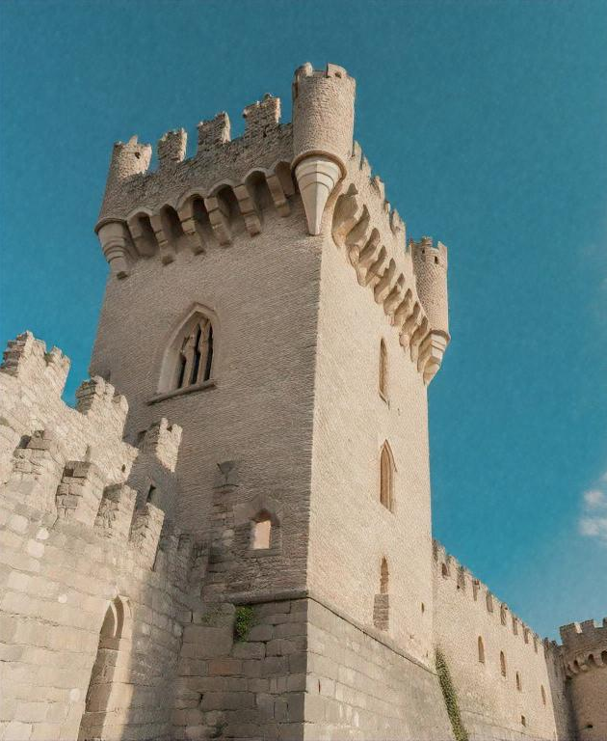
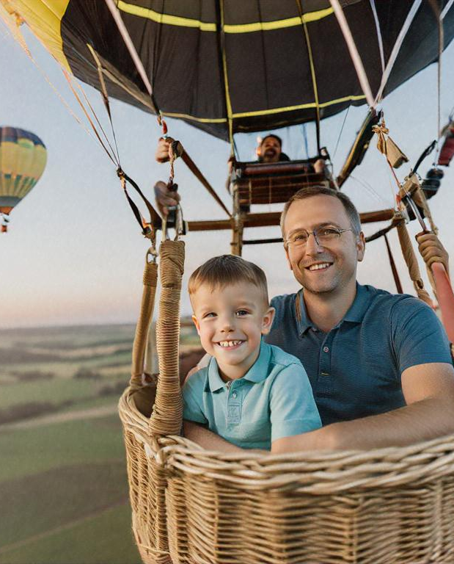
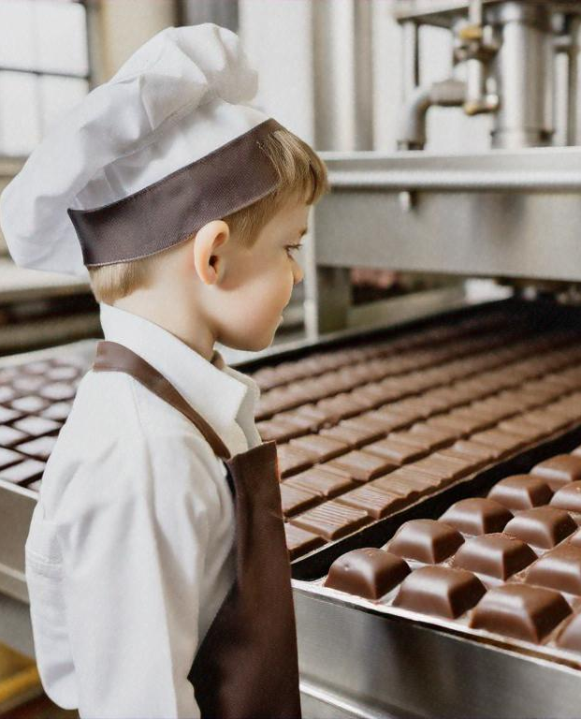
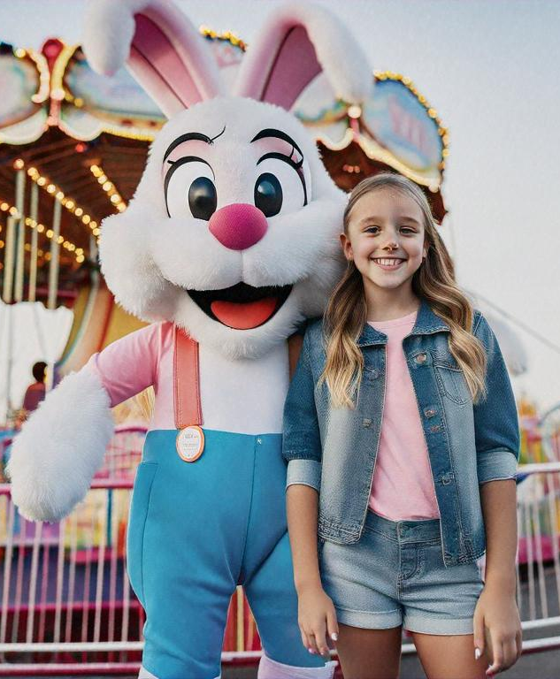
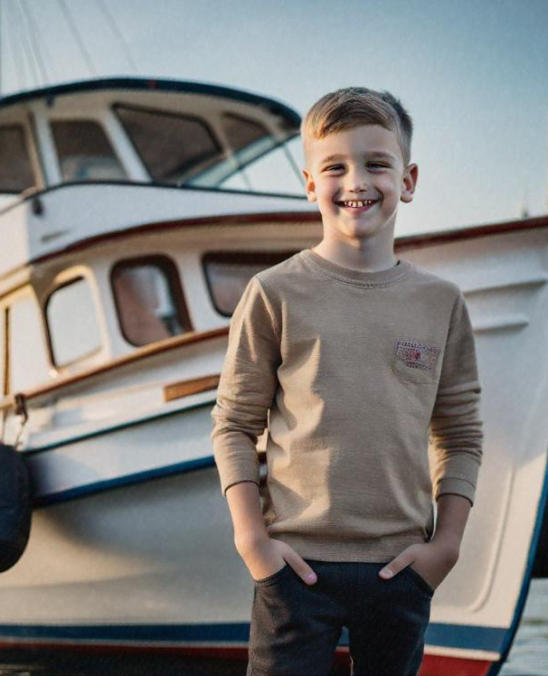
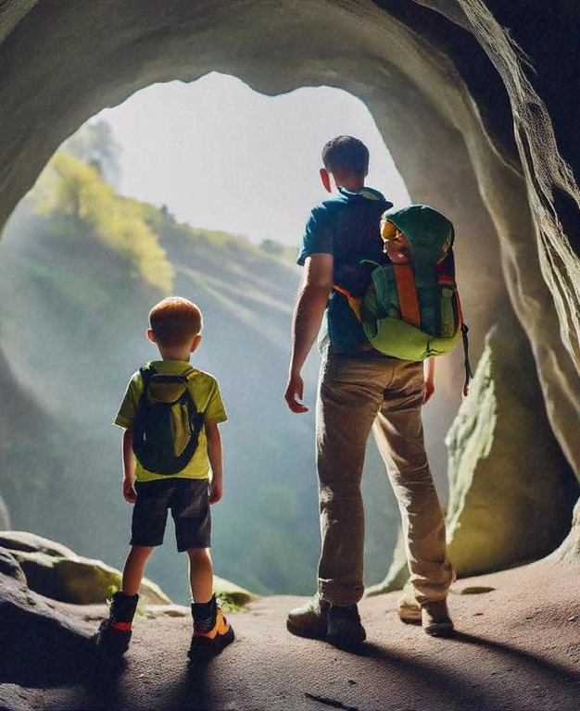
Read what she says and find out what she did to prepare for her trip.
Free upgrade!
A
B
C
D
Choose
2 tiles!
Lost passport!
E
F
G
H
Skip a turn!
Vocabulary
Vocab Building
Fun Quiz

Slide 24

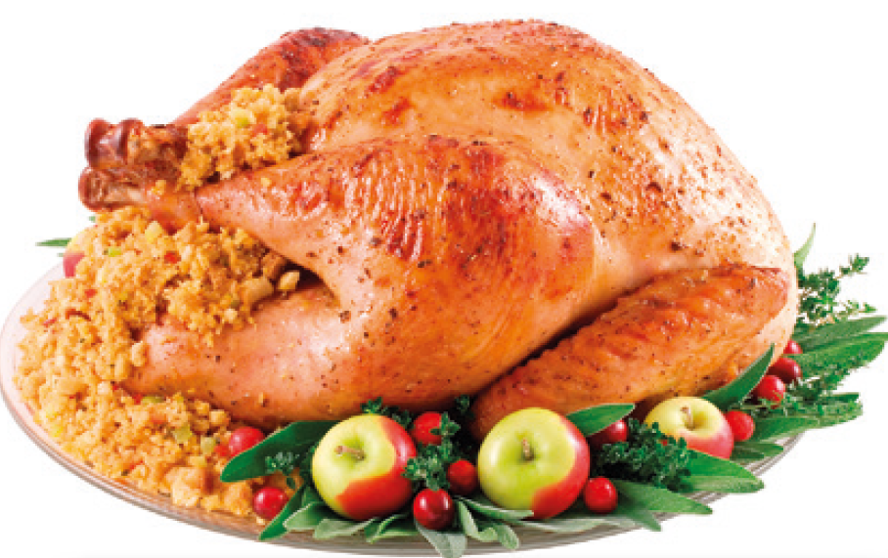
Let’s play another game about international cuisines!
How to play:
Play in teams.
You will only see part of an image. You need to be the first to raise your hand and guess the food correctly to win 2 points for your team.
The teacher will reveal the picture after you have made your guess.
If your team gets the wrong answer, the other team can try to win 2 points.
A
It’s roast goose. It’s a Chinese food.
Vocabulary
Vocab Building
Fun Quiz

Slide 25
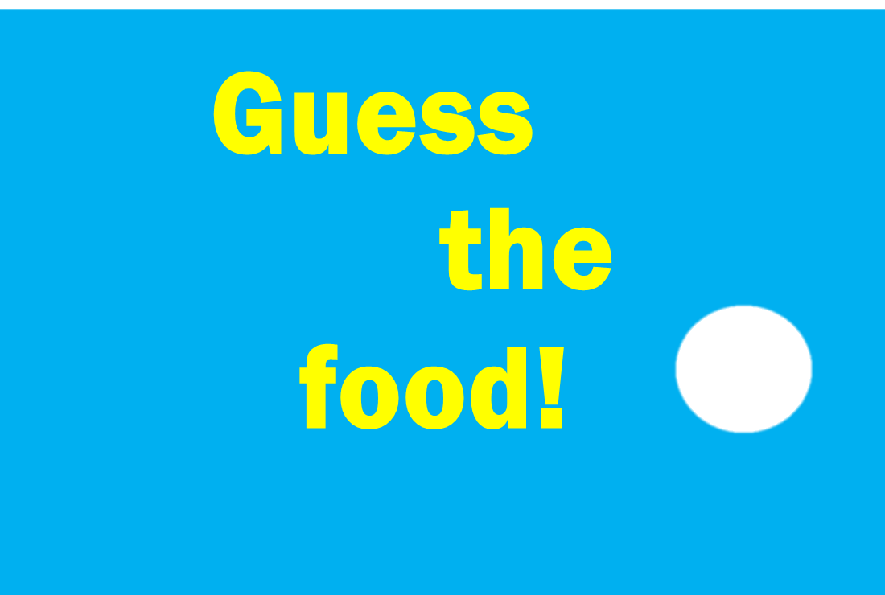
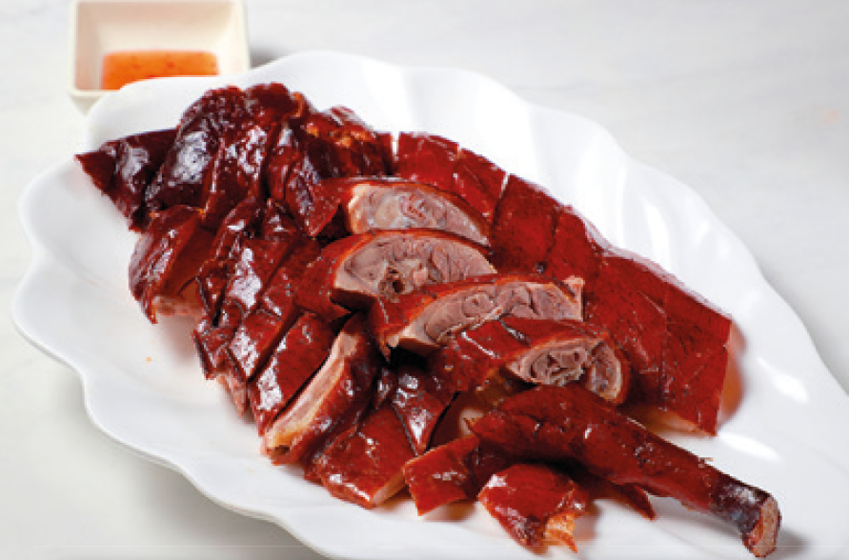
Read what she says and find out what she did to prepare for her trip.
A
Click to reveal!
Vocabulary
Vocab Building
Fun Quiz

Slide 26
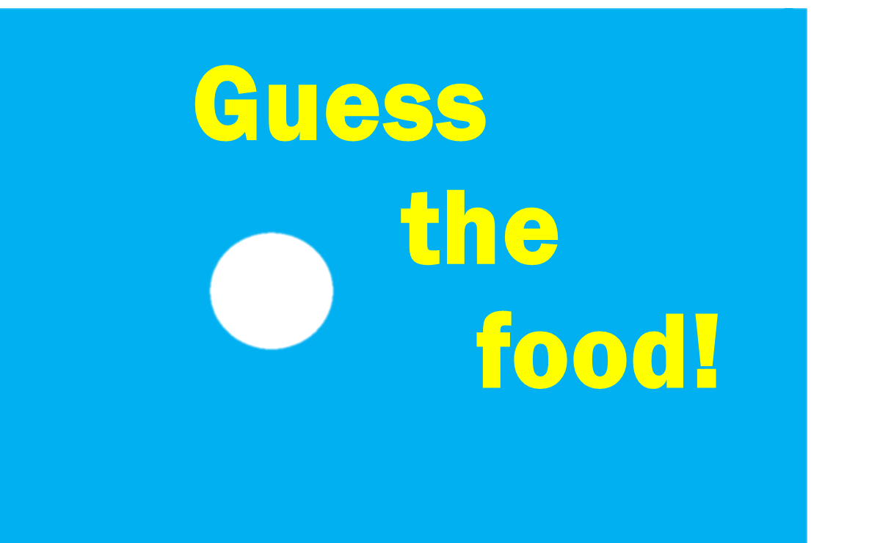
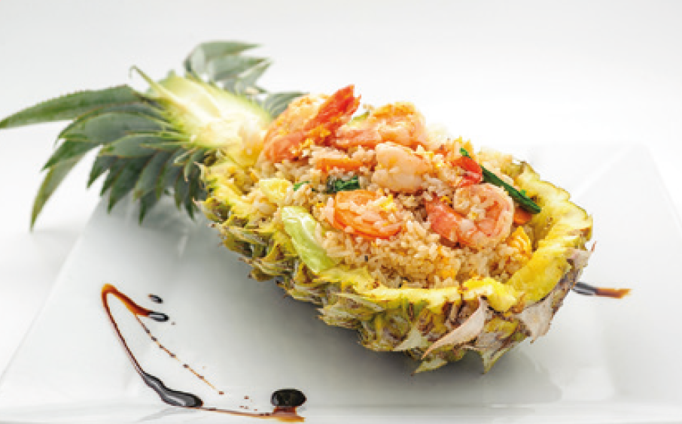
Read what she says and find out what she did to prepare for her trip.
B
Click to reveal!
Vocabulary
Vocab Building
Fun Quiz

Slide 27

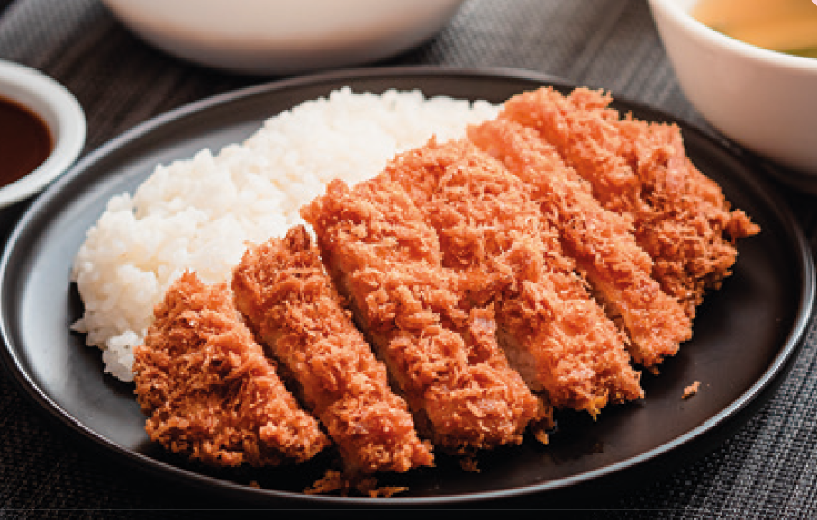
Read what she says and find out what she did to prepare for her trip.
C
Click to reveal!
Vocabulary
Vocab Building
Fun Quiz

Slide 28
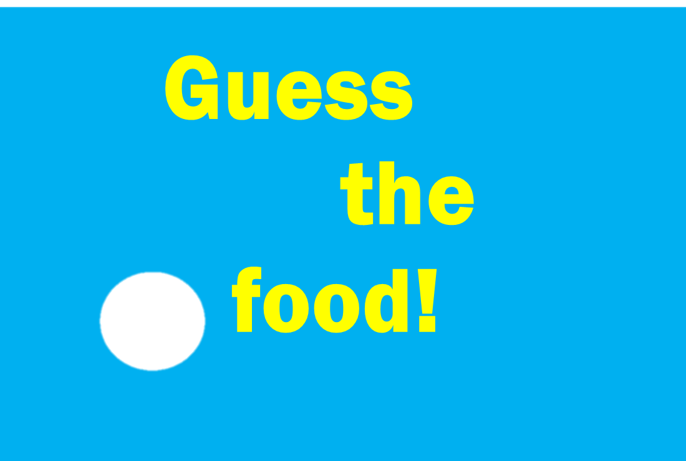
Read what she says and find out what she did to prepare for her trip.
D
Click to reveal!
Vocabulary
Vocab Building
Fun Quiz

Slide 29
Vocabulary Activity 2

Slide 30
Acknowledgements
We would like to thank the following organisations and people for permission to use their images:
alazur / Shutterstock
artisticco / stock.adobe.com
Credit line is not needed
Credit line is not needed
David Tadevosian / Shutterstock
Iosif Yurlov / stock.adobe.com
Kozlik / Shutterstock
lana_samcorp / stock.adobe.com
mast3r / stock.adobe.com
Mihai Simonia / Shutterstock
Mohammed Moses / Shutterstock
Nuttadol Kanperm / Shutterstock
Olga Lyubkina / Shutterstock
Osacr_Y / Shutterstock
pasphotography / Shutterstock
Phuong / stock.adobe.com
rogelson / Shutterstock
Rostislav Ageev / Shutterstock
shulers / Shutterstock
trattieritratti / Shutterstock
Vassamon Anansukkasem / Shutterstock
Vladimir / stock.adobe.com
zhouyilu / stock.adobe.com

