Slide 1
Chapter 4
Zoo animals

Slide 2
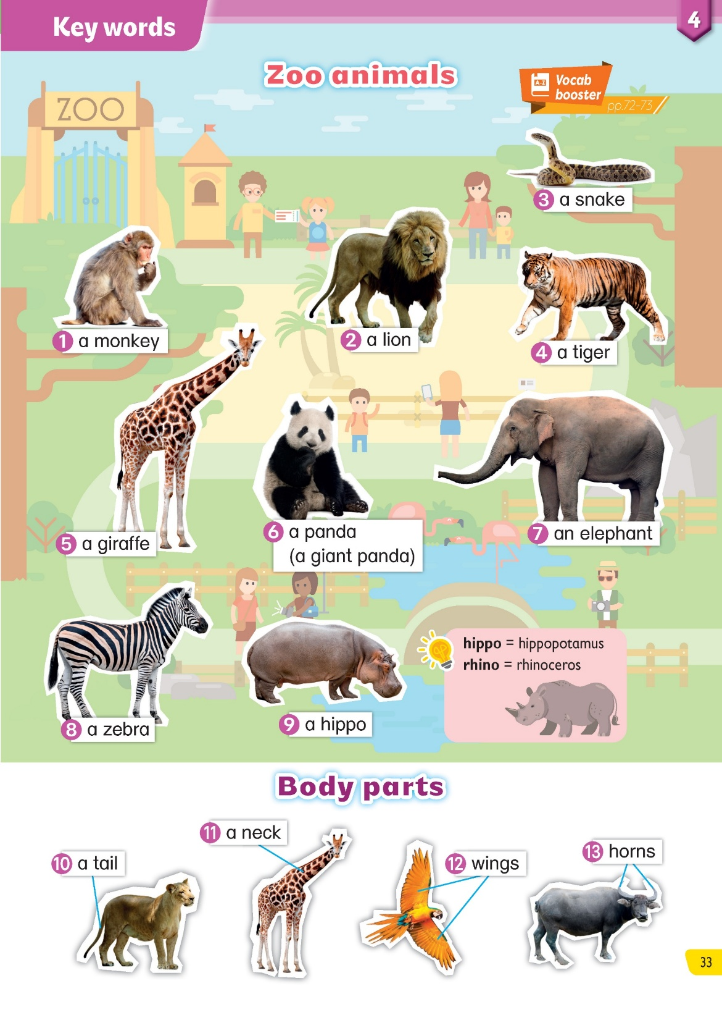

Slide 3


Zoo animals
Vocabulary
Fun Quiz

Slide 4
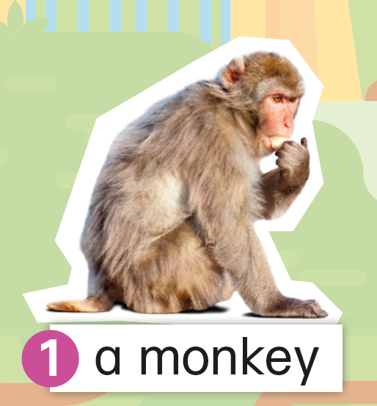
Vocabulary
Fun Quiz

Slide 5
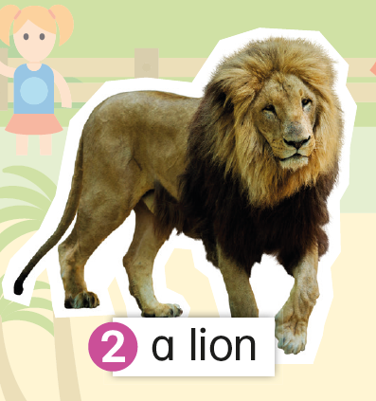
Vocabulary
Fun Quiz

Slide 6
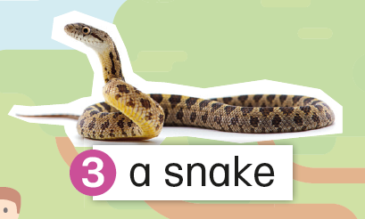
Vocabulary
Fun Quiz

Slide 7
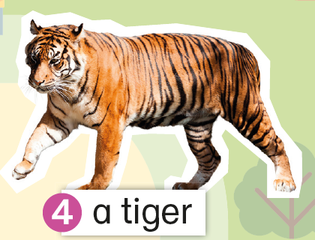
Vocabulary
Fun Quiz

Slide 8
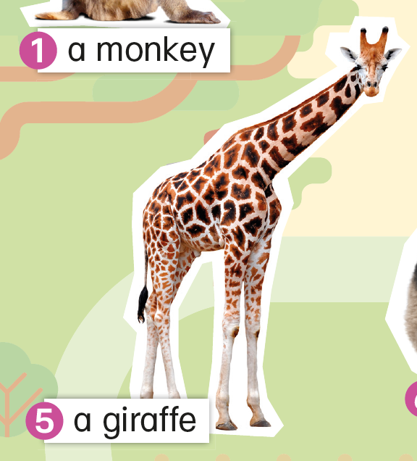
Vocabulary
Fun Quiz

Slide 9

Vocabulary
Fun Quiz

Slide 10
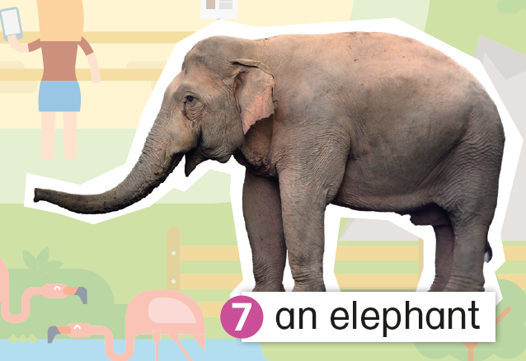

a elephant
Vocabulary
Fun Quiz

Slide 11
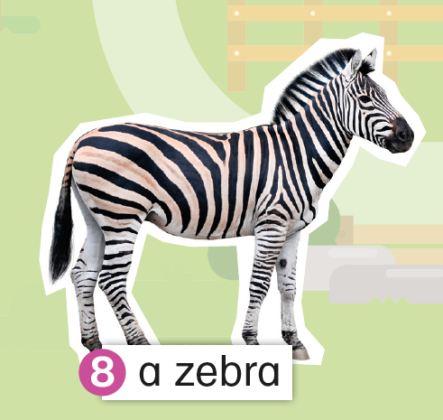
Vocabulary
Fun Quiz

Slide 12
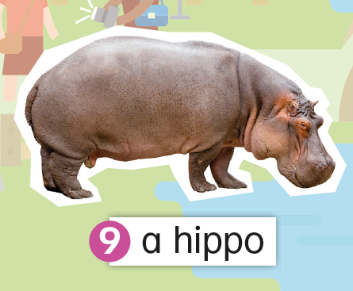

We can also say:
hippo = hippopotamus
rhino = rhinoceros
Vocabulary
Fun Quiz

Slide 13
Body parts
Vocabulary
Fun Quiz

Slide 14
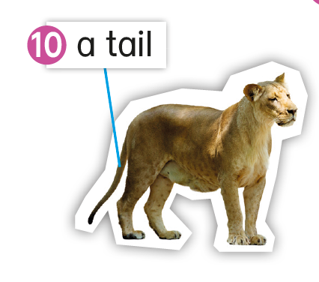
Vocabulary
Fun Quiz

Slide 15
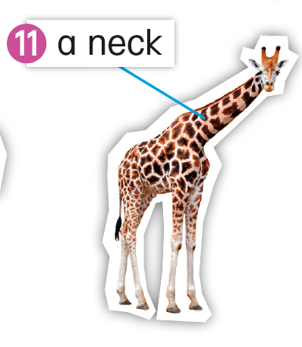
Vocabulary
Fun Quiz

Slide 16
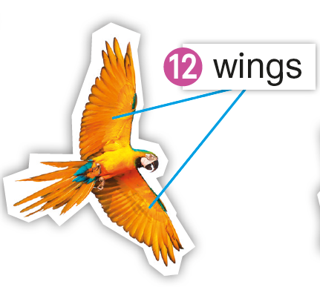
Vocabulary
Fun Quiz

Slide 17
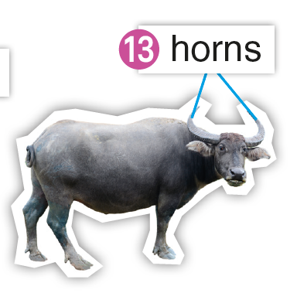
Vocabulary
Fun Quiz

Slide 18
Fun Quiz
Vocabulary
Fun Quiz

Slide 19

Can you guess the animal? Read the tips. Make your guess!
Animal 1
Click to read the tips.
It is yellow and brown.
Tip 1
It eats leaves.
Tip 2
Click to reveal picture.
Tip 3
It has a long neck.
It is a giraffe.
Vocabulary
Fun Quiz

Slide 20
Can you guess the animal? Read the tips. Make your guess!
Animal 2
Click to read the tips.
It is brown.
Tip 1
It has a long tail.
Tip 2
Click to reveal picture.
It eats bananas.
Tip 3
It is a monkey.
Vocabulary
Fun Quiz

Slide 21
Can you guess the animal? Read the tips. Make your guess!
Animal 3
Click to read the tips.
Tip 1
It is black and white.
Tip 2
It is fat.
Click to reveal picture.
It eats bamboos.
Tip 3
It is a panda.
Vocabulary
Fun Quiz

Slide 22
Can you guess the animal? Read the tips. Make your guess!
Animal 4
Click to read the tips.
Tip 1
It has short legs.
Tip 2
It is very large.
Click to reveal picture.
It has small ears.
Tip 3
It is a hippo.
Vocabulary
Fun Quiz

Slide 23
Can you guess the animal? Read the tips. Make your guess!
Animal 5
Click to read the tips.
It has a long body.
Tip 1
Tip 2
It has a small head.
Click to reveal picture.
It does not have legs.
Tip 3
It is a snake.
Vocabulary
Fun Quiz

Slide 24
Can you guess the animal? Read the tips. Make your guess!
Animal 6
Click to read the tips.
It is black and white.
Tip 1
It has a tail.
Tip 2
Click to reveal picture.
It runs quite fast.
Tip 3
It is a zebra.
Vocabulary
Fun Quiz

Slide 25
Vocabulary Activity 2

Slide 26
Acknowledgements
We would like to thank the following organisations and people for permission to use their images, audio and videos:
Andrii Bezvershenko / Shutterstock
Eric Isselee / Shutterstock
Iakov Filimonov / Shutterstock
Iakov Filimonov / Shutterstock
Independent birds / Shutterstock
J. Lekavicius / Shutterstock
jaroslava V / Shutterstock
Kwadrat / Shutterstock
Passakorn Umpornmaha / Shutterstock
PetlinDmitry / Shutterstock
Thanakorn Hongphan / Shutterstock
zuperia / Shutterstock

